Slide 1
Phasing structural variants using phased aligned data
Sachin Gadakh, PhD student
Supervisor : Prof. Dr. Dariusz Plewczynski
Laboratory of Functional and Structural Genomics
Centre of New Technologies
University of Warsaw

Slide 2
Objective
To phase structural variants using phased aligned data

Slide 3
Background
Haplotypes are Crucial: A haplotype refers to a set of DNA variations (alleles) that are inherited together on the same chromosome. Understanding haplotypes is critical for elucidating gene function, disease susceptibility, drug response, and population genetics.
Structural Variants (SVs) Impact: Structural Variants (SVs) are large-scale genomic alterations (>50 bp), including deletions, duplications, insertions, inversions, and translocations. They contribute significantly to genetic diversity and are implicated in a wide range of human diseases and traits.
The Challenge of SV Phasing: Determining the haplotype phase of SVs—assigning each SV to its specific parental chromosome—is significantly more challenging than phasing smaller variants like SNPs. This is due to their size, complexity, and often ambiguous mapping with short-read sequencing.
SNP Phasing is More Mature: Methods for phasing Single Nucleotide Polymorphisms (SNPs) are relatively well-established, utilizing statistical approaches (e.g., population data, family trios) or read-based methods (leveraging reads spanning multiple heterozygous SNPs).
Leveraging Phased Alignments: Modern sequencing technologies (like long-read sequencing or linked-reads) can produce phased alignments, where reads are already assigned to a specific haplotype (often indicated by tags like HP in BAM/CRAM files). This provides direct physical linkage information.
The Gap: Connecting Phased SNPs/Alignments to SVs: While phased SNPs and phased alignments exist, directly and accurately transferring this phase information to co-located or nearby SVs is not straightforward. SVs may not always be spanned by the same reads that define SNP haplotypes, or their breakpoints might be complex.
Importance of Phased SVs:
Compound Heterozygosity: Phased SVs are essential for identifying compound heterozygous events, where two different pathogenic variants (e.g., an SV and a SNP, or two SVs) occur on different alleles of the same gene, leading to disease.
Allele-Specific Effects: Understanding which haplotype an SV resides on can clarify its impact on allele-specific expression or regulation.
Improved Imputation & Association Studies: Accurate SV phasing can improve the imputation of missing genotypes and enhance the power of genome-wide association studies (GWAS) for SVs.
Project Goal: This project aims to bridge this gap by developing a method to integrate information from pre-phased SNPs and phased read alignments to accurately estimate the haplotype phase of identified SVs.
Potential for Novelty: Developing a robust tool or algorithm that effectively combines these distinct but complementary sources of phasing information for SVs would be a valuable contribution to the genomics toolkit.

Slide 4
Example using phased vs. unphased genetic data, which directly illustrates the difference between genotype and haplotype.
Suppose we look at 3 SNPs (single nucleotide polymorphisms) in a person’s genome:
SNP Position | Possible Alleles
SNP1 | A / G
SNP2 | C / T
SNP3 | G / A
This person has the following genotypes:
SNP1: A / G
SNP2: C / T
SNP3: G / A

Slide 5
Unphased Data (Genotype Only):
This tells us what variants the person has at each site, but not which variants are on the same chromosome. For example:
Genotype: A/G C/T G/A
From this, we know the person has:
One A and one G at SNP1
One C and one T at SNP2
One G and one A at SNP3
But we don’t know how the alleles are grouped. That is, we can’t say whether the "A" at SNP1 is on the same chromosome as the "C" or the "T" at SNP2.

Slide 6
Phased Data (Haplotypes Known):
Phasing tells us which alleles are on the same chromosome, i.e., reconstructing haplotypes.
Example of phased data:
Haplotype 1: A C G
Haplotype 2: G T A
This means:
One chromosome (say, maternal) has the alleles A-C-G.
The other (paternal) has G-T-A.
So now we not only know the variants, but we know how they are linked — which is crucial for understanding inheritance patterns, allele interactions, and recombination.

Slide 7
How phased and unphased SV call looks like?
chr1 820928 svim_asm.INS.3 PASS SVTYPE=INS;END=820928;SVLEN=247;READS=contig_3369,contig_3369 GT 1|1
chr1 820928 N <INS> PASS SVLEN=102;SVTYPE=INS;END=821030;CONFIDENCE=0.797674 GT ./. ./.
Phased
Unphased
chr1 934022 svim_asm.DEL.6 . PASS SVTYPE=DEL;END=934861;SVLEN=-839;READS=contig_1419 GT 1|0
chr1 934100 . N <DEL> . PASS SVLEN=841;SVTYPE=DEL;END=934941;CONFIDENCE=0.99136 GT ./. ./.
Phased
Unphased
Phased SVs from diploid assembly, unphased SVs are from alignment based

Slide 8
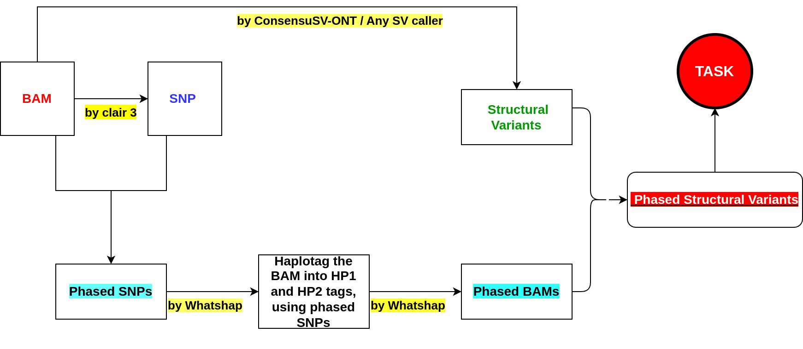
Pipeline
Possible issues to resolve read-groups assignment

Slide 9
Datasets
Families : Trios from 1000 genome project
The Yoruban | The Puerto Rican | The Southern Han Chinese
GM19238 | HG00731 | HG00512
GM19239 | HG00732 | HG00513
GM19240 | HG00733 | HG00514
Trios :

Slide 10
Input data to process
Phased BAM file
Phased SNP file
Commands for creating the input https://docs.google.com/document/d/1G0TGJUITZjKIrqk7Yxyx7fjoXns4yNataZo4ioJBDtg/edit?tab=t.0

