Slide 1

Mastering Shear:
Pressed Powder Mixing
A strategic review of mechanical unit operations in cosmetic manufacturing

Slide 2






The Foundation
The Scope
The Strategy
The Arsenal
Manufacturing pressed powder cosmetics requires precise handling of dry solids and slightly cohesive slurries, moving them from raw powders to a compressible matrix.
A masterclass in shear management. A single blending environment cannot satisfy the conflicting physical requirements of color development and ingredient protection.
We escalate and de-escalate mechanical shear using three distinct operations: Extreme High Impact, Low-Shear Gravity Folding, and High-Speed Fluidization.

Slide 3
Upstream Process Flow
1. Pigment Extension
3. Binder Pre-Mixing
5. De-clumping
Grinding raw, agglomerated colorants to maximum intensity.
Homogenising oils, silicones and fragrance into one liquid phase.
High-speed chopping of wet clusters into uniform granules.
Next: Transfer masterbatch
Next: Load into high-speed vessel
Next: Powder is compressible
2. Pearl Blending
4. Binder Dispersion
6. Final Pressing
Gentle folding of the extended base with fragile shimmer particles.
Micro-coating the dry mass with liquid binders via atomization.
Mechanical downward compression into metal or plastic pans.
Next: Prepare the liquid phase
Next: Break the wet clusters
End of upstream phase

Slide 4

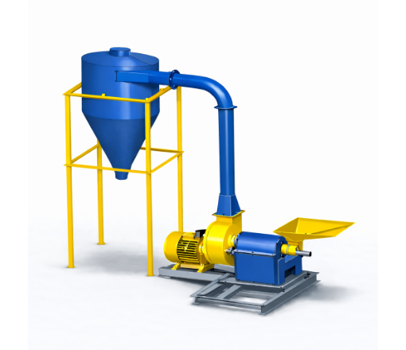
Step 1: Hammer Mill / Plow Blender
Encountered
First step: Working with raw, clustered inorganic pigments (e.g., iron oxides).
The Process
Smashes tightly packed primary pigment agglomerates down to their absolute smallest primary particle size.
Why this grinder?
Requires extreme, localized kinetic impact to prevent color streaks. Gentle mixers cannot physically break these dense clusters.
Energy Stats
High power consumption. Industrial units typically draw 5 kW to 20 kW+ to generate the extreme rotor RPMs necessary for shattering.

Slide 5
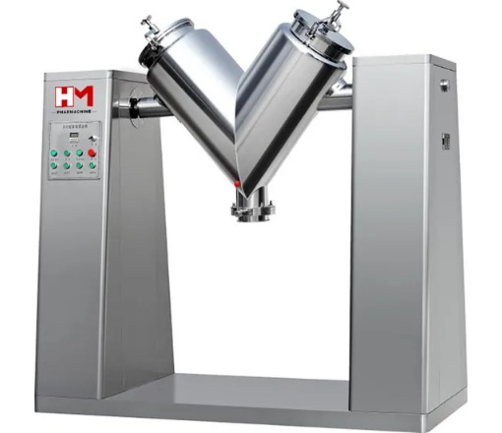
Step 2: V-Blender (Tumble Mixer)
Encountered
Second step: Adding bulk fillers and fragile pearlescent pigments to the extended color batch.
The Process
Homogeneously folds extended pigments with delicate shimmer particles without compromising their physical structure.
Why this mixer?
Requires absolute low-shear gravity folding. High shear forces would shatter the pearl plates, completely destroying the optical shine.
Energy Stats
Low power consumption. Standard 100L - 500L vessels operate at a slow 12-15 RPM, typically drawing only 1.1 kW to 2.2 kW.

Slide 6
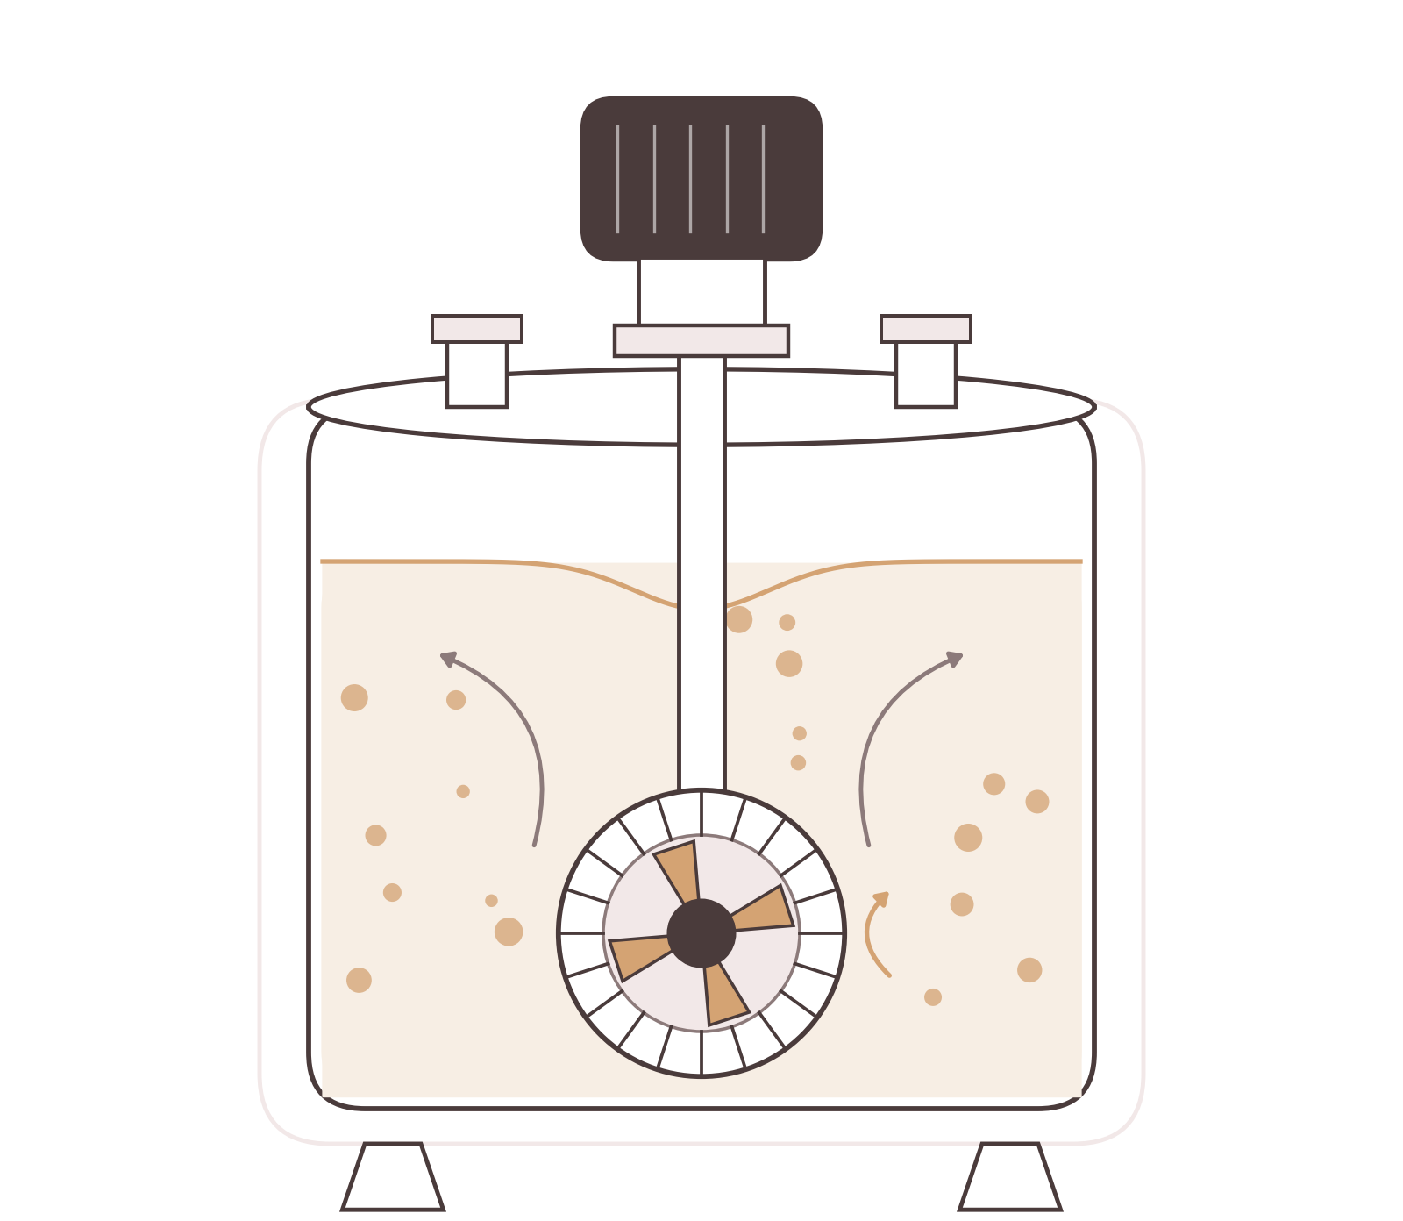
Step 3: High-Shear Rotor-Stator Homogenizer
Encountered
Pre-dispersion phase: Preparing liquid phase prior to atomization into the dry powder bed.
The Process
Emulsifies and homogenizes liquid binders (oils, silicones, esters, squalane), preservatives, and fragrances into a single, uniform liquid phase.
Why this mixer?
Requires high fluid shear to break oil-silicone phase segregation. Unhomogenized liquid feeds lead to clogged spray nozzles and uneven binder dispersion across the powder mass.
Energy Stats
Moderate power consumption. Industrial batch units (20L – 100L liquid tanks) typically draw 2.2 kW to 7.5 kW operating at 3,000 to 6,000 RPM.

Slide 7
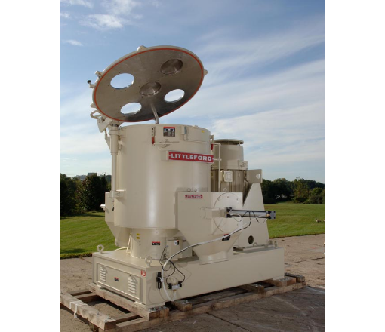
Step 4: High-Intensity Vertical Mixer
Encountered
Fourth step: Transforming the dry, blended powder into a cohesive matrix.
The Process
Disperses liquid binder (oils/silicones) as an atomized mist over a rapidly moving dry powder bed.
Why this mixer?
The high-speed bottom impeller creates a fluidized vortex, preventing liquid pooling and massive doughy clumps (fish-eyes).
Energy Stats
High power requirement. Often draws 15 kW to 30 kW+ to maintain the roping vortex under a heavy solid-liquid load.

Slide 8
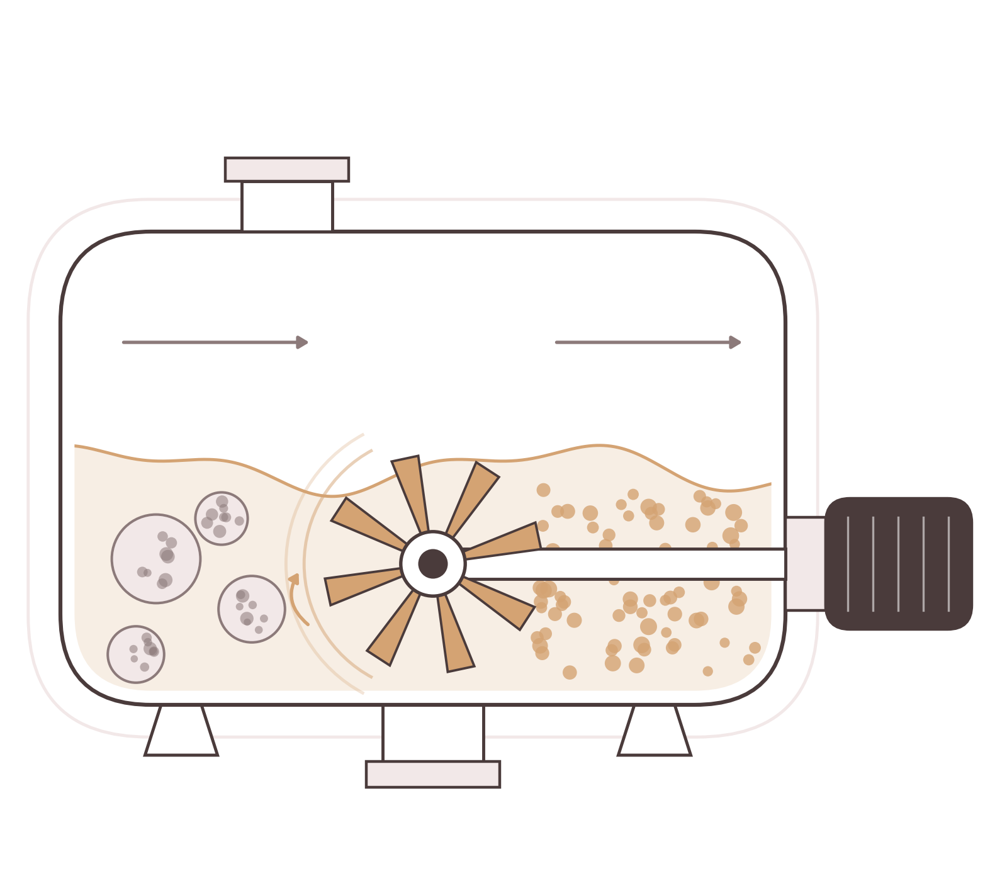
Step 5: High-Speed Chopper / Delumper
Encountered
Immediately following Step 4: A moist, binder-coated powder bed containing localized over-saturated clusters (“dough balls”).
The Process
Applies brief, targeted high-speed impact forces to shatter wet agglomerates, producing a uniform particle size distribution ready for pressing.
Why this mixer?
High-speed rotating blades (choppers) cut through high-moisture agglomerates without applying heavy compressive shear that would crush the pearl flakes incorporated in Step 2.
Energy Stats
Short-duration power load. Chopper motor drives draw 3 kW to 11 kW operating in controlled 1- to 3-minute high-speed bursts (up to 3,600 RPM).

Slide 9



Image Sources
https://5.imimg.com/data5/SELLER/Default/2026/2/586494937/PE/MV/LP/5066689/pigment-powder-hammer-mill.png
Source: www.indiamart.com
https://image.made-in-china.com/202f0j00hAKqHzJcfroQ/V-Blender-Mix-Dry-Powder.webp
Source: hmpharmachine.en.made-in-china.com
https://www.bplittleford.com/assets/content-images/Vertical_%20High_Intensity_Beige_Outdoors.jpg
Source: www.bplittleford.com

