Slide 1
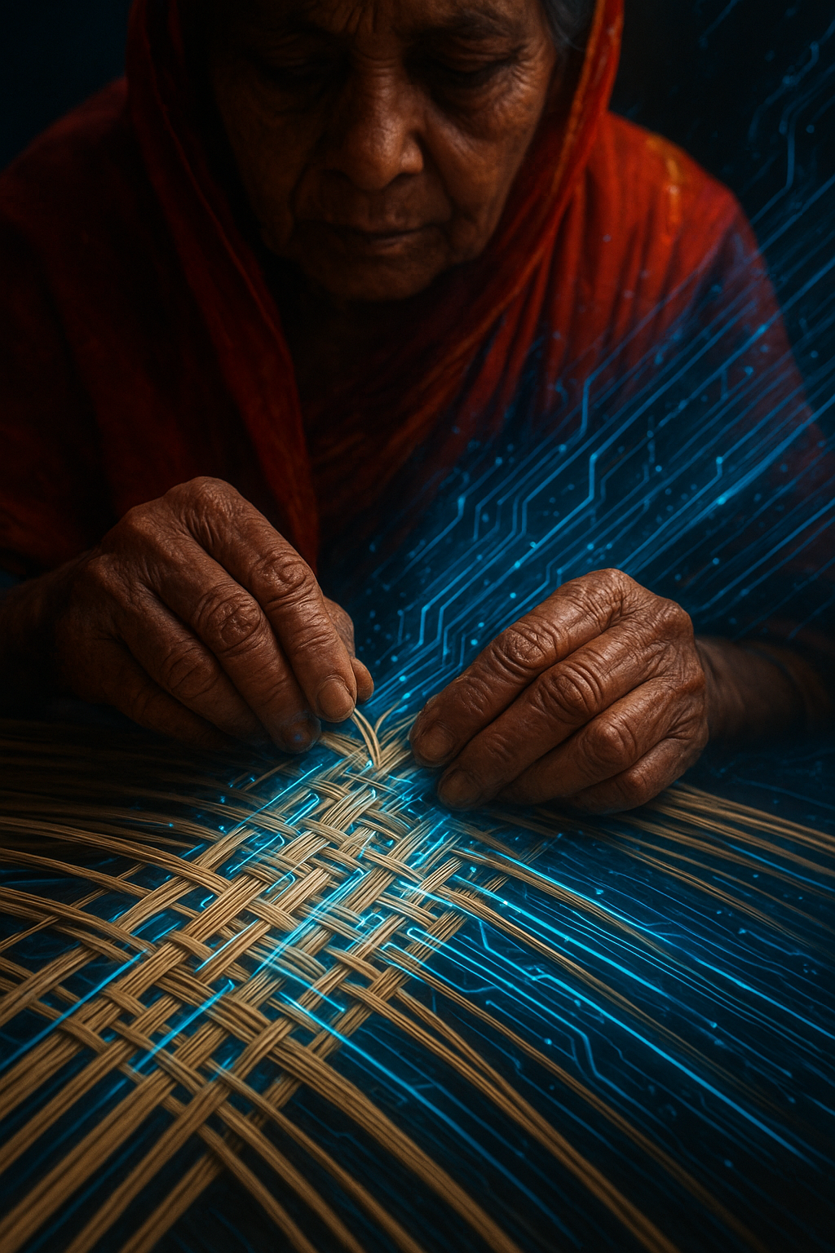
Local Artisan E-Marketplace
Team ErrorGPT
Md Shafkat Faruk Khan
2022 - 3 - 60 - 035
Uswat Fatemee Maysha Iqra
2023 - 2 - 60 - 077 2023 - 1 - 60 - 152

Slide 2
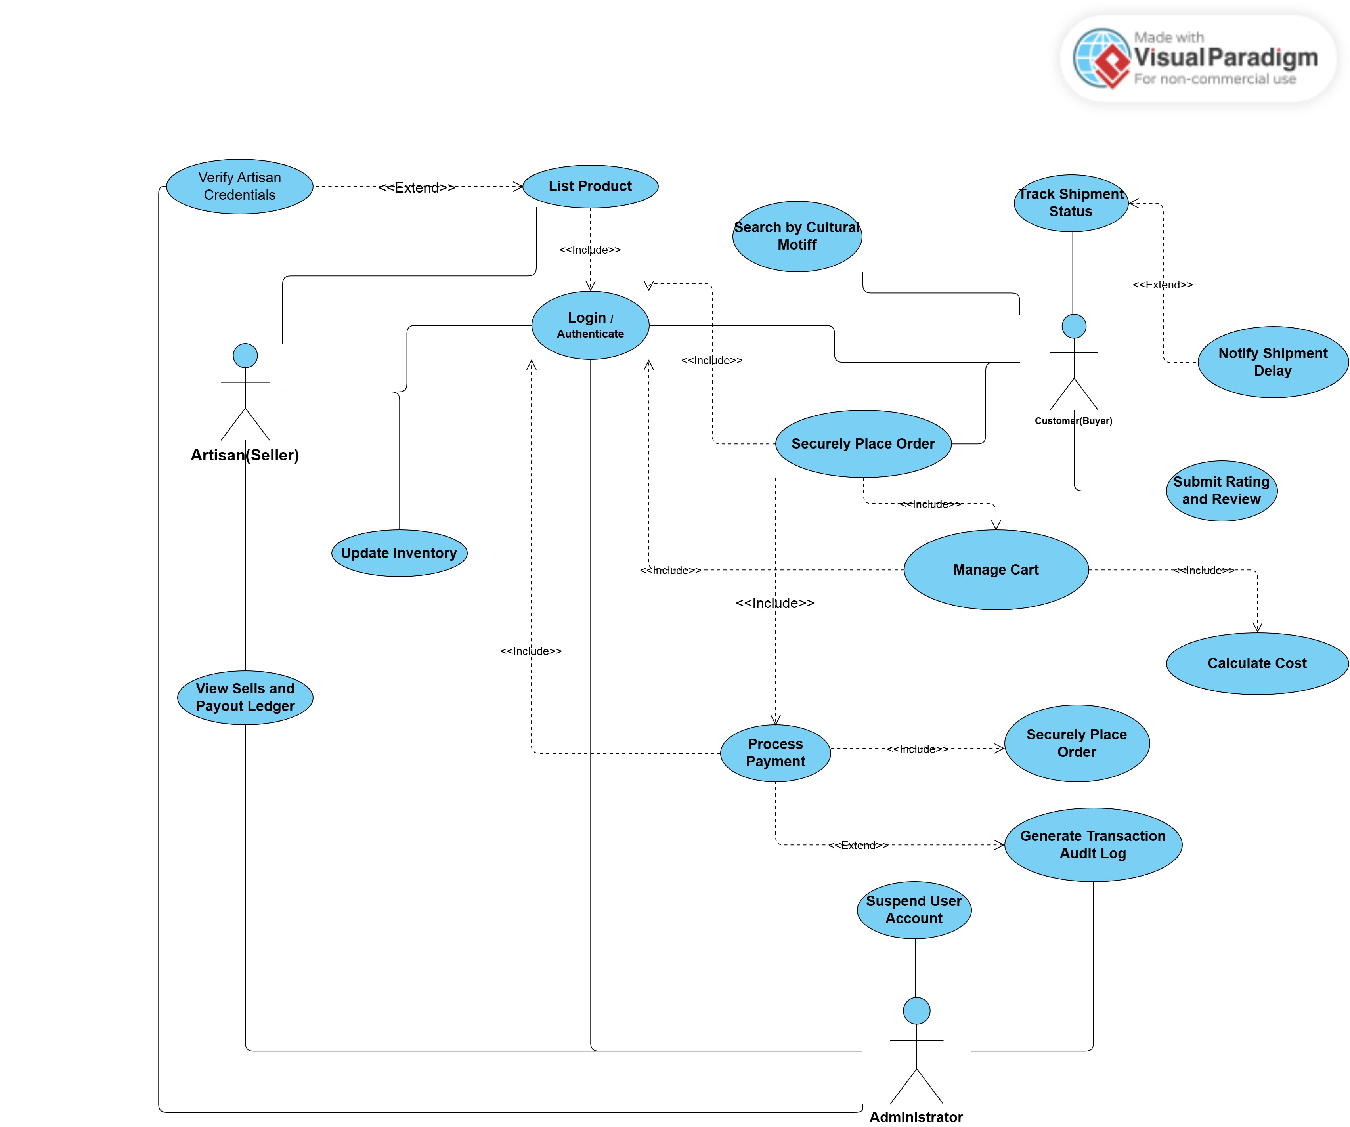
Use Case Diagram

Slide 3
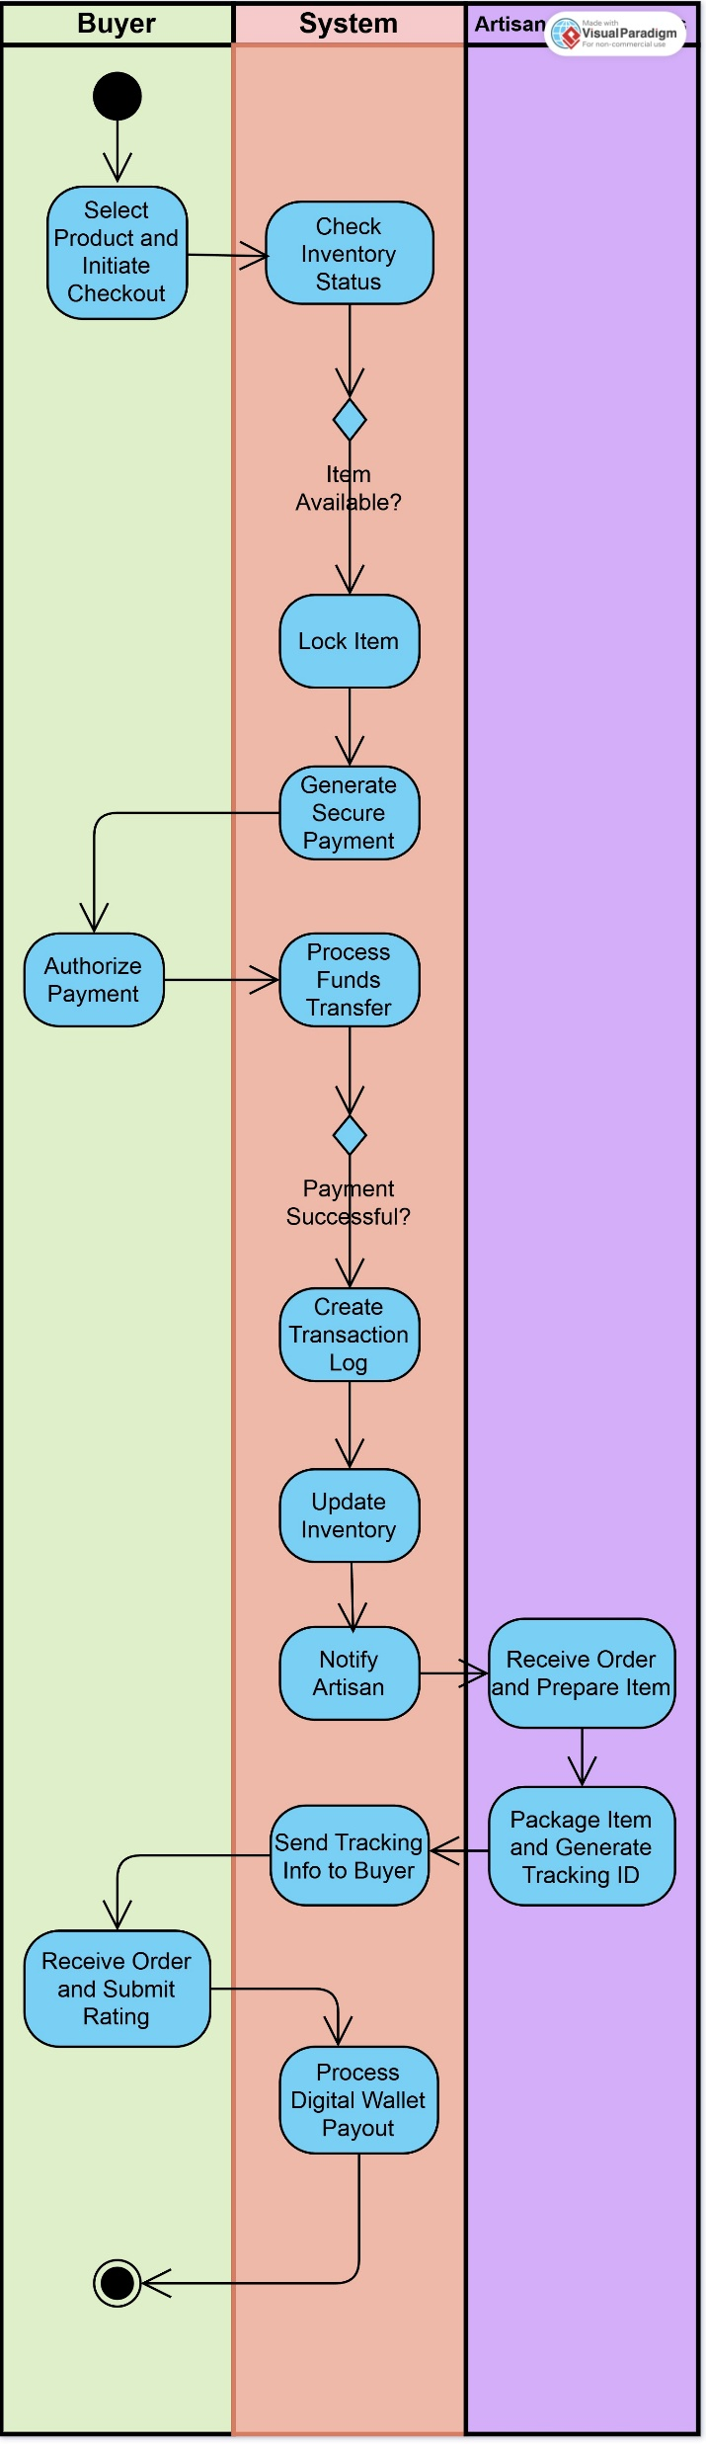
Activity Diagram
The Secure Purchase & Fulfillment Workflow
This diagram shows the three main roles—the Buyer, the System, and the Artisan—and how they work together to complete an order.
1. The Integrity Guarantee (Preventing Double-Selling):
The system's first job is the most important: It immediately locks the item (Lock Item step) when a buyer commits to purchase. This guarantees that nobody else—online or at the local bazar—can buy that unique mat at the same time. This is our core security check.
2. Seamless Financial Flow:
The system manages the payment process by calling the external service (like bKash) and then checking for success. It immediately logs the Transaction and updates the database, ensuring we have proof of payment before proceeding.
3. Professionalizing Logistics:
The flow moves smoothly from the System to the Artisan lane. This ensures that every confirmed sale results in a digital Tracking ID and a predictable payout, transforming the informal village delivery into a professional, traceable process.

