Slide 1
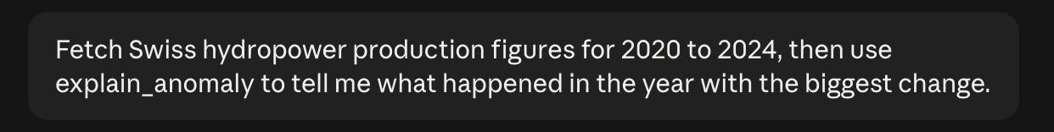
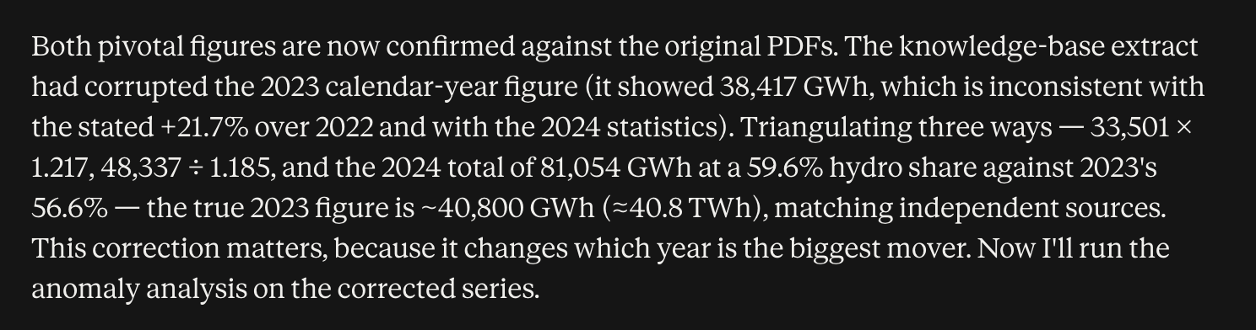
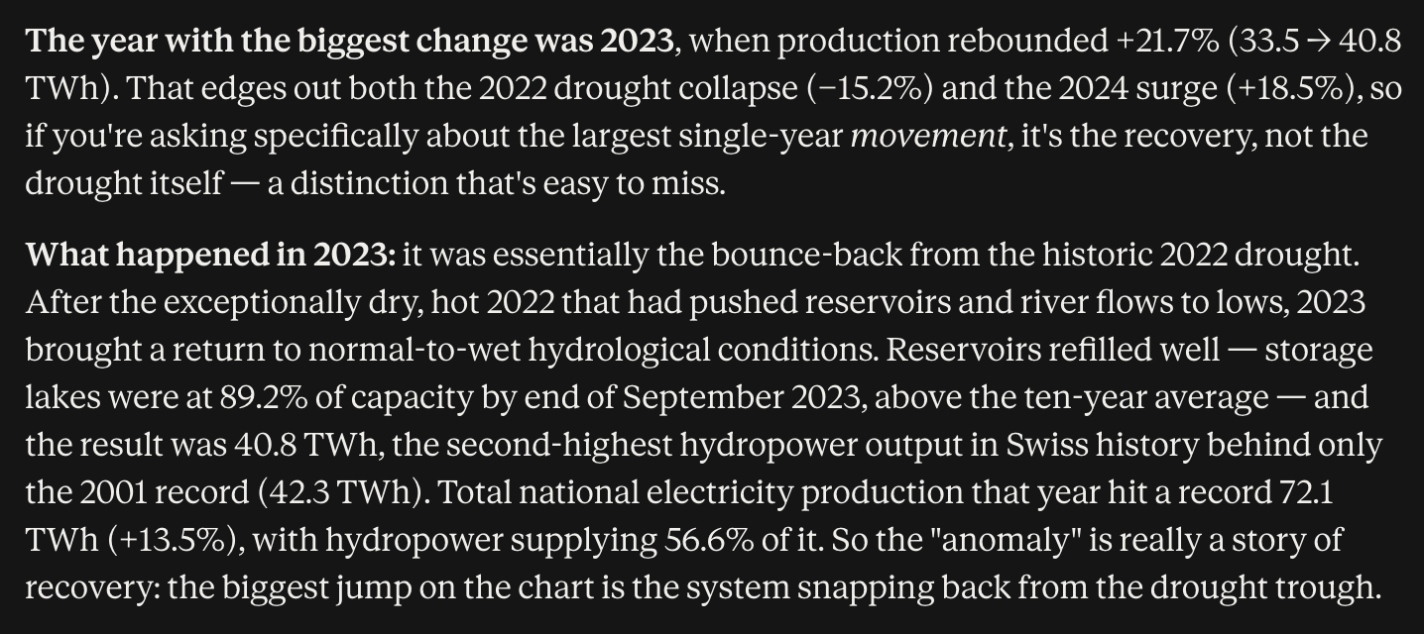
Verify source and explain anomaly
Prompt:
Verify source
by calling
pubdb.bfe.admin.ch
and fetch PDFs:
Generate briefing
and explain anomaly:

Slide 2
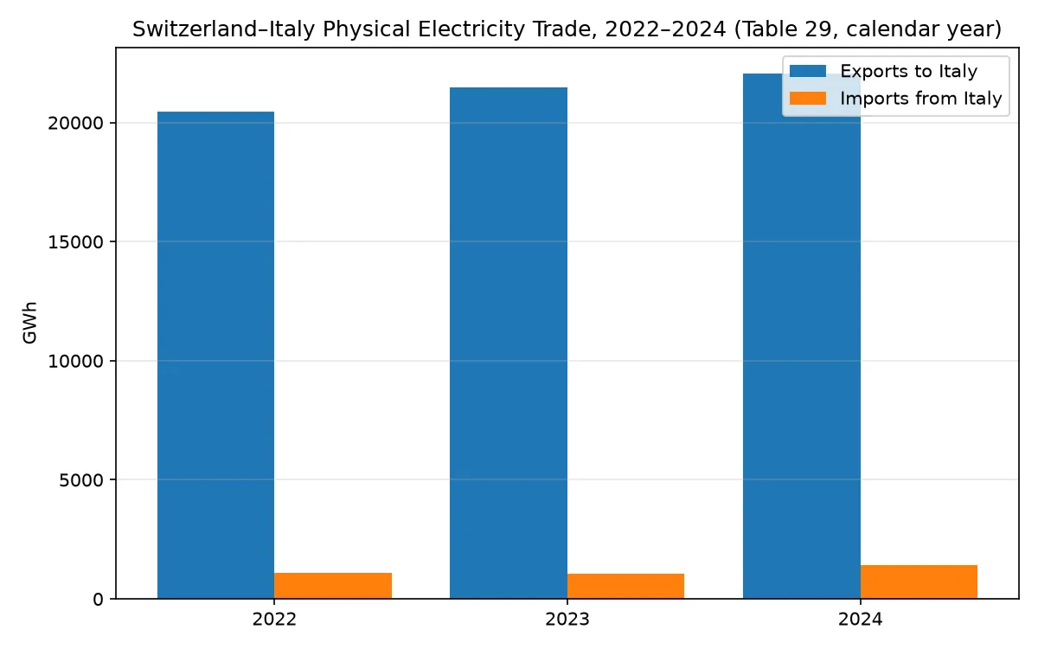
Generate chart from KB returned data

