Slide 1
SFOE OPEN ENERGY KNOWLEDGE AGENT
MY FOCUS
One question. The right retrieval tool. A grounded answer.
AI Agent & retrieval logic
AUTOMATIC TOOL SELECTION
AI AGENT
Knowledge Search
TRUSTED
USER
understands intent
SFOE
ANSWER
Natural-language
question
selects the best tool
+
Timeline Search
evidence
sources
checks the evidence
official sources
Chart / Data Search
Trust rule
If the SFOE evidence does not support an answer, the agent says so — instead of inventing one.
The Gateway provides trusted knowledge. The Agent makes it usable.
1
No tool knowledge needed
2
Better retrieval
3
Grounded answers
Source transparency
1
The user simply asks a question.
2
Different questions use different search modes.
Responses are based on SFOE evidence.
4
Official sources remain visible.
Mohsen Kalantar
Notes:
60-second pitch:
The SFOE already provides high-quality energy knowledge through the Open Energy Knowledge Gateway. My focus was the intelligent application layer on top of it. Instead of sending every question to the same search, the agent first understands the user's intent and automatically chooses the most suitable retrieval tool — knowledge search, timeline search, or chart and data search. It then retrieves official SFOE evidence and generates an answer with transparent sources. A key design principle is trust: if the available evidence does not support an answer, the system explicitly says so rather than inventing information. In short, the Gateway provides trusted knowledge, and the Agent makes that knowledge easy and reliable to use.
What role does hydropower play in Switzerland?
How has solar energy developed in Switzerland?
A good AI system should not only know how to answer questions; it should also know when the available evidence is not sufficient.
The prototype therefore demonstrates an end-to-end workflow
NVIDIA Nemotron 3 Super

Slide 2
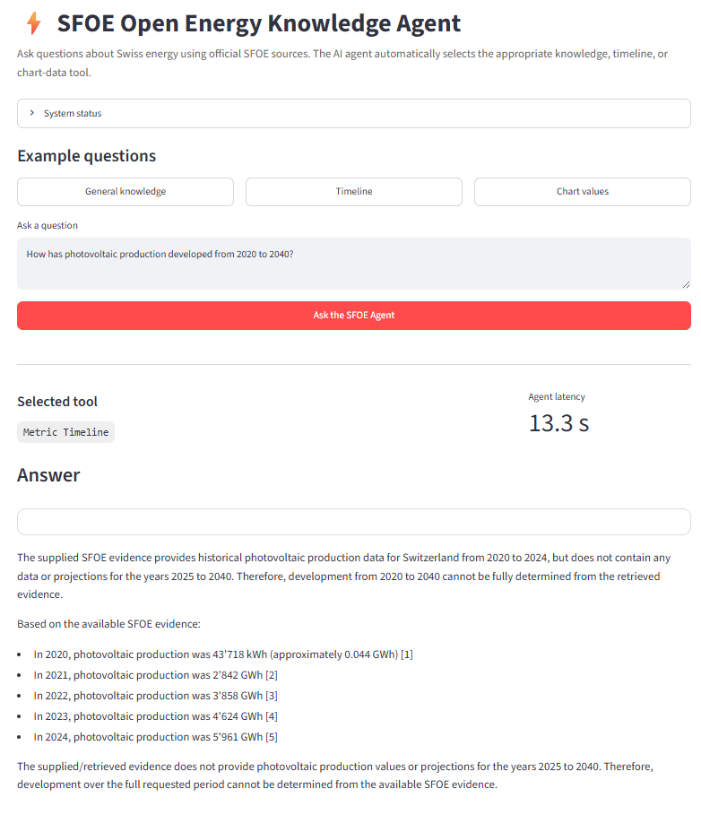
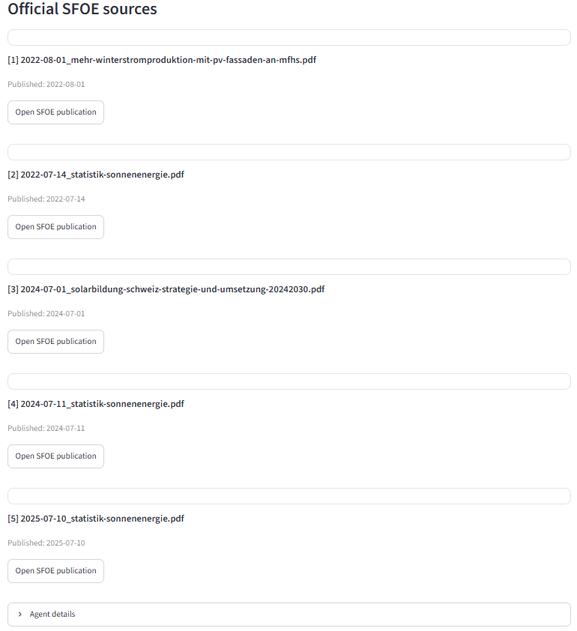
Prototype Demo – From Question to Trusted SFOE Answer
Mohsen Kalantar

