Slide 1

ENERGY DATA HACKDAYS · 2026
CHALLENGE · Bundesamt für Energie
Estimating Hourly
Energy Production
for Switzerland
A data-driven approach to nowcasting Switzerland's electricity supply at hourly resolution.
08.05.2026

Slide 2
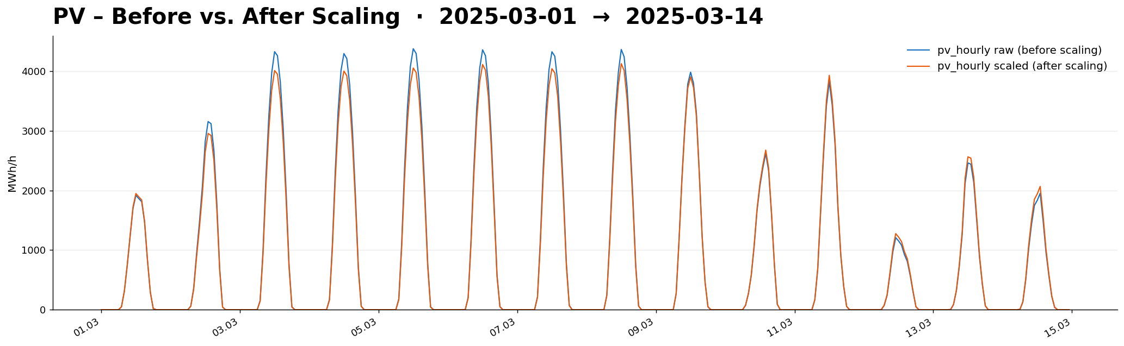
Simple scaling
PV-Production

Slide 3
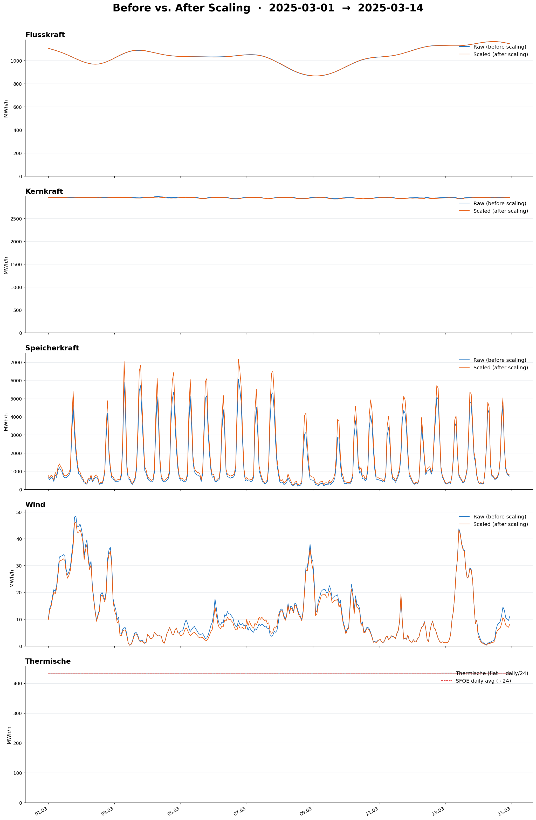
Simple scaling

Slide 4
Simple scaling

Slide 5
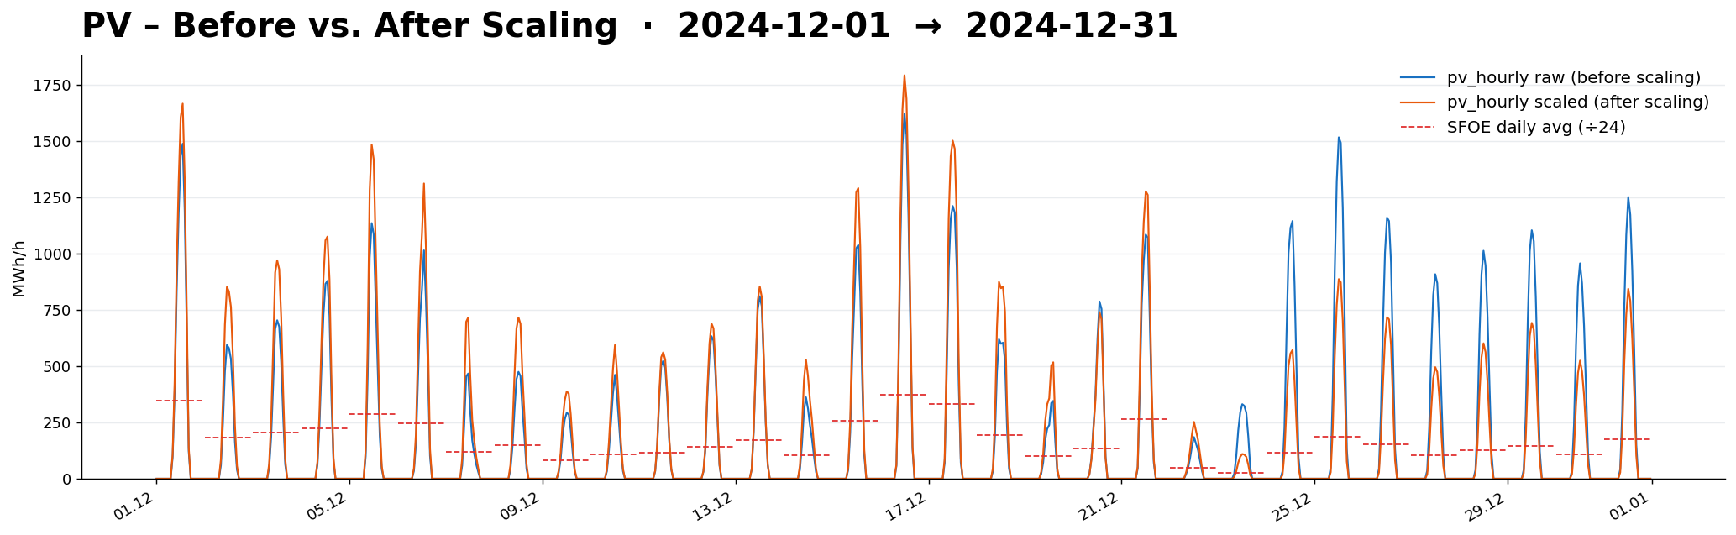
Simple scaling
Weather Conditions can influence the scaling factor

Slide 6
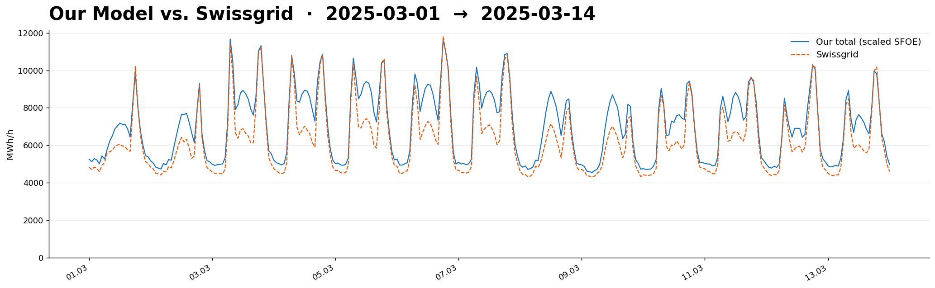
Swissgrid comparison
Scaling Approach vs. Swissgrid
Sum of all production types vs. Swissgrid
Explaines 89% of Variance (R²=0.89)

Slide 7
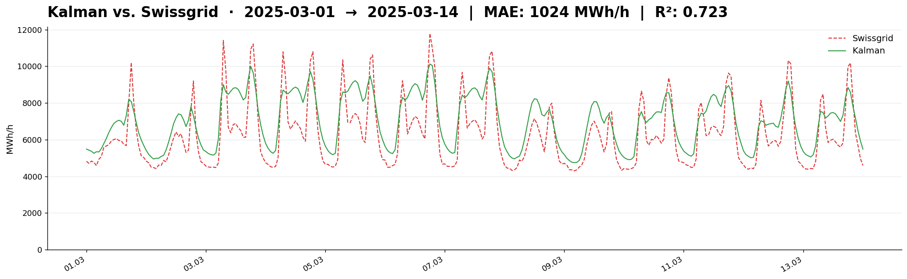
Swissgrid comparison
Sum of all production types vs. Swissgrid
Explaines 72% of Variance (R²=0.72)

Slide 8
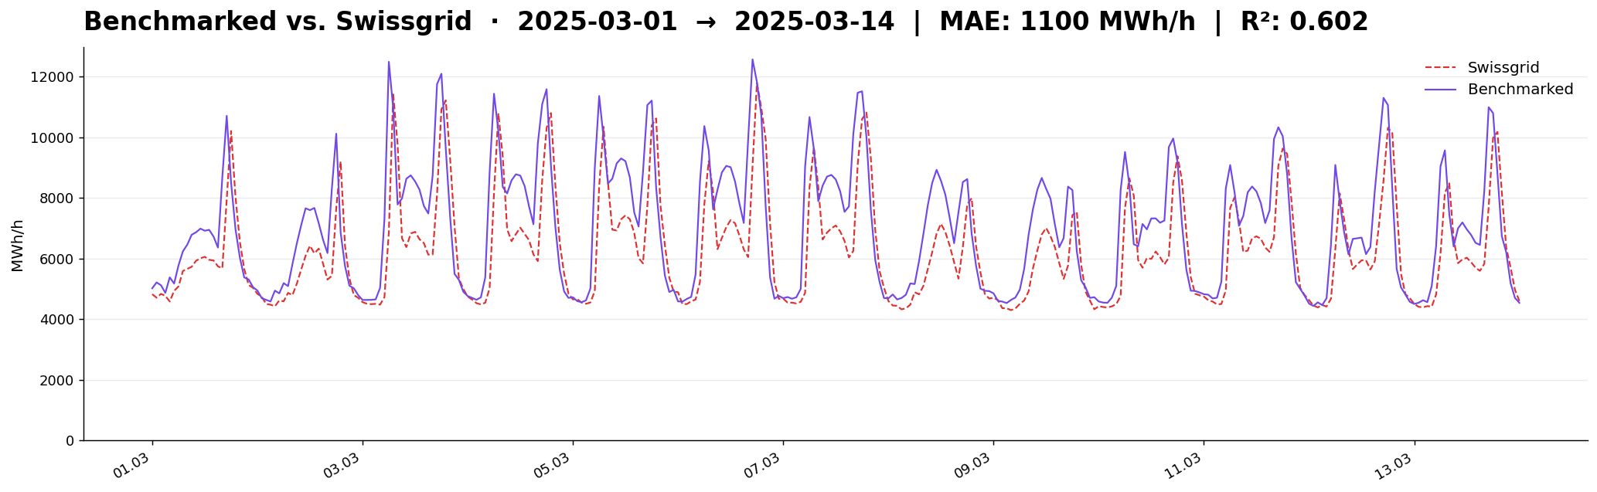
Swissgrid comparison
Sum of all production types vs. Swissgrid
Explaines 60% of Variance (R²=0.60)

