Slide 1
Teoh, Ahmed, F., & Lalor, E. C. (2022). Attention Differentially Affects Acoustic and Phonetic Feature Encoding in a Multispeaker Environment. The Journal of Neuroscience, 42(4), 682–691. https://doi.org/10.1523/JNEUROSCI.1455-20.2021
Keywords:
multi-speaker environment, attention, phonetic feature encoding, EEG

Slide 2
Background
Cocktail Party Problem: the ability to focus on a single talker amidst multiple sounds
Various theories model attention as a selective filter that rejects unattended message beyond a certain information processing stage (Cherry 1953; Broadbent 1958; Moray 1959; Deutsch and Deutsch 1963; Treisman 1964; Johnston and Wilson 1980)
Question: Does this filter operate at early or late stages of speech processing?

Slide 3
Background
Question: How does attention affect processing in different brain areas and at different latencies?
Neuroimaging studies
Single talker: core auditory regions code low-level features and combined in higher areas to yield more abstract neural codes (Binder et al. 2000; Davis and Johnsrude 2003; Okada et al. 2010)
Multi-speaker selective attention: primary auditory cortical responses represent all talkers irrespective of attentional state but only attended speaker is represented at higher areas ie. superior temporal gyrus (Mesgarani and Chang 2012; Zion Golumbic et al. 2013; J. O’Sullivan et al. 2019)
EEG/MEG studies
All talkers co-represented in early components, with distinct responses to the attended speaker appearing only in later components (Ding and Simon 2012b; Power et al. 2012; Puvvada and Simon 2017)

Slide 4
Background
Question: How does attention influence encoding of different speech representations thought to be encoded by the hierarchical network of the human cortex?
Encoding/decoding methods:
Neural indices of lexical and semantic processing can only be found for attended speech, in contrast to acoustically-driven measures (ie. those based on the amplitude envelope) that are less affected by attention (Brodbeck et al., 2018)
All of these findings supports notion that higher-order regions and higher-level representations are more greatly modulated by attention

Slide 5
Research questions or hypotheses
Examine how attention might differentially affect neurophysiological indices of hierarchical acoustic and linguistic speech representations at pre-lexical levels
2 main questions:
1. Does the brain process speech at the level of phonemes and, if so, does it do so for both attended and unattended speech?
Categorical responses to phonetic features OR simple acoustic features
To determine this, study will explore brain responses to speakers with very different acoustics (male vs. female)
2. At what hierarchical levels does attention influence processing?
Hypothesis: will see stronger attention effects on isolated measures of phonetic feature processing than on isolated measures of acoustic processing

Slide 6
Speaker Information
14 subjects (9 female + 5 male)
Between ages 19 – 30
Right-handed
Primary language: English
No history of hearing impairment or neurological disorder

Slide 7
Materials & Procedures
Undertook 40 one-minute trails in 2 separate blocks
Stimuli presented through headphones, with one side playing female talker and one side playing male talker
Subjects instructed to attend to one of two talkers
Counterbalanced paradigm shift used to ensure subjects attend to both male and female talkers and at both locations
Attended story segments presented contiguously and unattended segments presented in random order
After each 60s trial, subjects answered 4 multiple choice comprehension questions on both stories (attended and unattended)

Slide 8
EEG Data
Conducted in soundproof room
Biosemi ActiveTwo system used to record EEG data from 128 electrode positions on scalp and 2 over mastoid processes
Digitized at 512Hz

Slide 9
Stimuli
Stimuli taken from 2 works of fiction, one narrated by a female talker and one narrated by a male talker
Sherlock Holmes Novels
Male Speaker: The Hound of the Baskervilles
Female Speaker: A Study in Scarlett
Stimuli filtered using Head-Related Transfer functions, giving rise to perception of talkers at 90 degrees to left and right of subject

Slide 10
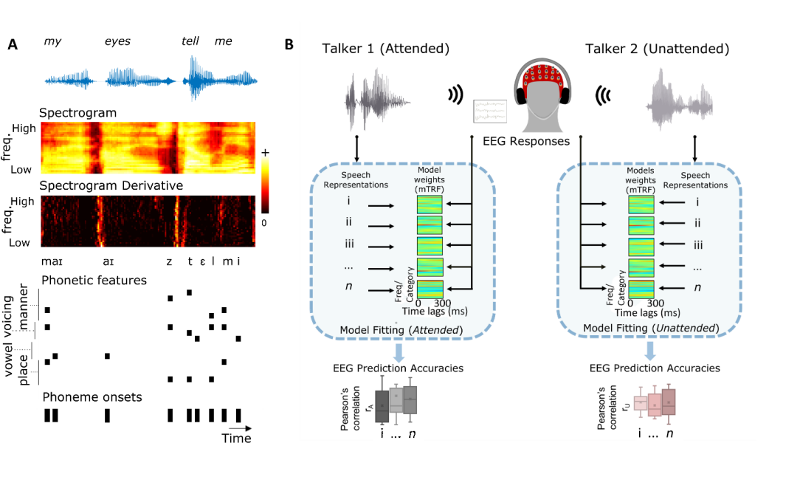
Stimuli (specific phonetic contrasts)
Speech Representations Measured:
Acoustic features:
Spectogram (s)
Spectogram Derivative (sD)
Phonetic features:
Phonetic Features (f)
Phonetic Feature Onsets (fo)
Fig. 1

Slide 11
Two-stage Data Analysis
Does the brain process speech at the level of phonemes and, if so, does it do so for both attended and unattended speech?
Compared performance of different models in predicting EEG responses to speech
Determined whether or not inclusion of categorial phonetic feature representation of speech (f) could improve prediction of EEG beyond other features
Determined whether improved prediction would hold for both attended and unattended speech
2) At what hierarchical levels does attention influence processing?
Identified ability of each stimulus feature to predict unique variance in the EEG responses and assessing whether that unique predictive contribution was affected by attention

Slide 12
Findings
1. For attended speech, including 19-dimensional phonetic features representation improved the prediction of the EEG responses beyond that obtained when only using acoustic features
Was not true for unattended speech
2. Unique predictive power of the phonetic feature representation was enhanced for attended versus unattended speech
Was not true for any other feature

Slide 13
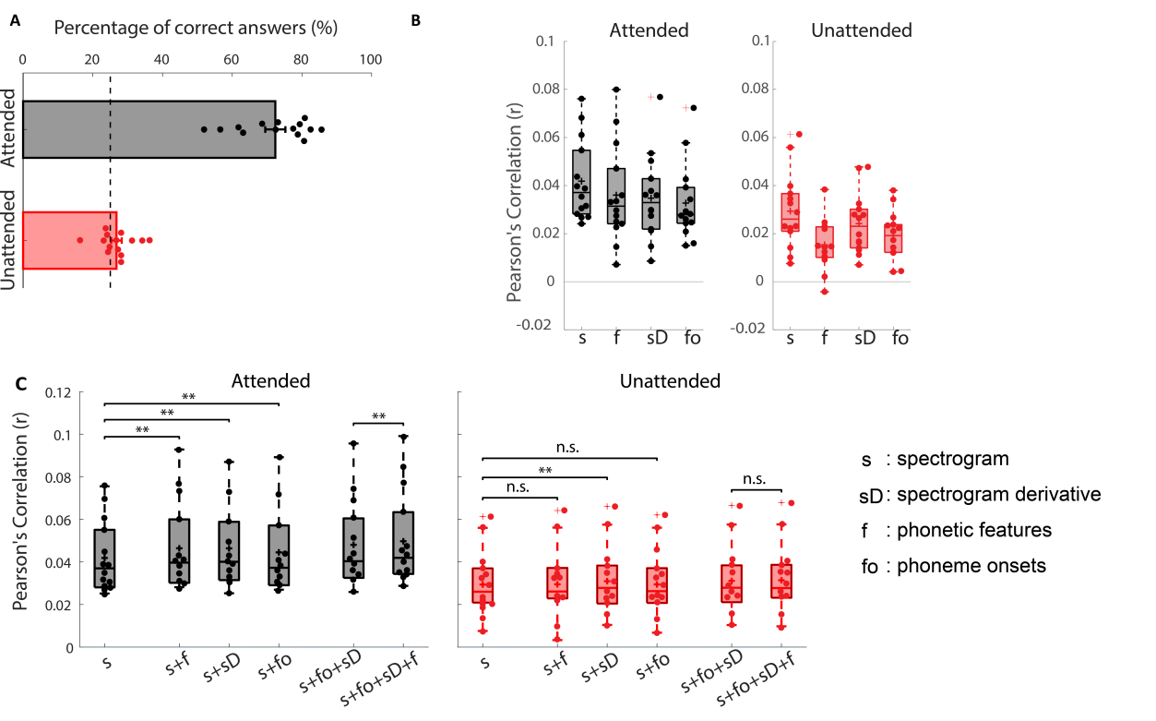
Fig. 2

Slide 14
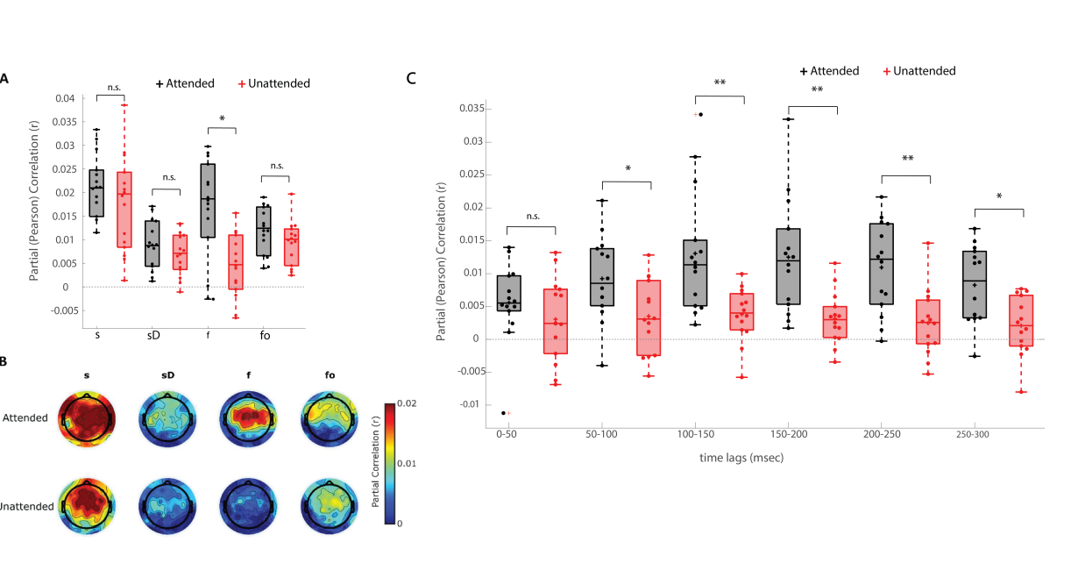
Fig. 3

Slide 15
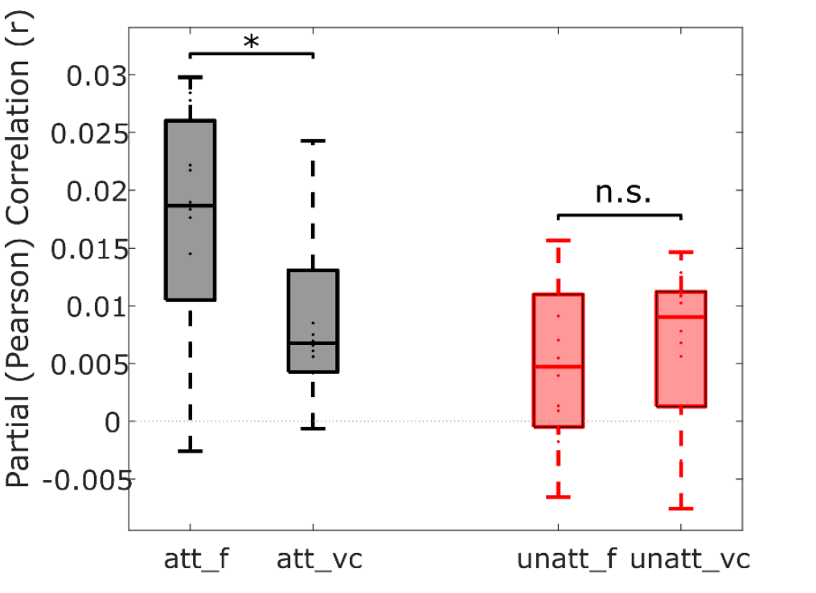
Fig. 4

Slide 16
Most relevant info
2 contributions to literature
1. contribute to debate around pre-lexical speech processing in cortex
2. contribute to debate on how selective attention affects processing of speech
Study shows that a phonetic feature representation has unique predictive power when modelling responses to attended speech, but not for unattended speech
Suggests processing attended speech may involve mapping from an acoustic to a categorical phonemic presentation
Controversial idea in current literature
Cocktail Party Attention debate: Study shows attention differentially modulates cortical processing of acoustic and phonetic information
Confirms stronger attention effects at higher levels of the speech processing hierarchy
These results combined with previous literature suggest that attention is categorically selective for speaker-invariant representations and, at most, attenuates lower-level acoustic (speaker dependent) measures

