Slide 1
Customers Insights Analysis
By Firdose Syed

Slide 2


Introduction
A customer is an individual or business that purchases another company's goods or services. Customers are important because they drive revenues. Without them, businesses can neither survive nor thrive.

Slide 3
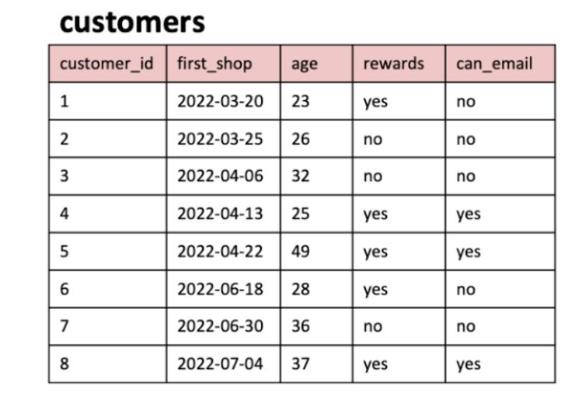
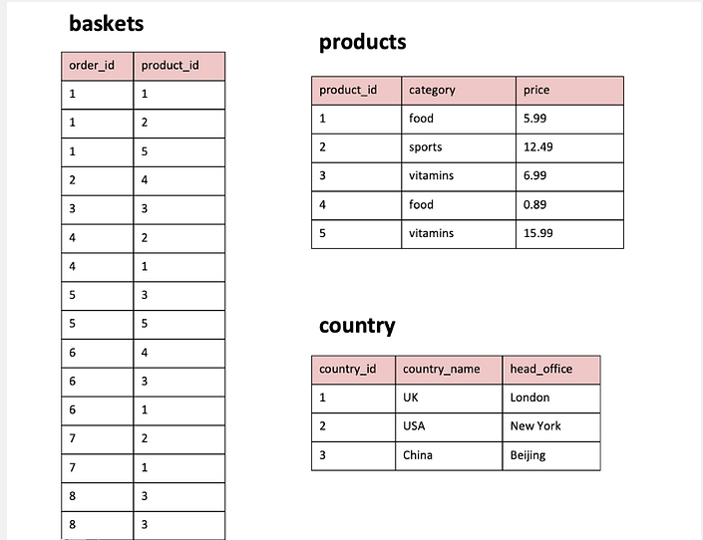
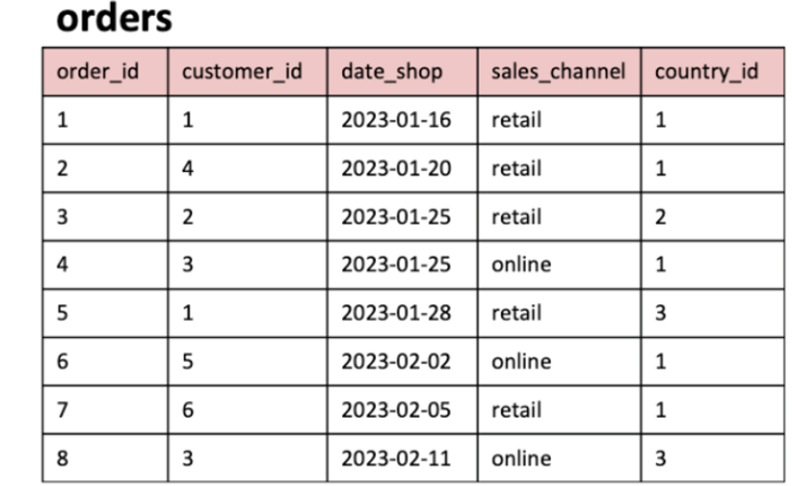
TABLES

Slide 4
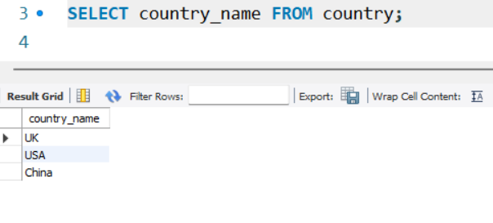
1. What are the names of all the countries in the country table?

Slide 5
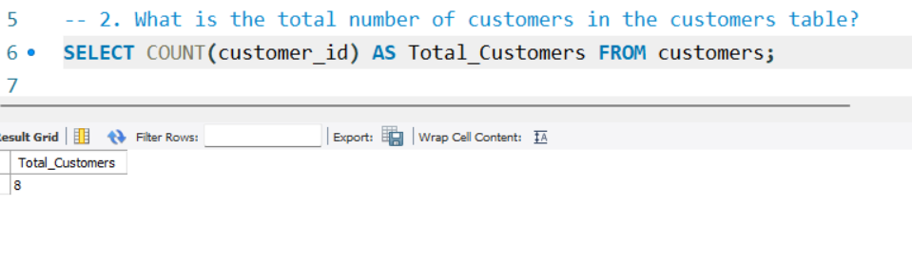
2. What is the total number of customers in the customers table?

Slide 6
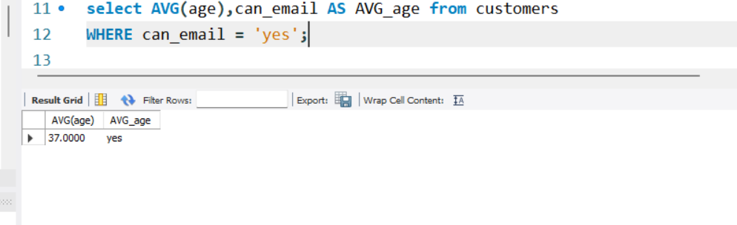
3. What is the average age of customers who can receive marketing emails (can email is set to 'yes')?

Slide 7
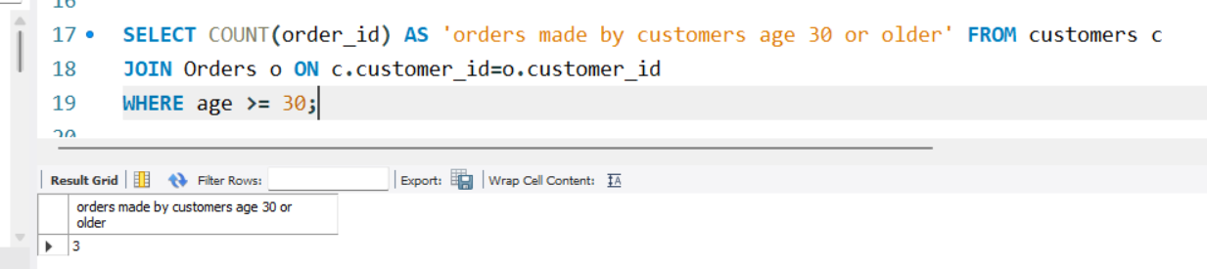
4. How many orders were made by customers aged 30 or older?

Slide 8
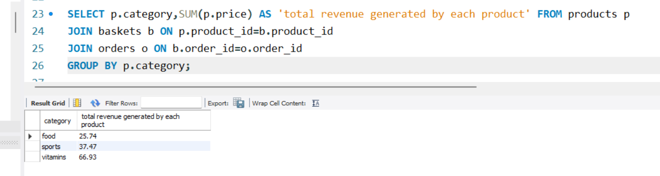
5. What is the total revenue generated by each product category?

Slide 9
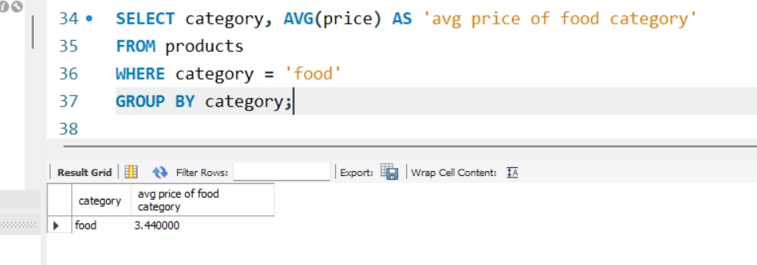
6. What is the average price of products in the ‘food’ category?

Slide 10
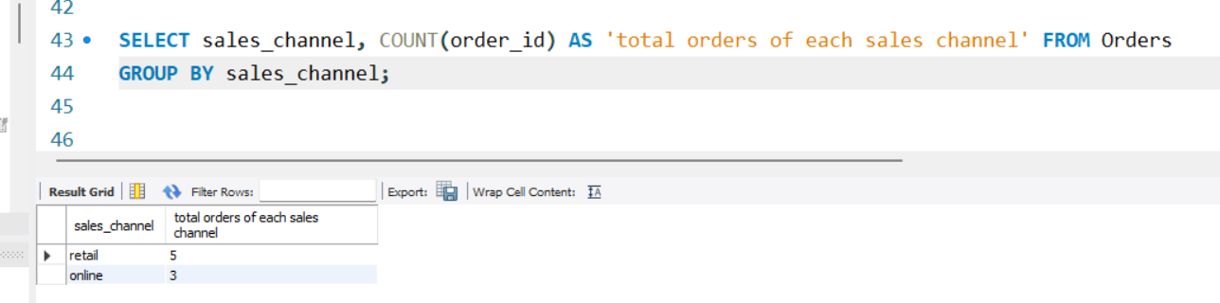
7. How many orders were made in each sales channel (sales channel column) in the orders table?

Slide 11
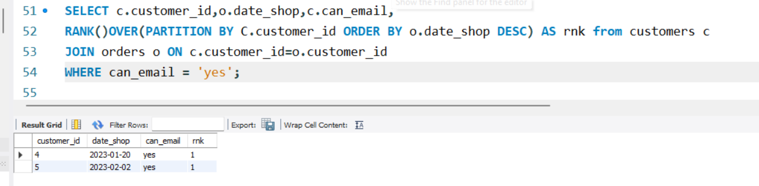
8.What is the date of the latest order made by a customer who can receive marketing emails?

Slide 12
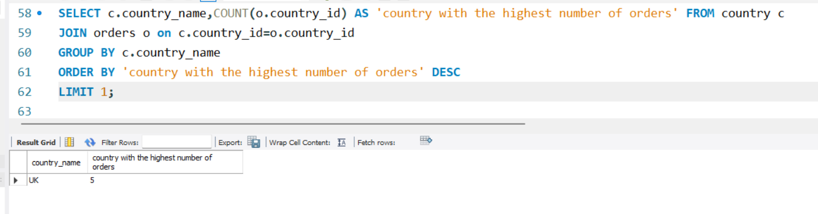
9. What is the name of the country with the highest number of orders?

Slide 13
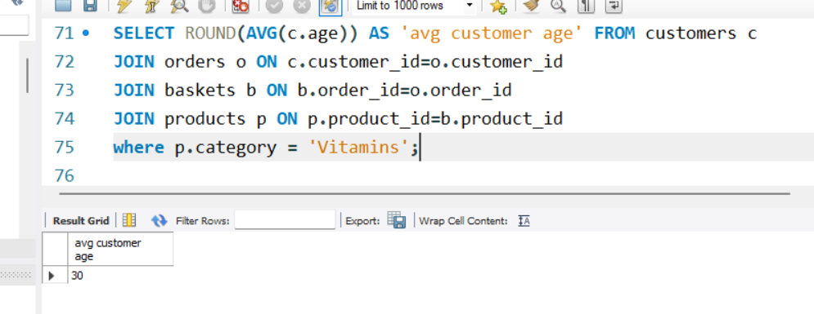
10. What is the average age of customers who made orders in the ‘vitamins’ product category?

Slide 14
THANK YOU

