Slide 1
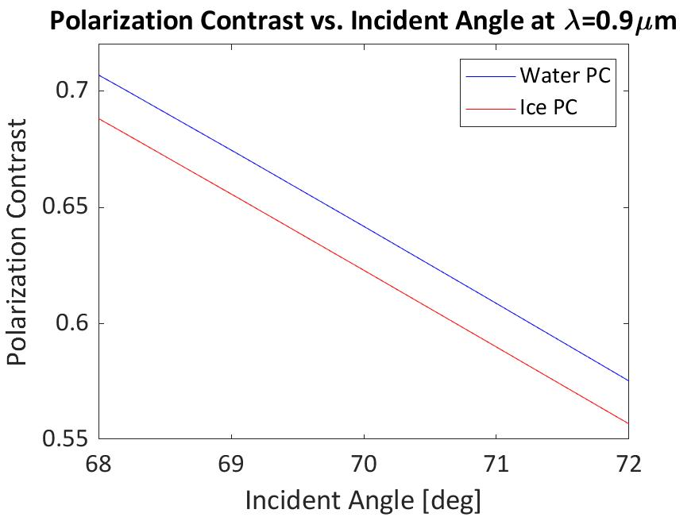
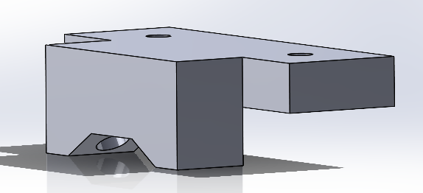
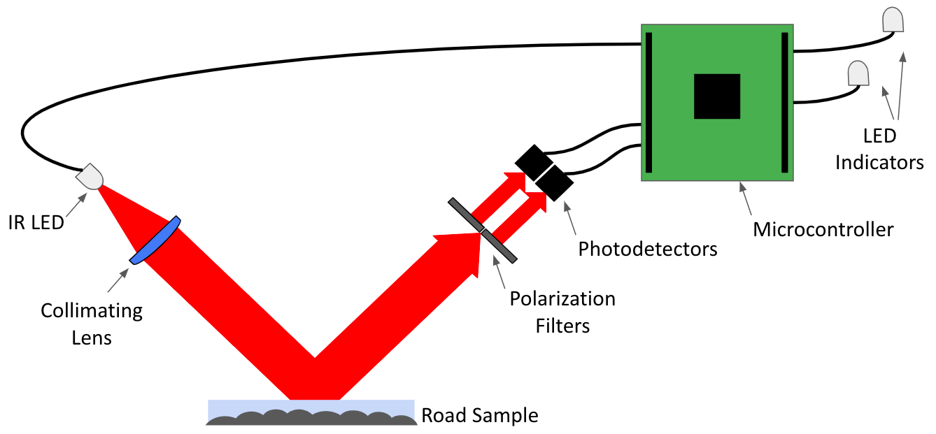
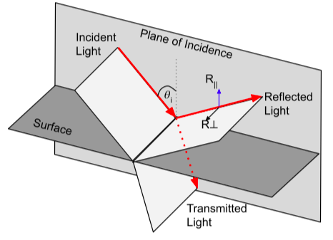
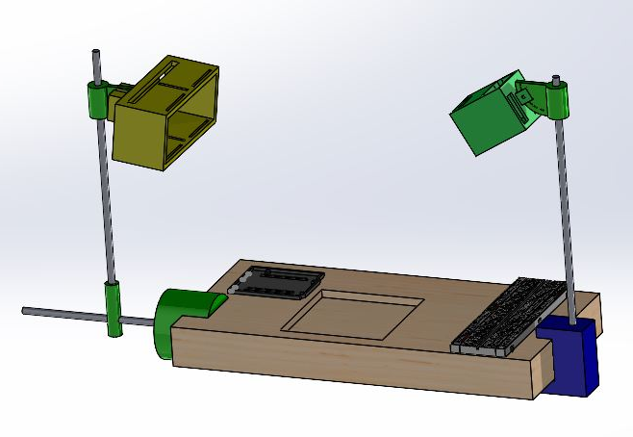
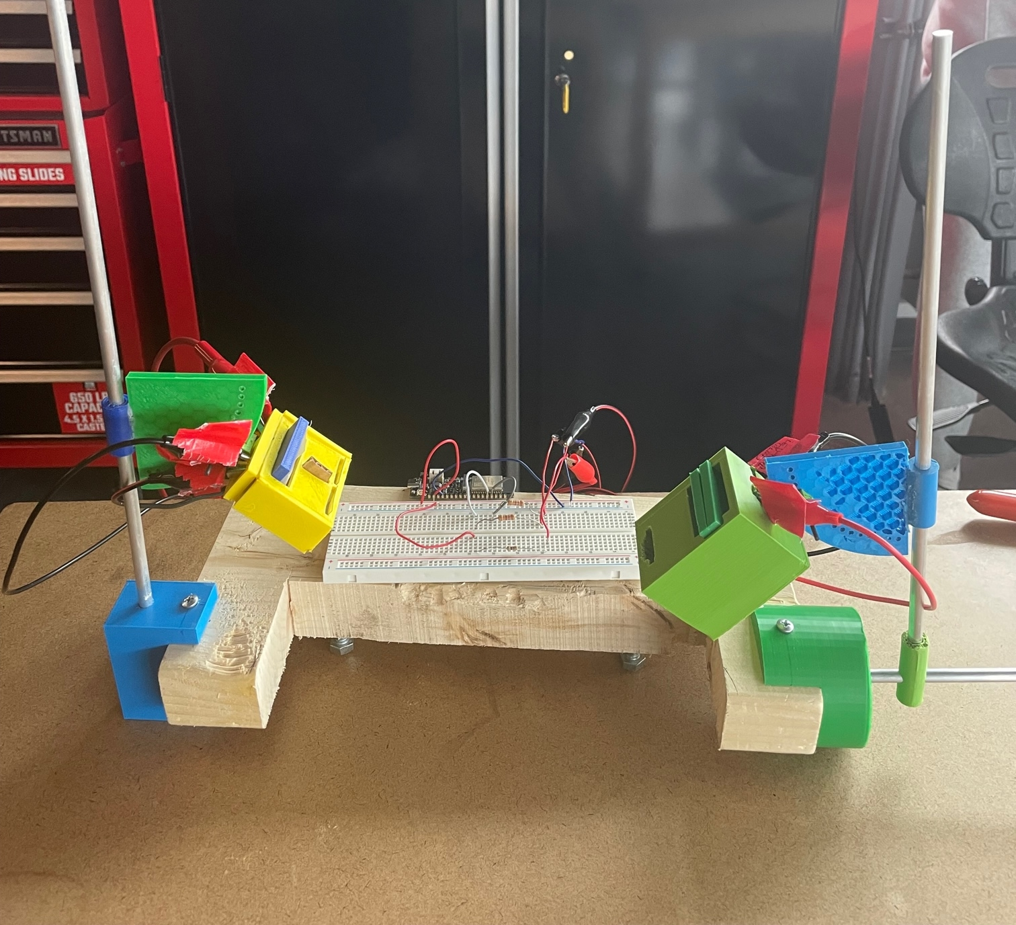
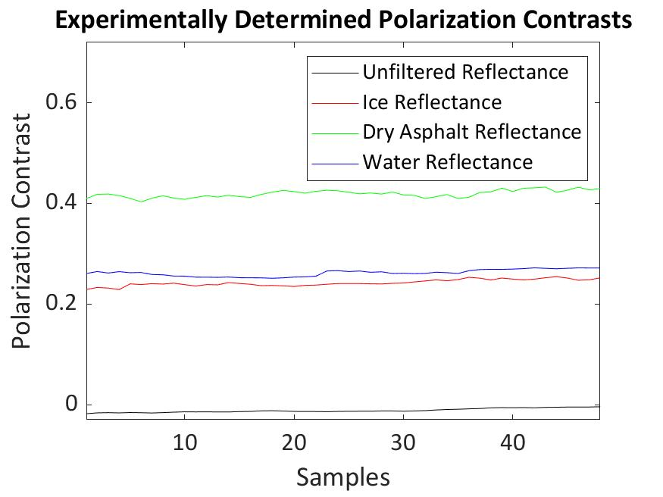
Design of Optical Ice Detector for Winter Road Safety
James Oddo, Tyler Andrade, Jacob Rainey, Seth Frohnheiser, and Andy Paul
Mentor: Dr. Allison Marn
Roger Williams University
Abstract
Proof of Concept
Final Device Design
Wet and icy road conditions pose a greater risk for accidents, especially on bridges, which tend to ice before roads. Modern automobiles may be equipped with temperature sensors that warn drivers of the potential for icy conditions when freezing temperatures are detected, but they do not provide a definitive characteristic of the road conditions. Alerting drivers about the actual upcoming road conditions may decrease the number of accidents that occur and allow local department of transportation officials to make informed decisions about managing hazardous roads. This project aims to develop an optical-based sensor that can reliably detect the presence of water or ice on road surfaces. Numerical simulations indicate that the polarization characteristics of light reflected off icy and wet road surfaces differ enough from each other that such a sensor is technically feasible. A test fixture has been 3D printed, outfitted with a microcontroller, infrared LED, photodetectors, and optical lenses and polarization filters to obtain experimental values for the intensity of reflected polarized light off different surfaces. Following testing, the final device design will be completed utilizing the experimental values to differentiate between road conditions. Further goals include potential collaboration with RIDOT in utilizing the system on the Mt. Hope bridge to increase safety for Roger Williams University students, faculty, and visitors.
Numerical Simulations
Optical Design
Ray tracing diagram showing optical path of light propagation through device design.
Test Fixture
Testing conducted on various wet, icy, and dry road samples to verify numerical simulations.
Using the results from proof of concept, final prototype designing is underway.
Small, compact housing
Minimally obstructive
Minimized debris entry
Reduced power consumption needed for LED
Implementation
This design will be fixed to the curb via extrusion from the housing
Operation with light propagation parallel to the roadway.
Material
Marketable device would need to be manufactured with stainless steel
Resistance to rusting and strength for durability
3% maximum difference in PC between ice and water was found at 69° for 900-1000nm NIR light.
Basis for optical component selection
NIR is non-distracting and invisible to humans.
Initial SolidWorks design of final device, maintaining the same optical path and including an extruded plate for mounting to concrete.
Background
Polarimetry
Parallel and perpendicular polarized light have different reflectance (R) responses depending on incident angle and surface refractive index.
Polarization contrast (PC) normalizes ratio of polarization reflectances.
Refractive indices of ice and water differ slightly.
Parallel and perpendicular reflectances, R|| (blue arrow) and R⟂ (black arrow) respectively, of reflected light at an angle of incidence, θ_{i}. The red arrows indicate the direction of light propagation.
Conclusions
Potential Errors
Wide variation of possible road conditions
Uneven surface and varied asphalt material composition
Temperature
Combinations of ice, water, slush, and snow
Salting and other road treatments
Overall road characteristic may not match analyzed sample
Imperfect alignment of invisible beam of light from NIR LED to photodetectors
Impact
Potential reduction in number and severity of winter weather accidents
Cost effective and environmentally friendly DOT management of roads
Future Work
Higher quality optical components for higher accuracy
More precise 3D printing and stainless steel manufacturing
Extensive longevity testing in road environment
Coordination with RIDOT to implement on high-risk roads
Dynamic ice detection for future implementation in cars’ sensing systems
SolidWorks design for test fixture, including the photodetector mount, an angle modifier, sensor mount, and lateral moving mechanisms.
Test fixture built using stock and custom 3D Printed parts (ABS and PLA), using 3D printers located in the SECCM Innovation Lab and Makerspace.
Design Considerations
Preliminary Testing Results
Cost
Under $300 for designing, prototyping, and final concept
Affordable widespread implementation
Size
Compact, minimally obstructive and non-distracting to drivers
Durability
Ability to withstand weather and road conditions, waterproof
Sub-freezing temperature operation
Power
Low power consumption to tap into preexisting power sources
Speed
Robust code
Rapid response time to alert drivers in real time
Results
Samples of ice, water, and asphalt produce distinct PC signals.
Data Manipulation
Reduced signal noise using 50 point moving average filter.
Upward drift may be due to mechanical instability of the fixture.
Continued Testing
More trials and statistical analysis are needed to determine acceptable detection ranges.
Acknowledgements
The work done towards the realization of this optical ice detector would not have been possible without the support of the RWU School of Engineering faculty and facilities, and the RWU Makerspace. The budget for the project was granted from RWU School of Engineering and RWU Provost’s Fund for Student Research.

