Slide 1
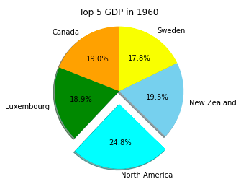
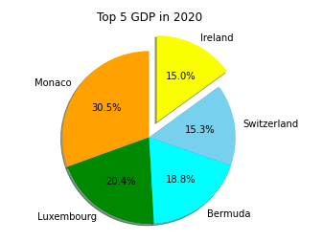
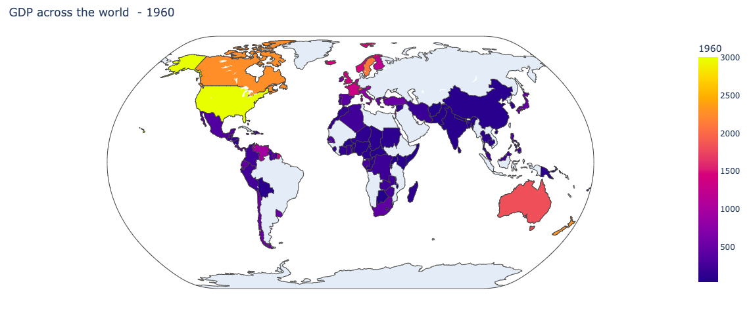
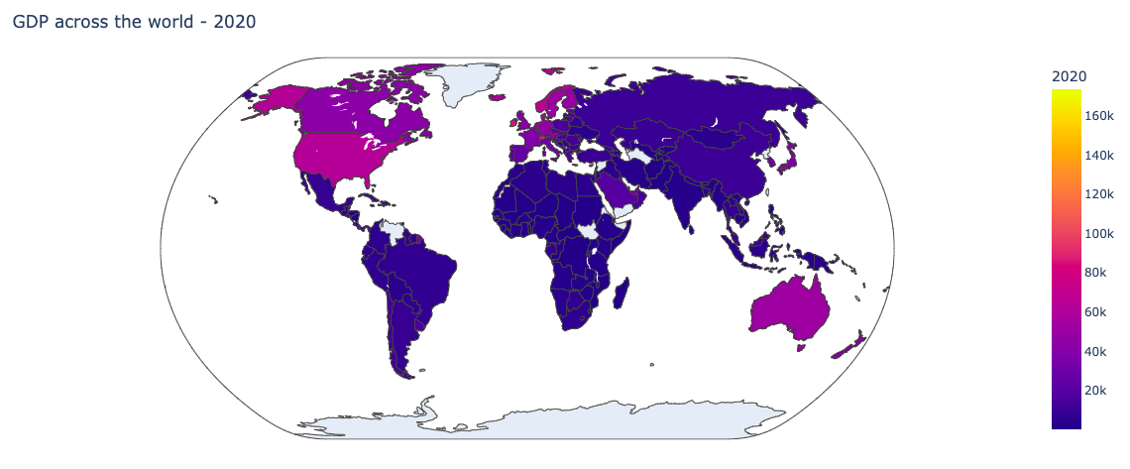
Analyzing the World GDP Per Country
Authors: Morgan Strassburg, Victoria Freitas, and Seth Frohnheiser
Advisor: Dr. Bhandari
Roger Williams University
Introduction
Tables/Graph
Conclusion
Our project is on analyzing the World GDP per capita. We are analyzing this data to see which countries have the highest GDP and how countries GDP changes from 1960 to 2020. The comparison between 1960 and 2020 will help us to understand which countries have the highest GDP growth rates over the past few decades. GDP is gross domestic product, which is the total monetary or market value of all finished goods and services produced within a country’s borders in a specific time period. This will also help us to realize which countries have had the greatest economic progress and which one's struggle with growth capacity. By using data from ”Worldbank” we are able to sort and manipulate this data to create polarizing graphs that show the percentage of GPDs shared by the top five countries in the year of 1960, 2020, and their overall comparison. Additionally, we can use this wide range of data to formulate interactive plots that allow viewers to examine their country’s GDP as well as any other countries that may interest them. Through these findings we will enable viewers to gain a better understanding of their country’s economic progress as well as the cause-and-effect relationship it may have with others in it’s surrounding area.
Using various tools of python and implementing libraries such as NumPy, Pandas, and Matplotlib, we were able to analyze real world data of countries GDP between the years of 1960 and 2020 to understand the economic growth and innovation of each country. We were able to organize, clean, and manipulate the GDP of different countries to observe changes and trends to discover growth rates. The top 5 GDP of 1960 and 2020 were visualized in bar plots, interactive geo maps, and pie charts to understand each country's economic performance over time. Comparing the starting year of 1960 and the ending year of 2020, we can see that there is growth in all of the countries GDP over the course of the past 60 years. Bar plots compared the first 5 rows of countries in the given data set in 1960 and 2020. It is evident that Monaco's economy has increasingly done well over the last 60 years. The highest GDP recorded was in the United States at $3007 in 1960. The minimum GDP was in Afghanistan at $40 in 1960. The Top 5 GDP in 1960 and 2020 were observed where in 1960 the United States had the highest GDP making up 23.6% of the top 5 countries and in 2020 Monaco had the highest GDP making up 30.5% out of the top 5 countries. Consolidating the data of all countries, we see that the mean GDP of all countries was $ 482 in 1960 and $14,354 in 2020. This is approximately a 2,800% increase in GDP amongst all countries.
Method
Sorting:
By sorting in Microsoft Excel, we are able to create manageable data which is easy to read and comprehend
By sorting data from largest to smallest for each year we can easily read our files to output these values in Anaconda
Coding:
Through various coding methods we are able to implement functions that manually create unique and colorful plots
Imported libraries such as ”pandas”, “numpy”, “matplotlib”, “plotly”, and “seaborn” were used because of their ease of use and plotting capabilities
Limitations
Data:
Some countries did not report their GDP values for specific years
Difficult data management due to number of data points
The GDP values analyzed were not in USD currency creating for differing data points other than what were expected
Plots:
Pie charts were created for only the top five countries for specific years
Interactive world maps were only created for two years and do not allow viewers to pick a specified year
Due to unspecified GDPs world maps can look sparse
Model
References
Types of figures:
A variety of figures were created to visually convey data to viewers
The various graphs created were heatmaps, bar plots, pie charts, and interactive world maps
Figures of importance:
The most prevalent figures are those that allow us to analyze the top five countries for various years and the interactive world maps
Pie charts with percentages of the top five countries for different years create visuals able to be analyzed by their respective percentages
Interactive world maps allow us to view each country across the globe at any country over the course of our 60-year data set
“GDP per Capita (Current US$).” Data, https://data.worldbank.org/indicator/NY.GDP.PCAP.CD?view=chart.
Numerical Python: Scientific Computing and Data Science Applications with Numpy, SciPy, and Matplotlib, Second Edition by Robert Johansson, published by Apresss. ISBN 978-1-4842-4245-2, ISBN 978-1-4842-4246-9(eBook)
Acknowledgments

