Slide 1
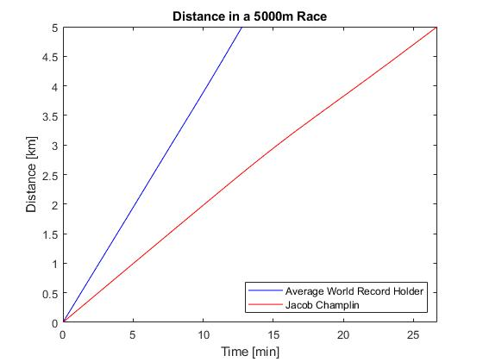
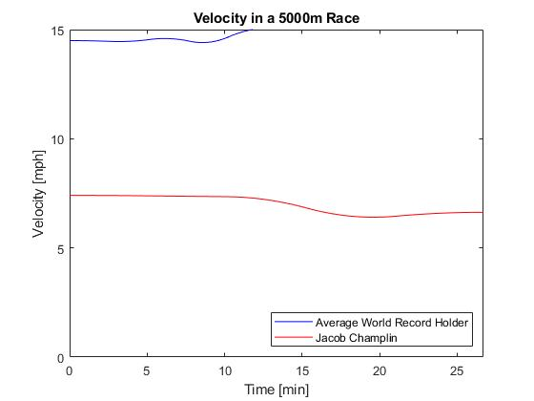
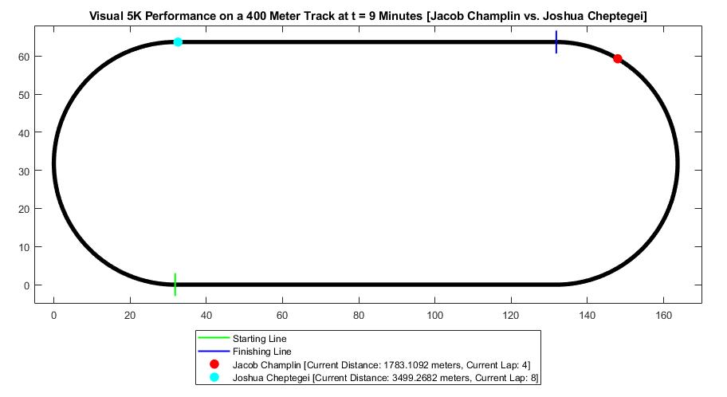

Analyzing 5K Track Performance Using Cubic Spline Interpolation
Jacob Champlin and Seth Frohnheiser
Professor: Dr. Warnapala
Roger Williams University
Introduction
Solution
Visual Running Model (Velocity and Acceleration)
Numerical analysis has many applications in daily life and because of this we are able to use it to our advantage when experimenting with new and exciting problems. The specified problem to be examined is that of 5k long-distance runners, their techniques, improvements, and mindsets while running. Through the use of cubic spline interpolation, we can create a system of equations to determine when and where a specified athlete is at any given moment in their race. By doing this we can get a better understanding of how athletes perform differently for different sections of their race. This problem is paramount in allowing athletes to determine how they size up to their competitors, viewing their personal improvement, and analyzing their speeds at specific portions of the race. As a result, athletes can prioritize their, training, speeds, and techniques to optimize their performance.
In order to find out how professional distance runners ran during 5k races, ten different 5k world record holders were examined using a total of 6 data points. These data points were used for creating 5 individual natural cubic spline equations for each runner. An average spline was also found.
Table 1: Times of 10 World Record Runners at each 1K Meters interval. Units are in minutes.
The average performance of the ten world record holders was plotted against casual runner Jacob Champlin. These interpolated splines allow for distance to be estimated as a continuous function in time. Also note how these lines are not perfectly straight but are slightly curved due to the splines being third order polynomials.
World Record Holders | Time at 0 Meters | Time at 1K Meters | Time at 2K Meters | Time at 3K Meters | Time at 4K Meters | Time at 5K Meters
Joshua Cheptegei (2020) | 0 | 2.53888889 | 5.06888889 | 7.58722222 | 10.09222222 | 12.59055555
Said Aouita (1985) | 0 | 2.58566667 | 5.23033333 | 7.85000000 | 10.53600000 | 13.00666667
Said Aoiuta (1987) | 0 | 2.58916667 | 5.21716667 | 7.77283333 | 10.43416667 | 12.97316667
Haile Gebrselassie (1994) | 0 | 2.61000000 | 5.22833333 | 7.84833333 | 10.47166667 | 12.95000000
Moses Kiptanui (1995) | 0 | 2.58666667 | 5.19666667 | 7.78333333 | 10.38666667 | 12.92166667
Haile Gebrselassie (1995) | 0 | 2.57166667 | 5.15000000 | 7.71666667 | 10.23666667 | 12.74000000
Haile Gebrselassie (1997) | 0 | 2.57666667 | 5.11000000 | 7.63666667 | 10.22000000 | 12.69833333
Daniel Komen (1997) | 0 | 2.54500000 | 5.09000000 | 7.62166667 | 10.14183333 | 12.66200000
Haile Gebrselassie (1998) | 0 | 2.58000000 | 5.10666667 | 7.65500000 | 10.20166667 | 12.65666667
Kenenisa Bekele (2004) | 0 | 2.55400000 | 5.09116667 | 7.62233333 | 10.13216667 | 12.62250000
Model
Taking the derivative of the splines gives the instantaneous velocity of each runner. Note how the professional runners keep a constant speed for about 76% of the race, and then slightly increase speed for the final 24%.
Cubic Spline Interpolation:
Given a function ‘f’ defined on [a,b] and a set of nodes a = x₀< x₁<…< x_{n}=b, a cubic spline interpolates ‘s’ for ‘f’ is a function that satisfies the following conditions
S(x) is a cubic polynomial, denoted S_{j}(x), on the subinterval [x_{j}, x_{j+1}] for each j = 0, 1,…, n-1;
S_{j}(x_{j}) = f(x_{j}) and S_{j+1}(x_{j+1}) = f(x_{j+1}) for each j = 0, 1,…, n-1;
S_{j+1}(x_{j+1}) = S_{j}(x_{j+1}) for each j = 0, 1,…, n-2; (Implied by (b).)
S’_{j+1}(x_{j+1}) = S’_{j}(x_{j+1}) for each j = 0, 1,…, n-2;
S’’_{j+1}(x_{j+1}) = S’’_{j}(x_{j+1}) for each j = 0, 1,…, n-2;
One of the following sets of boundary conditions is satisfied:
S’’(x₀) = S’’(x_{n}) = 0 (natural (or free) boundary);
S’(x₀) = f’(x₀) and S’(x_{n}) = f’(x_{n}) (clamped boundary).
Visual Running Model (400 Meter Track)
Conclusion
Using the acquired equations, the first running model performed visually compared Joshua Cheptegei and Jacob Champlin on a 400 Meter Track.
Each graph states each competitors:
Current Lap
Current Distance
Position on the 400 Meter Track
Specified Time of Interest
Through numerical analysis and more specifically cubic spline interpolation, we were able to accurately examine the correlations of a given runner’s velocity, acceleration, and distance at a given moment throughout their race.
Results:
On average professionals keep a moderate pace throughout with an end acceleration
Each runner can be placed into an average case but must be considered individually for strategy and consistency
Future Work:
App implementation to allow the public to track and compare times
Use of more runners and data points allowing for comparison between any two athletes
S_{j}(x) = a_{j} + b_{j} (x-x_{j}) + c_{j} (x-x_{j}) ² + d_{j} (x-x_{j}) ³
Formula 1: Cubic Spline Formula used for interpolation
Method
Data Acquisition:
Used references to find reputable times for various athletes at unique intervals
Acquired times of group member times to create an accurate comparison between professionals and nonprofessionals
Data Manipulation:
Used excel to organize each athletes' times by step sizes of 1 kilometer
Data Usage:
Used MatLab to create functions and plots of athlete’s times in accordance with the conditions of cubic splines
Plot Management:
- Comparing acquired data between plots to draw comparisons, differences and intersectionality
Drawbacks
Comparison: | Only 5 data points Only comparing yourself to one other person Finding data for individuals that are not professionals is difficult as they do not actively track split times Each person is different and therefore finding the optimal places to speed up or slow down is difficult
MATLAB: | Using software such as MATLAB is inconvenient for the average user An app would be ideal for tracking and comparing data
Dutch, Taylor. “A World Record Was Shattered within Seconds in Monaco.” Runner's World, Runner's World, 2 Nov. 2021, https://www.runnersworld.com/news/a30952158/joshua-cheptegei-5k-world-record/.
Quercetani, Roberto. A World History of Long Distance Running, 1880-2002: Track Events - Men and Women. SEP, 2002.

