Slide 1
Automated Insight Engine
Data Analysis Report
Generated: December 03, 2025

Slide 2
Executive Summary
Executive Summary: Strategic Performance & Growth Imperatives
Our business exhibits a robust profitability foundation but faces critical challenges impacting revenue growth and competitive positioning. Total Revenue stands at 49,489,500.0 with a healthy Total Profit of 18,749,760.0, yielding a strong Profit Margin of 37.886339526566246% and an impressive ROI of 60.99518083106754. Customer satisfaction remains high with an average Rating of 4.789344262295082 and a low Return Rate of 0.020311475409836063.
Critical Performance Indicators & Threats:

Slide 3
Executive Summary (continued)
Despite these strengths, a significant concern is the 0.0% revenue growth, indicating stagnation, and a "stable" revenue trend. This is highly problematic given a "growing trend in UnitsSold" and further exacerbated by a concerning negative correlation between UnitsSold and Revenue of -0.17884356001460117. This suggests that increasing unit sales are paradoxically associated with decreasing revenue, a critical anomaly demanding immediate inv

Slide 4
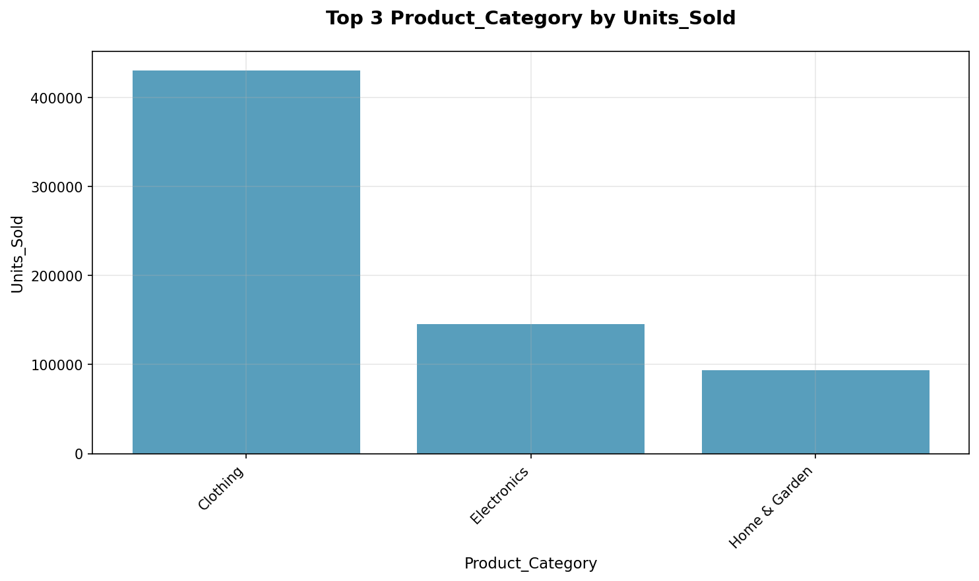
Key Findings
• Here are 5 strategic business findings extracted from the provided metrics: The business is experiencing a "growing trend in UnitsSold" with a "trenddirection": "increasing", yet "revenuegrowth" is 0
•
• This, combined with the negative correlation between "UnitsSold" and "Revenue" (-0
• , indicates that the increase in volume is likely driven by lower-value products or discounts, which dilutes overall revenue
• To accelerate revenue, the company should investigate the product mix and pricing strategy behind high-volume sales, as merely increasing "UnitsSold" currently does not translate to revenue growth

Slide 5
Data Statistics
• Total Records: 366
• Total Columns: 14
• Columns: Date, ProductCategory, ProductName, Region, Channel

Slide 6
Recommendations
• Capitalize on High-Performing Segments for Immediate Revenue Growth
• Mitigate Volatility in Core Metrics to Stabilize Market Share
• Optimize Cost Structure and Address Declining Cost Trend
• Enhance Customer Experience by Reducing Return Rate
• Optimize Marketing Spend for Efficient Customer and Revenue Acquisition

