Slide 1
Automated Insight Engine
Data Analysis Report
Generated: December 03, 2025

Slide 2
Executive Summary
## Executive Summary: Strategic Performance Review & Growth Imperatives
Current State & Performance Indicators:
The business demonstrates a robust operational foundation, reflected in a strong Profit Margin of 37.89% and an impressive Return on Investment (ROI) of 60.99%. Total revenue currently stands at $49.5 million. Customer satisfaction is excellent, evidenced by an average Rating of 4.79 and a low Return Rate of 2.03%. These metrics highlight a high-quality product/service and efficient core operations.
Strategic Opportunities & Threats:

Slide 3
Executive Summary (continued)
Opportunities:
1. Proven High Performance: The existence of numerous high-performing segments (e.g., 117 in UnitsSold, 104 in Revenue) presents immediate, low-effort opportunities to scale successful models and drive rapid revenue growth.
2. Customer Loyalty & Quality: High customer ratings and low return rates indicate a strong product-market fit and loyal customer base, which can be leveraged for expansion and competitive differentiation.
3.

Slide 4
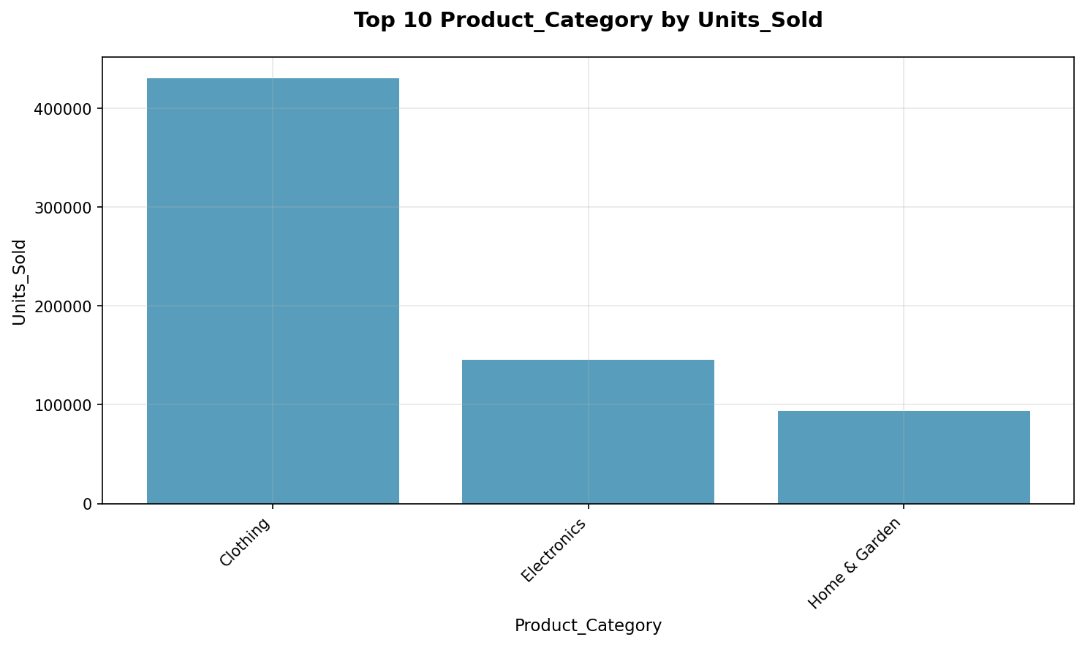
Key Findings
• Pricing/Product Mix Anomaly: Increased Sales Volume Negatively Impacts Revenue and Cost.
• Untapped Customer Lifetime Value: Low Repeat Purchase Rate Limits Revenue Growth.
• Quality-Driven Competitive Advantage: High Customer Satisfaction Linked to Reduced Returns.
• Operational Instability: High Volatility in Demand and Customer Acquisition Hinders Efficiency.
• Seasonal or Segmented Market Dominance: Significant but Inconsistent Market Share Peaks.

Slide 5
Data Statistics
• Total Records: 366
• Total Columns: 14
• Columns: Date, ProductCategory, ProductName, Region, Channel

Slide 6
Recommendations
• Recalibrate Pricing and Product Mix for Profitable Growth.
• Scale High-Performing Segments and Replicate Success Drivers.
• Implement Predictive Analytics for Demand and Customer Volatility Mitigation.
• Strategically Optimize Costs for Enhanced Profitability and Value.
• Enhance Customer Loyalty and Market Penetration with Data-Driven Engagement.

