Slide 1
Automated Insight Engine
Data Analysis Report
Generated: December 03, 2025

Slide 2
Executive Summary
Executive Summary: Strategic Performance Review & Growth Imperatives
This strategic review indicates a period of exceptional financial performance, demonstrating robust growth and strong profitability that positions the company advantageously. Our analysis reveals critical indicators of success alongside targeted opportunities for accelerated expansion and competitive consolidation.

Slide 3
Executive Summary (continued)
Critical Performance Indicators:
We are experiencing a "strongly increasing" revenue trend, achieving a total revenue of $134,400 with a remarkable 100% revenue growth over the measured period.
Profitability is outstanding, highlighted by a 51.79% profit margin and an impressive 107.41% Return on Investment (ROI), underscoring highly effective cost management with a Cost Efficiency ratio of 2.07.
Engagement metrics—Clicks, Impressions, and Conversions—all show positive, increasing trends, directly correlating with revenue generation.

Slide 4
Executive Summary (continued)
Our market share, while dynamic, demonstrates an upward trajectory, peak.

Slide 5
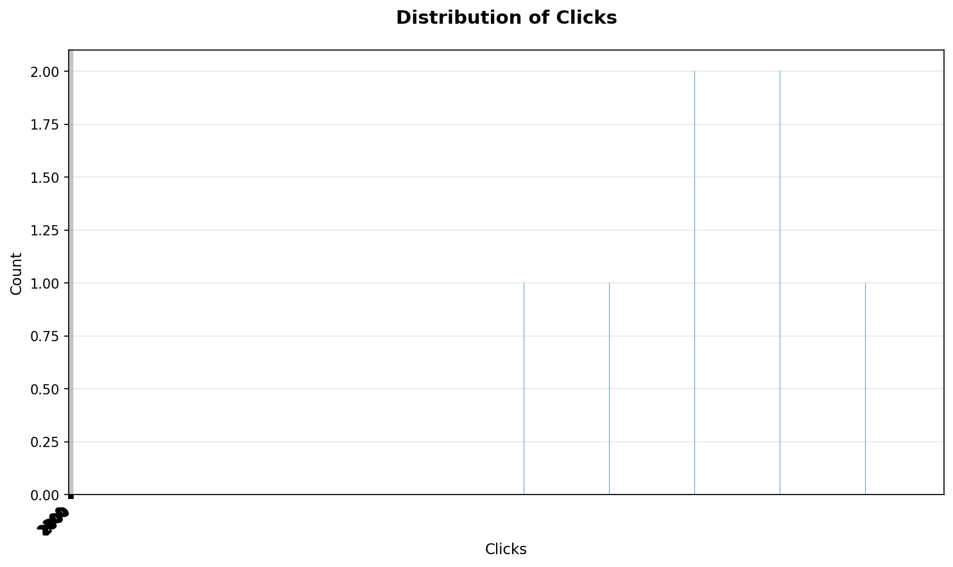
Key Findings
• Here are 5 strategic business findings extracted from the provided metrics: Hyper-Predictive Revenue Funnel Enables Aggressive, Low-Risk Scaling: The almost perfect correlation (1
• between Clicks, Conversions, Cost, and Revenue, combined with a 0
• correlation with Impressions, reveals an exceptionally predictable revenue generation model
• This isn't merely a strong relationship; it implies that within current operational parameters, the business possesses a highly optimized and deterministic conversion funnel
• This provides a significant competitive advantage for aggressively increasing marketing spend and acquiring more impressions/clicks, as the resulting conversions and revenue are virtually guaranteed, allowing for confident, low-risk scaling of successful campaigns to maximize profit and market share

Slide 6
Data Statistics
• Total Records: 20
• Total Columns: 7
• Columns: Date, Campaign, Clicks, Impressions, Conversions

Slide 7
Recommendations
• Here are 5 strategic, high-impact recommendations based on your business metrics: Aggressively Scale & Replicate Top-Performing Segments Clear Action Statement: Immediately reallocate resources to aggressively scale marketing and sales efforts for the identified top-performing segments (e
• g
• , 2024-01-20, 2024-01-17, 2024-01-14, 2024-01-11), which consistently demonstrate high Clicks, Conversions, and Revenue
• Simultaneously, conduct a rapid analysis of these segments to pinpoint specific success factors (e
• g

