Slide 1


IMPLEMENTING AI DRIVEN THREAT DETECTION
Presented by:
Nishant Gaurav 2141007068
Suraj Ghosh 2141007017

Slide 2




IDENTIFYING THE PROBLEM
Traditional systems fail to detect and mitigate advanced threats
Risks include data breaches, financial losses, and compromised privacy.
Need for an advanced AI-driven threat detection system for cloud environments.
Increasing sophistication and frequency of cyber threats.

Slide 3



ROOT CAUSE ANALYSIS
Traditional systems' inability to handle large and complex data sets effectively.
Lack of real-time monitoring and automated response mechanisms.
Inability to adapt to evolving threats and learn from new data.

Slide 4
IMPLEMENTATION STEPS:
Solution Overview:
Development of an AI-driven threat detection system using advanced AI and ML techniques.
Key Features:
Real-Time Monitoring: Continuous surveillance of network traffic and user activities.
Adaptive Learning: Machine learning algorithms evolving with new data.
Automated Response: Immediate actions to mitigate threats.
Integration with Existing Systems: Enhances current cybersecurity infrastructures without significant changes.

Slide 5
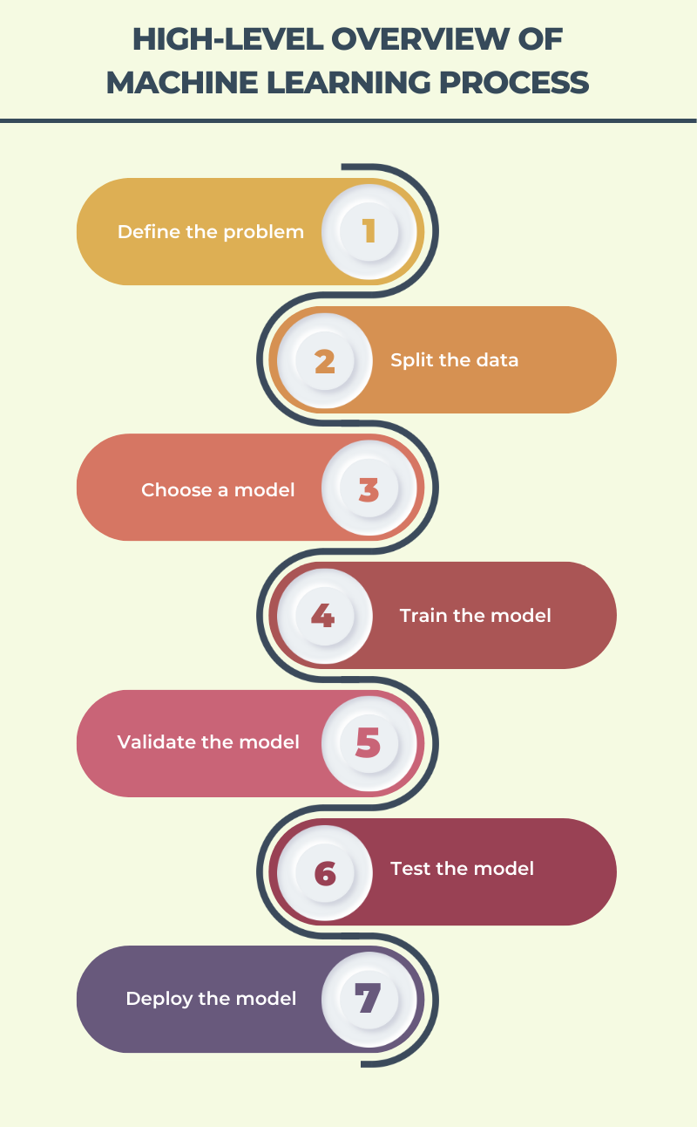
Solution Development
Implementation Steps:
Data Collection: Aggregating data from network traffic, user behaviors, & system logs.
Data Preprocessing: Cleaning and preparing data for analysis.
Model Training and Evaluation: Using ML models like Random Forest, Decision Tree, and K-Nearest Neighbors.
Visualization: Visualizing model performance and data correlations.

Slide 6
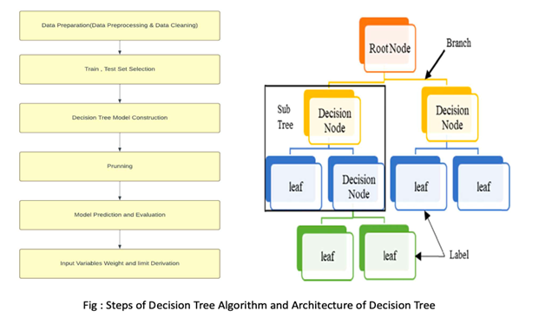
Decision Tree Model:

Slide 7
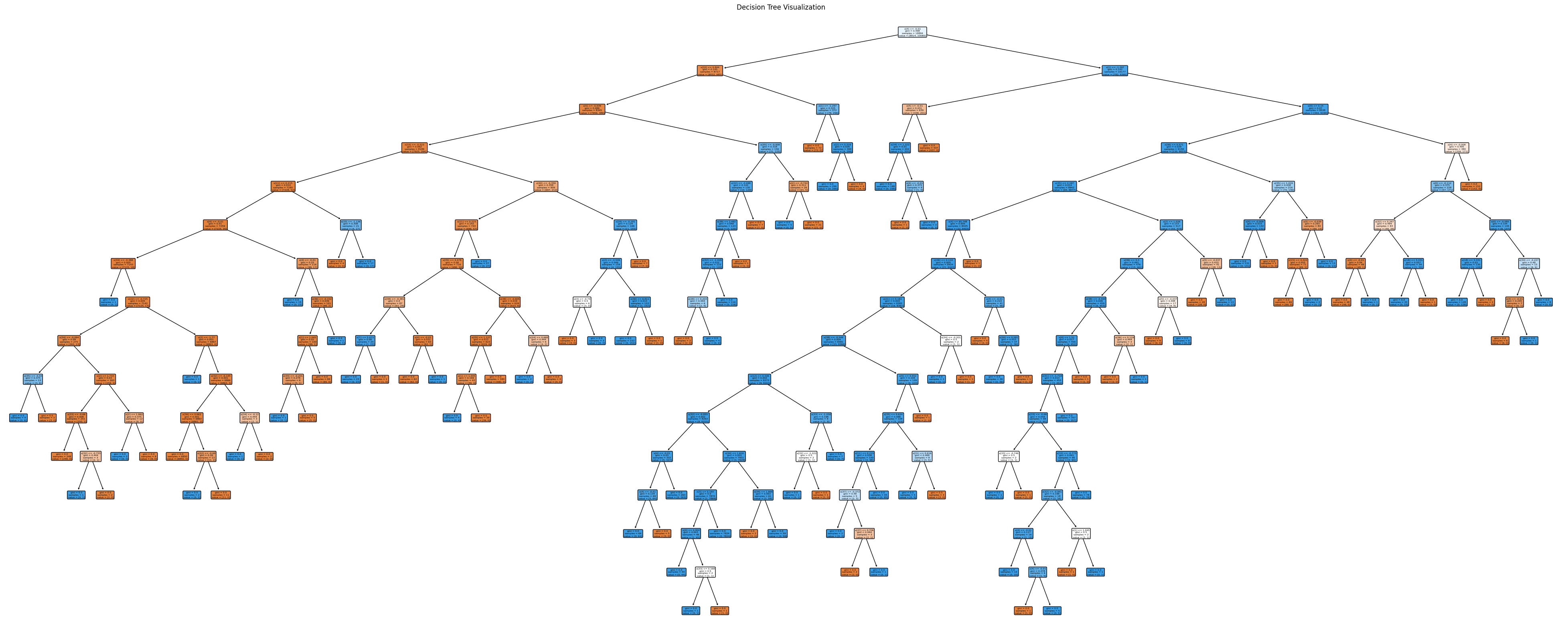
RESULT :
Decision Tree Model:

Slide 8
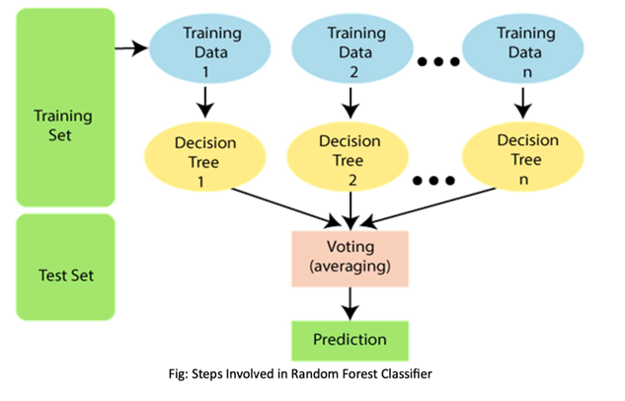
Random Forest Model:

Slide 9
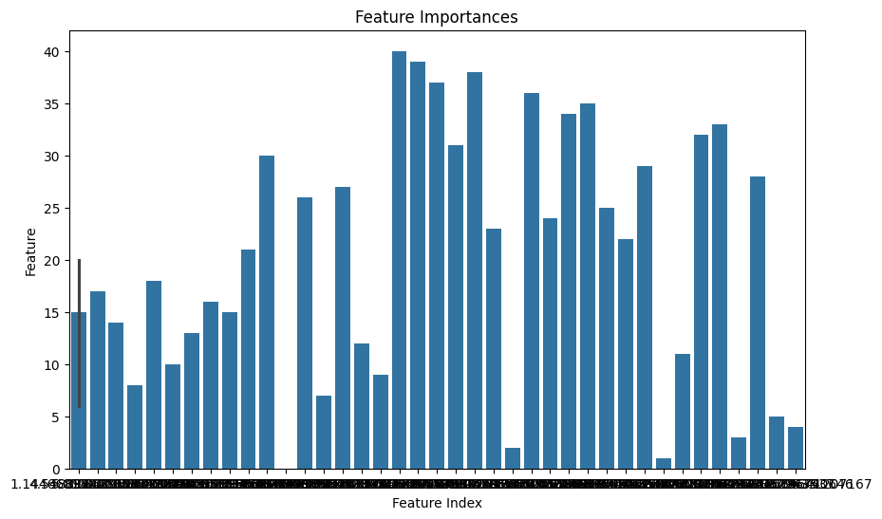
RESULT :

Slide 10
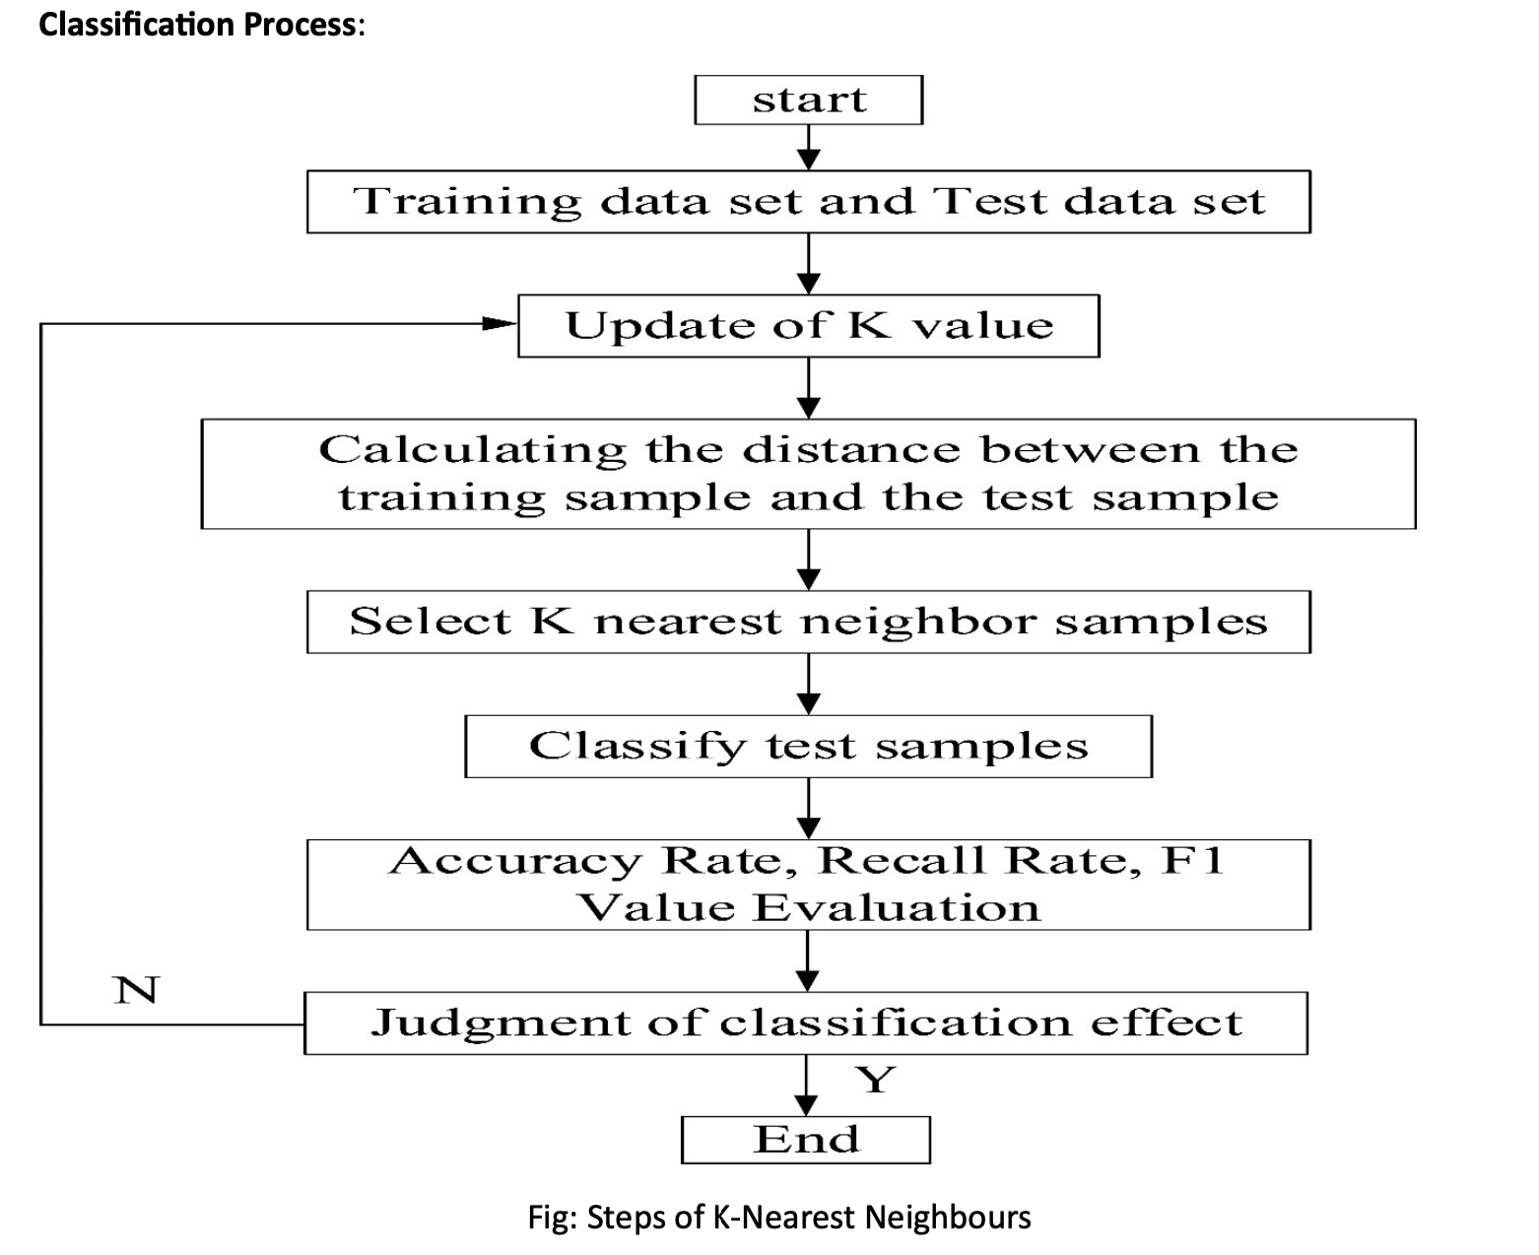
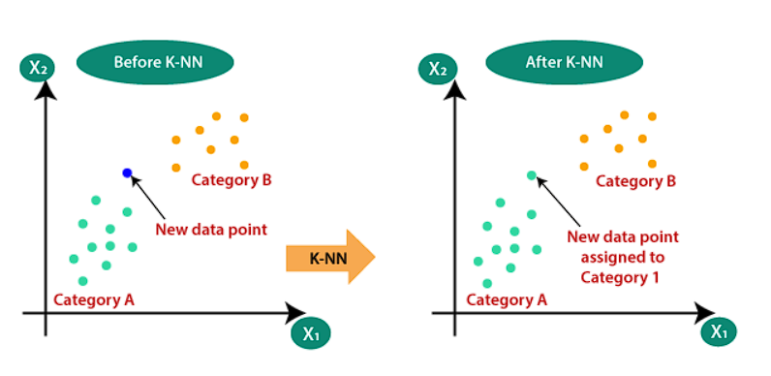
K-Nearest Neighbours Model :

Slide 11
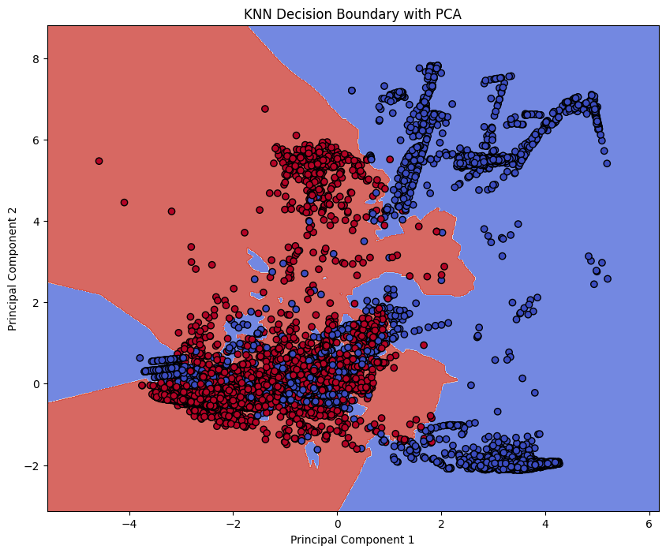
RESULT :
K-Nearest Neighbors Model:

Slide 12
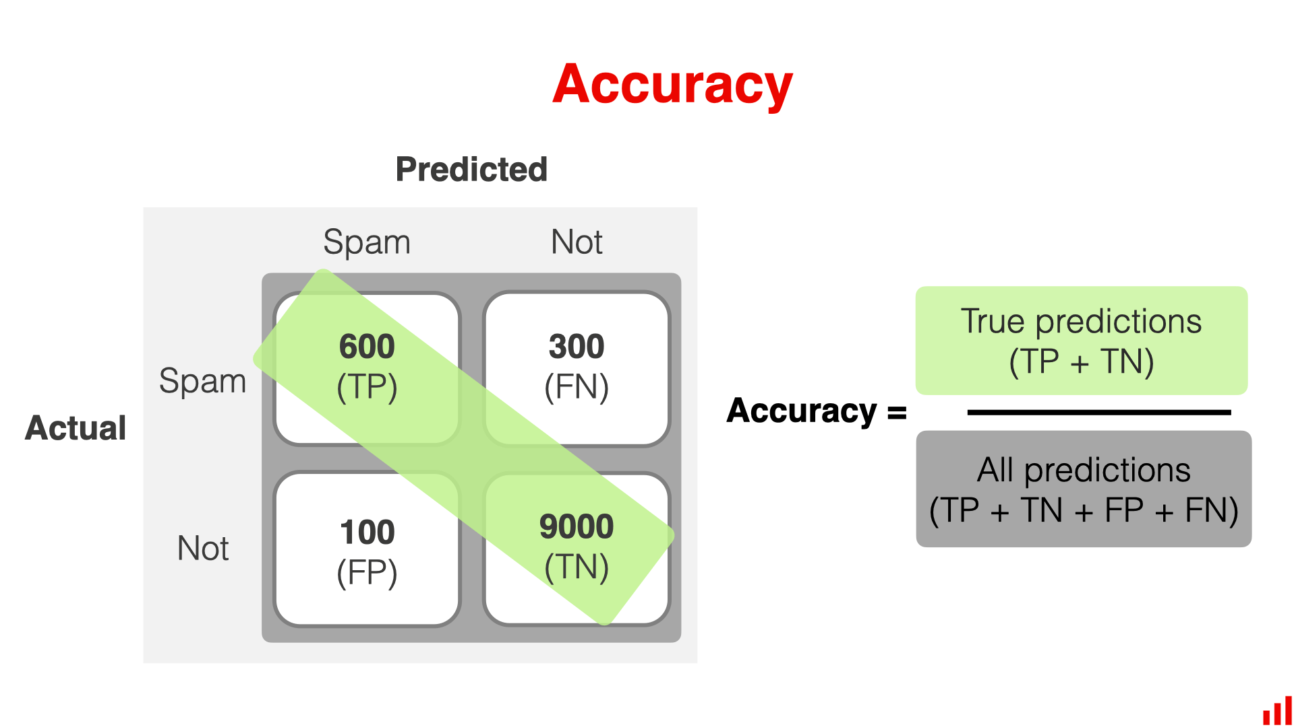
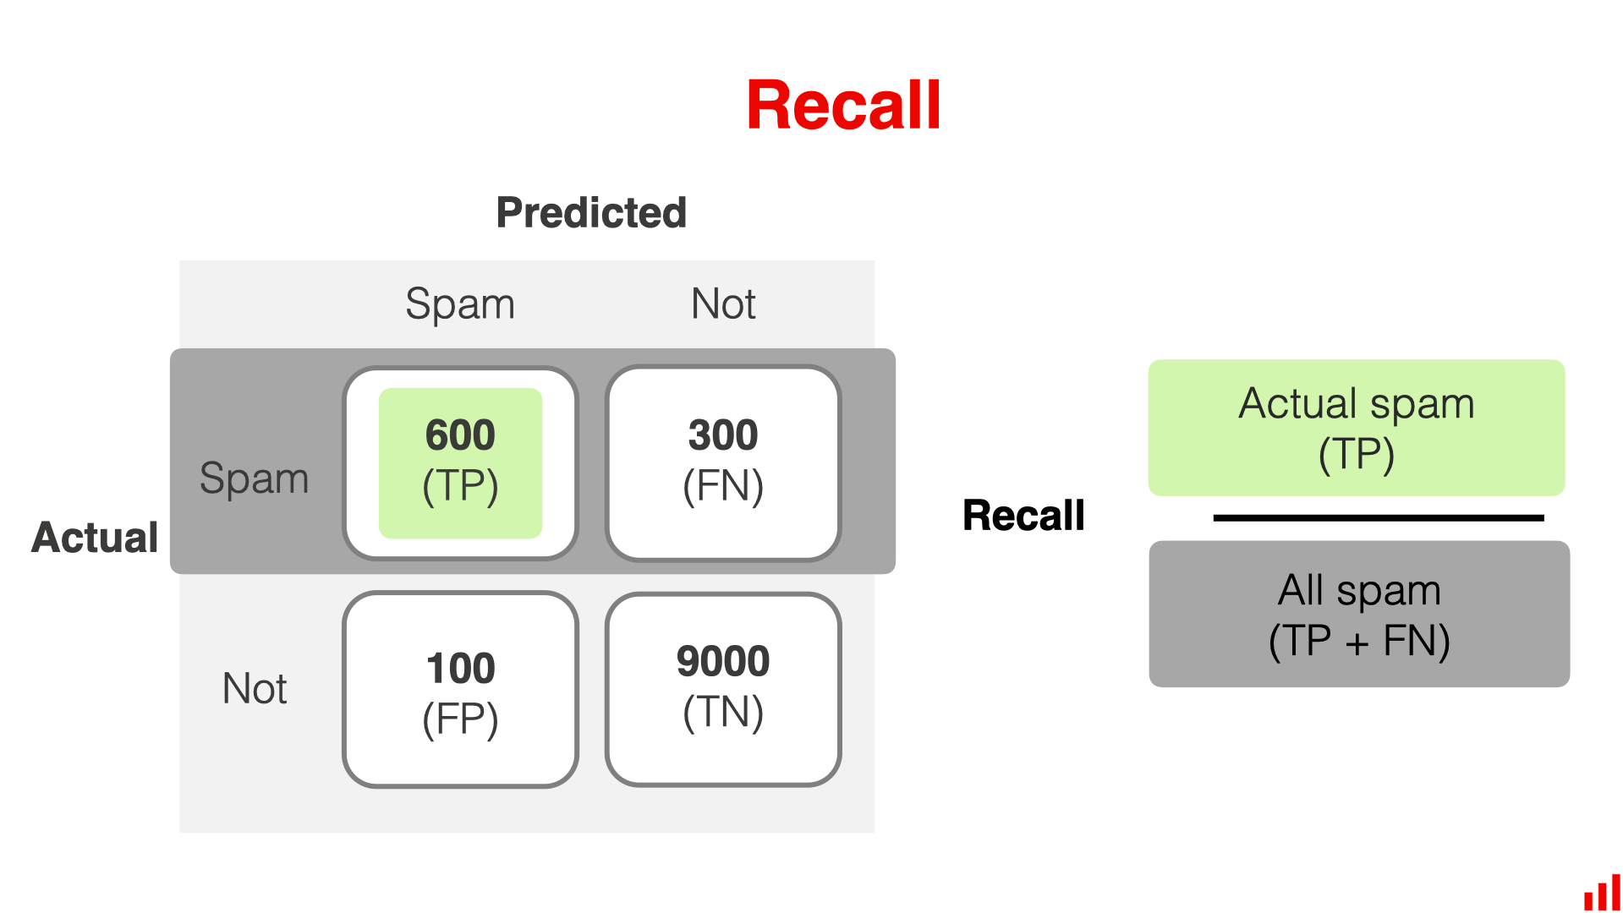
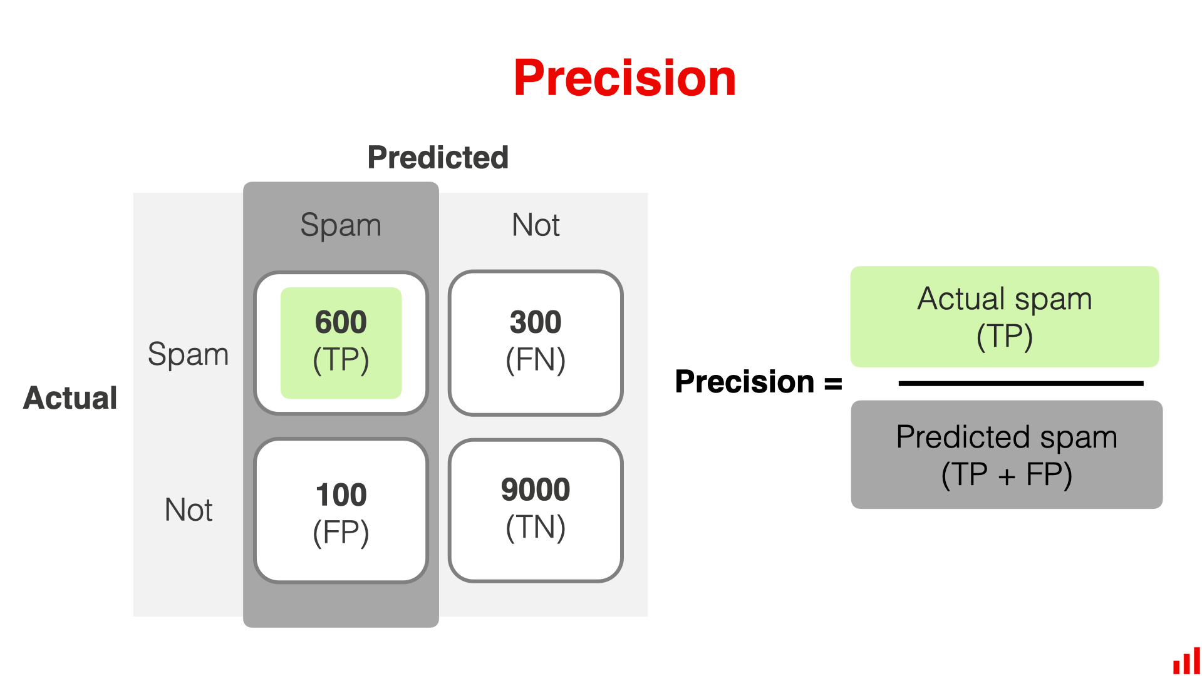
COMPARING MODELS

Slide 13
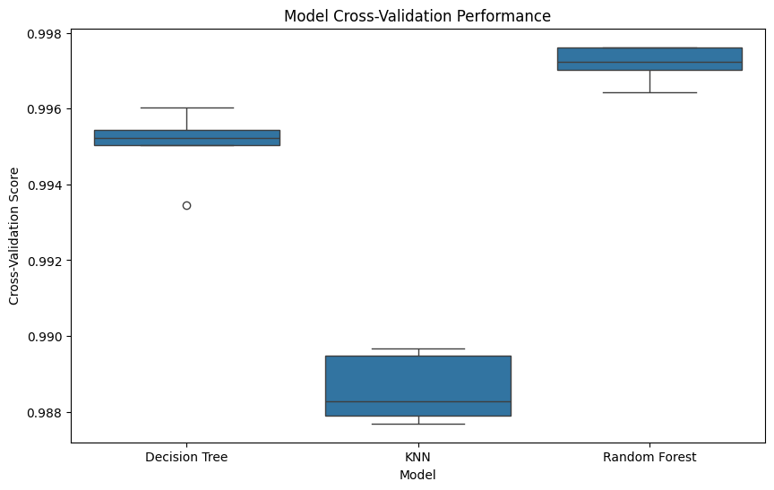
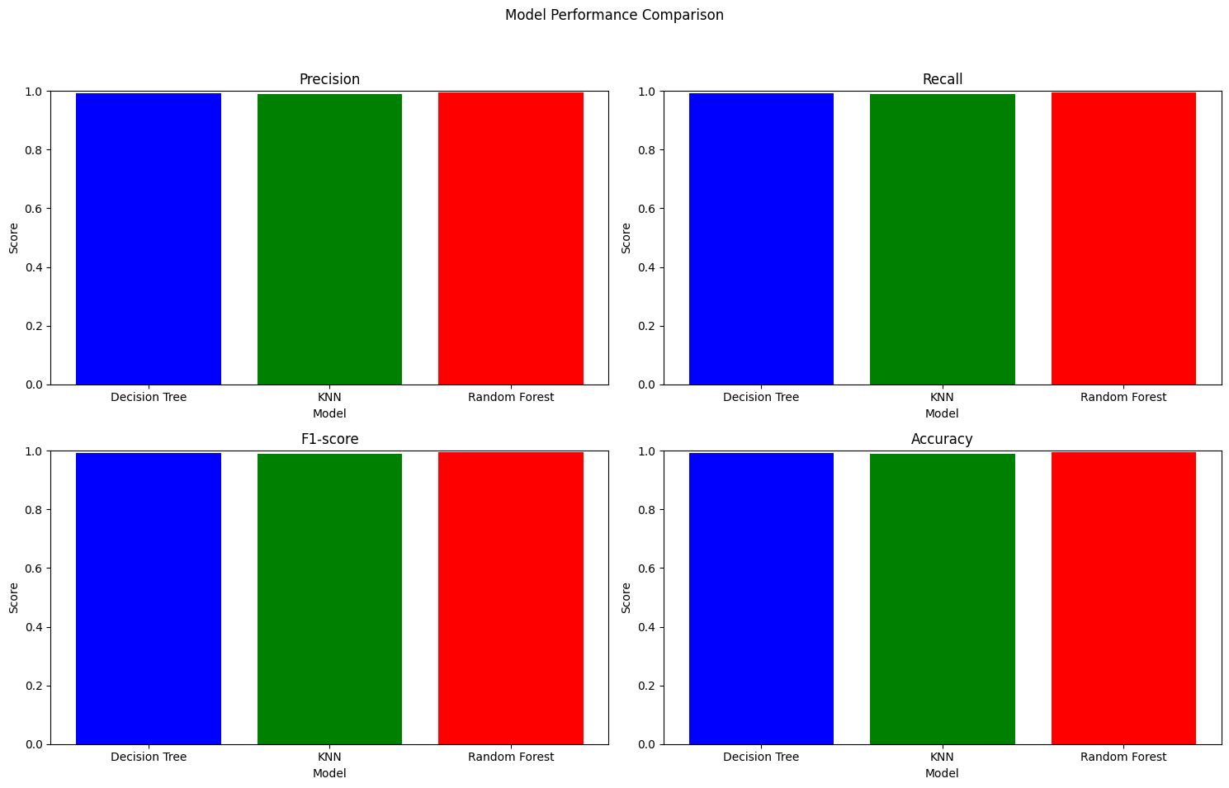
COMPARING MODELS

Slide 14
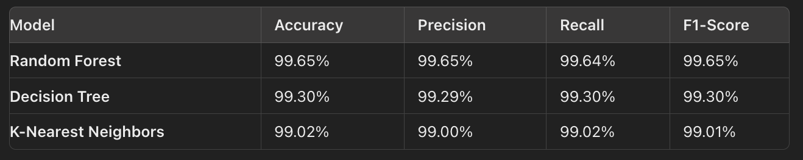
CONCLUSION
Conclusion
AI-driven threat detection significantly improves threat identification and response times.
The system reduces false positives and provides real-time alerts.
Integration with existing systems enhances overall cybersecurity without major overhauls.
Continuous learning and adaptation to new threats ensure long-term efficacy.

Slide 15

REFERENCES
IEEE.
Goodfellow, I., Bengio, Y., & Courville, A. (2016). Deep Learning. MIT Press.
Bishop, C. M. (2006). Pattern Recognition and Machine Learning. Springer.
Shalev-Shwartz, S., & Ben-David, S. (2014). Understanding Machine Learning: From Theory to Algorithms. Cambridge University Press.
Chollet, F. (2018). Deep Learning with Python. Manning Publications.
Russell, S. J., & Norvig, P. (2009). Artificial Intelligence: A Modern Approach. Prentice Hall.
Sommer, R., & Paxson, V. (2010). Outside the Closed World: On Using Machine Learning for Network Intrusion Detection. In 2010 IEEE Symposium on Security and Privacy (pp. 305-316).
Yang, Y., & Shami, A. (2020). On Hyper

Slide 16

.

