Slide 1
MSME TRANSFORMATION
Order Flow Mockups
V1 Updated on 27 Jan 2020

Slide 2
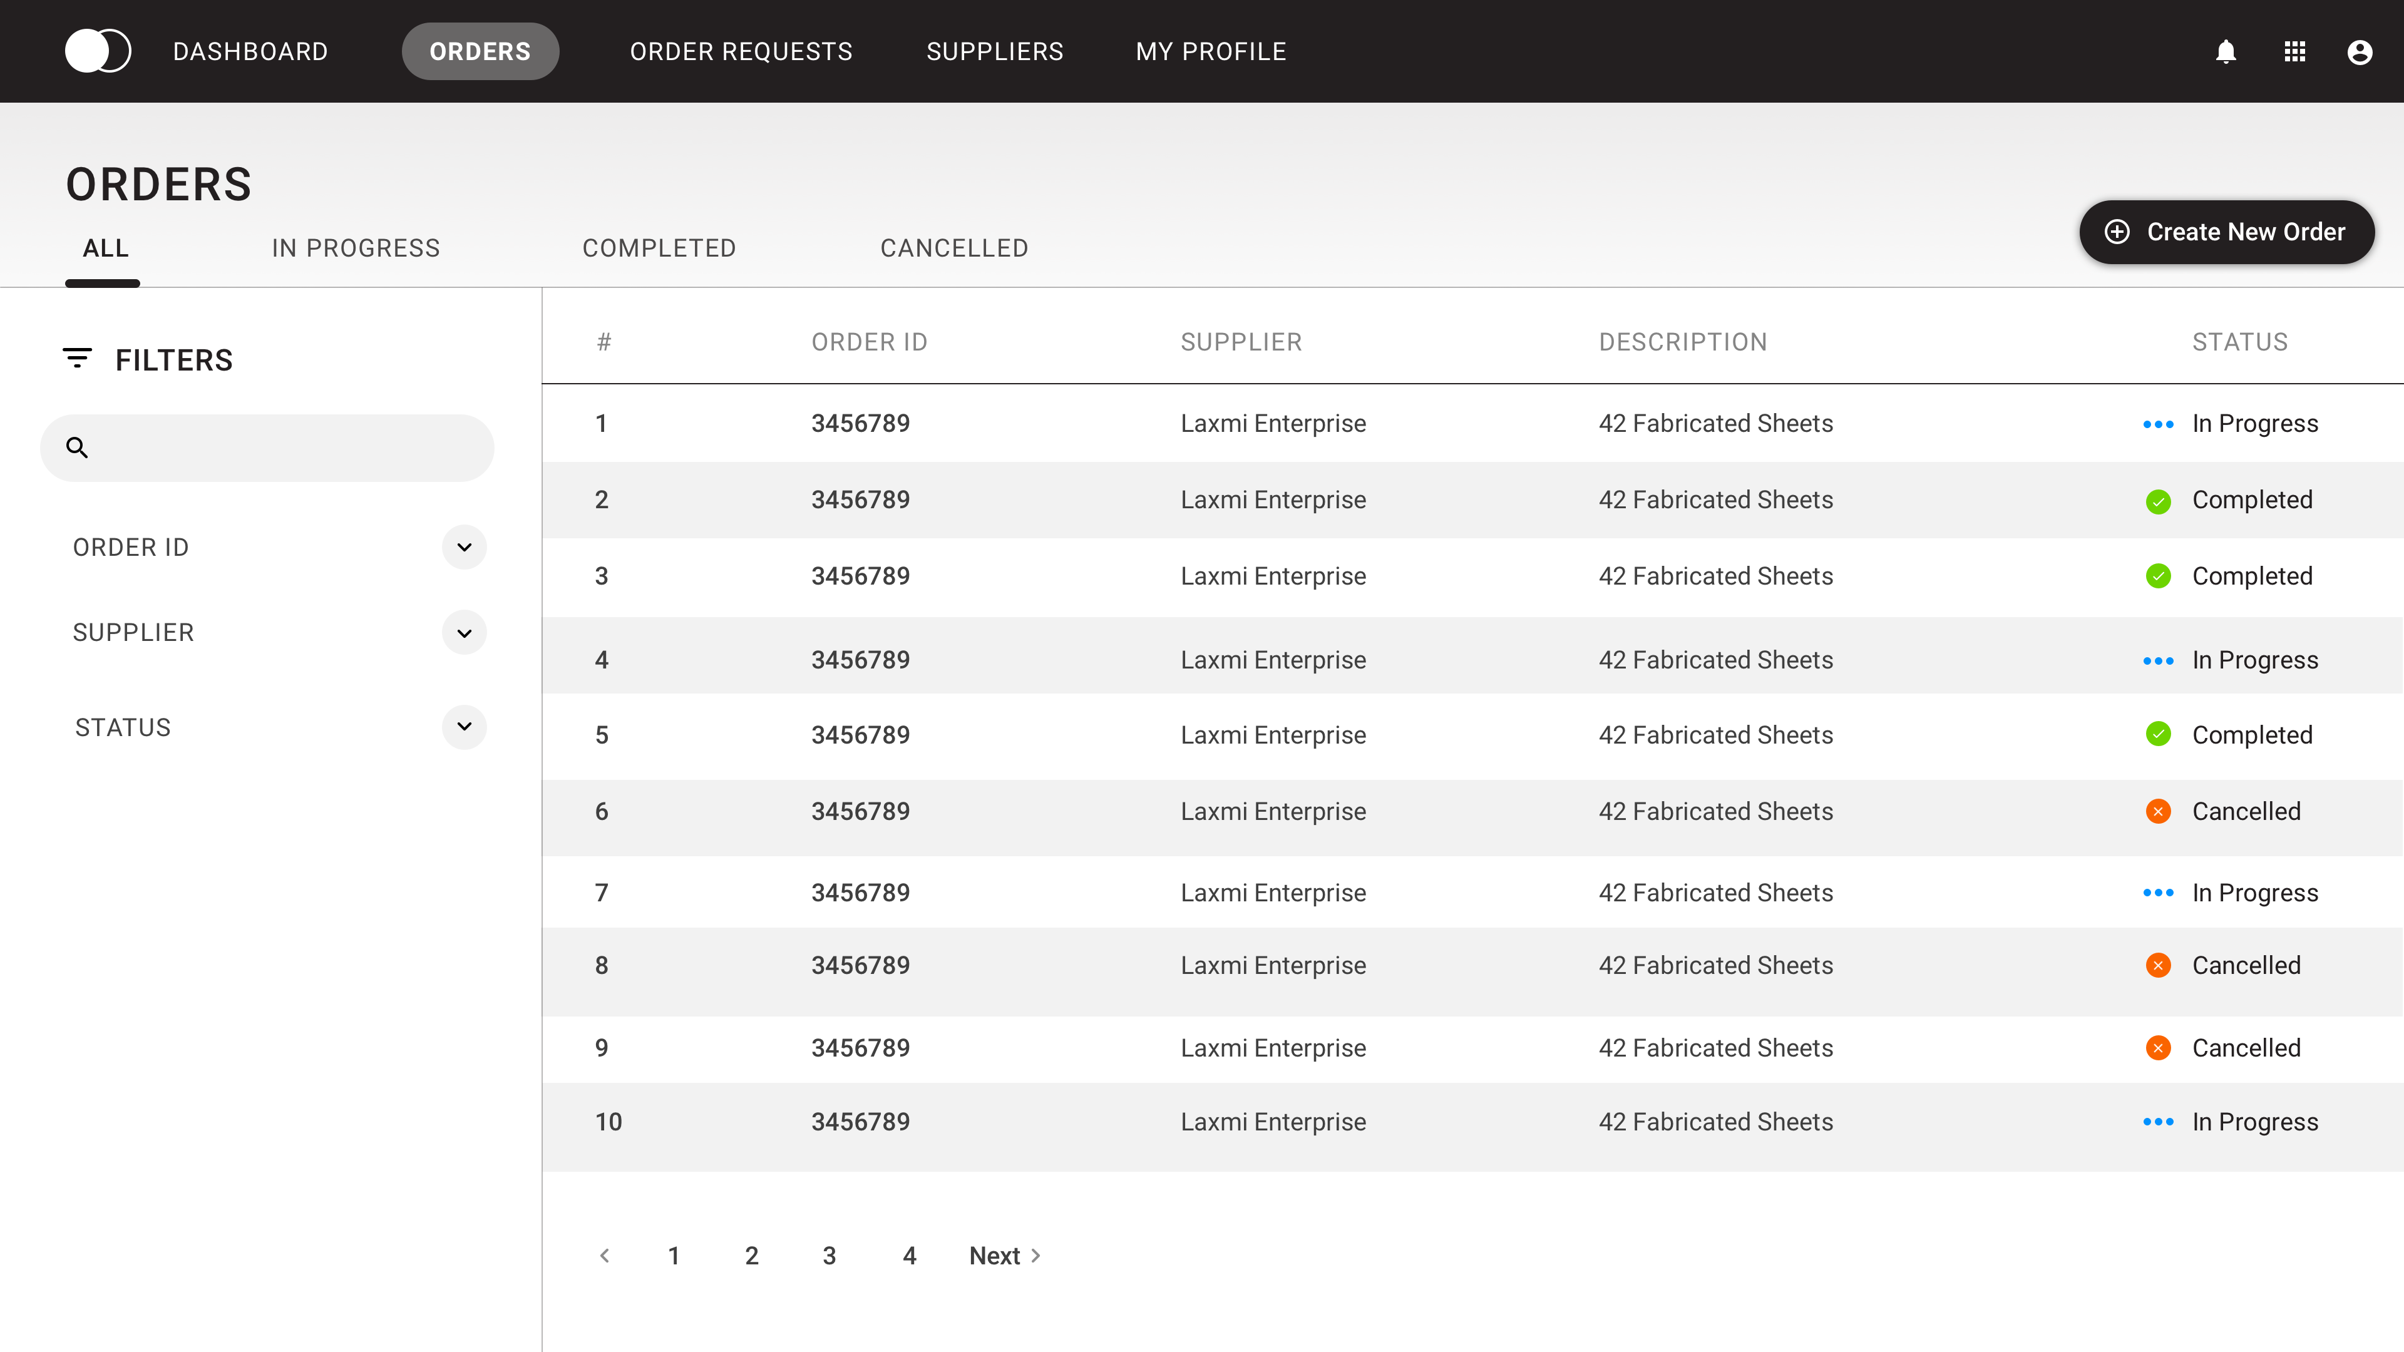

ORDERS
Orders are bucketed into three tabs depending on their status.
Search Filters can be applied to find relevant Orders. Clicking on a line item from the table will give more details about the order.
Users can also initiate a new Oder here.

Slide 3
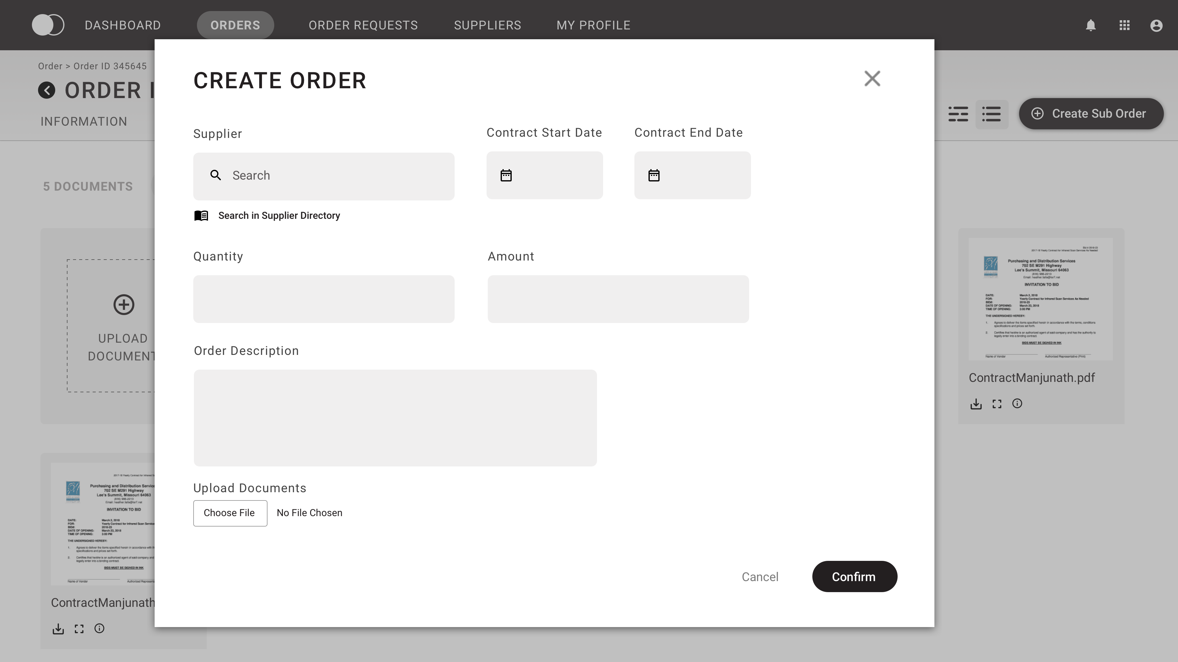
ORDERS
Suppliers can create a new order by filling in the required information in the modal.

Slide 4
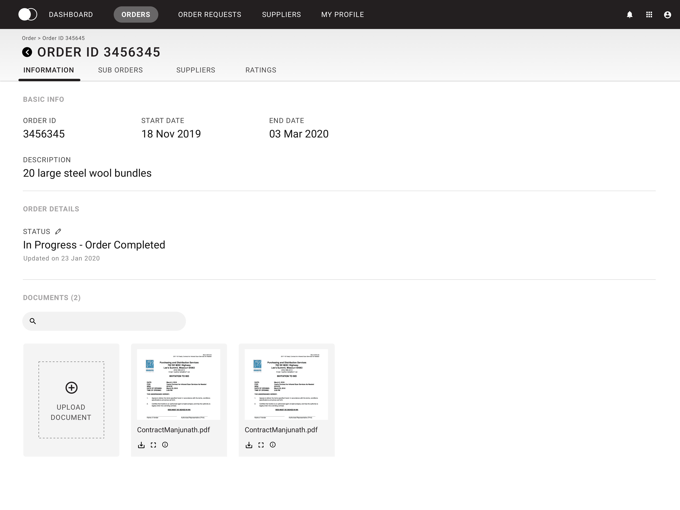
ORDERS
On clicking an Order ID, details pertaining to the selected order ID can be seen in four different tabs.
The first tab i.e, Information tab, contains Basic info, Order Status and the Documents uploaded for the order ID.
The order status can be edited here if the user is a participating supplier in the Order.

Slide 5
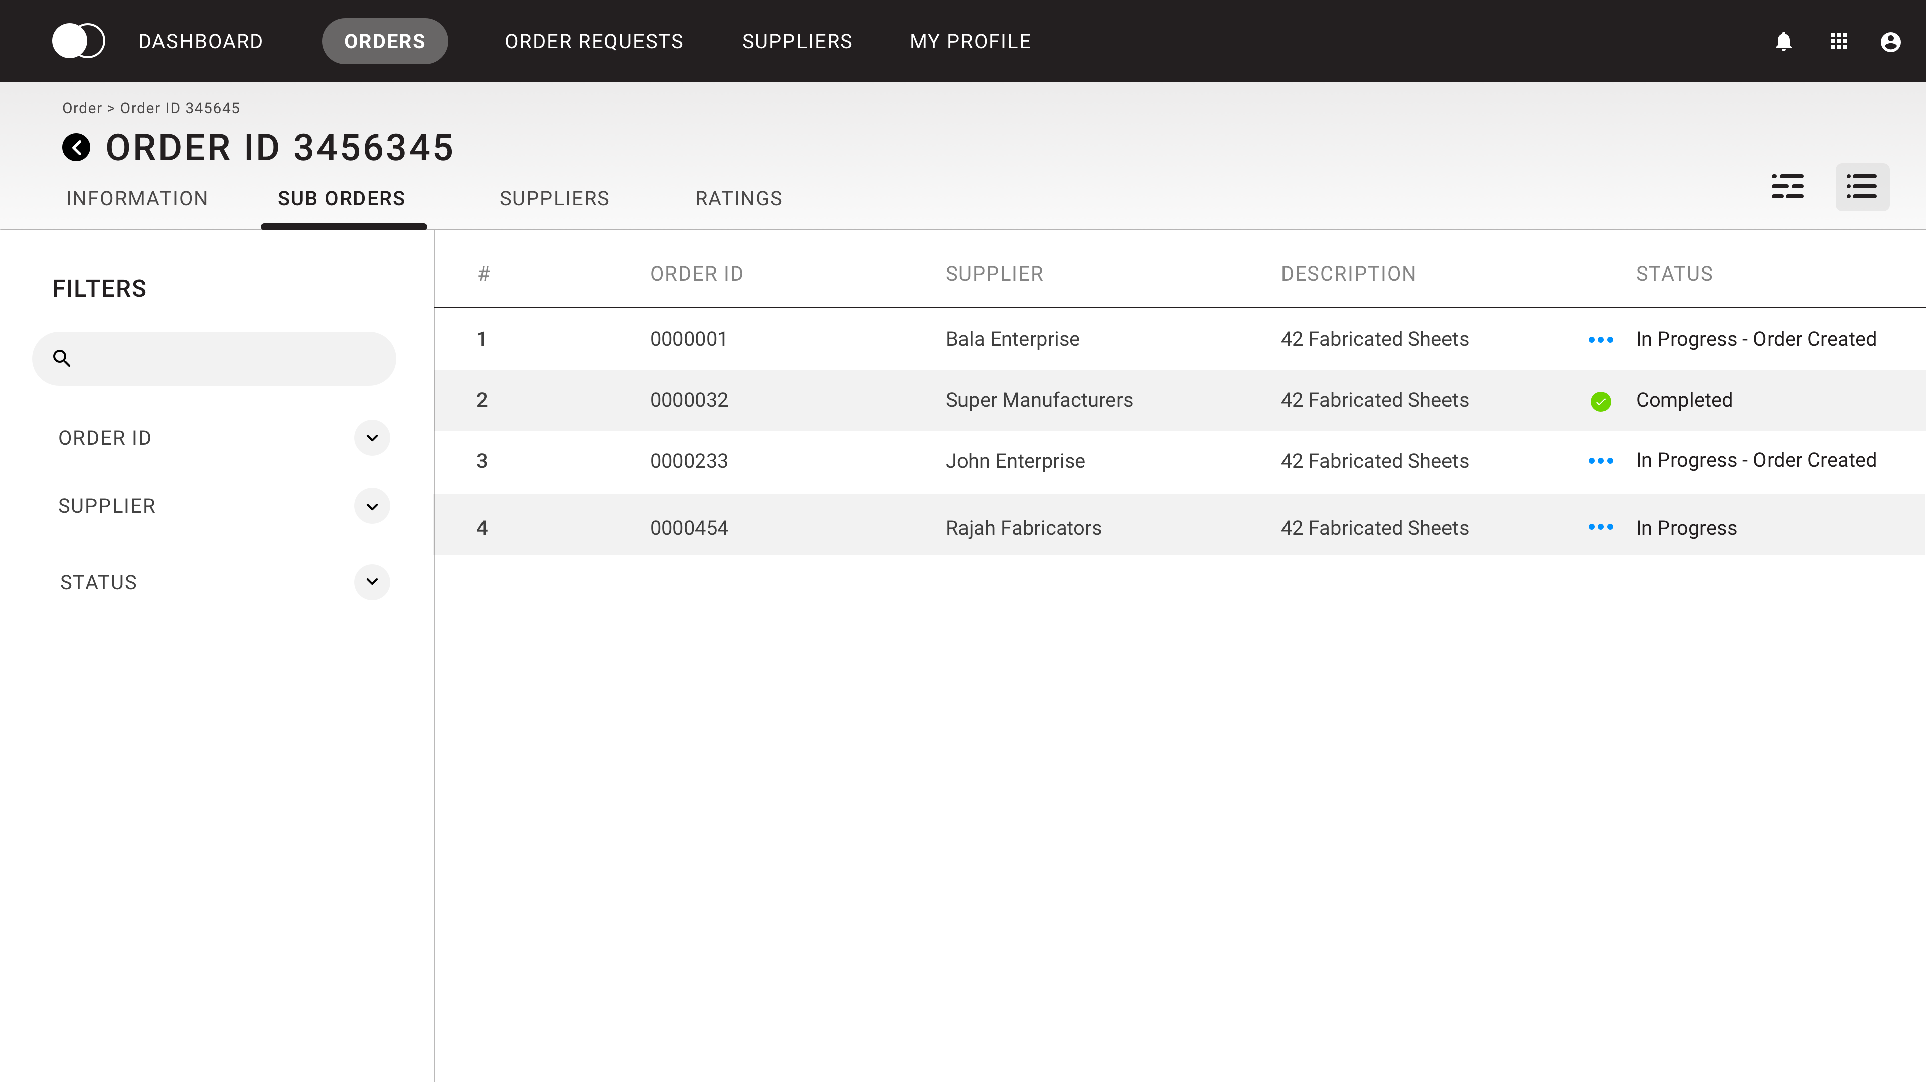
ORDERS
Sub Order tab lets users find child orders for the selected Order ID.
Users can also toggle between two views i.e, Tabular and Tree view.

Slide 6
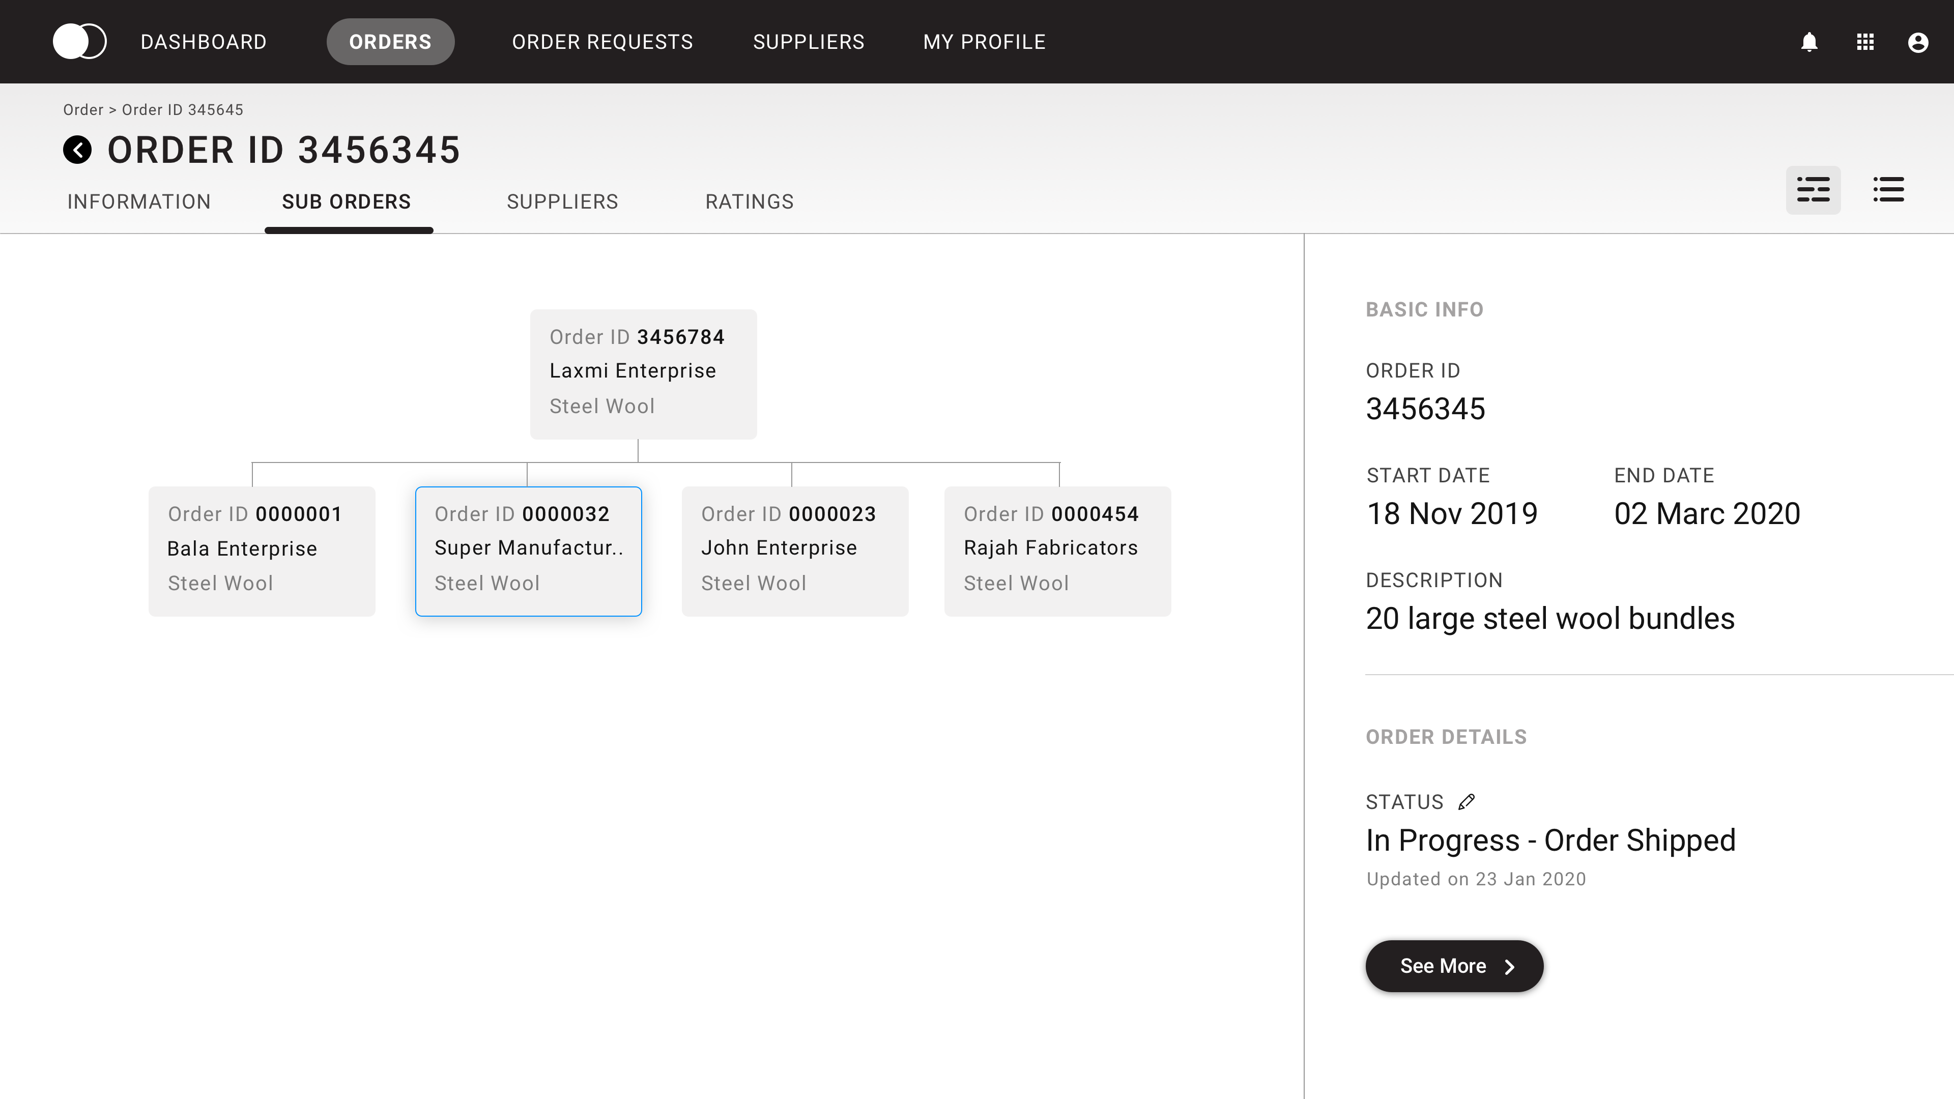
ORDERS
Tree view provides a graphical representation for the Parent -Child order relationship.

Slide 7
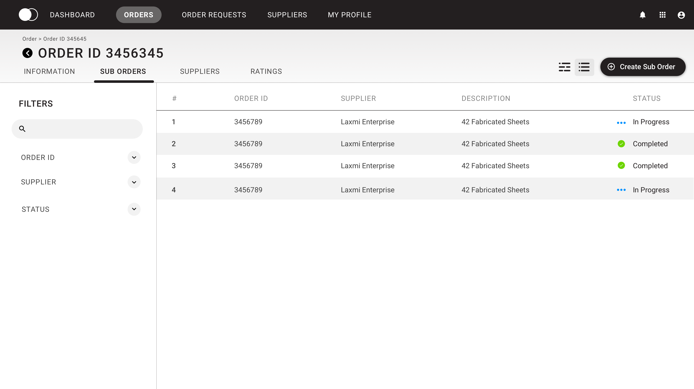
ORDERS
Supplier can create a sub-oder for the selected Order ID. Although, only a participating supplier (child) in the order can initiate a new sub order.

Slide 8
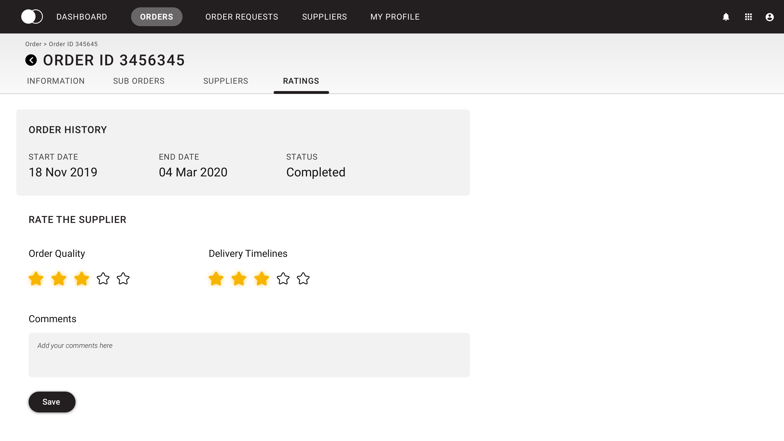
ORDERS
Supplier can provide feedback and ratings based on two criteria-
Order Quality and Delivery Timelines

Slide 9
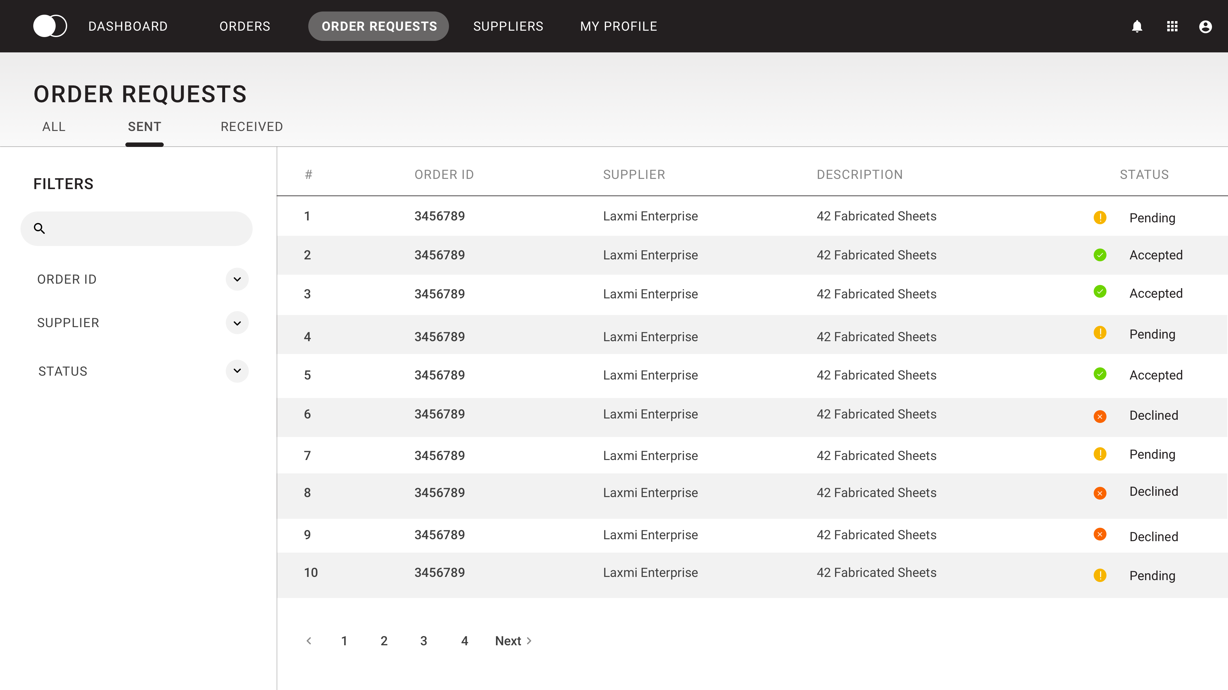
ORDER REQUESTS
Suppliers can view requests sent and received from other suppliers while creating a new Order.

Slide 10
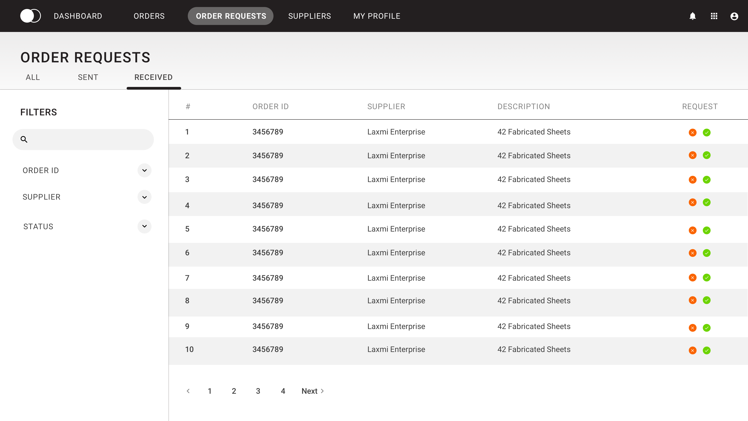
ORDER REQUESTS
Suppliers can quickly accept and decline a new order request.

Slide 11
THANK YOU!

