Slide 1

ACR Group Reporting
First Level variance Reconciliation
Key Screens Version 1

Slide 2
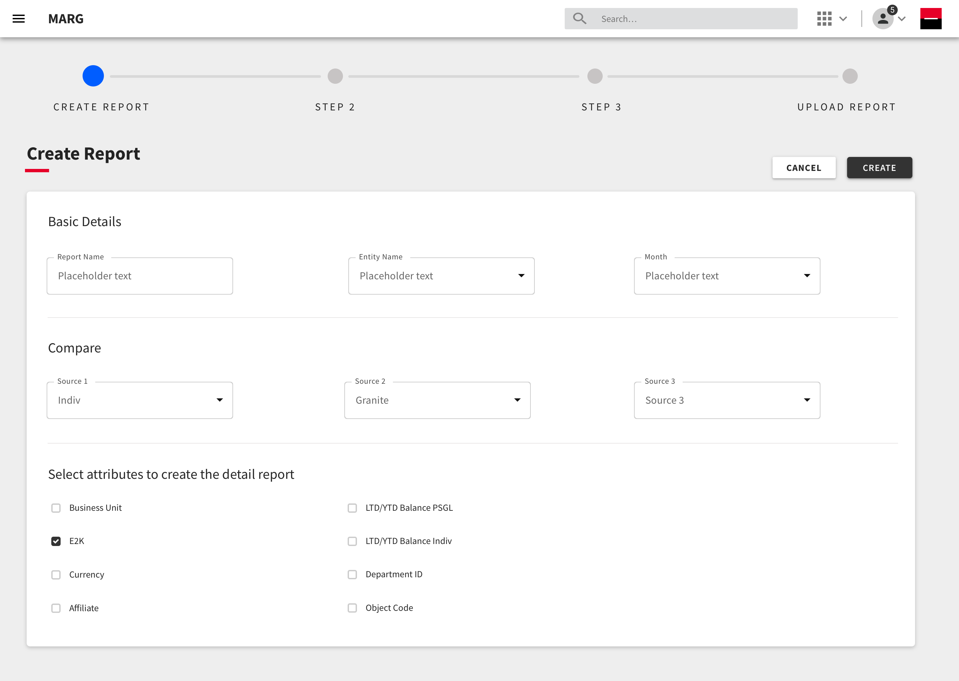
Creating the Report
Providing the necessary details in order to create the report.
Inputing the basic details of the report that will help users to Identify and fetch this report.
Selecting the data sources to create a comparative table.
Selecting the Attributes that act as the axis for the comparison.

Slide 3
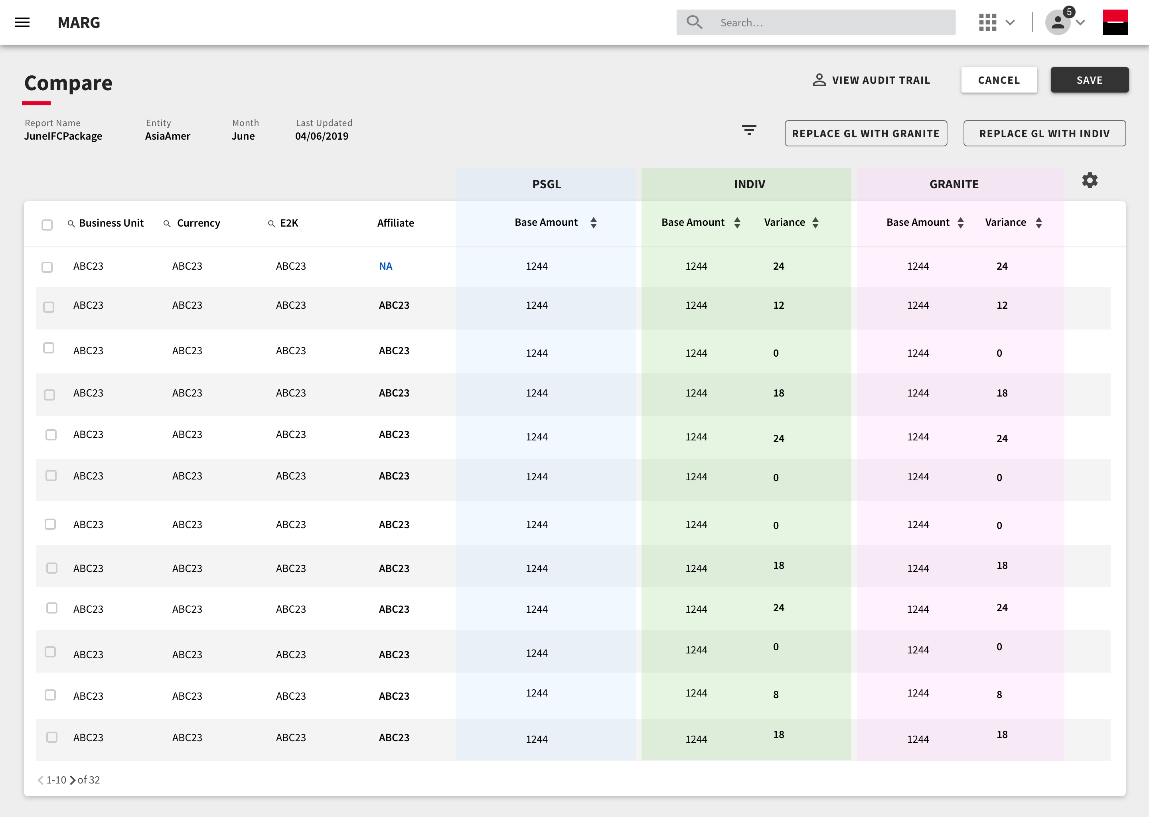
Comparison Table
Comparing the data coming from the selected data sources in a tabular format. This will allow the users to look at the variances recorded and take appropriate steps.
Users can also replace PSGL data with selected data sources for respective line items.
All the changes made by the users will be recorded in the Audit trail.
Attributes selected that act as the axis for the comparison.

Slide 4
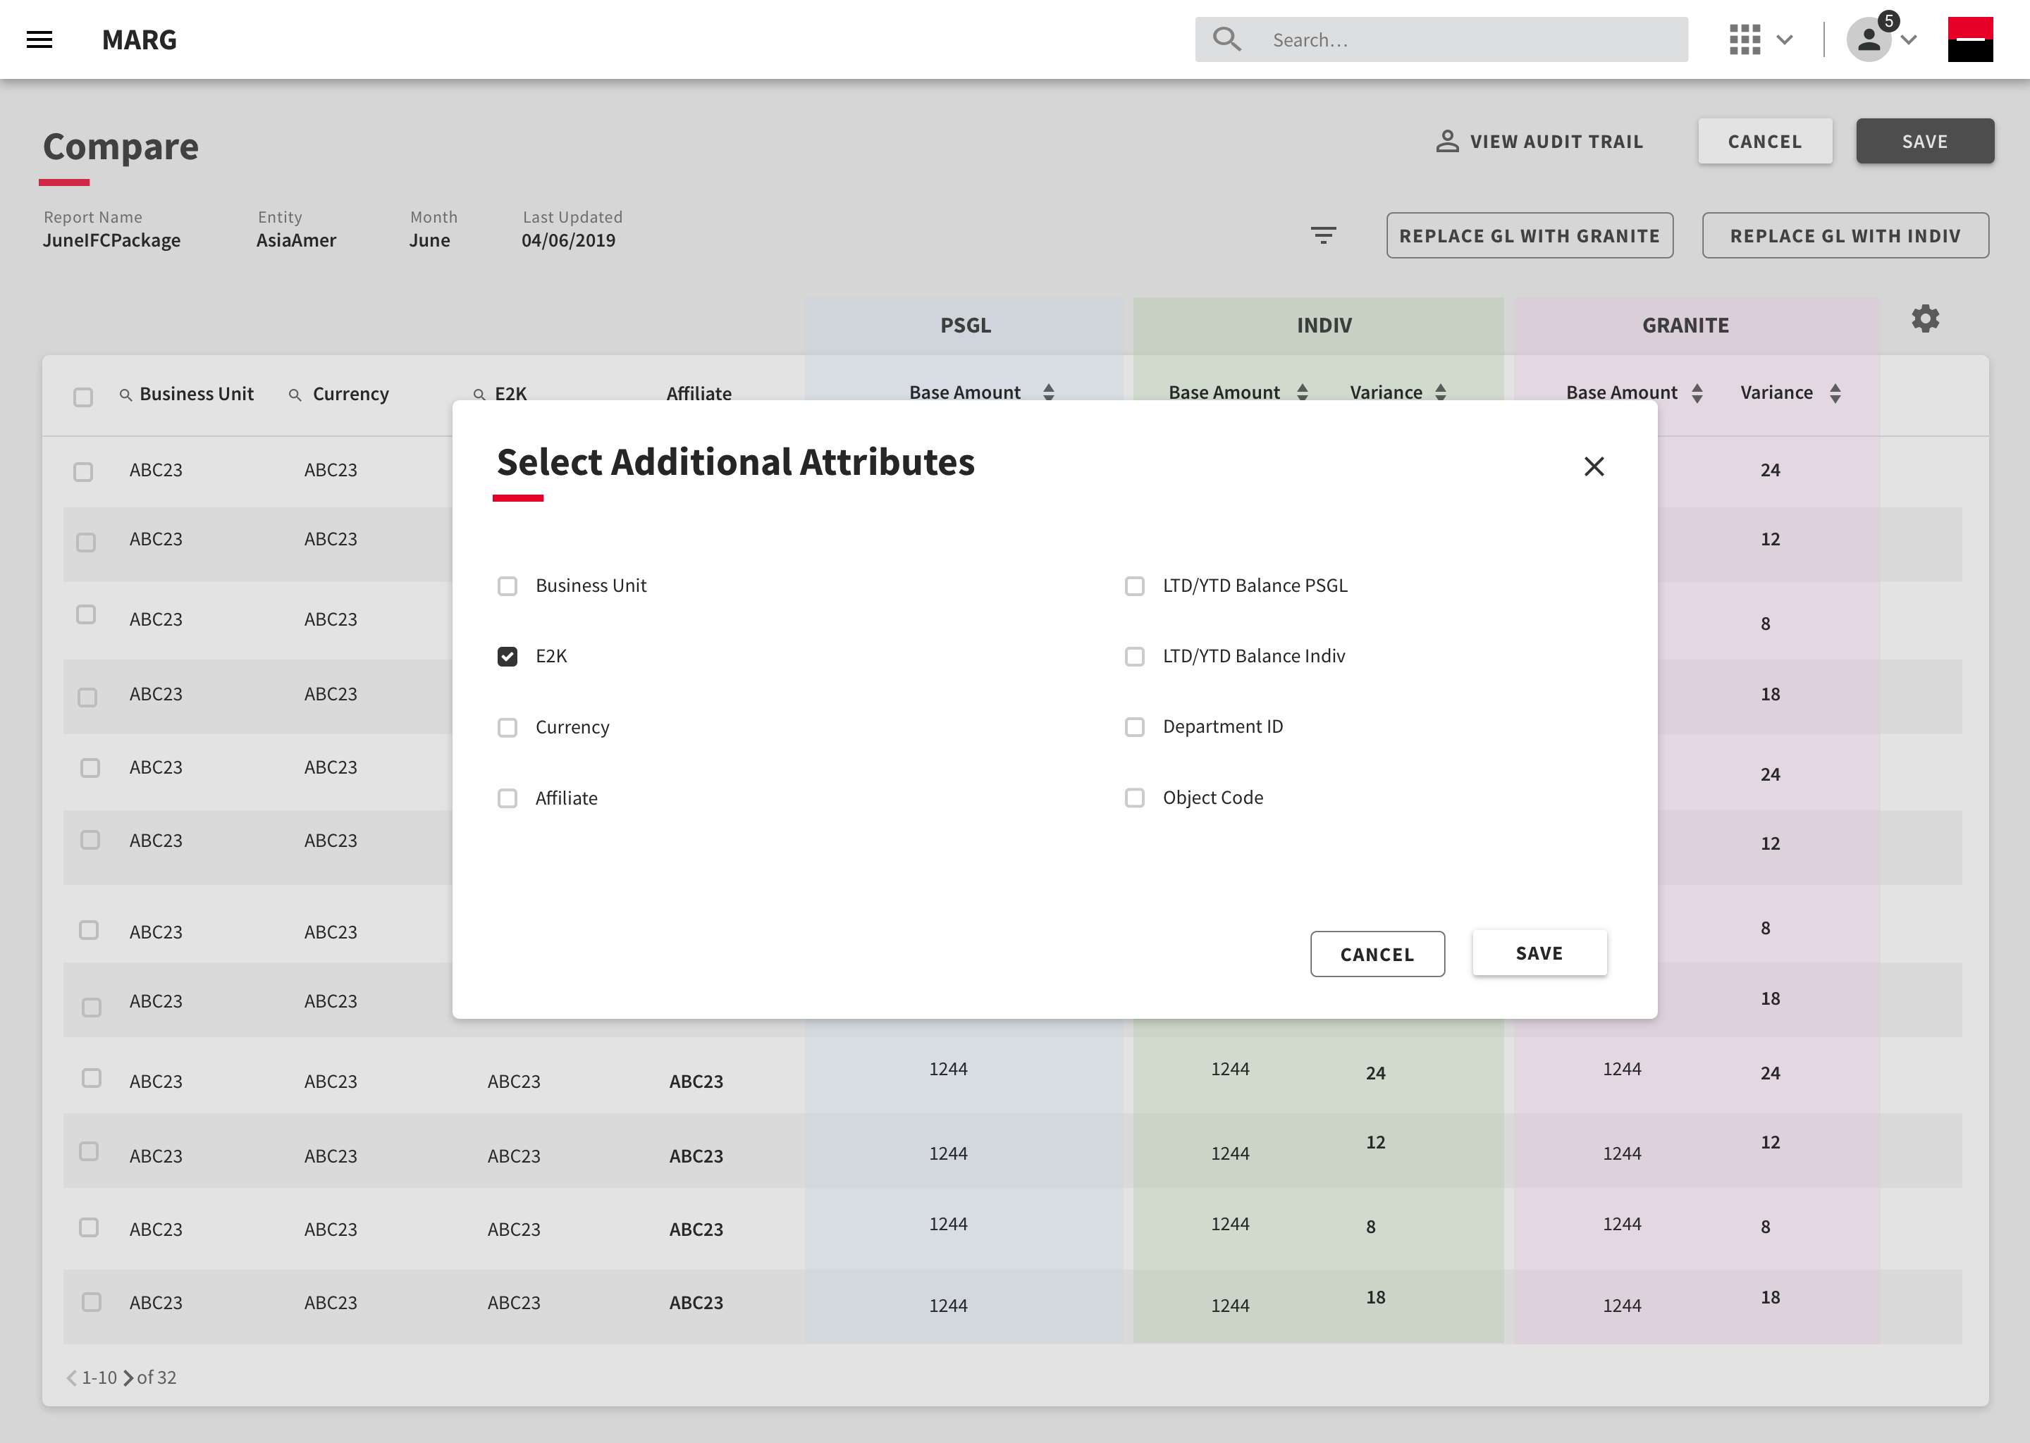
Attributes
Users can also select additional attributes to be displayed on the table.

Slide 5
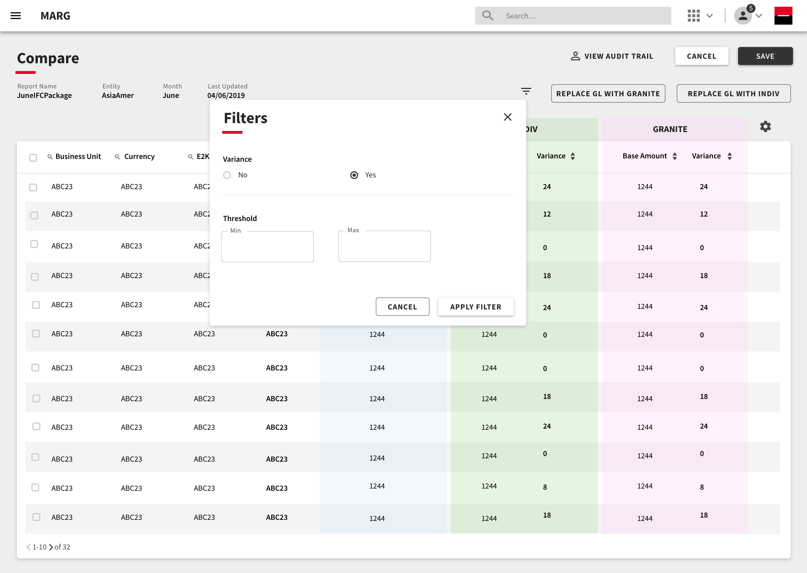
Filters
Data on the table can be further filtered on the basis of breaks recorded in the variances. Thresholds can be defined in case there is a break recorded.

Slide 6

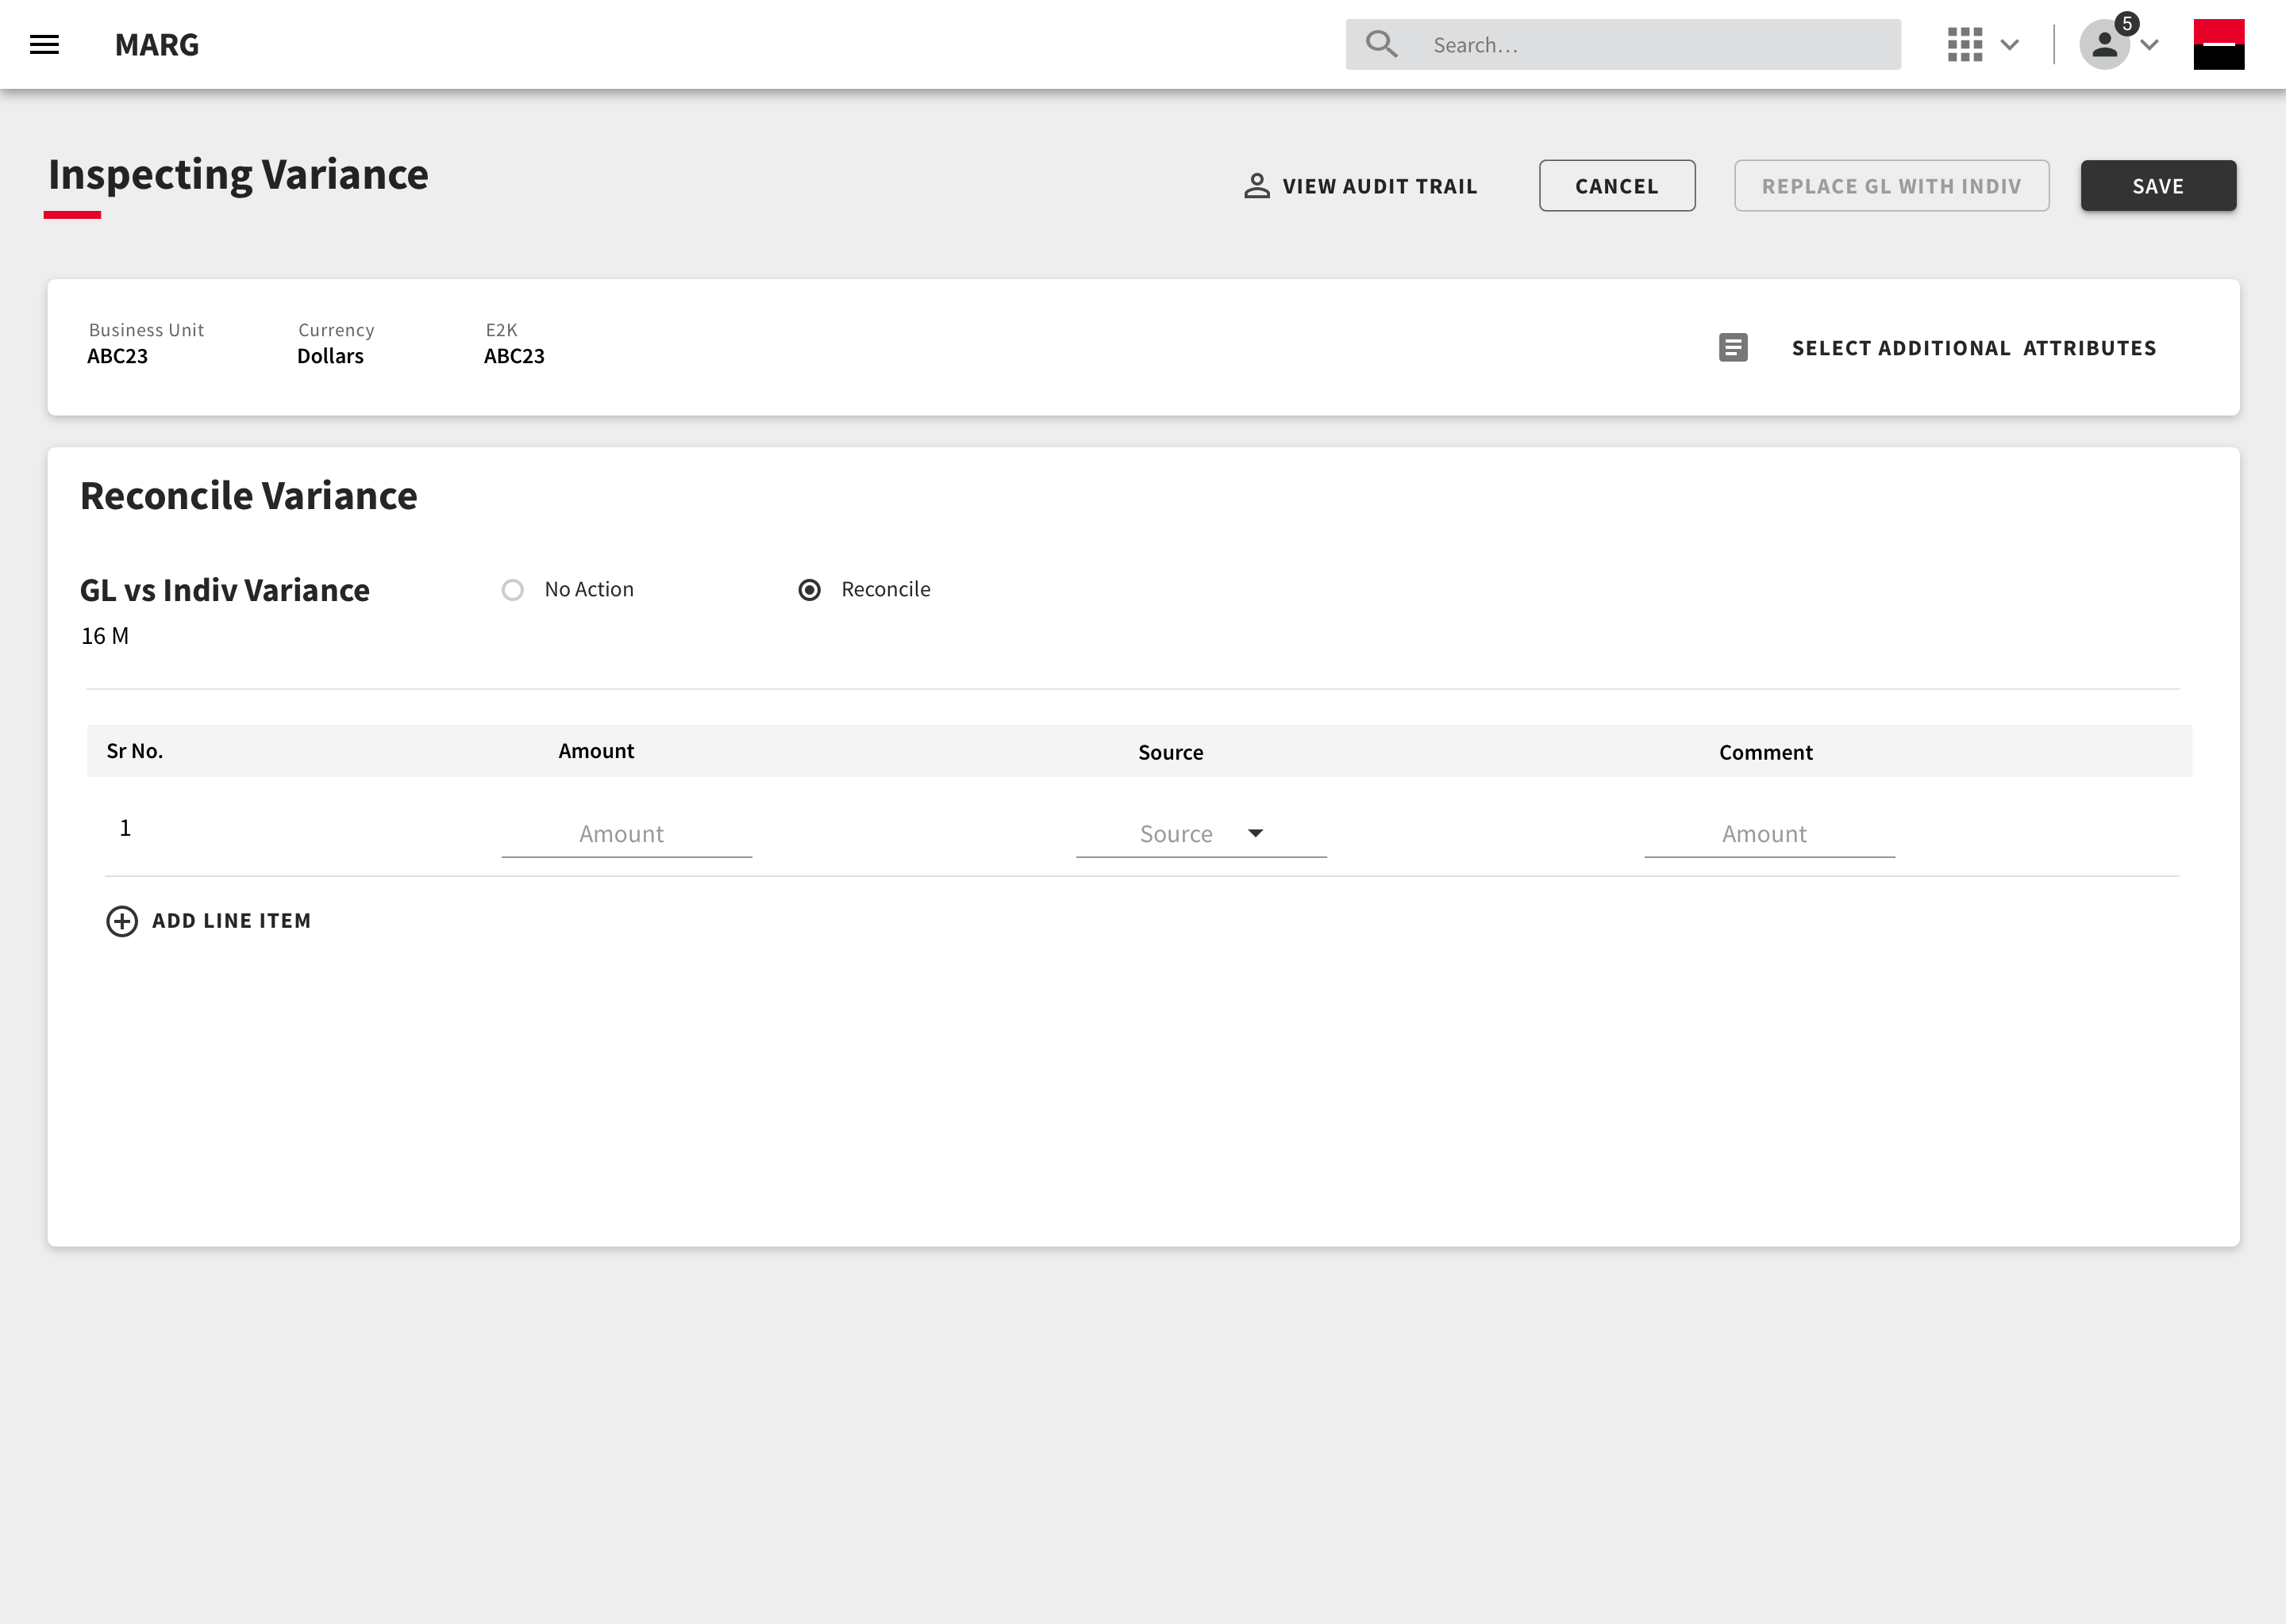
Inspecting Variance from Indiv
On clicking the line item , the user can further inspect the variance.

Slide 7
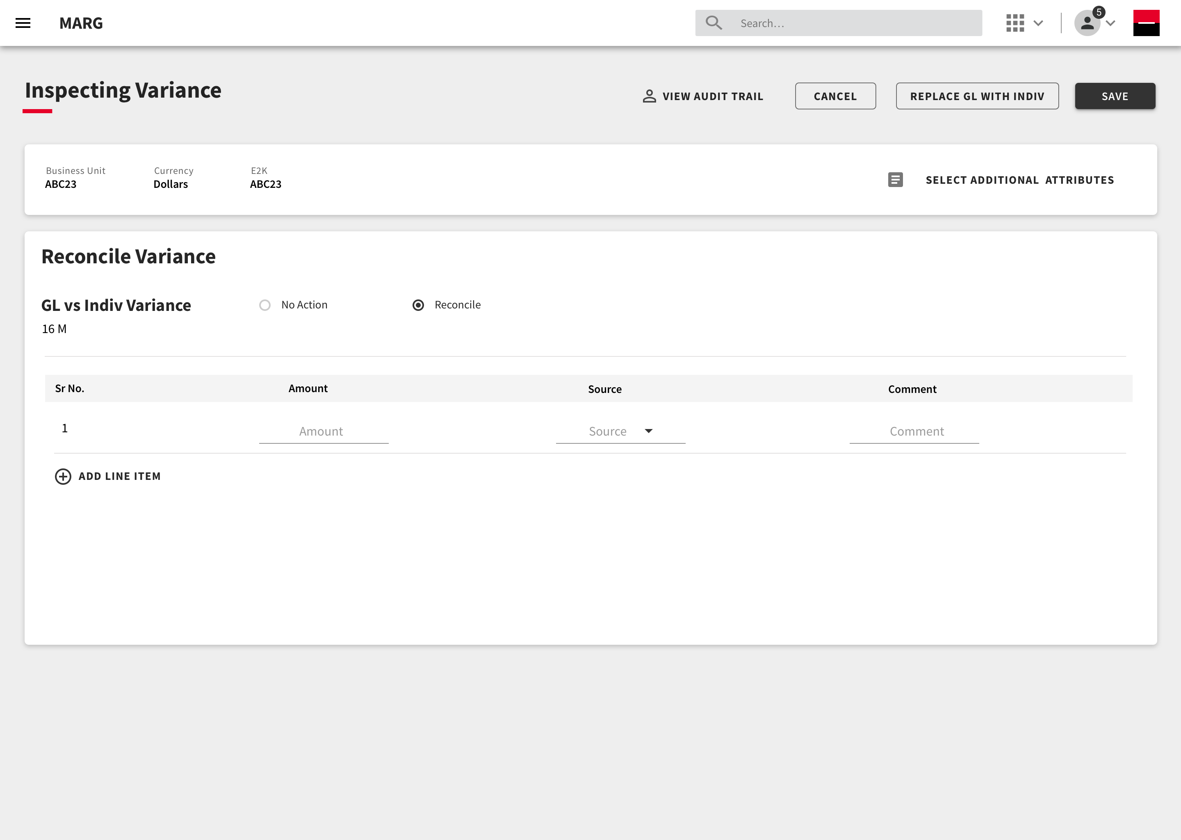
Reconciling Variance
The user can decide to reconcile the variance by assigning the appropriate source.
They can also divide the variance into various number of line items.

Slide 8
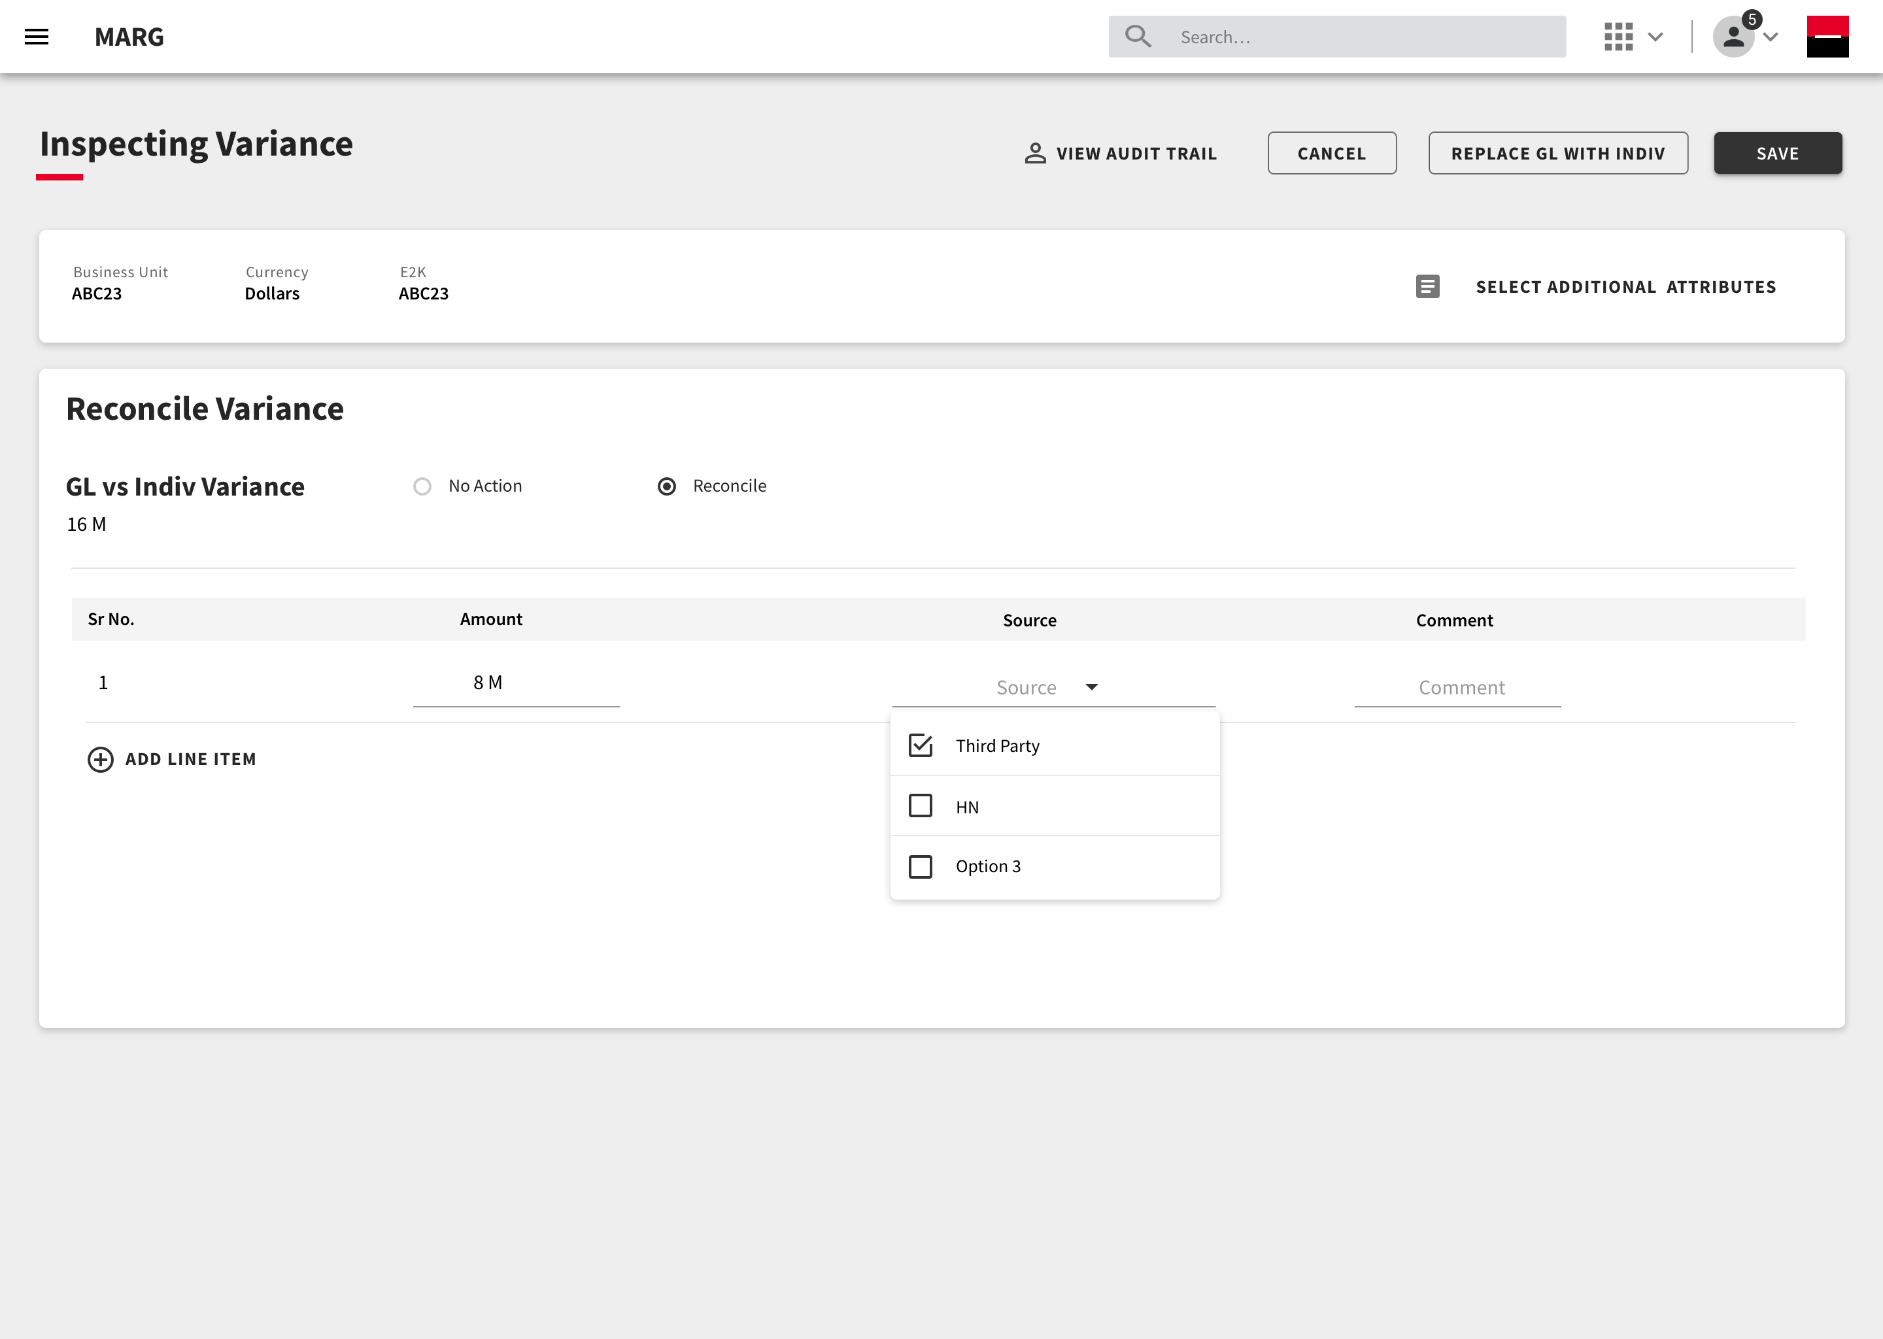
Reconciling Variance

Slide 9
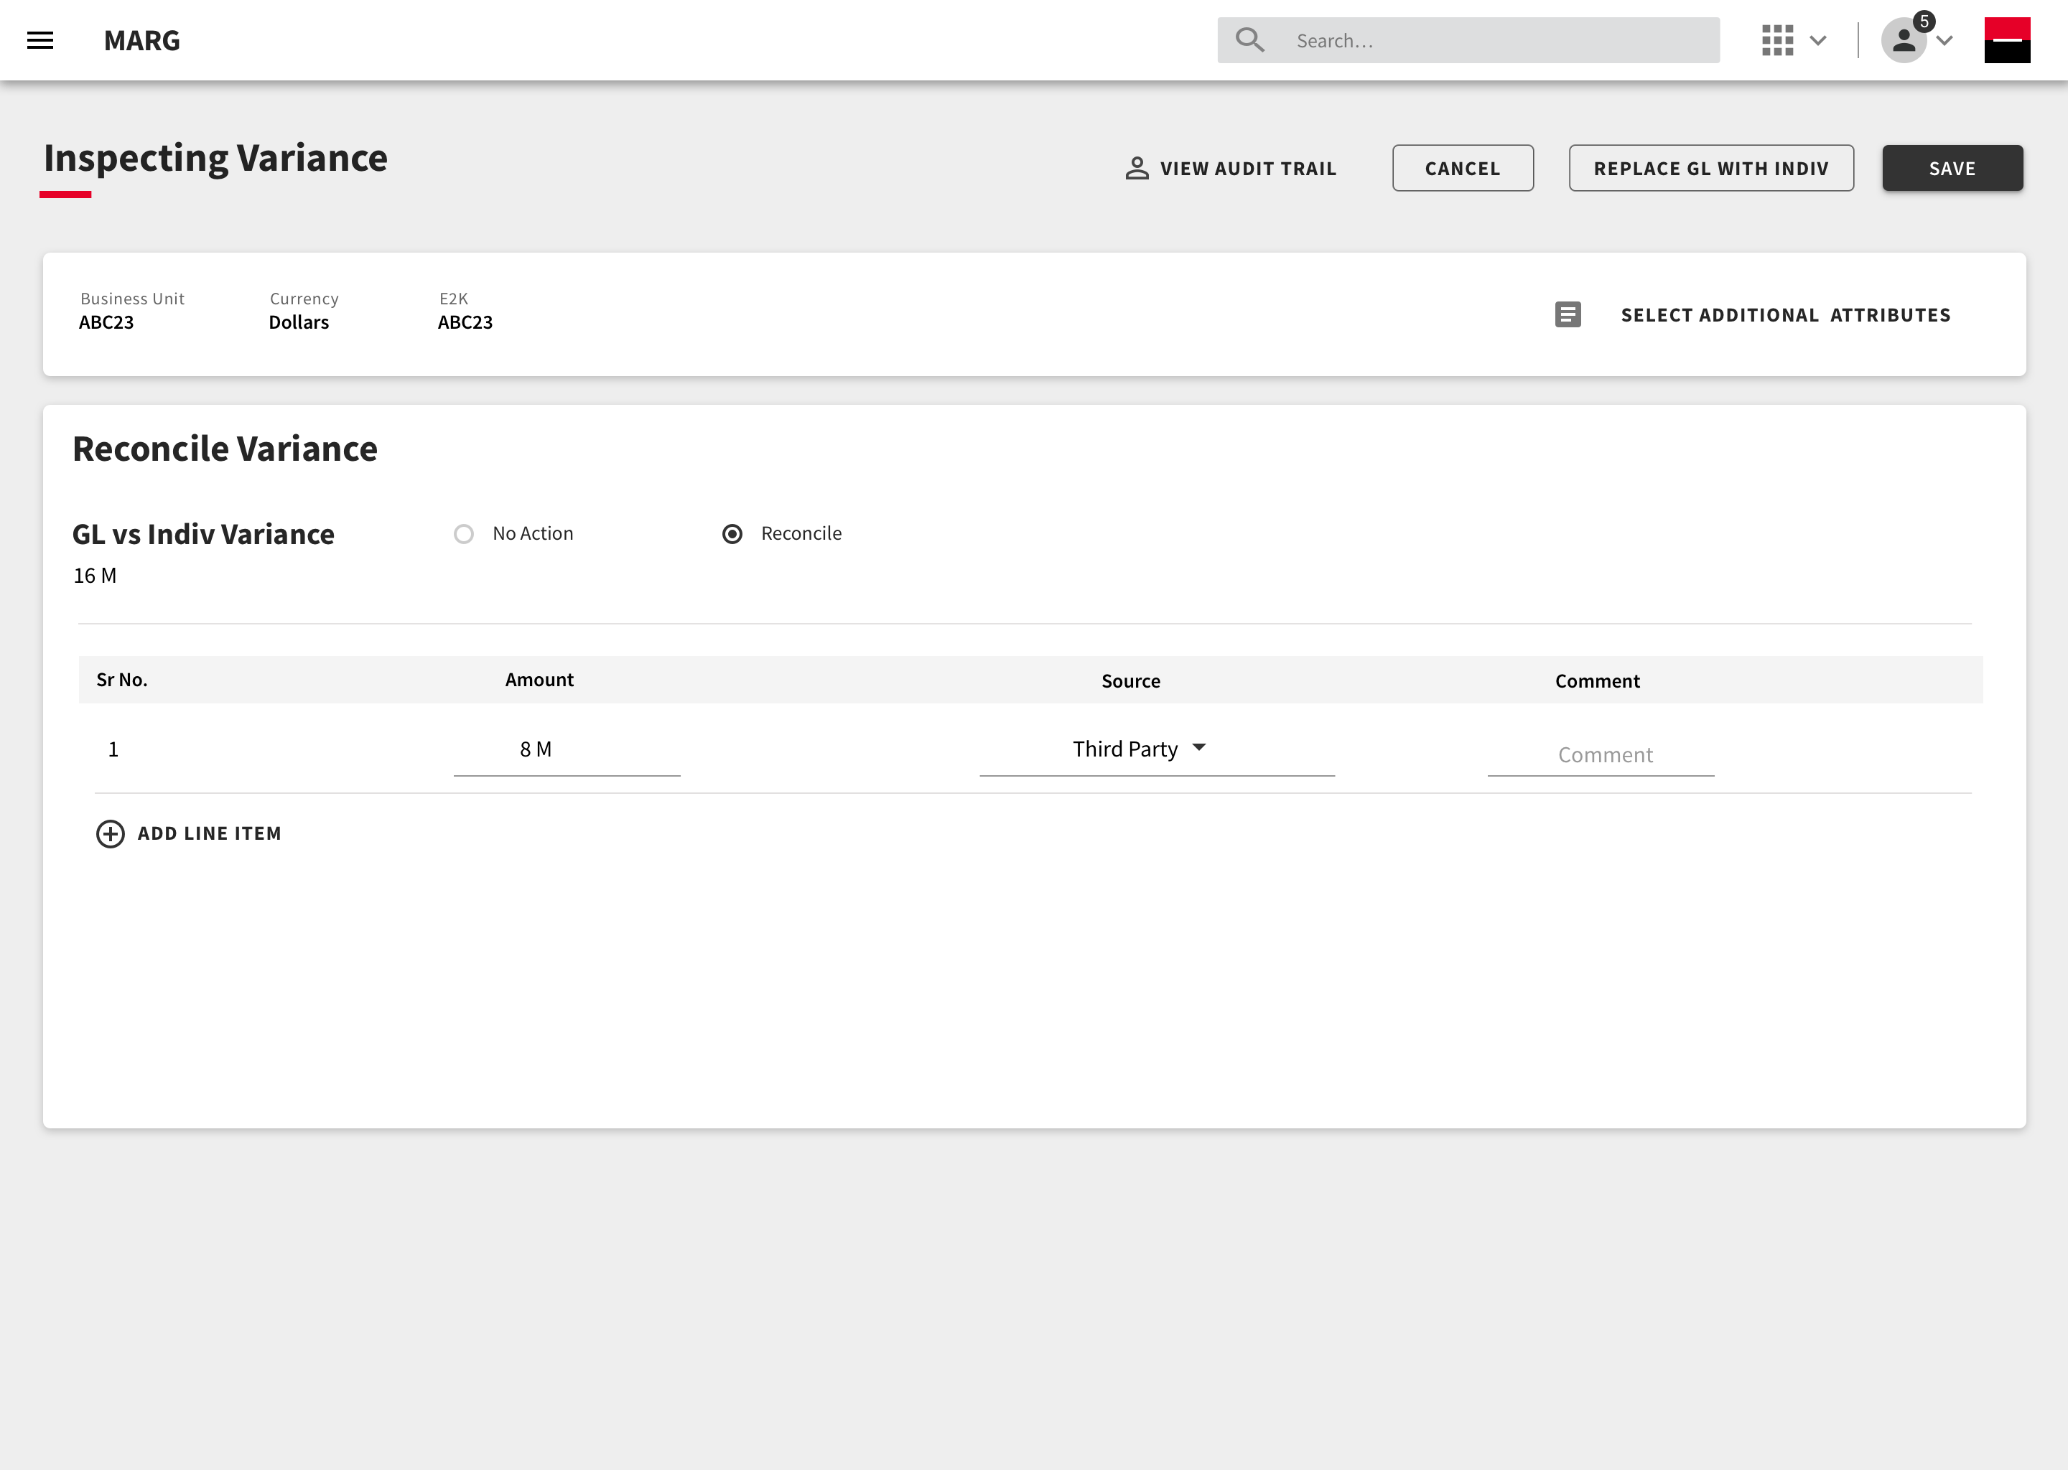
Reconciling Variance

Slide 10
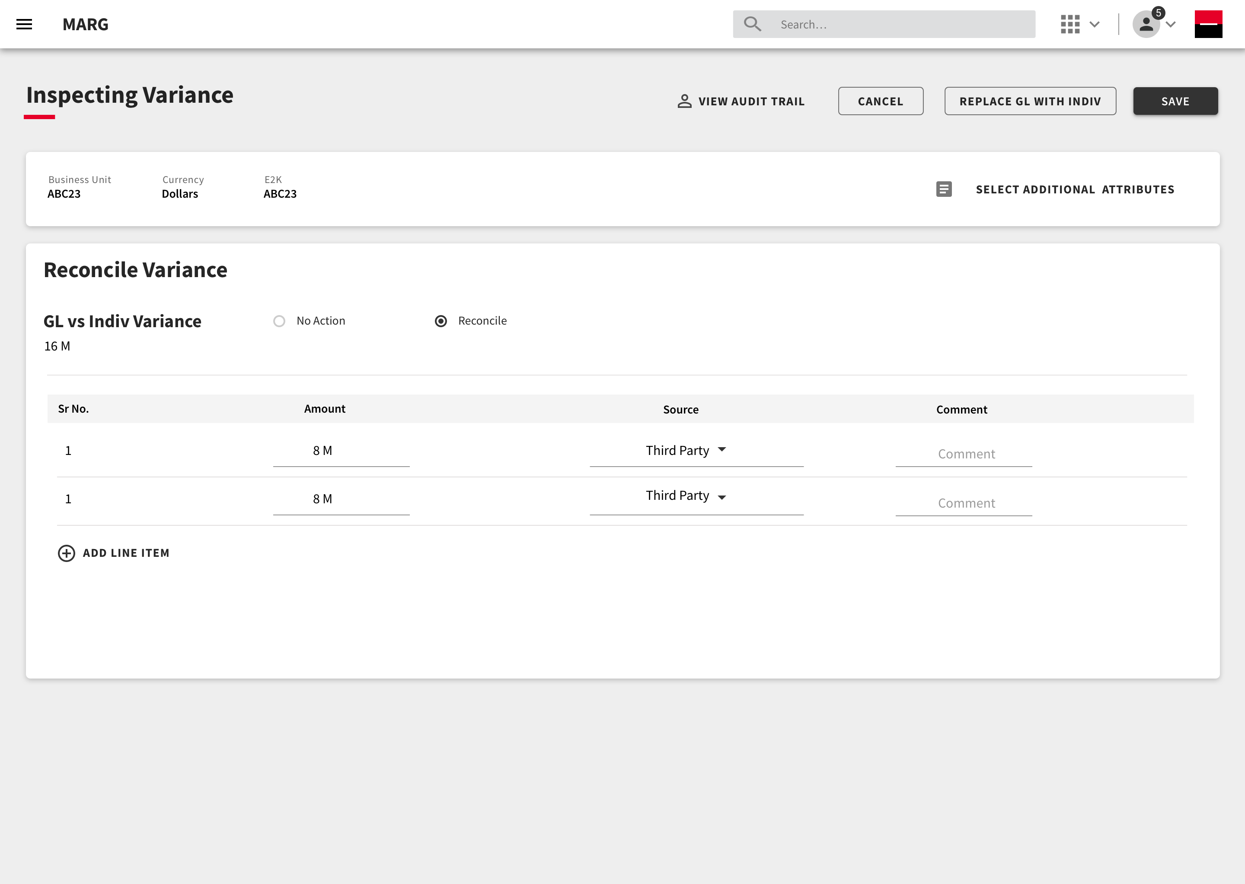
Reconciling Variance
Once the variance is reconciled, the user can now replace GL Data with Indiv Data for this particular line item.

Slide 11
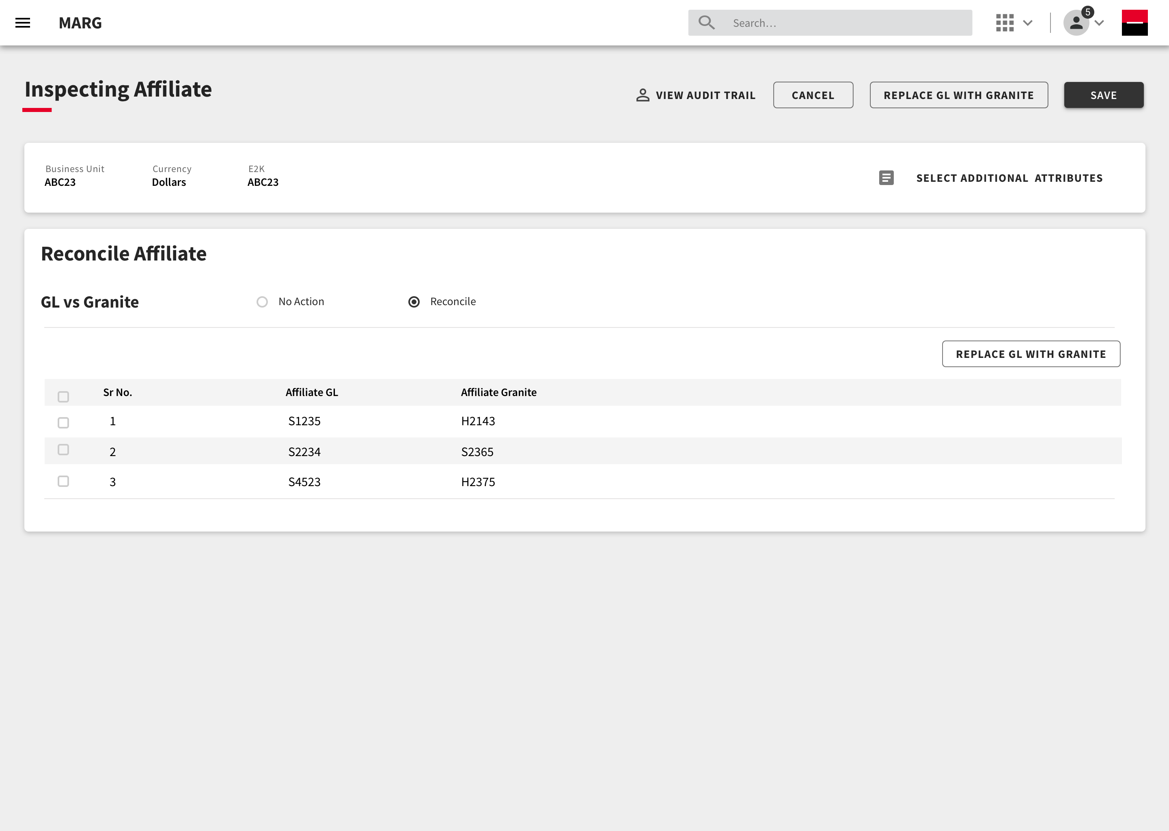
Reconciling Affiliate from Granite
On clicking the line item , the user can further inspect the variance.

Slide 12
Reconciling Affiliate
Once the variance is reconciled, the user can now replace GL Data with Granite Data for this particular line item.
The table provides a comparative view of affiliate data from PSGL and Granite.
The user can decide to the replace the GL data with Granite here.

Slide 13
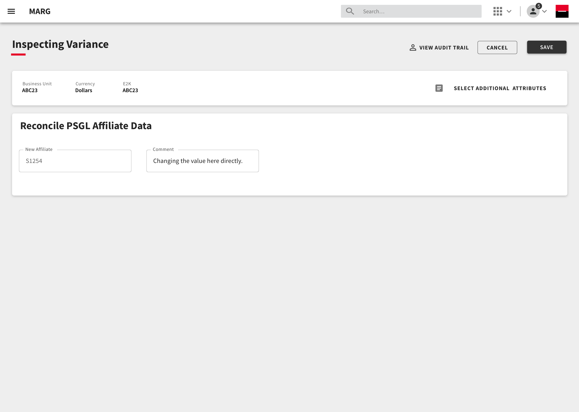
Reconciling Affiliate from PSGL
On clicking the line item , the user can further inspect the affiliate and change it accordingly.

Slide 14
Thank you.

