Slide 2
a. SWOT Analysis
Assess the internal and external factors,
Current and future potential.
Step 1
Mapping the As-Is
b. Customer Persona & Expectations
Identify your customers and understand
Their current journey. Identify opportunity
areas.

Slide 3
SWOT Analysis
STRENGTH
WEAKNESS
OPPORTUNITY
THREATS

Slide 4
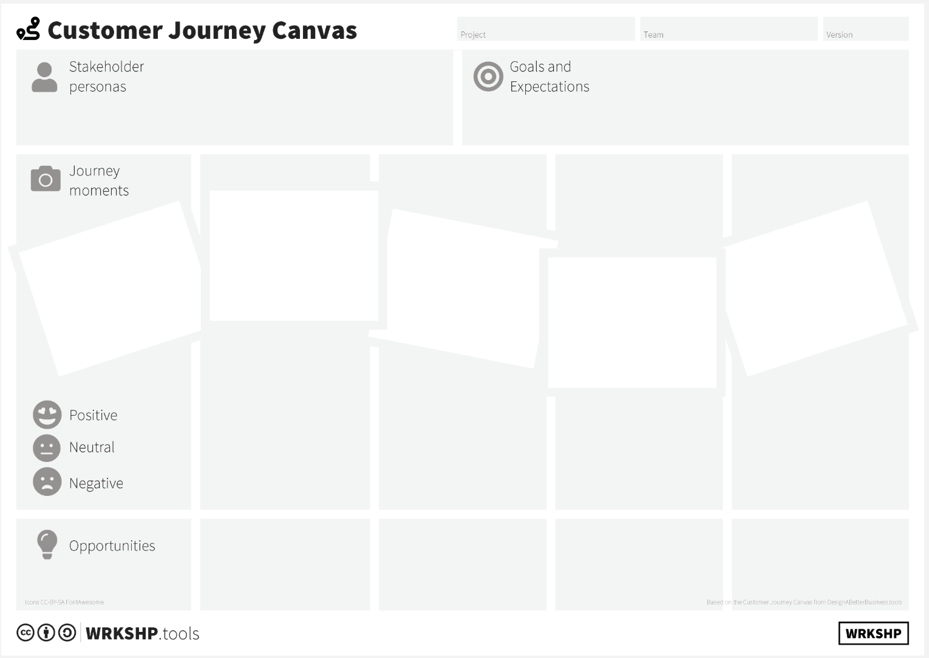
Customer Journey Canvas

Slide 5
Define your Vision
The vision statement will be all-encompassing
Statement that acts as an anchor throughout
Your journey.
Step 2
Vision

Slide 6
Vision

Slide 7
Define your Business Model
The business model canvas gives you insights about the customers you serve, what value propositions are offered through what channels, and how your company makes money.
Step 3
Business Model

Slide 8
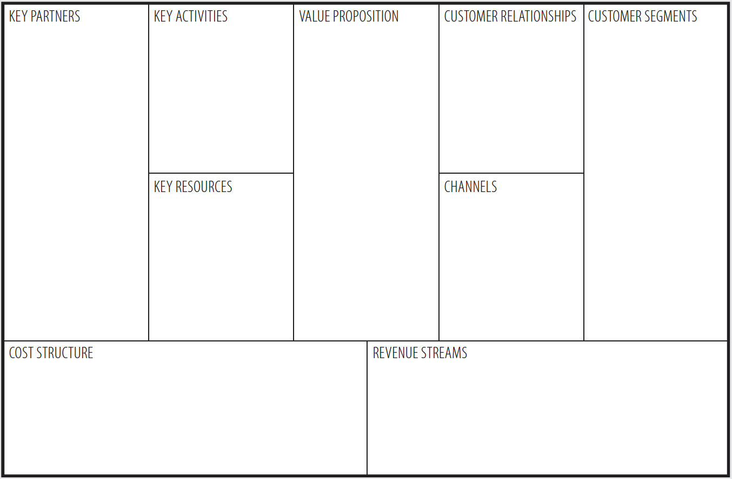
Business Model Canvas
Success Criteria
Operating Model
Delivery Model
Threats

Slide 9
Step 4
Define The key milestones to
realise the vision
Milestones

Slide 10
Milestones
Step Definition
Stakeholders

