Slide 1

ACR Group Reporting
Variance Reconciliation
Key Screens Version 3

Slide 2
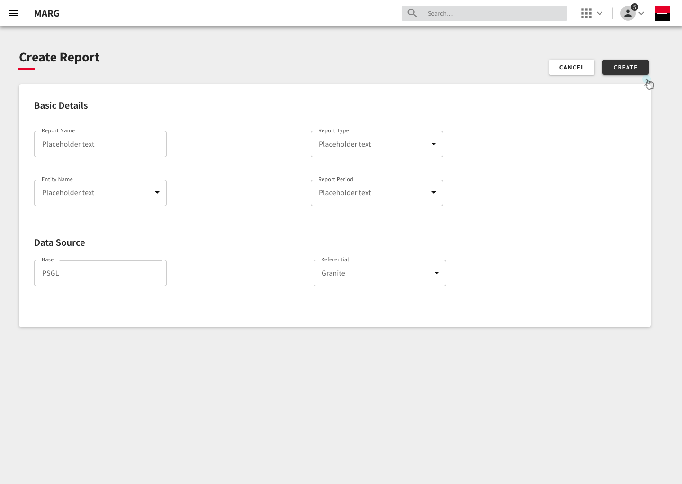
Creating the Report
Providing the necessary details in order to create the report.

Slide 3
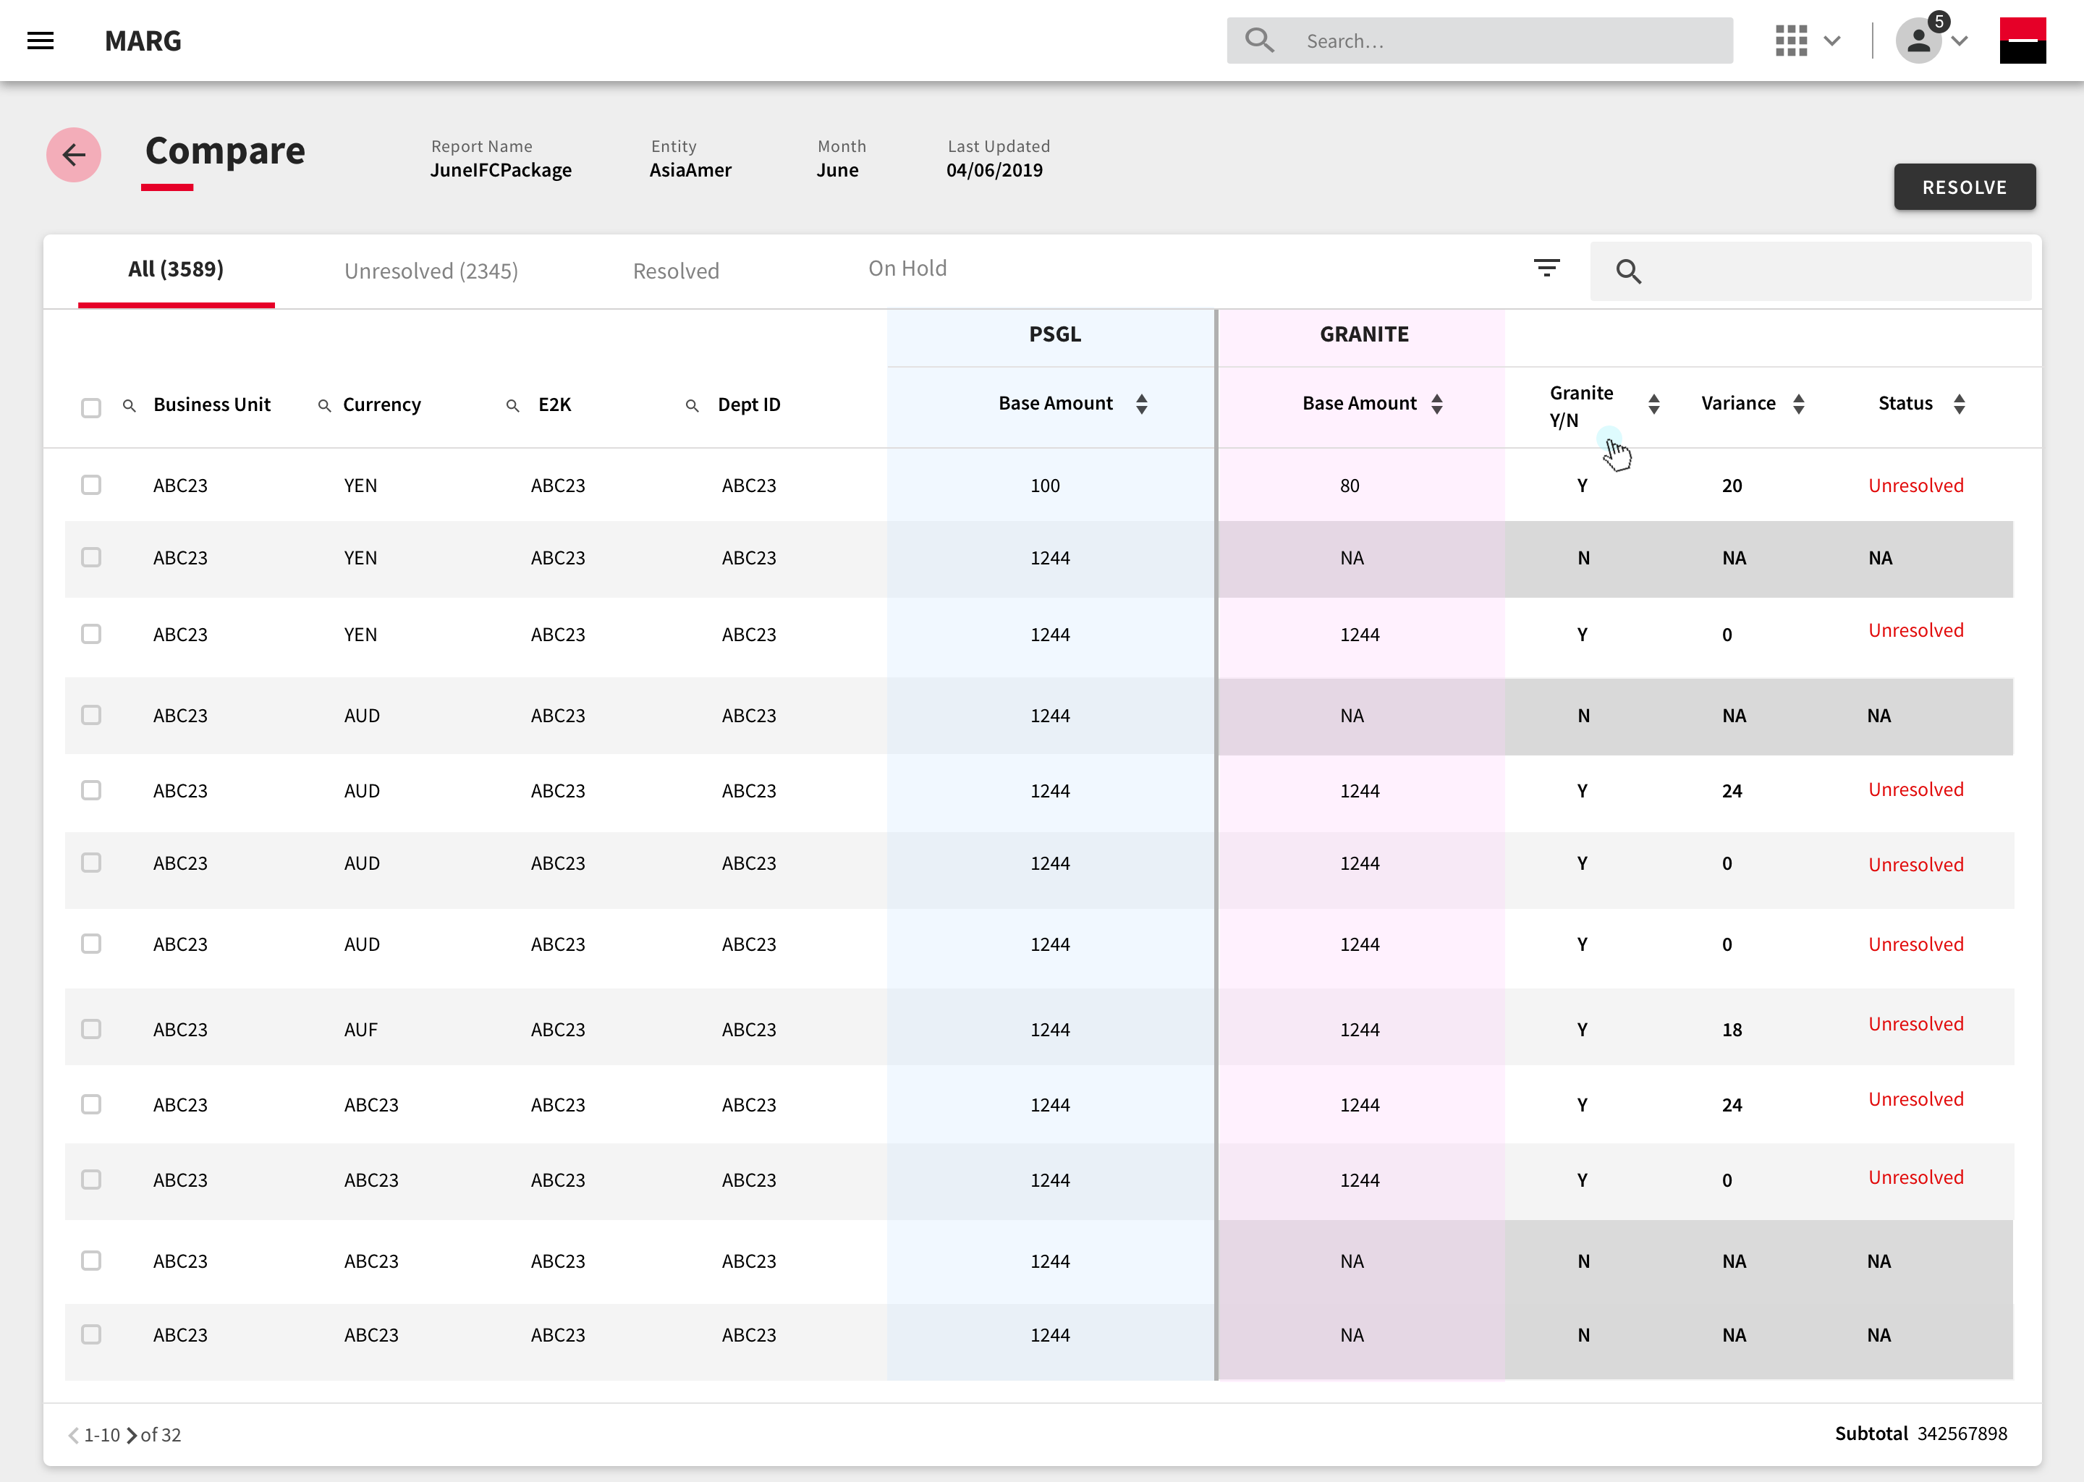
Comparison Table
Comparing the data coming from the selected data sources in a tabular format. This will allow the users to look at the variances recorded and take appropriate actions.

Slide 4

Filters

Slide 5
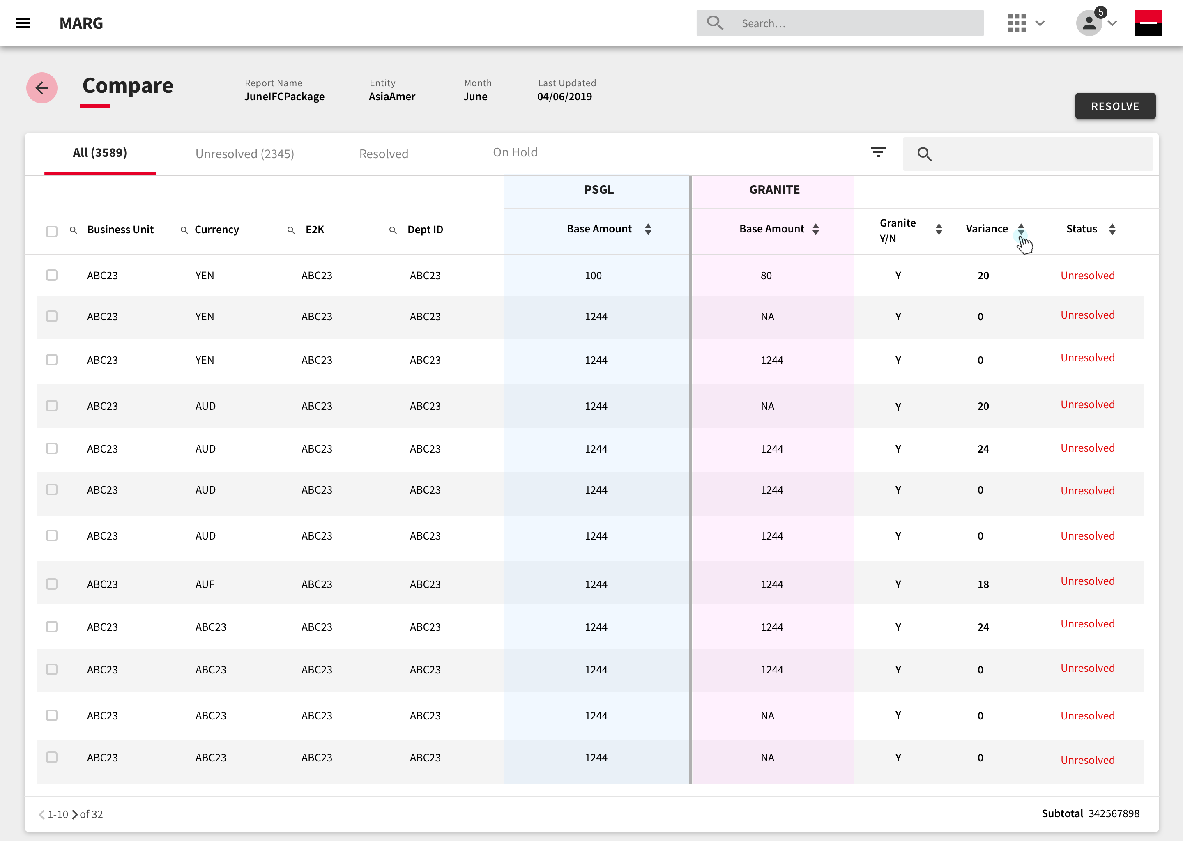
Filters

Slide 6

Filter Variance and Threshold

Slide 7


Slide 8
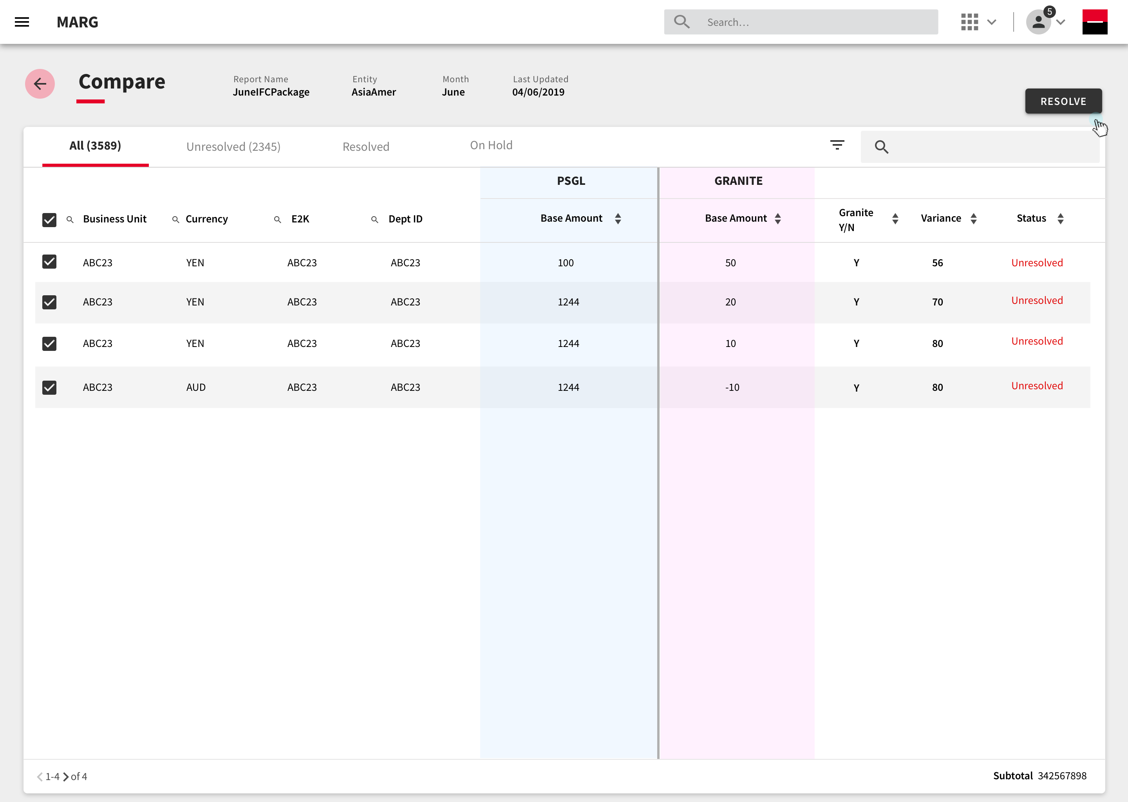
Selecting line items to resolve

Slide 9
Actions on line items
1. Reverse : Reversing PSGL data and adding granite data to the ledger.
2. On Hold: Line item action is on hold until further clarity.
3. Manual Entry: Manually adding line items to balance out the total.

Slide 10
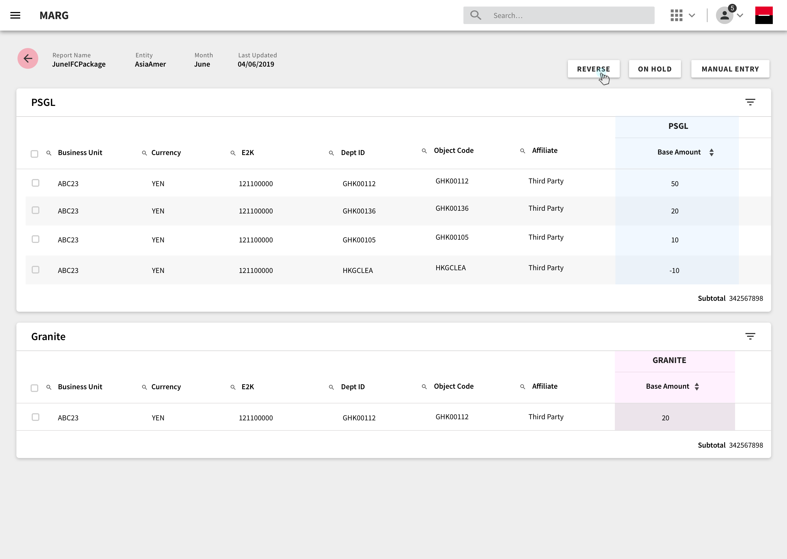
1. Reverse

Slide 11
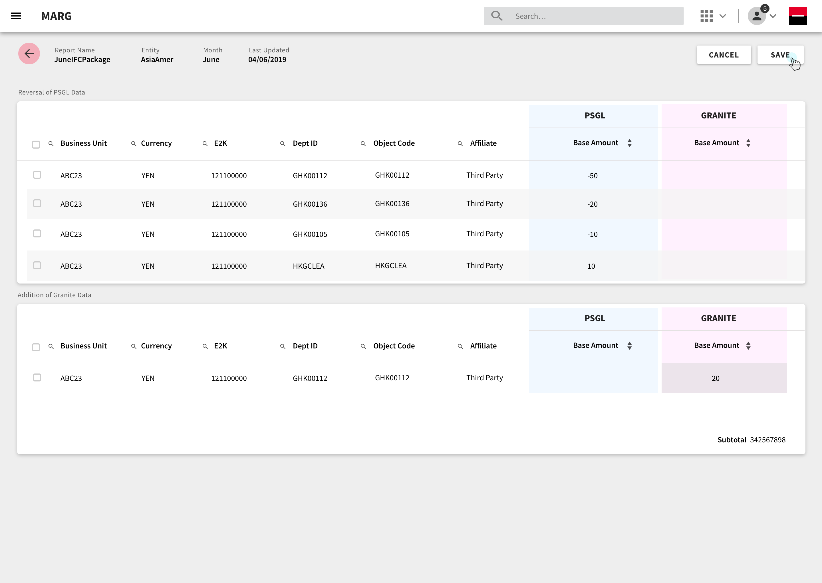

Slide 12
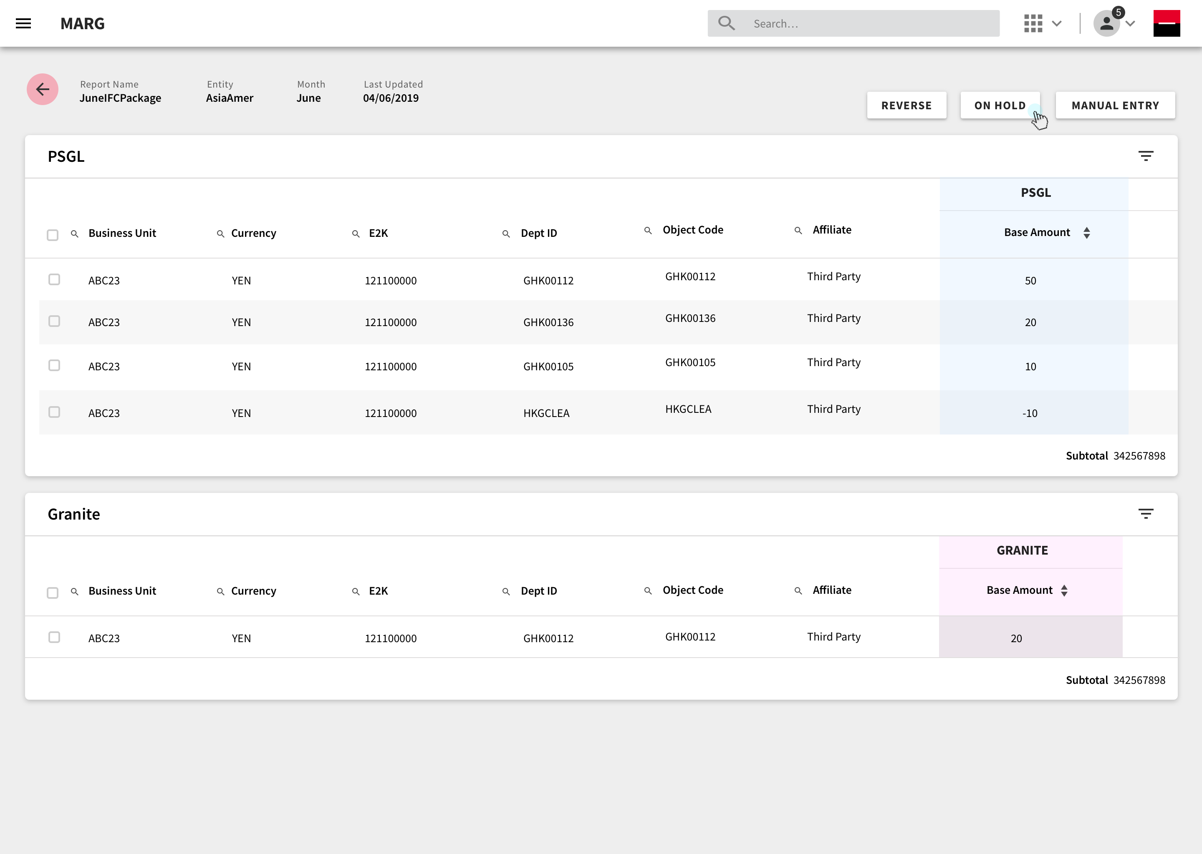
On Hold

Slide 13
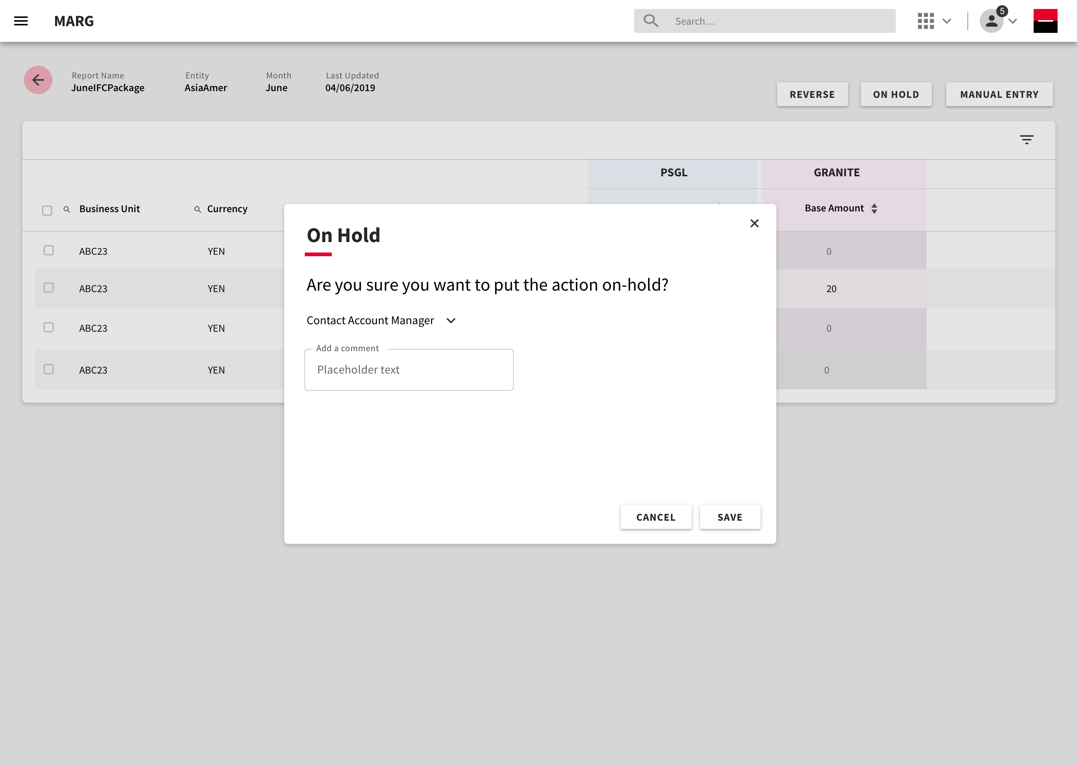

Slide 14
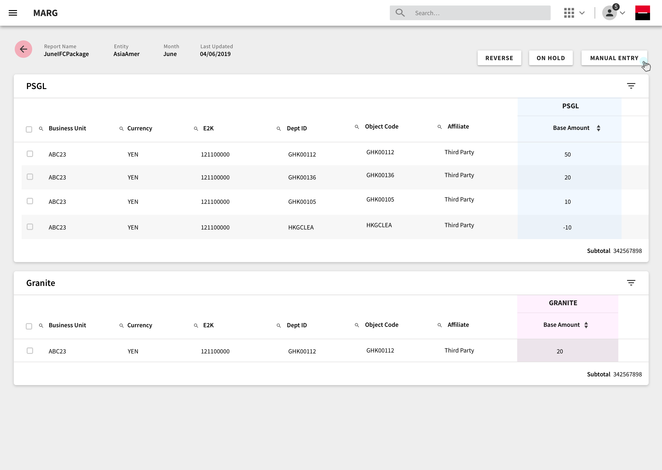
Manual Entry

Slide 15
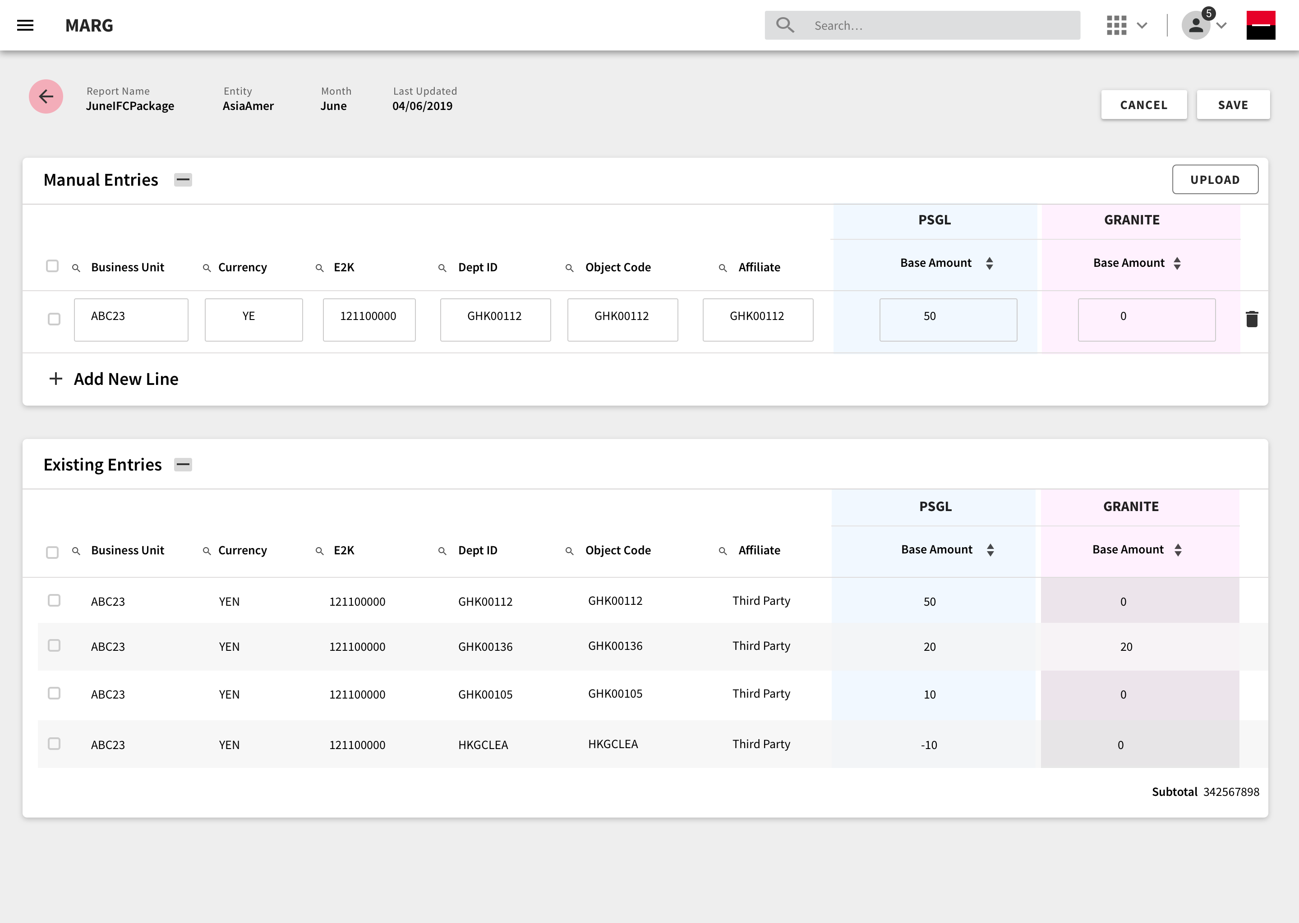

Slide 16
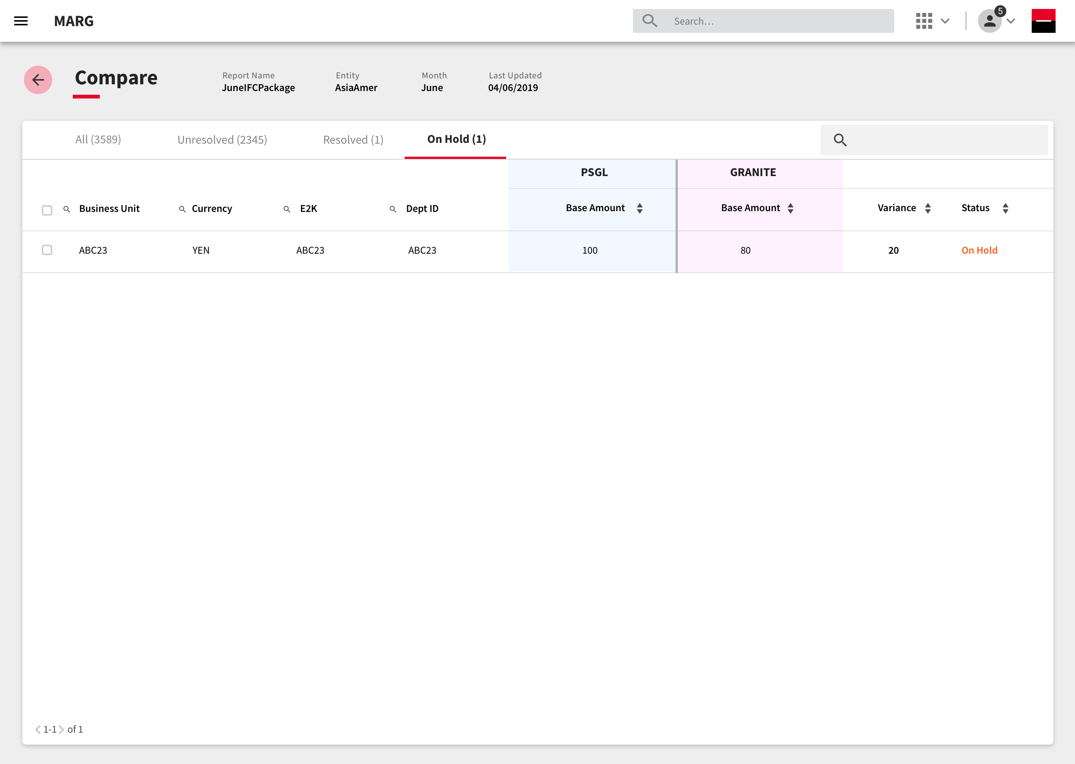
Compare - Tab View

Slide 17
Thank you.

