Slide 1


UTAR INTERVESITY SCIENCE SYMPOSIUM-UISS-2023
Title
RELATIONSHIP OF HEART RATE VARIABILITY MEASURES WITH TRAIT EMOTIONAL INTELLIGENCE IN THE PRESENCE OF ACUTE MENTAL STRESS
QUEST INTERNATIONAL UNIVERSITY
Speaker
Shagufta Yasir
Masters of science( Scholar)

Slide 2

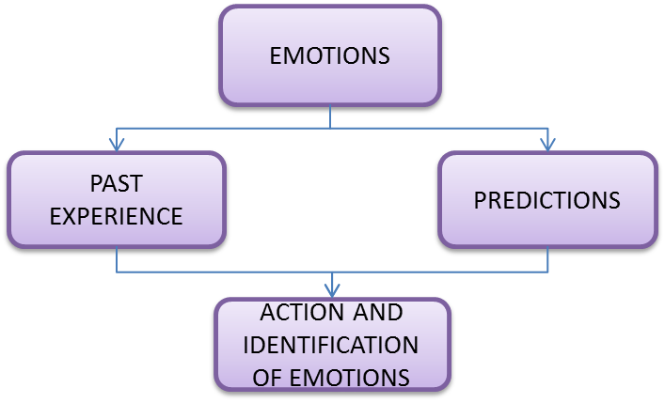

EMOTIONAL INTELLIGENCE
IMPORTANCE

Slide 3
INTRODUCTION
Relationship of stress hormone with EI
(Liu, Li, Shangguan, & Shi, 2019)
Ability EI is associated with RMSSD
(Vanuk, Alkozei, Raikes, Allen, & Killgore, 2019)
LF/HF shows negative relationship with emotional regulation
(Ruth Castillo, 2013)
Trait EI is associated with better performance in physical stress domain
(Nihal & DOĞAN,2019)
Stress coping and Skills development for stress management
(Por, Barriball, Fitzpatrick, & Roberts, 2011) (Houghton, Wu, Godwin, Neck, & Manz, 2012)
Correlation with biological responses
(Heponiemi, 2004)(Feldman et al., 1999)
Stress and mental health
(Ciarrochi, Deane et al. 2002)
Buffer acute stress response
(Lea, Davis, Mahoney, & Qualter, 2019)
HRV and Personality traits as a predictor of mental stress
(Zohar, Cloninger, & McCraty, 2013)

Slide 4
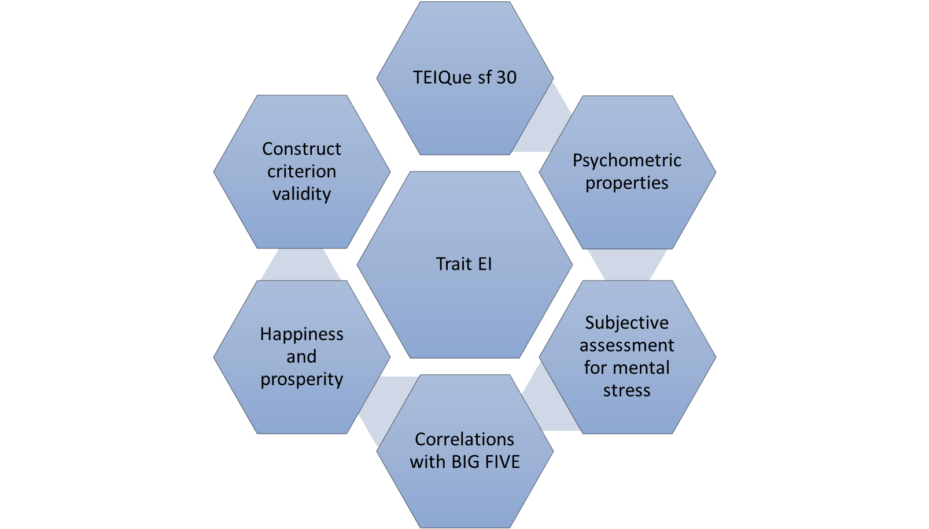




TRAIT EMOTIONAL INTELLIGENCE
WELLBEING
SELF CONTROL
EMOTIONALITY
SOCIABILITY

Slide 5
RESEARCH OBJECTIVES
Determine the emotional intelligence of the study participants.
Measure the baseline stress index through HRV measures.
Finding out the correlation between EQ and HRV measures of study participants.
PROBLEM STATEMENT
Lack of data regarding the physiological correlates of trait emotional intelligence in response to mental stress.
HYPOTHESIS
Heart rate variability indices correlate with emotional intelligence in the presence of mental stress.

Slide 6
METHODOLOGY

Slide 7
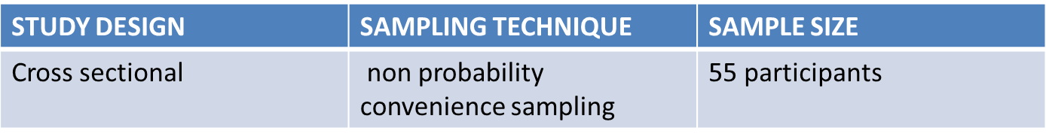
INCLUSION | EXCLUSION
Ages between 18 and 35 Provide informed consent | Incomplete questionnaires Minors under the age of 18.
All participants who are able to read write and provide answers to arithmetic task. | HRV data with significant noise or artifacts.

Slide 8
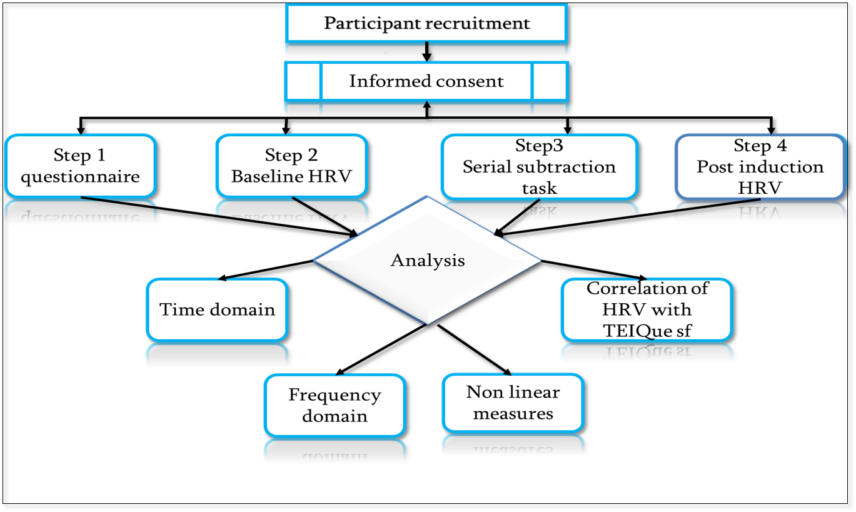
DATA COLLECTION PROCEDURE AND ANALYSIS

Slide 9
RESULTS

Slide 10
TIME DOMAIN
SDNN shows significant mean difference at baseline.

Slide 11

*
**
**
**
**
**
(LF, HF and LF/HF ratio) at T1, (LF, HF) at T2 and (LF/HF ratio) at T3 shows significant mean difference.

Slide 12
NON LINEAR MEASURES
**
**
**
(SD2,SD2SD1ratio, ApEn, DFAα1, DFAα2 ) at T1 and T2 and (DFAα1) at T3 shows significant mean difference.

Slide 13
WELL BEING
TIME DOMAIN
FREQUENCY DOMAIN
*
*
**
Positive and negative correlations at baseline and recovery with time domain and negative correlation at baseline of HRV variables with time domain.

Slide 14
NON LINEAR DOMAIN
*
*
*
*
*
SD1 SD2 shows positive correlation at baseline and recovery with SD2SD1 shows negative correlation T3

Slide 15
SELF CONTROL
TIME DOMAIN
FREQUENCY DOMIAN
*
LF shows positive correlation at baseline
SD2 shows positive correlation at T3

Slide 16
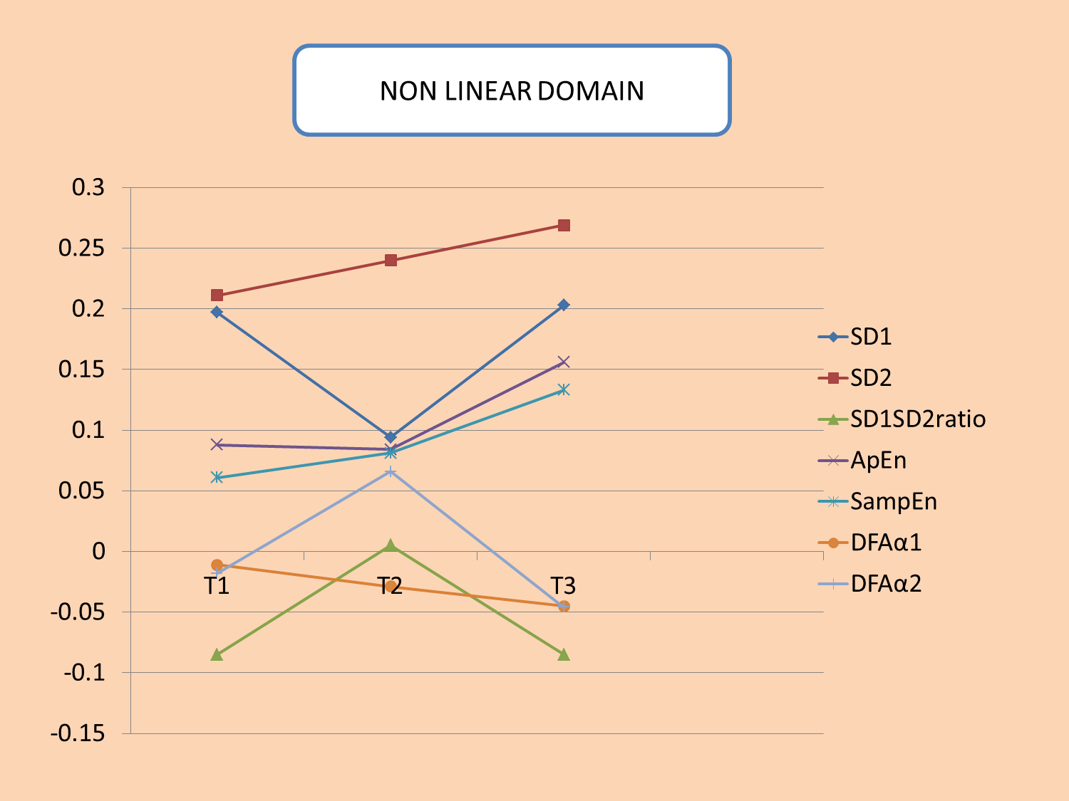
*

Slide 17
EMOTIONALITY
TIME DOMAIN
FREQUENCY DOMAIN
**
*
*
*
*
*
Significant positive correlations at T1 and T3 while stress index shows negative correlation time domain.

Slide 18
NON LINEAR MEASURES
*
*
SD2 shows positive correlations at T1 and T3 and DFAα2 shows negative correlations.

Slide 19
SOCIABILILTY
TIME DOMAIN
FREQUENCY DOMAIN
**
HF shows negative correlation at T3

Slide 20
NONLINEAR
*
ApEn shows negative correlation at T1 and T2.

Slide 21
CONCLUSION
The result suggest that HRV may serve as physiological indicator of emotional intelligence in the context of acute mental stress.

Slide 22
REFERENCES
Cheng, Y., Su, M., Liu, C., Huang, Y., & Huang, W. (2022). Heart rate variability in patients with anxiety disorders: A systematic review and meta‐analysis. Psychiatry and Clinical Neurosciences, 76(7), 292–302.
Dåderman, A. M., & Kajonius, P. J. (2022). An item response theory analysis of the Trait Emotional Intelligence Questionnaire Short-Form (TEIQue-SF) in the workplace. Heliyon, 8(2).
Hao, T., Zheng, X., Wang, H., Xu, K., & Chen, S. (2022). Linear and nonlinear analyses of heart rate variability signals under mental load. Biomedical Signal Processing and Control, 77, 103758.
Laborde, S., Dosseville, F., Guillén, F., & Chávez, E. (2014). Validity of the trait emotional intelligence questionnaire in sports and its links with performance satisfaction. Psychology of Sport and Exercise, 15(5), 481–490.
Petrides, K., Perazzo, M. F., Pérez-Díaz, P. A., Jeffrey, S., Richardson, H. C., Sevdalis, N., & Ahmad, N. (2022). Trait emotional intelligence in surgeons. Frontiers in Psychology, 13, 829084.
Prajapati, V., Routray, A., & Guha, R. (2020). Cardiac autonomic flexibility is associated with higher emotional intelligence. Cogent Psychology, 7(1), 1870809. https://doi.org/10.1080/23311908.2020.1870809
Sambol, S., Suleyman, E., Scarfo, J., & Ball, M. (2022). Distinguishing between trait emotional intelligence and the five-factor model of personality: Additive predictive validity of emotional intelligence for negative emotional states. Heliyon, 8(2).

Slide 23


