Slide 1
IMAGE PROCESSING USING MACHINE LEARNING

Slide 2
CONTENT

Slide 3
OUTLINE
Introduction to Machine Learning
The example application
Machine Learning Methods
Decision Trees
Artificial Neural Networks
Instant Based Learning

Slide 4
WHAT IS MACHINE LEARNING??
Machine Learning (ML) is constructing computer programs that develop solutions and improve with experience
Solves problems which can not be solved by enumerative methods or calculus-based techniques
Intuition is to model human way of solving some problems which require experience
When the relationships between all system variables is completely understood ML is not needed

Slide 5
What is Image Processing ??
The goal of image processing is to enhance or compress image/video information.
Uses pixel-wise operations such as transforming one image into another. For example applying a rotation on pixels.
There is no extraction of meaningful information from those pixel-wise operations.
This Image Processing is A subset of MACHINE LEARNING.

Slide 6
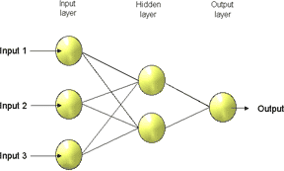
ARTIFICIAL NEURAL NETWORKS(ANN)
Made up of interconnected processing elements which respond in parallel to a set of input signals given to each.

Slide 7
INSTANT BASED LEARNING
A learn-by-memorizing method: K-Nearest Neighbor
Given a data set {X_{i}, Y_{i}} it estimates values of Y for X's other than those in the sample.
The process is to choose the k values of X_{i} nearest the X and average their Y values.
Here k is a parameter to the estimator. The average could be weighted, e.g. with the closest neighbor having the most impact on the estimate.

Slide 8
PROPOSED WORK
Exploring Machine Learning Algorithms That will be very helpful in our project like VARIOUS REGRESSIONS , DECISION TREES ETC.
Learn About DEEP LEARNING , building CNN ,RNN AND ANN.
BUILDING AN IMAGE PROCESSING PLATFORM THAT CAN DO VARIOUS THINGS LIKE OBJECT IDENTIFICATION , FRAUD DETECTION AND OTHER THINGS MENTIONED IN NEXT SLIDE.

Slide 9
PROJECTS UNDER IMAGE PROCESSING
SOIL MOISTURE DETECTION
FRAUD DETECTION
VEHICLE DETECTION
COLLISION PREVENTION
DRIVER SAFETY ALGORITHMS
PLAN DETECTION
PEDESTRIAN DETECTION

Slide 10
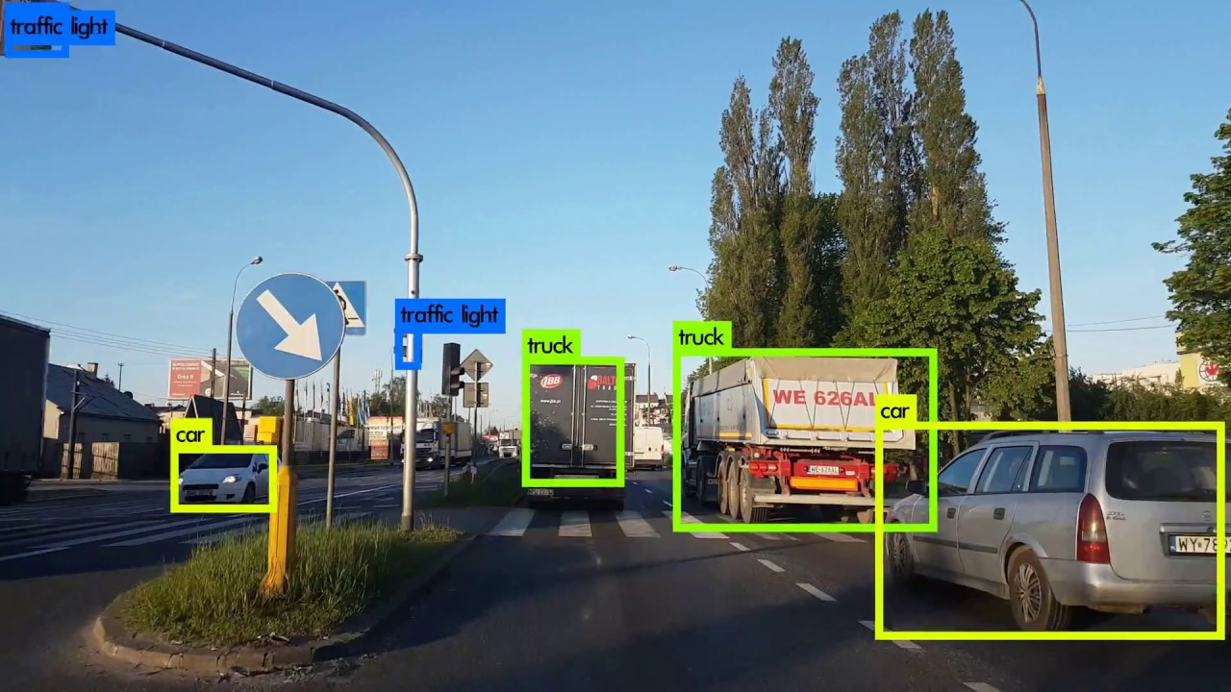
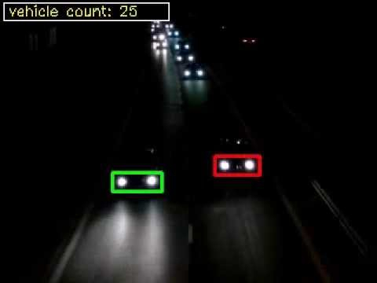
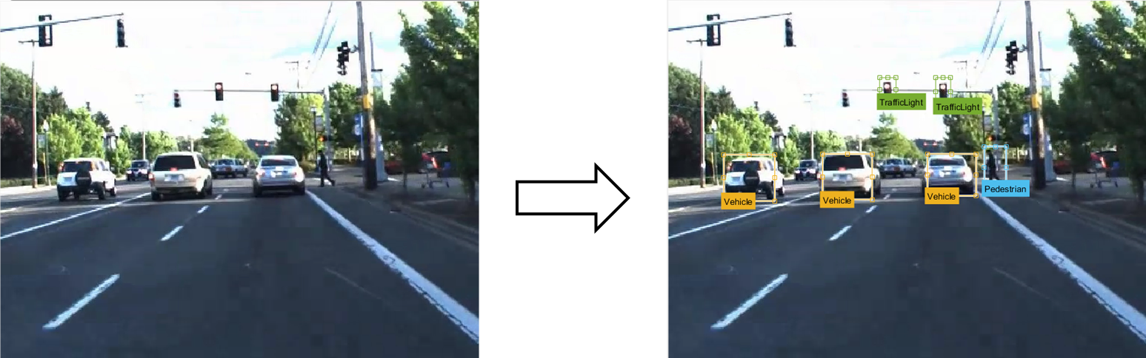
GLIMPSE OF VEHICLE DETECTION

Slide 11
METHODOLOGY
MACHINE LEARNING ALGORITHMS
DEEP LEARNING OVERVIEW ANN, CNN
READING DIFFERENT RESEARCH PAPERS AND APPLYING NEW TECHNOLOGIES IN OUR PROJECT

Slide 12
REFERENCES
SOME OF THE CONTRIBUTIONS(RESEARCH PAPERS) IN THE FIELD OF IMAGE PROCESSING USING ML ARE :
https://pdfs.semanticscholar.org/dc97/4442dfb8181d88c82ef9aa62630f3ae4e1a4.pdf
https://pdfs.semanticscholar.org/16e1/091cd01cd8b0eb25e2cbe7efe39be423255f.pdf
http://ascpro.ascweb.org/chair/paper/CPRT120002010.pdf
https://www.researchgate.net/publication/265481813_VEHICLE_DETECTION_USING_IMAGE_PROCESSING_FOR_TRAFFIC_CONTROL_AND_SURVEILLANCE_SYSTEM

