Slide 1
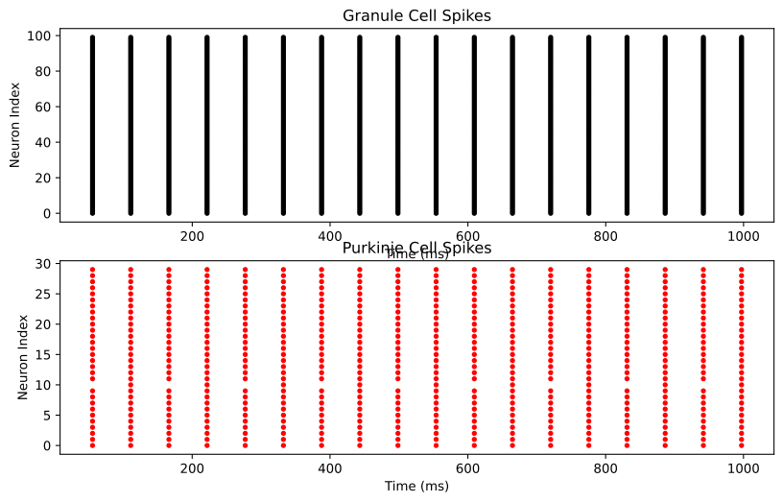
Comment 1: The Granule cells voltage changed from 1.5mV to 16mV. This is the best optimized and efficient output according to us, even though it is very basic model consisting only Granule and Purkinje cells.

Slide 2
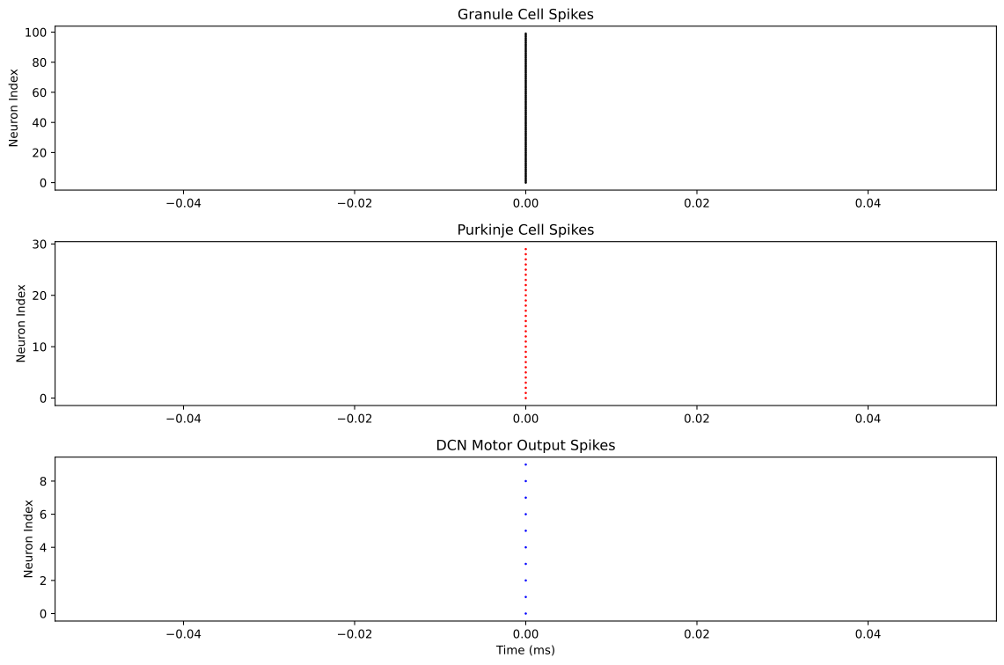
Comment 2: The resistance increased from 1Mohm to 10 Mohm. In Granule neurons sensory input, we added some noise (stronger amplitude) for some activity to monitor the cell. This was by far the least choice output.

Slide 3
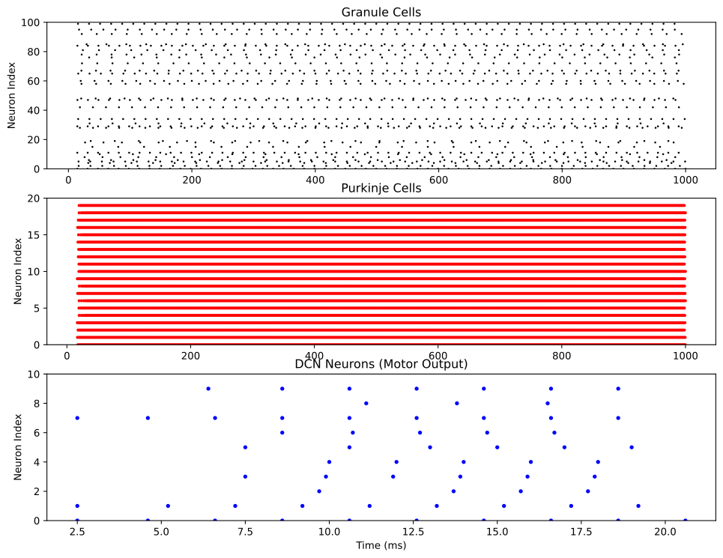
Comment 3: We set up an extra network, added mossy fibers for better working of the simulation.

Slide 4
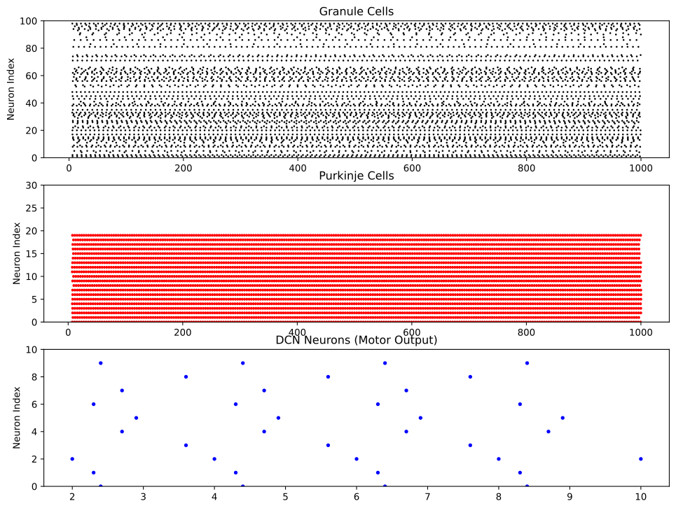
Comment 4: Resistance increased to 20 Mohm. The membrane's threshold voltage was lowered from -55 to -50 mV. Code snippet:
sensory_input = TimedArray(
np.sin(2 * np.pi * (1/500) * np.arange(0, duration/ms, defaultclock.dt/ms)) * 2 * nA,
dt=defaultclock.dt
)
We multiplied by 2 in this snippet for better results.

Slide 5
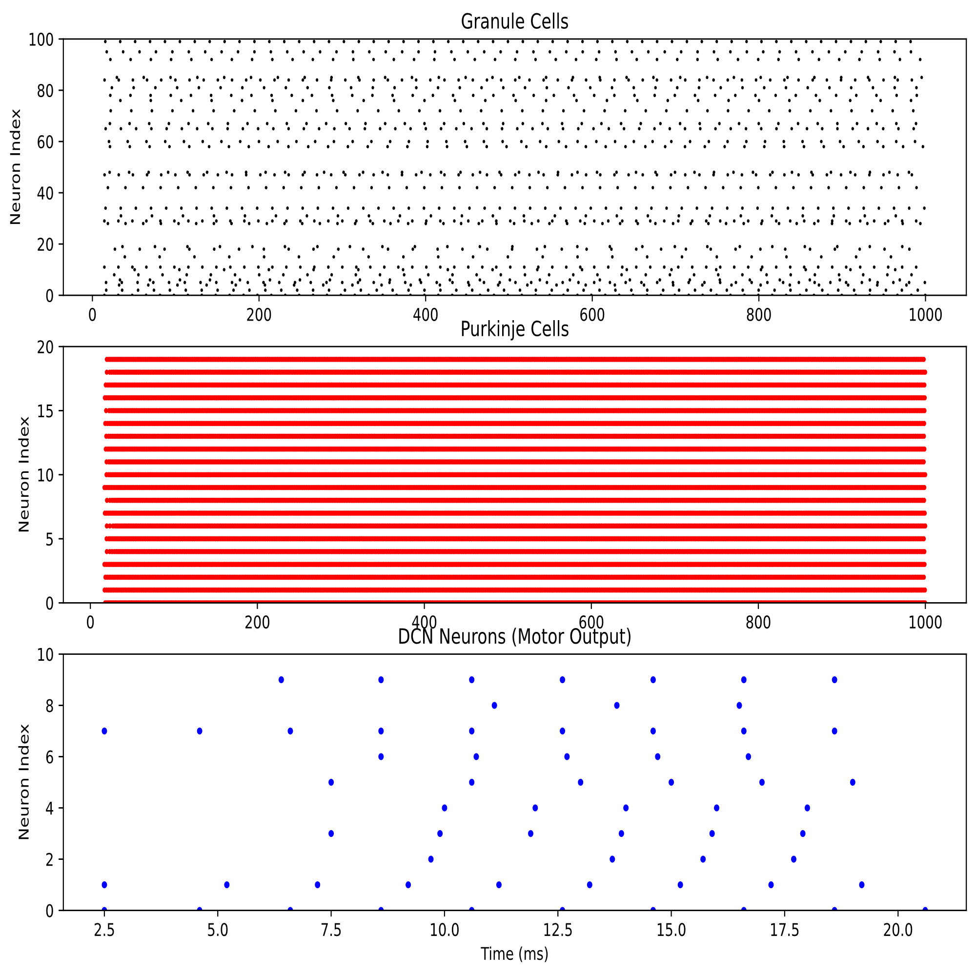
Comment 5:In this we have modified the Purkinje cells threshold voltage Increased to -50mV. Resistance is 20mohm here. Purkinje -> DCN (reduced inhibition) 0.2->1.0 synapses_granule.connect(p=0.3) from (p=0.1) mossy_to_dcn = PoissonGroup(10, rates=100*Hz) # Increased from 50Hz

Slide 6

Comment 6: synapses_granule = Synapses(granule_neurons, purkinje_neurons, on_pre='I += 0.8 * nA') # Reduced strength synapses_granule.connect(p=0.2) # Reduced connection probability v_thresh_granule = -52 * mV # Slightly lower threshold for granule cells v_thresh_purkinje = -55 * mV # Higher threshold for Purkinje cells v_thresh_dcn = -55 * mV

Slide 7
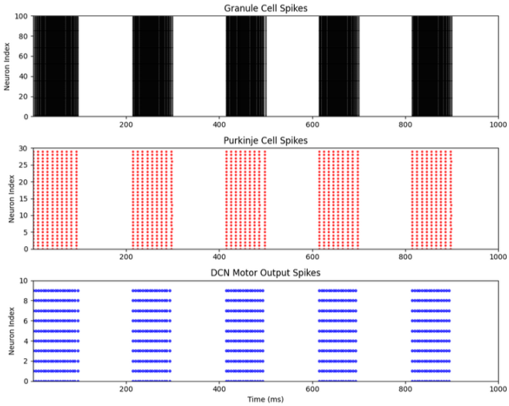
Granule cells are stimulated with a higher rate of input activity.
Adjusted Purkinje cell inhibition parameters for reduced oscillatory patterns.
Key configurations include:
Threshold voltages (granule: -52 mV, Purkinje: -55 mV, DCN: -55 mV).
Connection probabilities tuned for balance between excitation and inhibition.

