Slide 1
PREDICTING THE CORRELATION OF VALUES CORRESPONDING TO HAPPINESS QUOTIENT OF COUNTRIES

Slide 2
Predicting Happiness quotient results in the following:
Happiness quotient determines how happy are the people of the country.
All the misconceptions about happiness are sorted out, say for instance “money buys happiness”.
Happiness indirectly corresponds to better efficiency of the people living in the country.

Slide 3
Data
Kaggle has been a supportive platform which provided with the following data set.
The data mainly consisted of ranks of different countries based on the scores they received. The score of individual countries is based on several independent variables.

Slide 4
Data Cleaning and Approach
The data mainly consists of seven variables.
A dataframe consisting of the csv file is created. The columns are renamed for convenience.
Most variables are numeric values. The ones that are not are converted to numeric values.
All the columns are not needed for modelling. Thereby a new dataframe is created which only consists of required models.

Slide 5
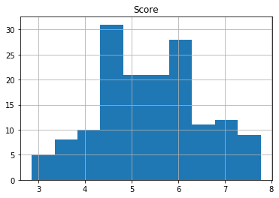
Histogram Approach
A histogram is created with the variables score and country. It shows how score varies according to country. It is a very rough depiction just to make sure all the variables are properly converted and if they can be applied with various operations.

Slide 6
Modelling
There are various approaches to modelling. The approach undertaken is linear regression.
The aim of this model is to look at correlation of various variables, we are looking at approaching through linear regression.
For convenience we stick to showing correlation between the variables, GDP and score are considered.
Before modelling process begins, the data is split into train and test data.

Slide 7
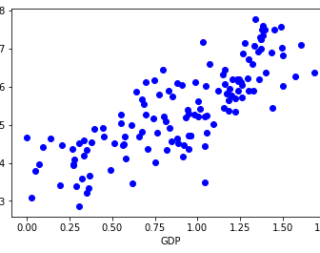
Scatter plot to show correlation
Scatter plots are the best way to look at correlations between variables.
In the given scatter plot we can clearly see, there is a positive correlation between the variables.

Slide 8
Training
In this phase the model is first split in 70:30 ratio.
We use linear regression to train the model and thereby find coefficient of regression and intercept of regression.
Coefficient:2.227
Intercept: 3.39

Slide 9
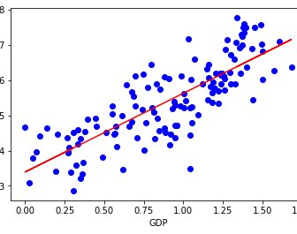
When we try and insert a line through the various points we get a scatter plot as shown.
If we observe carefully we can see that though the line passes through the points it is not a best fit.

Slide 10
Testing
In testing we utilize the model created using training data and predict using testing data.
In order to see how the model performed we use mean square error, r square etc.

Slide 11
Evaluation and Conclusion
An attempt has been made to understand training and testing of the happiness dataset. There are various possible models available to perform the evaluation of such models, but linear regression gives us a better clarity on correlations, which is why it was chosen. Since the available data set was quite small with very less values the model might not have given the perfect evaluations but there is a future prospectus to it, where we can determine the overall score of a new country when given its other independent variable values.

Slide 12
THANKYOU

