Slide 1

The GPSTk: GLONASS, RINEX 3.00 and More
Thomas L. Gaussiran, Eric Hagen, R. Benjamin Harris (presenting), Chris Kieschnick,
Jon C. Little, Richard G. Mach,David C. Munton, Scot L. Nelsen, Colin P. Petersen,
David L. Rainwater, Brent A. Renfro, Brian W. Tolman
Applied Research Laboratories, The University of Texas at Austin
Dagoberto Salazar
Grupo de Astronomia y Geomatica, Universitat Politècnica de Catalunya
ION-GNSS-2009
Thursday, September 24, 2009
Savannah, Georgia

Slide 2
Overview
Fundamentals of the GPSTk
Web presence
Functionality
Getting Started
RINEX 3.00 branch
Clock tools

Slide 3
GPSTk Fundamentals
Ultimate goal: free researchers and developers from GNSS algorithm development
Design and implementation
  Core library + Applications
  Object oriented, ISO standard C++, platform independent → portable
  Version 1.6 contains 158,000 handwritten lines of code¹
    Estimated value of $6 million (COCOMO model)
    Ver 1.1: 70,000 lines of code (handwritten)
Released under Lesser GNU Public License, or LGPL
  You have the right to use, modify and redistribute this code
  LGPL license is not viral, unless
    You modify the GPSTk to make your derivative work AND
    You are externally distributing that work
  The license file in the distribution contains the full license
¹Metrics generated using David A. Wheeler's SLOCCount utility

Slide 4
Project Web Presence
Website at http://www.gpstk.org/
  Site is a wiki : Users can modify/reprogram the site
  Features include
    Equations in LaTeX
    Revision history
    Powerful searching
    Question and answer application
    Tagging
  Daily snapshot of library documentation
  Growing user manual
SourceForge services provide
  Download of source or binaries
  Code repository
  Access to the developer mailing list
IRC channel #gpstk at freenode.net for developers interaction in real time

Slide 5
Library Capabilities
RINEX manipulation
Time conversion, manipulation and storage
Matrix computation
Basic transforms of time and location
Precise ephemeris processing
Range prediction and error modeling
Reference frame computations
Statistics
Troposphere delay models
Earth orientation transforms
Expression evaluation
FIC processing
Almanac processing
Low level BINEX input and output
Broadcast ephemeris processing
Clock models
Code generation
Cycle slip and discontinuity correction
Numerical integration
Combinations and difference computations
Data structures
Navigation solution
Astronomical functions

Slide 6
Getting Started
You can download the stable packages
  Binary packages for Windows 32 bit, Mac OSX, Linux x386, Linux x86_64, Solaris
  Source
You can also get the latest code using Subversion, an open source revision control system
  To anonymously check out the code base
  svn checkout https://gpstk.svn.sourceforge.net/svnroot/gpstk
  To update your code base: svn update
To build the project
  Requires the jam utility, which automates compiling and linking
  Change to the gpstk dev directory and type jam.
  Grab some coffee...
  make can be used as well. Check the website for details.
To build the library documentation
  Requires Doxygen, a utility that generates documentation from code
  and Graphviz, a package for graphs and visualizations
  Change to the gpstk dev directory and type doxygen
  Go check your email...

Slide 7
Data Structures
GNSS Data Structures (GDS) are a feature of the procframe library
  Data structures can be chained to processing objects and vice versa
  Processing objects can provide smoothing, differences, transformations
  Successive operations add, modify or remove information to the stream
  Connection is made using C++ streaming operator >>
Now GDS supports precise point positioning (PPP).
Examples:
gRin >> myFilter >> model >> solver;
gRin >> myFilter >> model >> baseChange >> solverNEU;
gRin >> getPC >> getLC >> getLI >> getMW >> markCSLI >>
markCSMW >> smoothPC >> pcFilter >> modelPC >> mopsW >>
baseChange >> solverWMS;

Slide 8
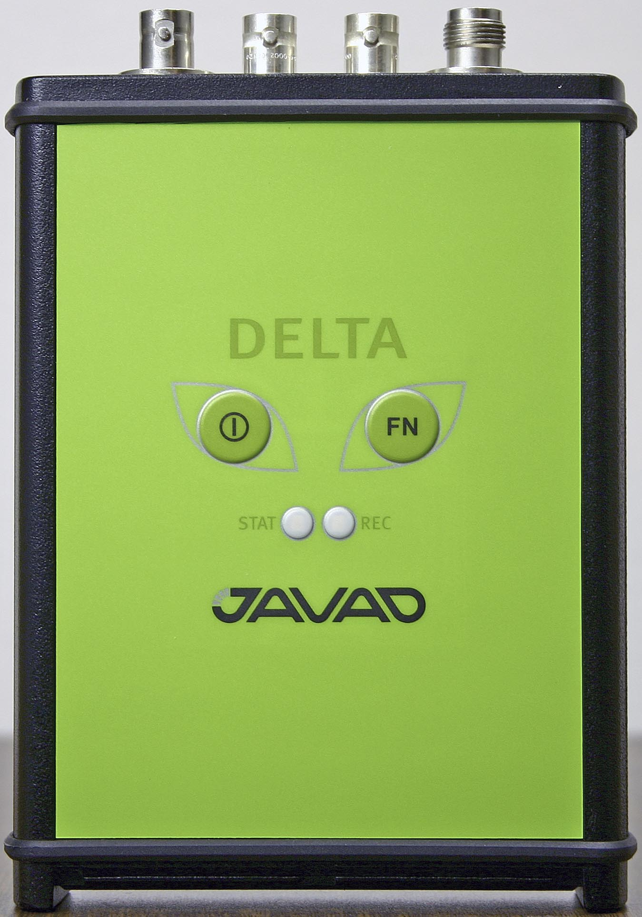
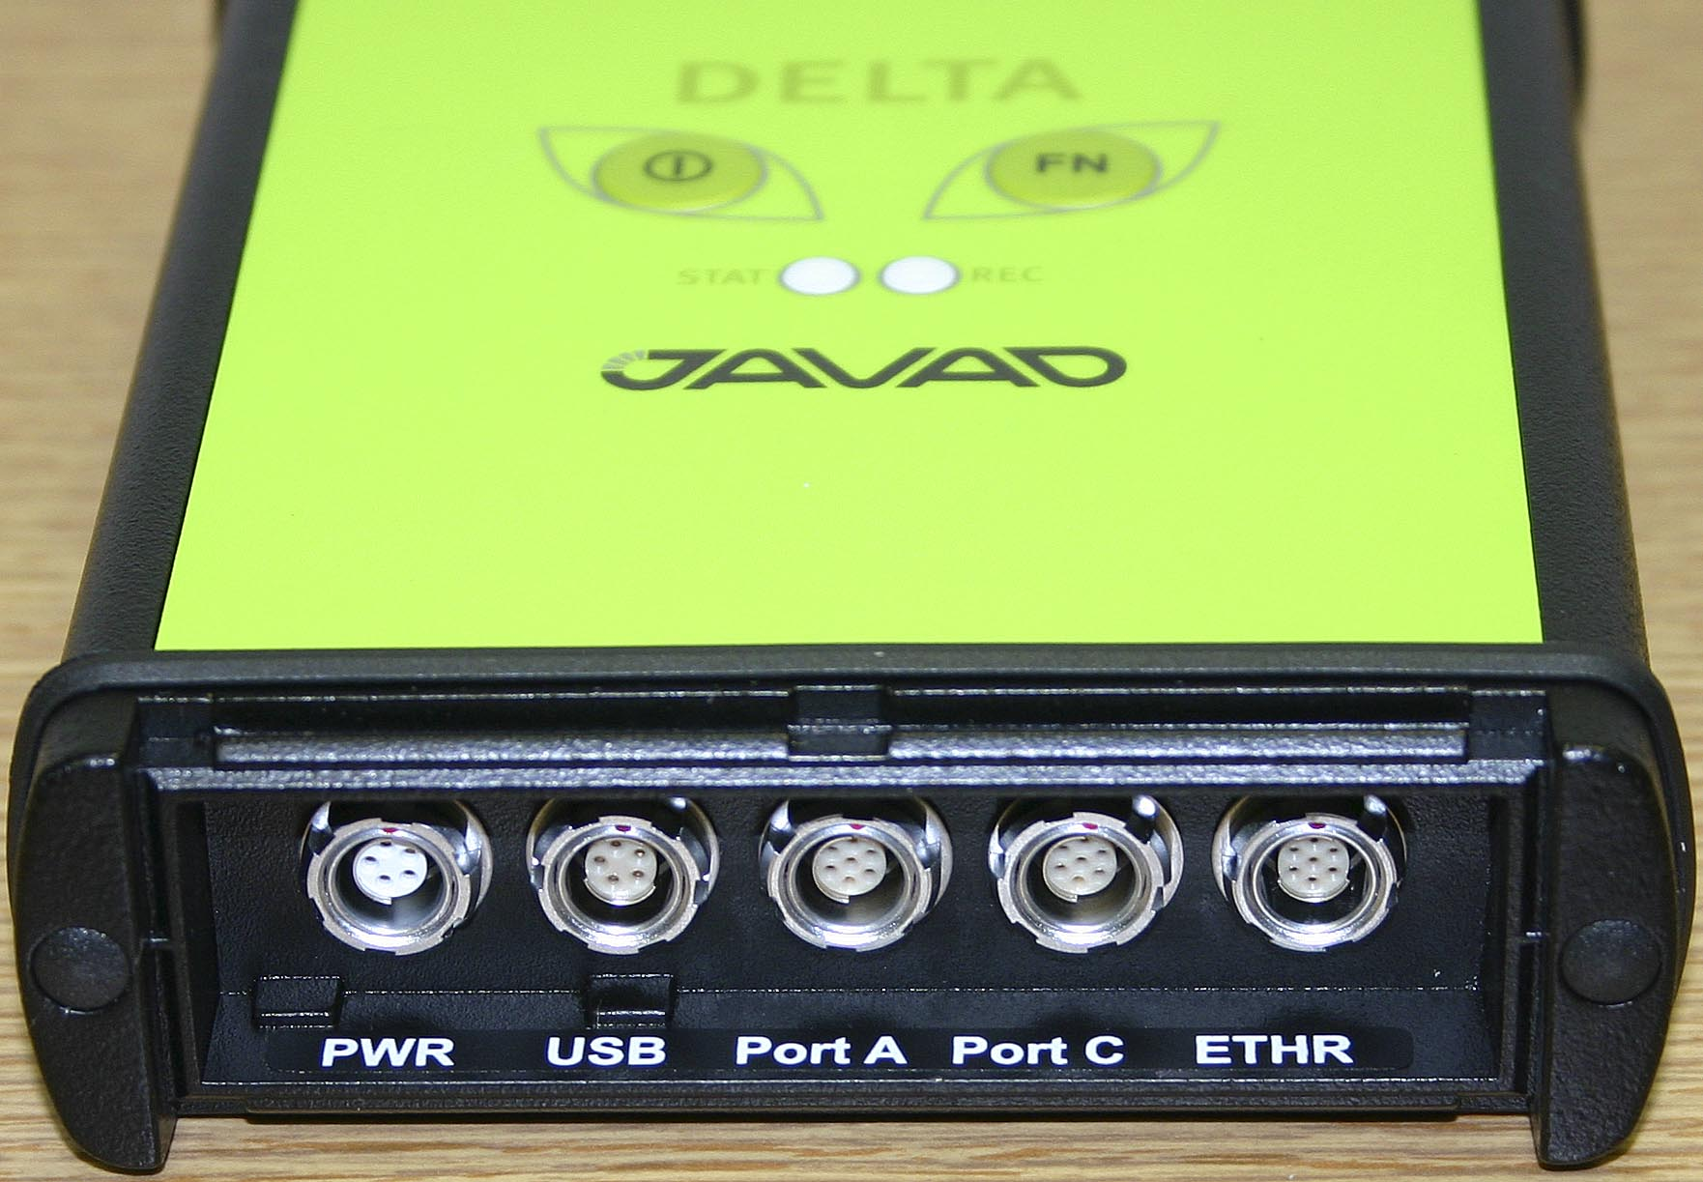
Why RINEX 3.00 Support?
Anticipating Galileo
Revival of GLONASS
Multi-GNSS receivers
  Cost dropping
  Availability is growing
Applications (e.g. PPP) will benefit
  Increased robustness
  Increase signals in obstructed views
RINEX 3.00 standard is available

Slide 9
Issues in Growing the GPSTk beyond GPS
Time system
  Originally GPSTk assumed a single unifying time system – GPS time
Coordinate system
  GPSTk computations all done in WGS84 (G1150)
Data storage and access
  Storage and access optimized for GPS data
Navigation Data
  Broadcast and precise GPS ephemeris only
Observation Data
  GPS only (small support for GLONASS via RINEX 2.11)

Slide 10
Issues in Growing the GPSTk
Time system
  Originally GPSTk assumed a single unifying time system – GPS time
  Each GNSS will have its own unique time system
Coordinate system
  GPSTk computations all done in WGS84 (G1150)
  Assume each system will have a unique realization of ITRF
Data storage and access
  Storage and access optimized for GPS data
  Data structures must now reflect the different forms of data from each system
  But, we still would like a unifying design for all...
Navigation Data
  Broadcast and precise GPS ephemeris only
  Must handle multiple forms of broadcast nav data
Observation Data
  GPS only (small support for GLONASS via RINEX 2.11)
  Full RINEX 3 support

Slide 11
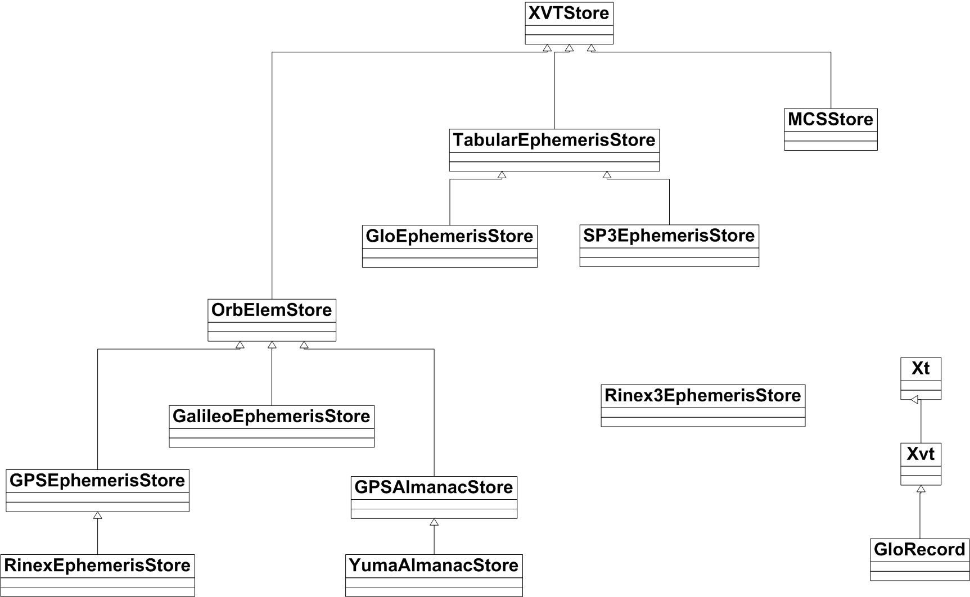
Design

Slide 12
Current Status of RINEX 3.00 and GLONASS
Working SVN branch established
  All changed publicly available
RINEX 3.00 support added to core library:
  Different time systems and handling has been incorporated
  Different reference frames handling is present
  General design is present that should be expandable
    Specific implementations are in place for GPS, GLONASS
    Placeholders for Galileo
  Observation, navigation file handling for RINEX3
  Utitlites/classes for RINEX 2.x seamless conversion to RINEX3 complete
What remains?
  Integrating to main branch
  Port existing applications to RINEX 3

Slide 13
Clock Tools
Tools to measure the stability of a receiver attached to a clock, or just the stability of a given clock
Stability metrics implemented include:
  Allan Deviation (nallandev)
  Overlapping Allan Deviation (oallandev)
  Modified Allan Deviation (mallandev)
  Total Deviation (tallandev)
  Overlapping Hadamard Deviation (ohadamarddev)
  Dynamic Allan Deviation (dallandev) – undergoing revision
Clock tools and Stable 32 yield similar results

Slide 14
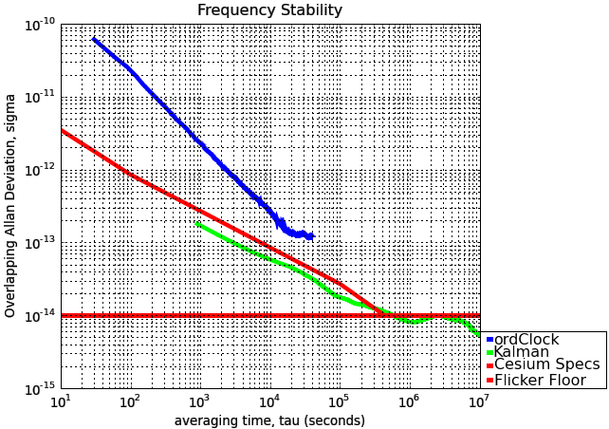
Example of Stability Analysis
ordGen –o s141220a.08o –e s141220a.08n –w 414_220a.08m | ordClock | ORDPhaseParser | rmoutlier | oallandev > ordClockout
cat 2007.85414 | rmoutlier | oallandev > Kalmanout
allanplot ordClockout Kalmanout –c –l

Slide 15
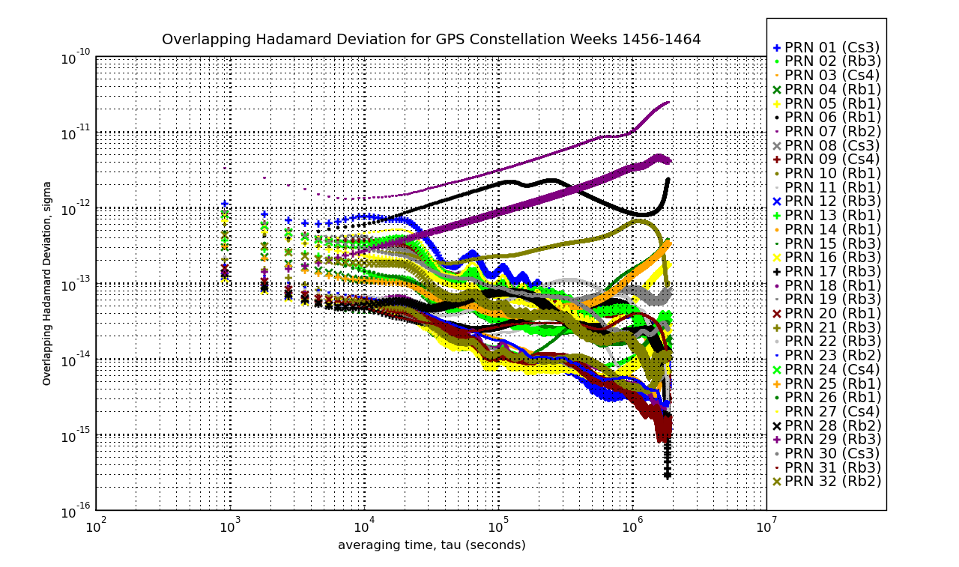
Example of GPS Clock Stabilities

Slide 16
Questions? Comments?
http://www.gpstk.org/
gpstk@arlut.utexas.edu

