Slide 1
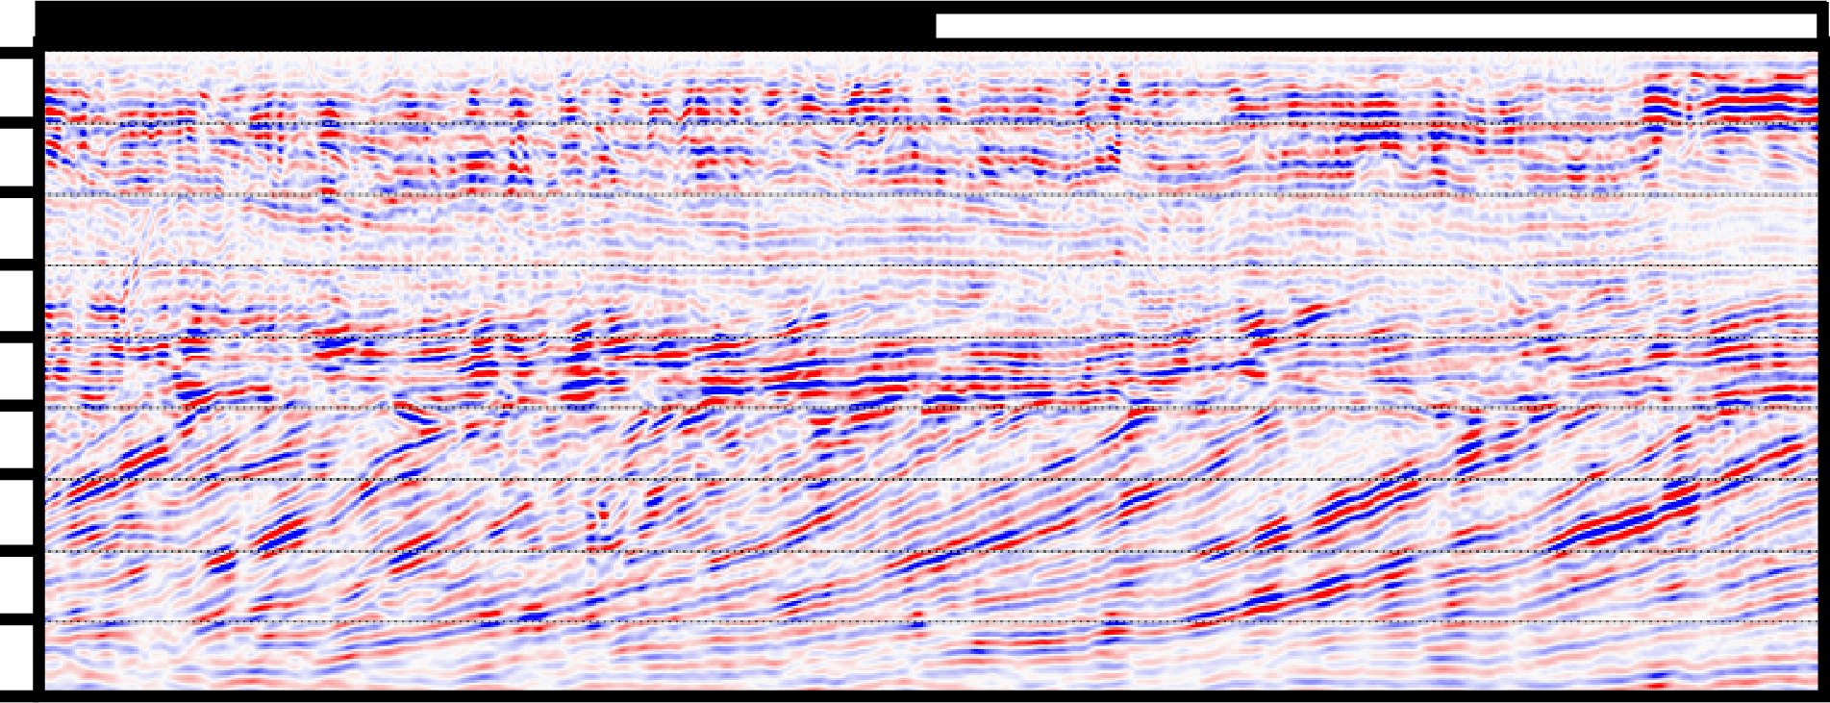
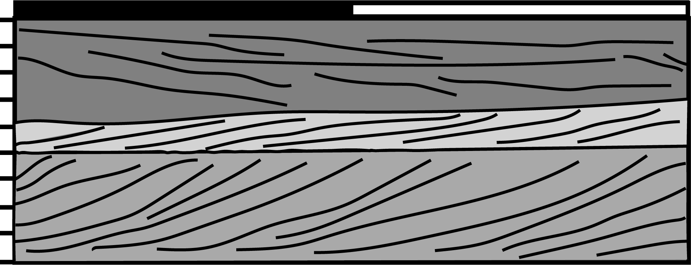
100 m
2
NW
0
Approximate Elevation
(m MSL)
-2
-4
-6
2
0
Approximate Elevation
(m MSL)
-2
-4
-6

Slide 2
Central Question
How can machine learning be used to reduce human error in interpreting Ground Penetrating Radar Profiles?
100 m
2
0
Approximate Elevation
(m MSL)
-2
-4
-6

Slide 3
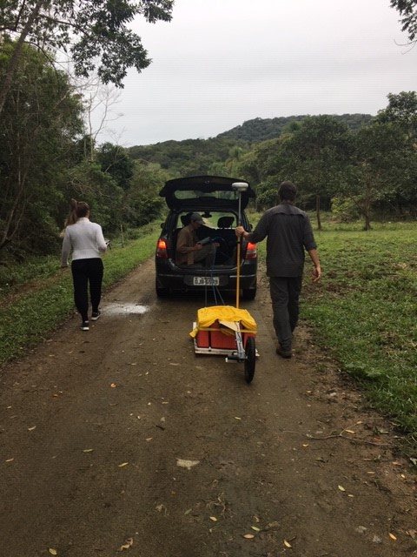



Data Description
Discrete data
Testing data: 240
Training data: 500

Slide 4
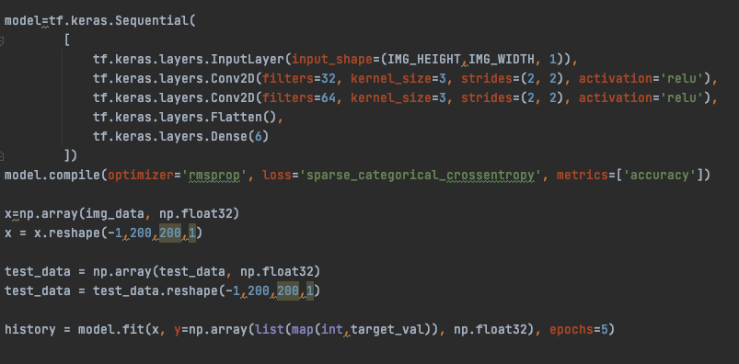
Machine Learning Model
Provide the specification for your applied machine learning model that presented the most promise in providing a solution to your problem. Include the section from your script that specifies your model architecture. Provide a brief description of how you implemented your code in practice.

Slide 5
Conclusion & Model Performance
Low model accuracy
Different implementation and feature assessment than previous models
Improving model accuracy?
S. Park, J. Kim, S. Jeong and S. Park, "GPR Data-Based Computer Vision for the Detection of Material Buried Underground," 2019 3rd International Conference on Smart Grid and Smart Cities (ICSGSC), 2019, pp. 41-44, doi: 10.1109/ICSGSC.2019.00-21.
M. Pham and S. Lefèvre, "Buried Object Detection from B-Scan Ground Penetrating Radar Data Using Faster-RCNN," IGARSS 2018 - 2018 IEEE International Geoscience and Remote Sensing Symposium, 2018, pp. 6804-6807, doi: 10.1109/IGARSS.2018.8517683.

