Slide 1
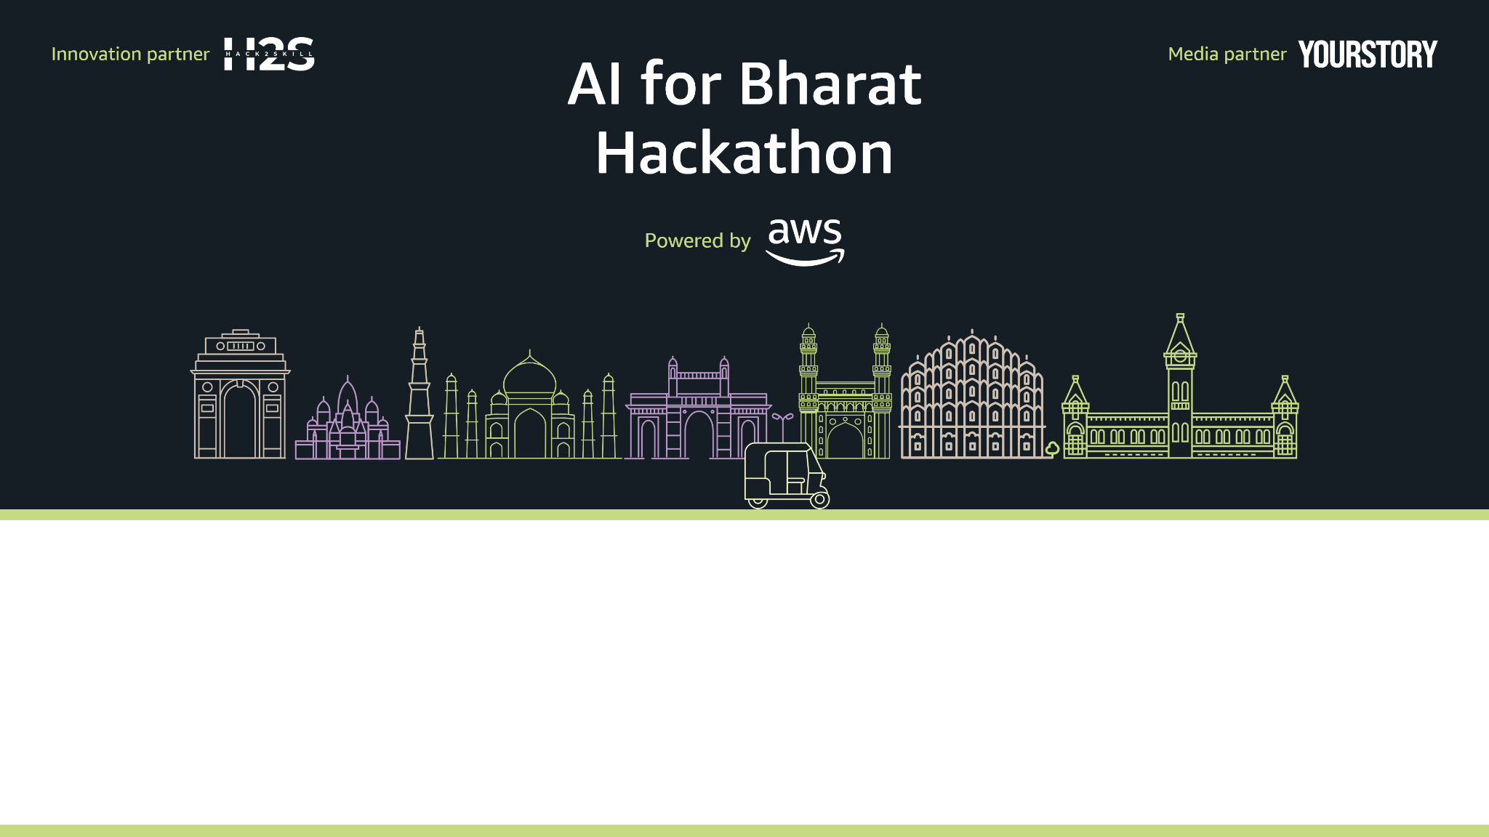
WB Digital Sahayak
Voice-First Welfare Eligibility Engine for West Bengal
Team Web | Team Leader: Souvik Karmakar
Problem Statement: Overcoming the digital and literacy barriers preventing millions in West Bengal from accessing ₹25,000+ crores in annual welfare benefits due to complex rules and high "failed visit" costs

Slide 2
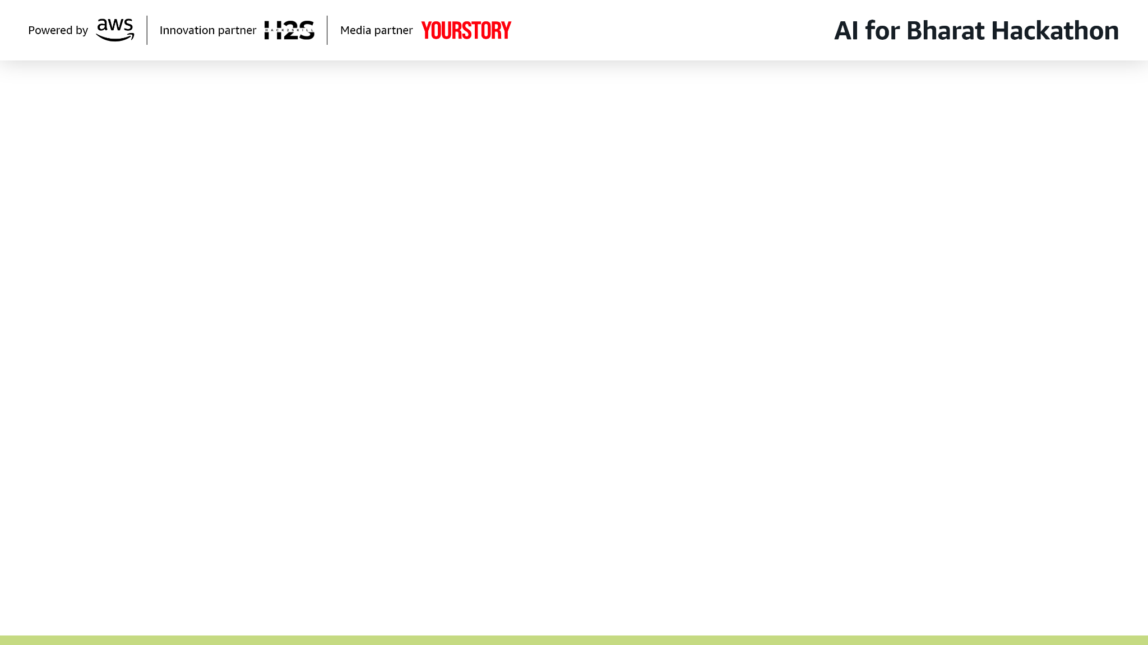
The Problem
Citizens lack digital literacy, face English-only portals, and receive no guidance before office visits — leading to wasted time, money, and rejected applications.
₹25K+
40%+
₹500
Crores Unclaimed
Applications Rejected
Cost Per Visit
Annual welfare benefits going unclaimed in West Bengal
Due to missing or incorrect documents
Average expense for failed office trips by rural families

Slide 3
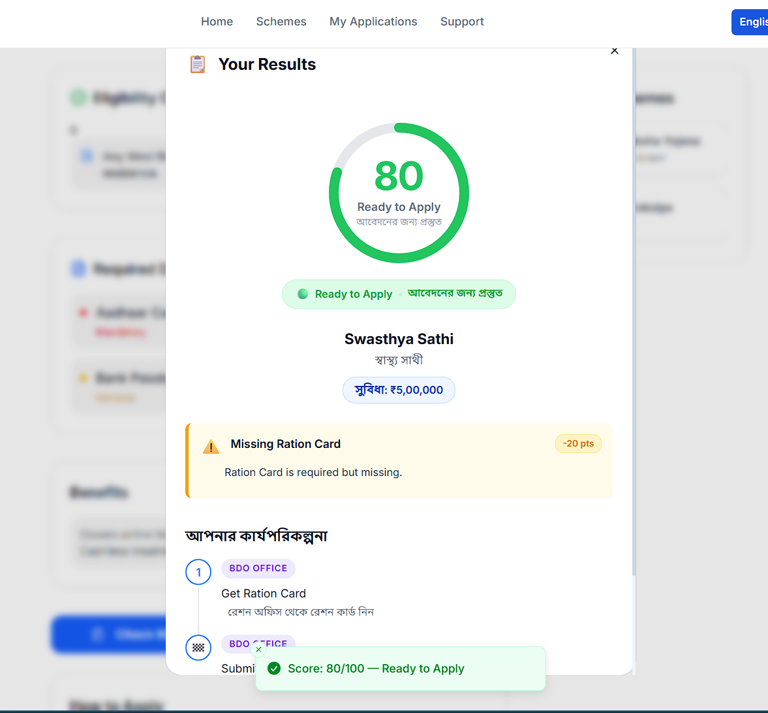
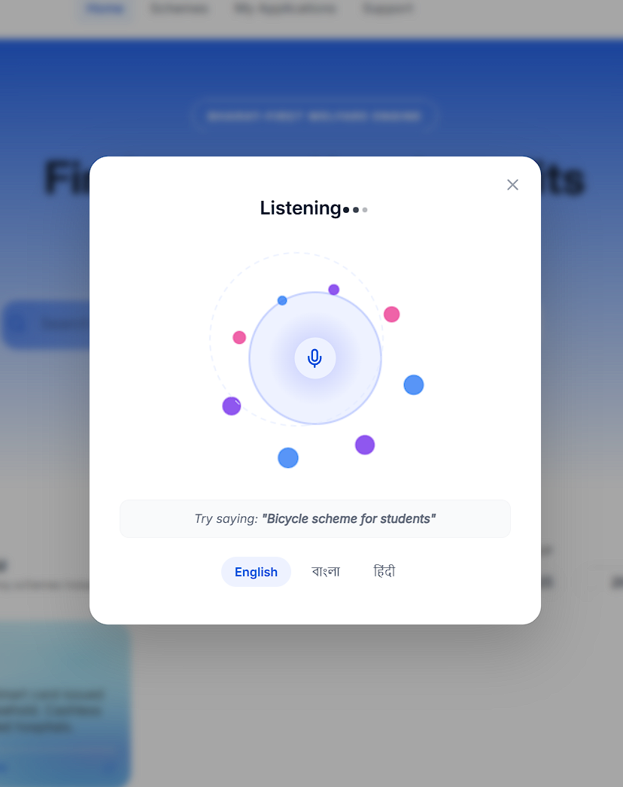
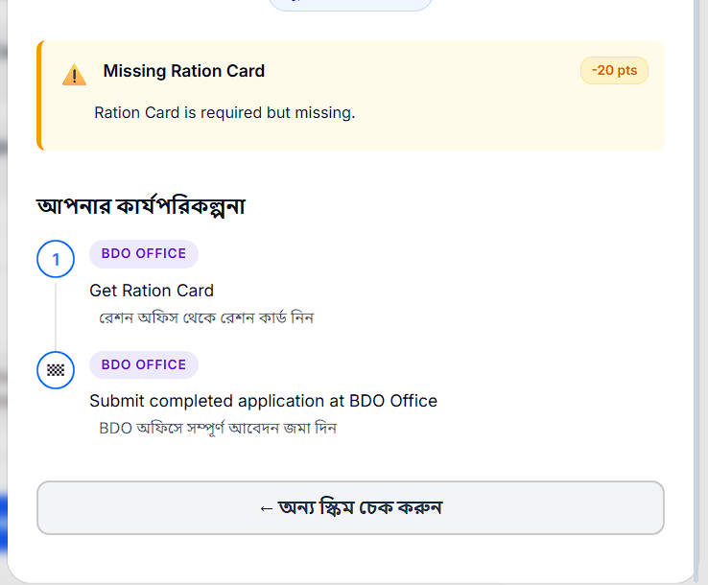
WB Digital Sahayak — Your Digital Friend
WB Digital Sahayak is a voice-first, AI-driven unified eligibility engine for West Bengal citizens. It acts as a "Digital Sahayak" (helper) that speaks Bengali, calculates eligibility deterministically, and provides a Readiness Score before any office visit.
Voice-First: Native Bengali interaction via Sarvam AI
MVP Focus: Lakshmir Bhandar scheme (architecture supports multi-scheme)
Beyond Yes/No: Provides a step-by-step readiness roadmap

Slide 4
Why We Win
How is it different?
How does it solve the problem?
Our USP
Existing portals are text-heavy, English-centric, and require high digital literacy. We are Voice-First AND Deterministic — we don't chat, we calculate.
Zero-Hallucination Architecture: Rules-based eligibility engine + AI explanations. Cross-scheme Intelligence: Eligible for Lakshmir Bhandar → auto-suggest Kanyashree.
Readiness Score (0–100%) ensures citizens visit offices only when 100% prepared, eliminating wasted ₹90-130 travel costs per failed visit.

Slide 5
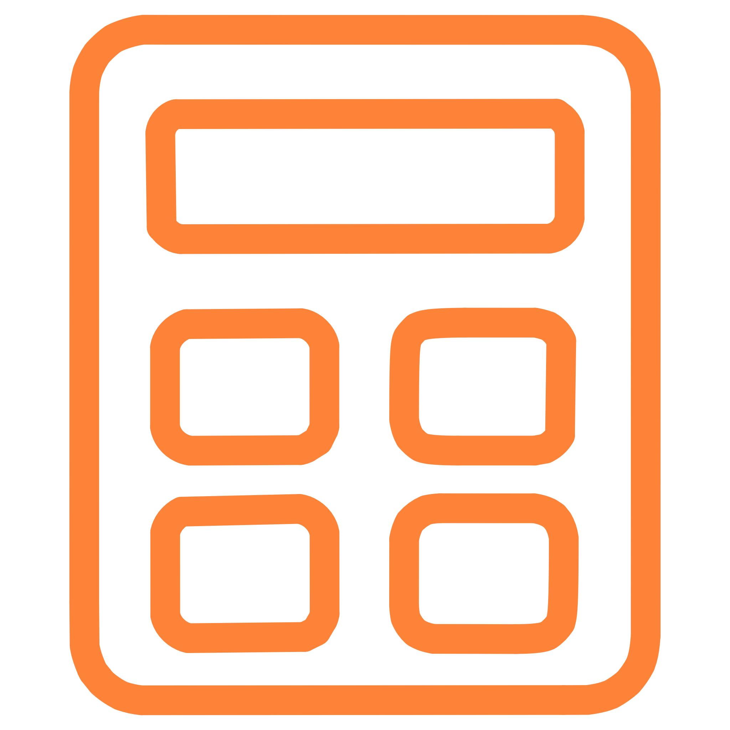


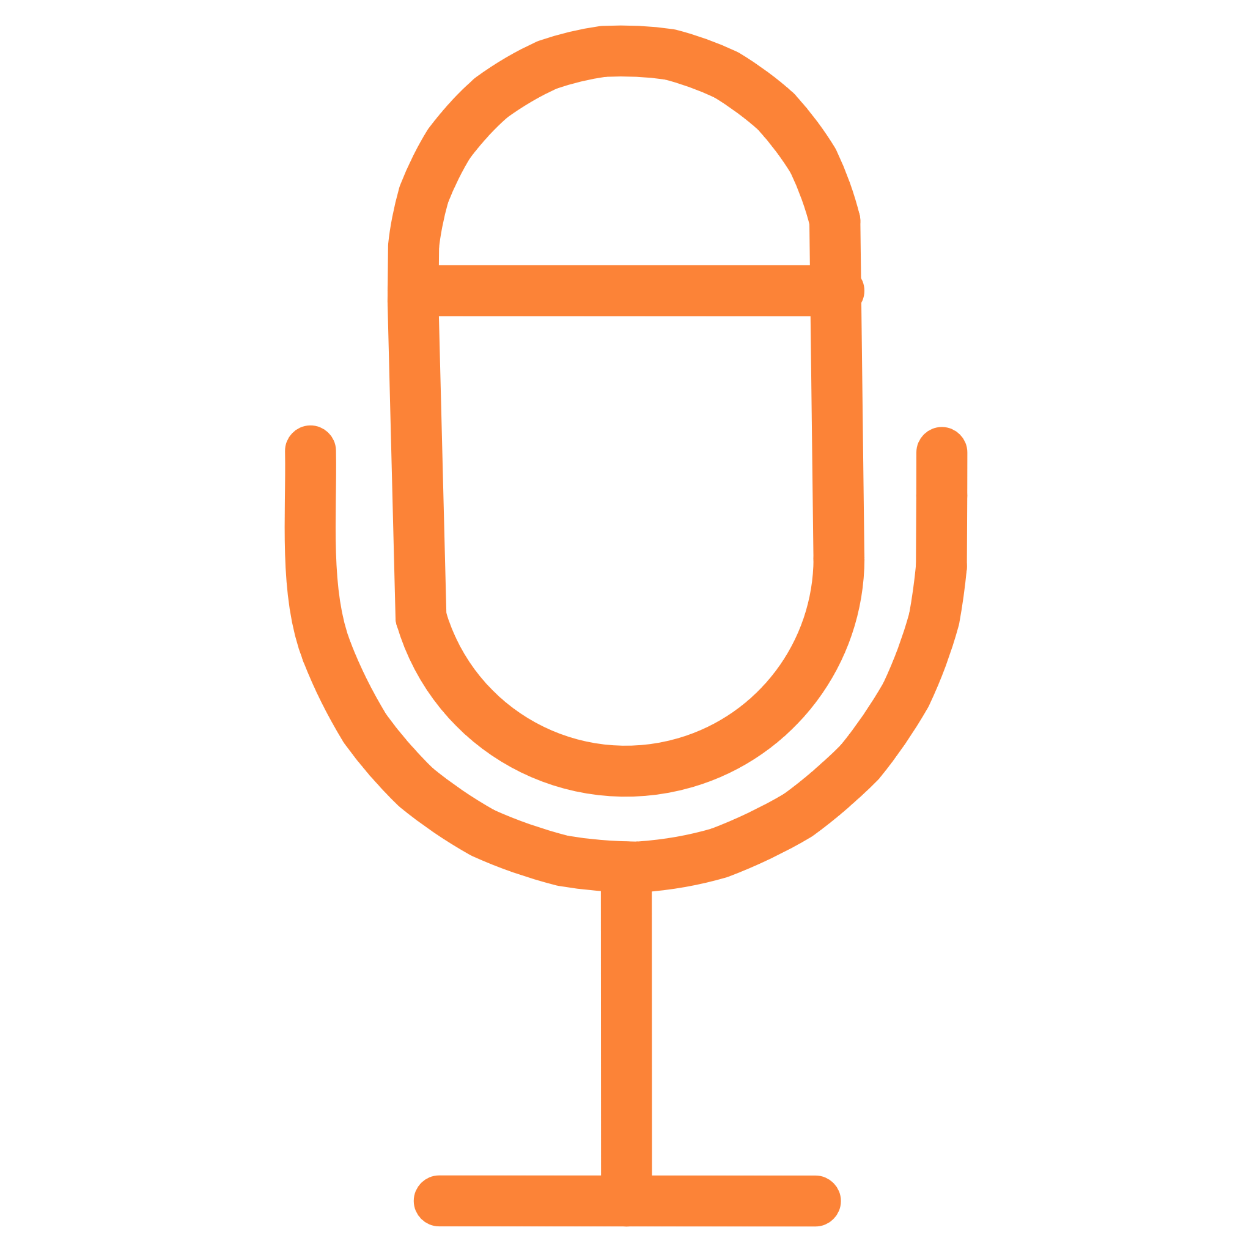

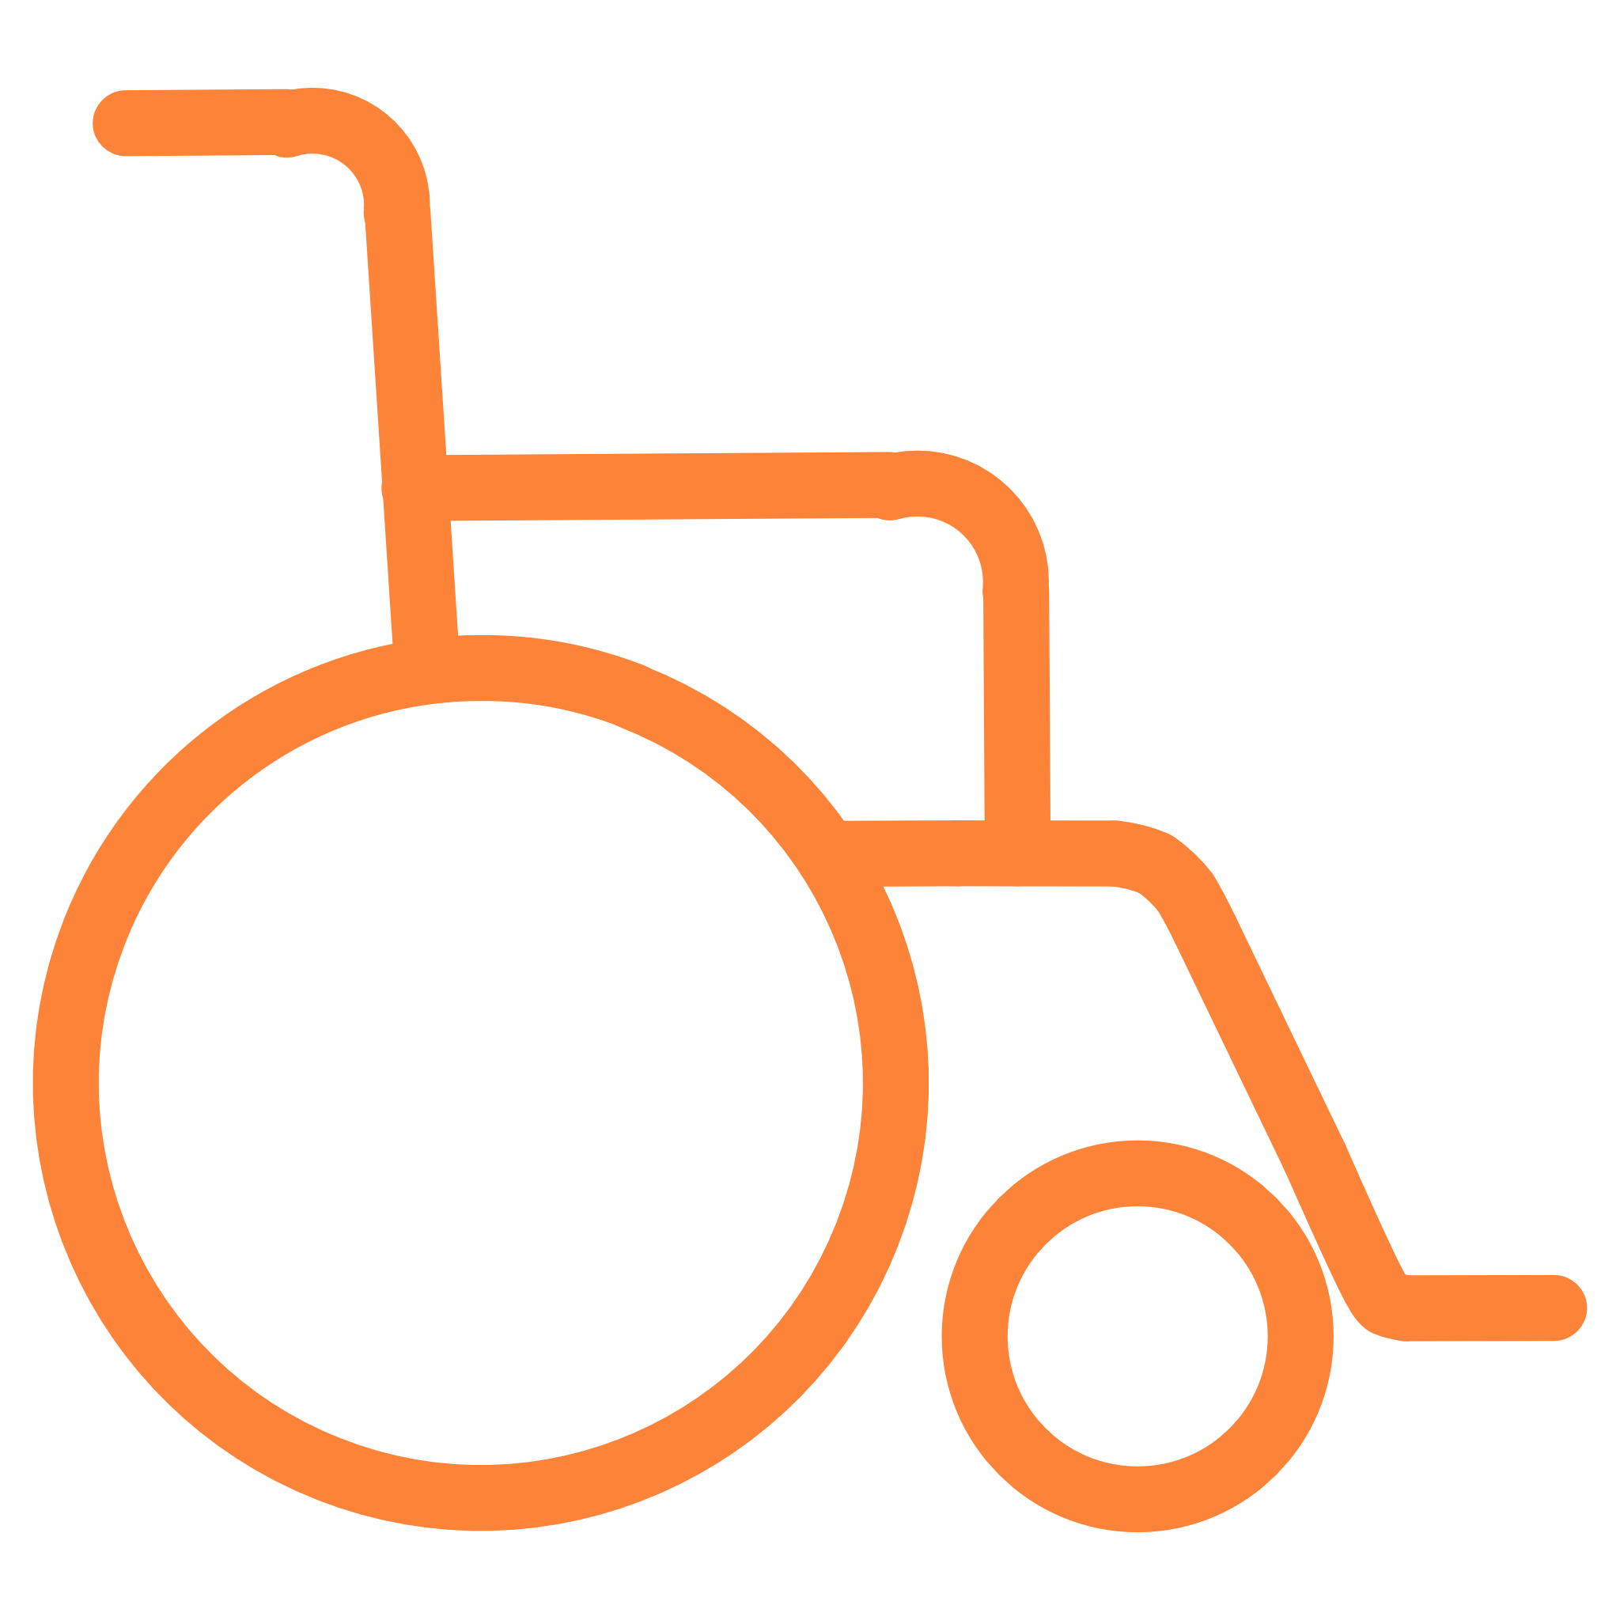
Core Features
Deterministic Eligibility Engine
Readiness Score (0–100%)
Rules-based logic, no AI guessing on eligibility
Real-time application maturity feedback
Missing Document Identification
Voice-First Interface
Tells exactly what's missing (e.g., "Aadhaar not linked")
Sarvam AI Bengali STT/TTS
Proactive Renewal Alerts
Multi-Channel Access
WhatsApp/Voice reminders for expiring benefits
Works on low-end phones via WhatsApp and Web

Slide 6
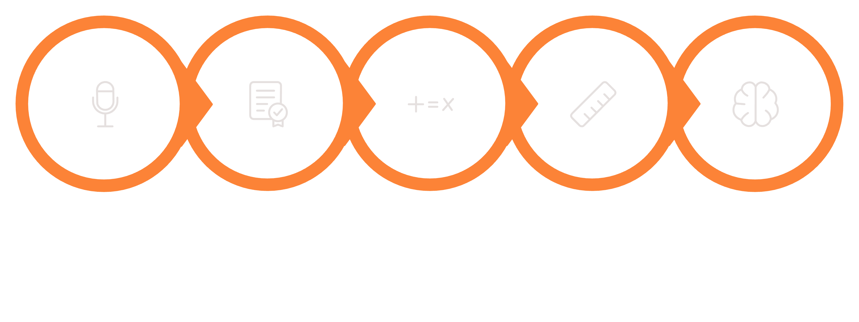


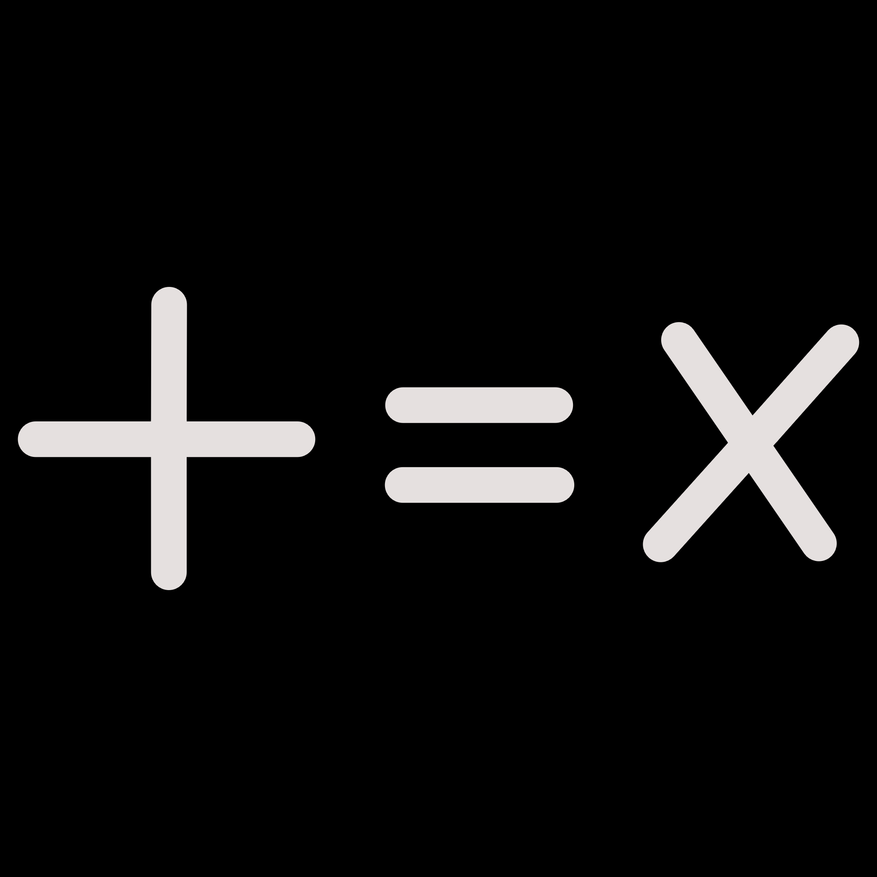


How It Works — End to End
STT Transcription
Intent Extraction
Eligibility Check
Explanation Generation
User Speaks
SARVAM AI
NOVA NANO, MICRO

Slide 7
System Architecture
Interface Layer
Application Layer
Web App, WhatsApp (Twilio), Sarvam AI Voice Widget
AWS API Gateway → AWS Lambda (Python)
Intelligence Layer
Data Layer
Deterministic Rules Engine + Amazon Bedrock (Claude Haiku) + Knowledge Base (S3-backed)
Amazon DynamoDB (user sessions) + Amazon S3 (scheme docs)
Cross-cutting: AWS CloudWatch (monitoring) + AWS IAM (security)

Slide 8
Technology Stack
AI/ML
Indic Voice
WhatsApp
Amazon Bedrock (NOVA Nano & Micro, Titan embed V2)
Sarvam AI — Bengali STT + TTS
Twilio Business API
Compute
Storage
API Layer
AWS Lambda (Serverless)
Amazon S3 (documents) + Amazon DynamoDB (sessions)
AWS API Gateway + Python
Monitoring
AWS CloudWatch + AWS IAM

Slide 9

Cost Analysis — 10,000 Users/Month
$55
$75
$17
$42
Amazon Bedrock
Sarvam AI API
AWS Infrastructure
Twilio WhatsApp
Claude Haiku, 10M tokens (₹4,600)
Bengali STT+TTS (₹6,300)
Lambda + DynamoDB + S3 + CloudWatch (₹1,400)
Business API (₹3,500)
Total: ~$200/month | Cost per Citizen: ₹2/month
Value Return: ₹45–50 saved per avoided failed office visit
Phase 2 Optimization: Switch to Indian WhatsApp provider → Save 50% → $168/month (₹1.40/user)

Slide 10
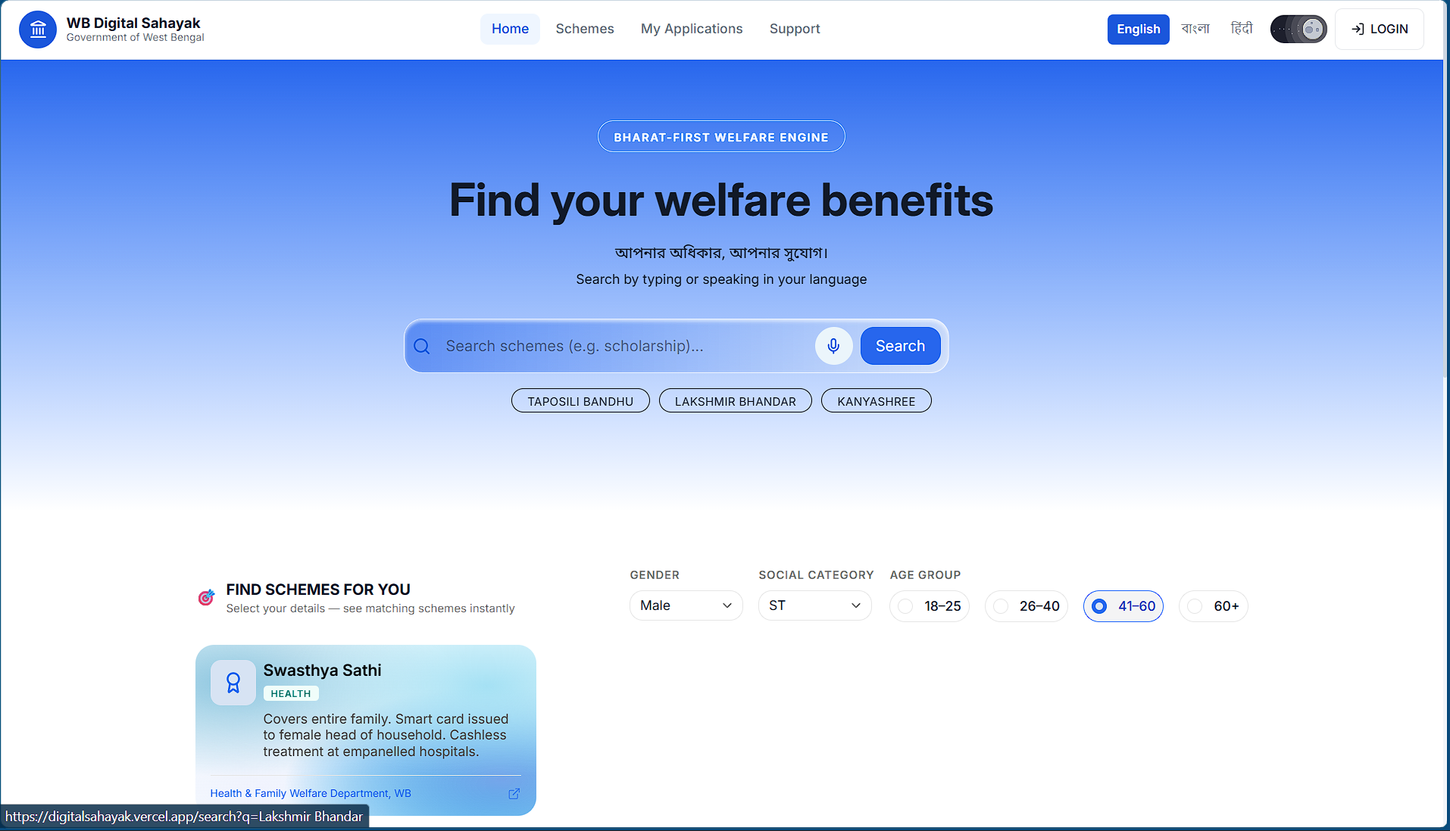
Impact & Roadmap
20-User Proof of Concept
18/20 users found Readiness Score helpful
Average 2.3 documents missing per user identified
90% said they would use it before their next office visit
Estimated ₹90–130 savings per user in travel costs + Daily laboure ~₹400 = ~₹500
10 days faster application process
Roadmap
01
Phase 1 (MVP/Now)
Lakshmir Bhandar, production architecture, 20 pilot users
Scale projection: 10K users → ₹9–13 lakh saved annually
02
Phase 2 (3 months)
4 schemes + DigiLocker integration + Swasthya Sathi
03
Phase 3 (1 year)
20+ WB schemes + tribal dialects (Santali)

Slide 11
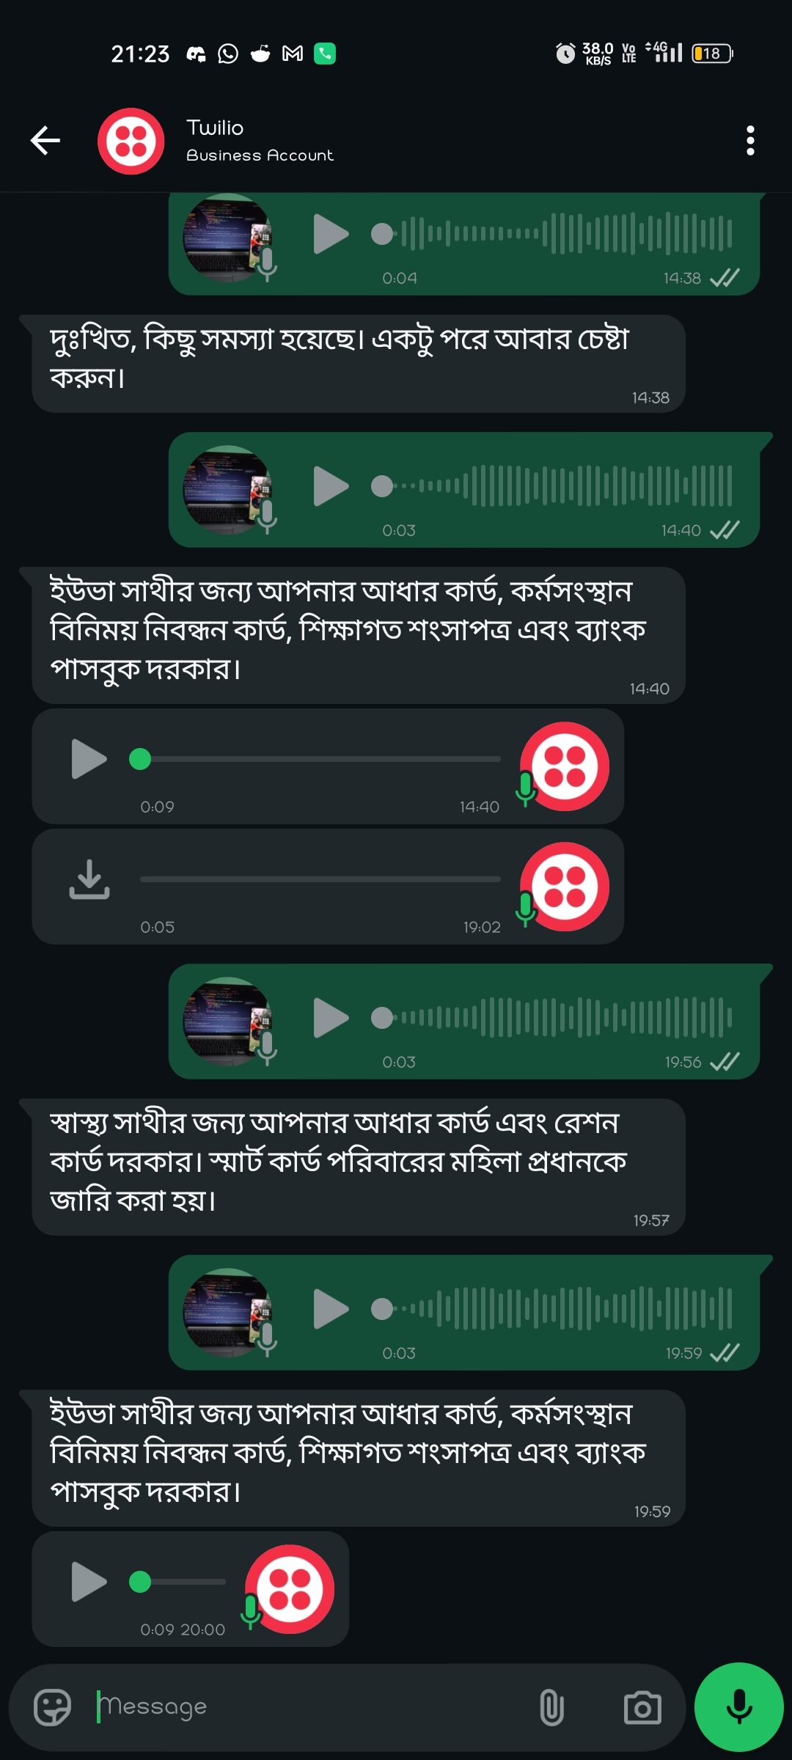

Prototype in Action
From voice query to eligibility assessment in under 8 seconds
User Speaks in Bengali
1
WhatsApp chat interface accepts voice input: "আমি কি লক্ষ্মীর ভান্ডার পাবো?" (Will I get Lakshmir Bhandar?)
Deterministic Eligibility Check
2
System processes query through Sarvam AI, cross-references scheme rules, calculates readiness score: 65/100
Personalized Action Roadmap
3
User receives specific next steps: "Link Aadhaar to bank at nearest CSC" and "Collect Voter ID photocopy"
Fully functional prototype deployed on AWS infrastructure — voice-to-eligibility in under 8 seconds

Slide 12
Risks We've Already Thought Through
Anticipating challenges with scalable solutions
Challenge
Risk Level
Our Mitigation
Bengali dialect variations (rural vs urban)
Medium
Sarvam AI trained on 10+ Bengali dialects; fallback to text if STT confidence < 70%
Scheme rule changes by government
High
Rules stored as versioned JSON in S3 — update without redeployment; admin panel planned for Phase 2
Low smartphone penetration in rural areas
High
WhatsApp works on 2G/basic Android; USSD/IVR fallback planned for Phase 3
User trust in AI for sensitive welfare data
Medium
No PII stored; session-based only; transparent "how we calculated this" explanation shown

Slide 13

Voice is the Great Equalizer
West Bengal does not lack welfare schemes — it lacks accessible verification. WB Digital Sahayak puts a prepared, informed citizen in front of every government officer. We are turning voice into a tool for social justice.
Ready to Deploy
Ready to Scale
Production-ready architecture on AWS
Modular design for 100K+ users
Ready for Bharat
Multi-language support for Phase 2
Team Web | Souvik Karmakar | AI for Bharat Hackathon 2026
GitHub: WB-Digital-Sahayak.git
Demo Video: Video

Slide 14
