Slide 1

ETL
Easy to learn

Slide 2

21CE144- Param Thummar 21CE152 – Dhruv Vekariya
Our Team

Slide 3

Problem VS Solution
Problem:
Can’t get knowledge of every different field at one platform which is absolutely free !!!
If any person wants to start his teaching career than it is difficult to operate , maintain and built new platform , it takes more cost.

Slide 4
Problem VS Solution
Solution :
We are providing free platform that will help learner to learn from experts and get advance quality knowledge.
ETL provides some advance features for free , and it saves much more time , energy of experts as well as learners .

Slide 5
Feature
Feedback for each of the channel.
User Authentication & Quick notification.
Sign-in & Sign-up & User profile
Faculty can make their own channel for teaching.
Student can visit and learn from every channel.

Slide 6

What we have done
Homepage
Experts Login Page
Learns Login Page
Expert Profile
Learner Profile
Expert Registration Form
Learner Registration Form
First Skill
Second Skill

Slide 7

Home Page

Slide 8
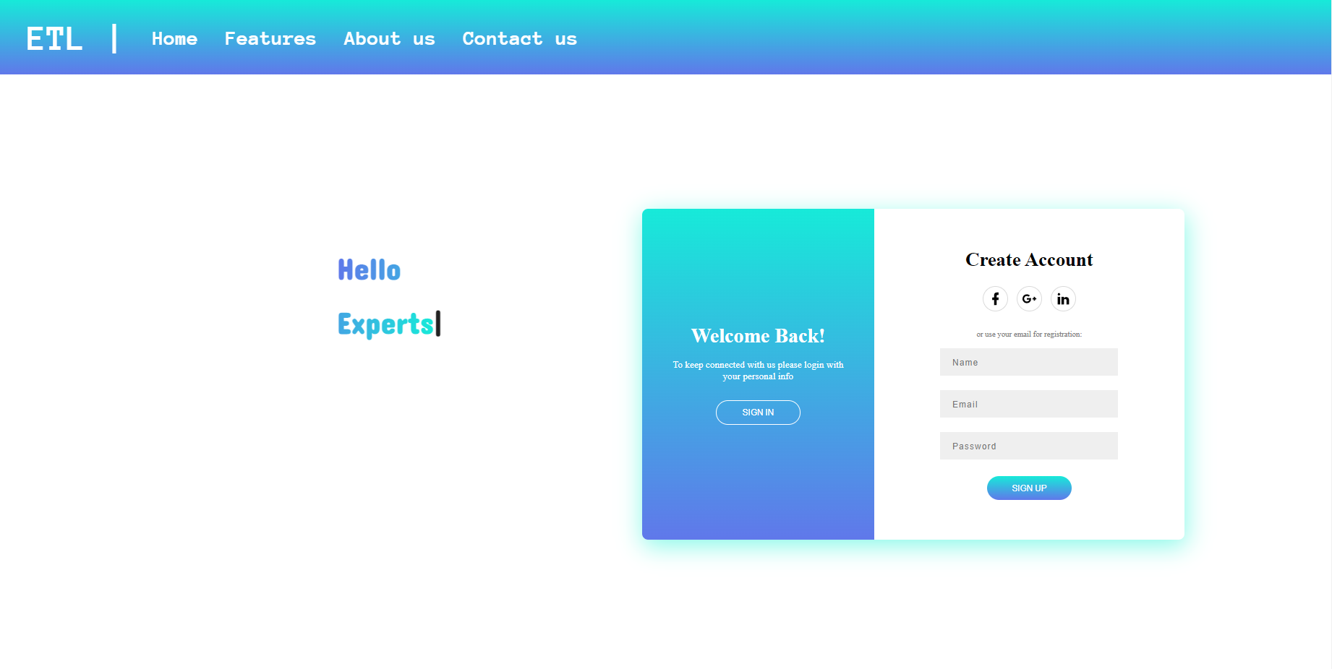
Experts Login Page

Slide 9
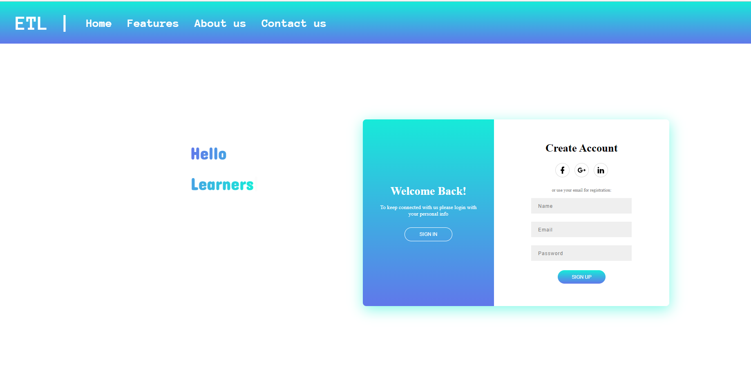
Learners Login Page

Slide 10
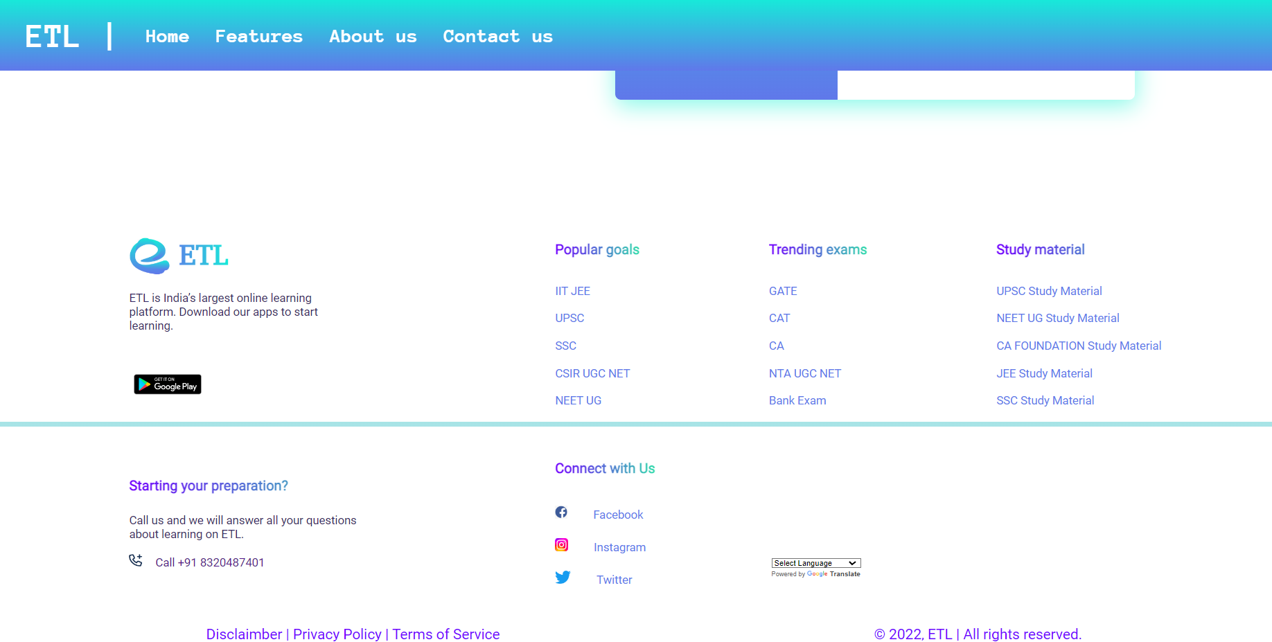
Footer(Contact Us)

Slide 11
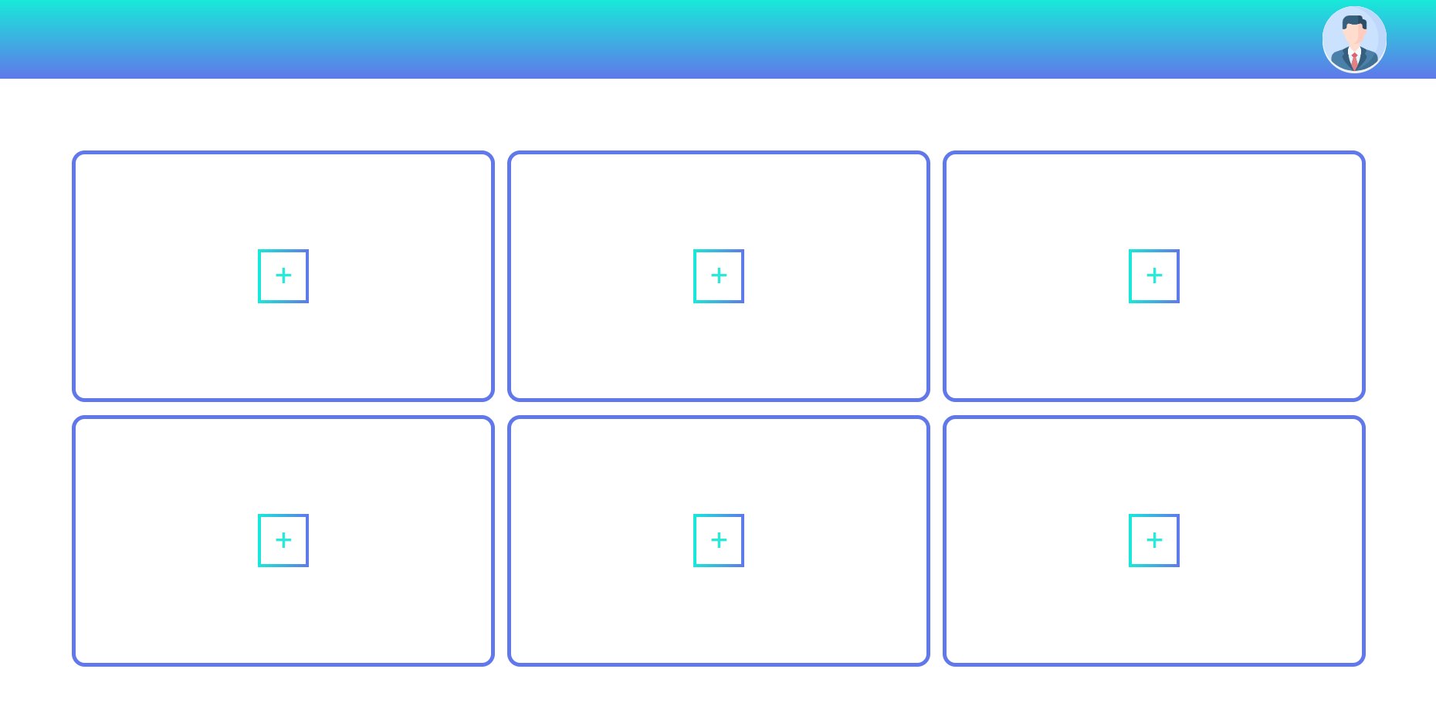
Expert Profile

Slide 12
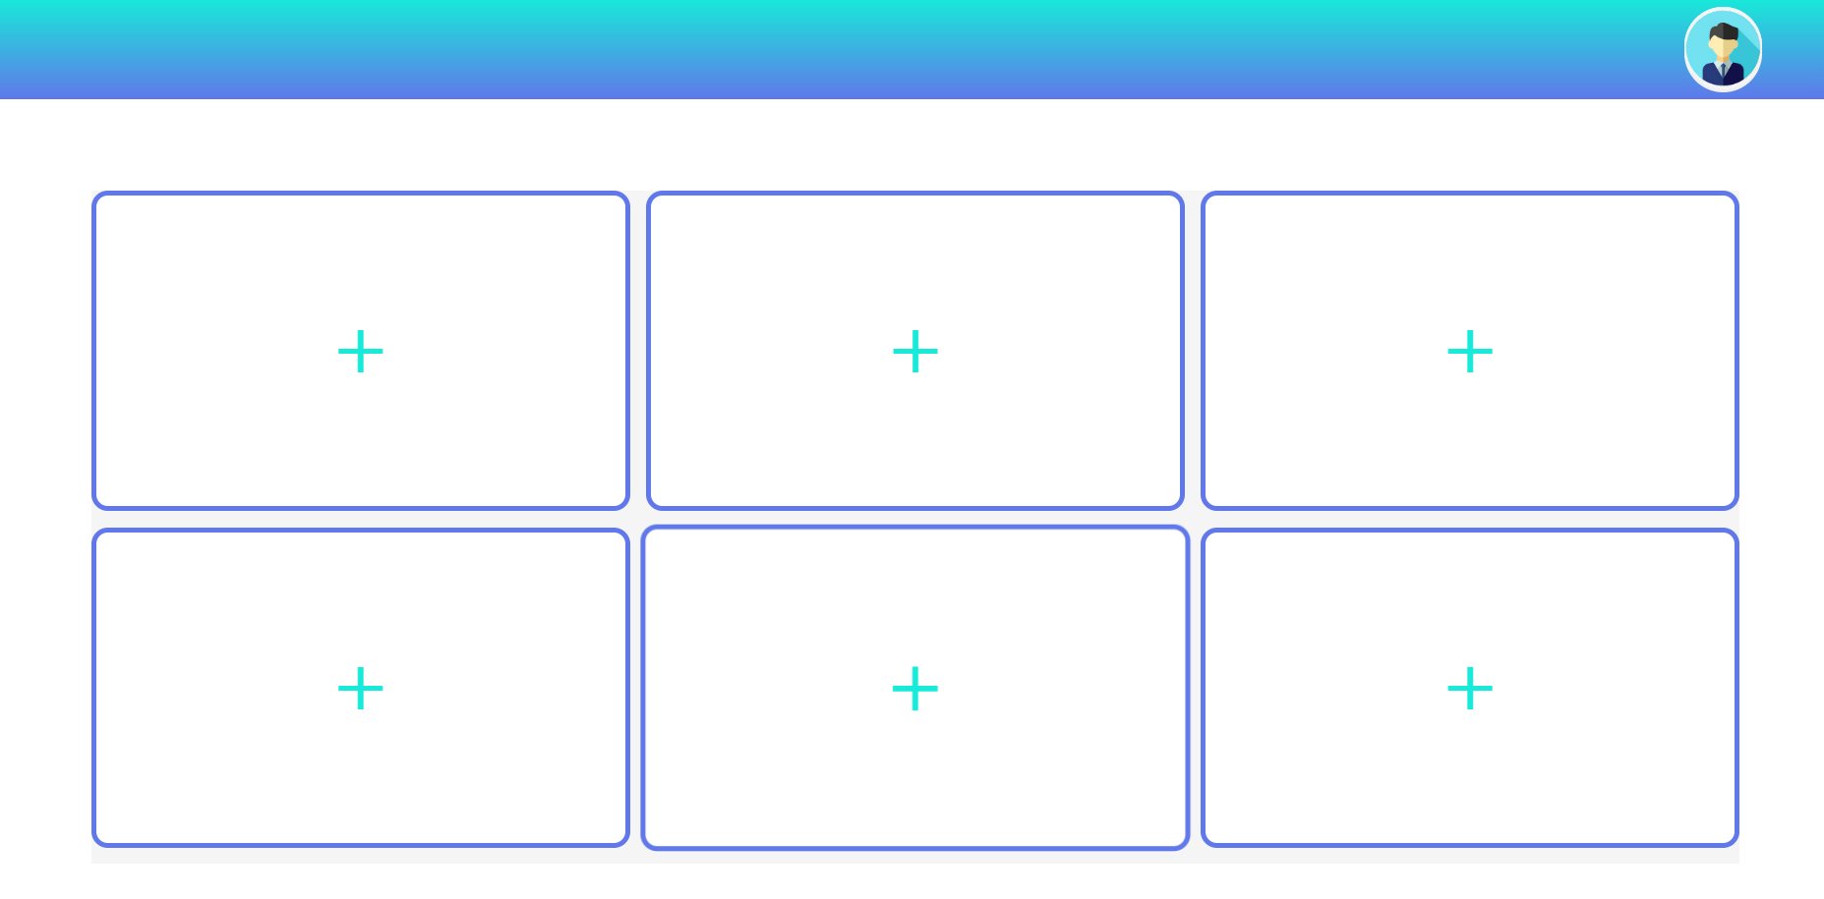
Learner Profile

Slide 13
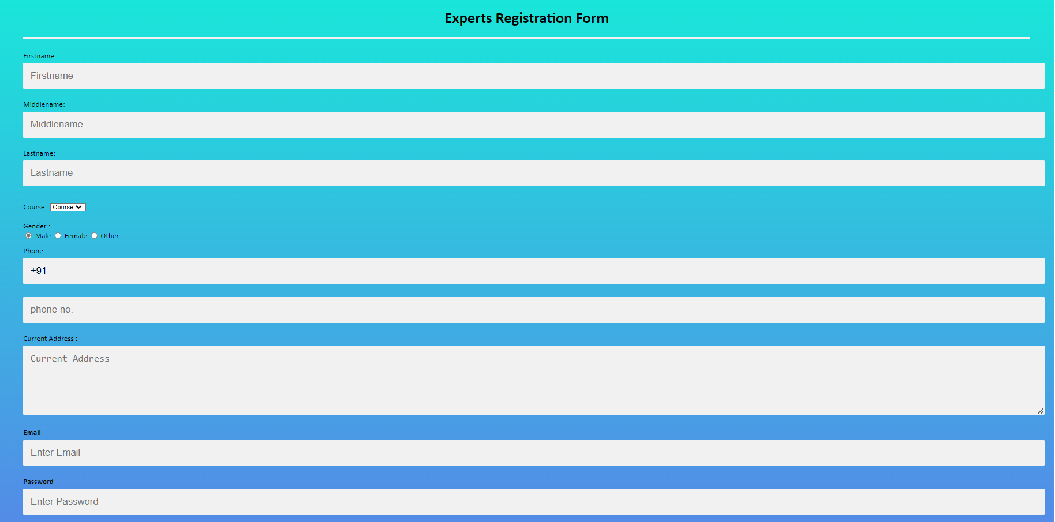
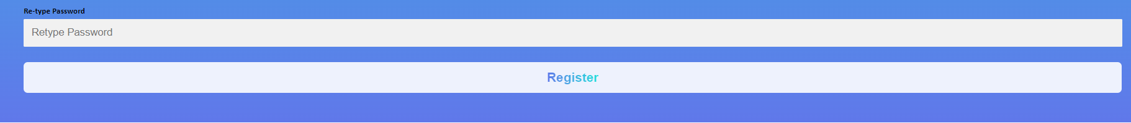
Expert Registration Form

Slide 14
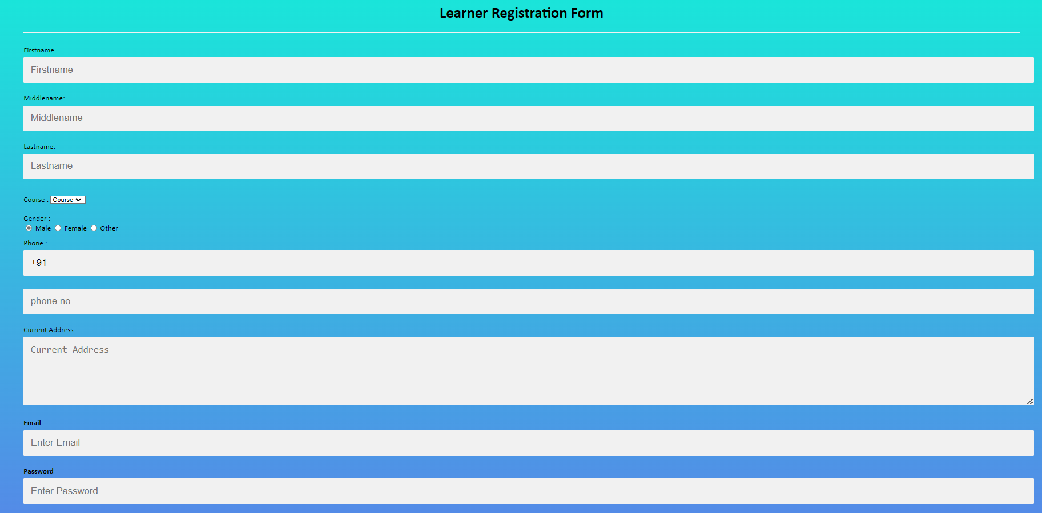
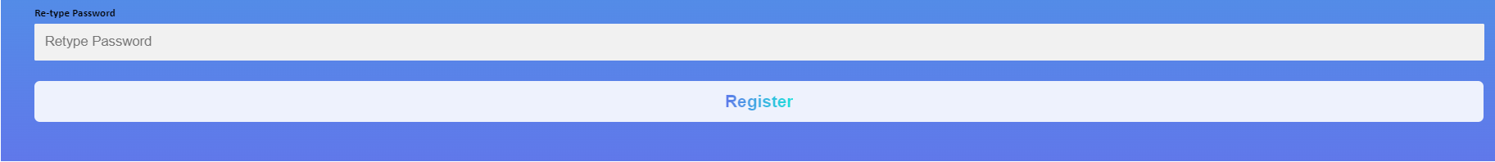
Learner Registration form

Slide 15

Thank You
Faculty Name :
Dhruvi MAm
21CE144 - param thummar
21CE152 - Dhruv Vekariya

