Slide 1
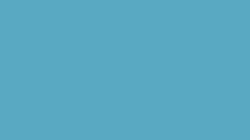

A compact inertial datalogger

Slide 2
What does it measure?
measured: calculated:
Acceleration (g)
Orientation (quaternions)
Time (ms)
GPS (x,y,z)
Rotational Speed (degrees second ⁻¹)
Velocity (ms⁻¹)
Displacement (m)

Slide 3
What's so special?
Small & Accurate
Most recorders professional or amateur either have 1 or the other.
Vertigo has both.

Slide 4
What are we doing?
The raw data on its own is completely useless.
Problems that occurred which we solved:
Sensors produce a drift
Sensors produce lots of noise

Slide 5
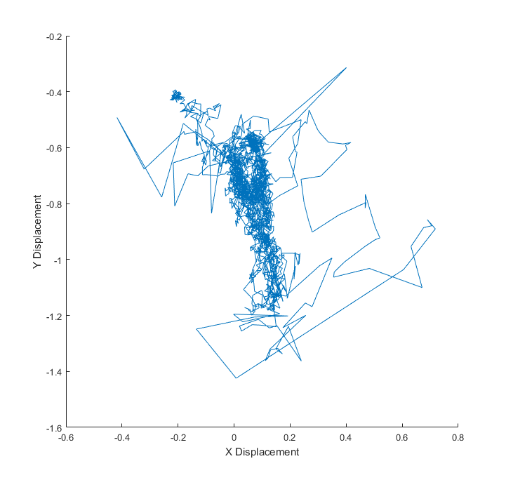
Raw Data

Slide 6

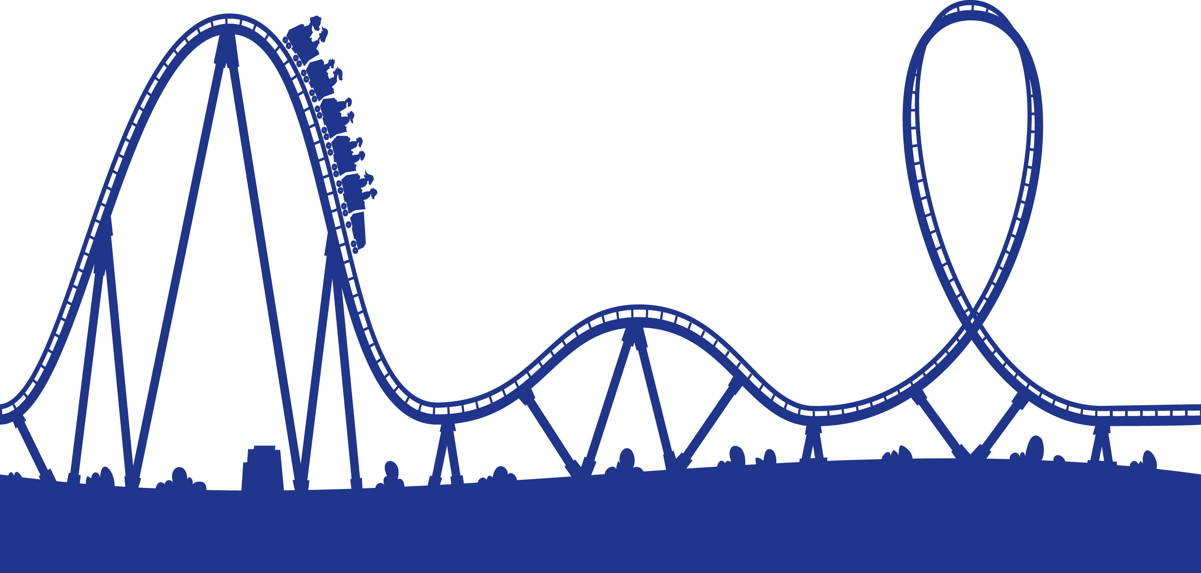
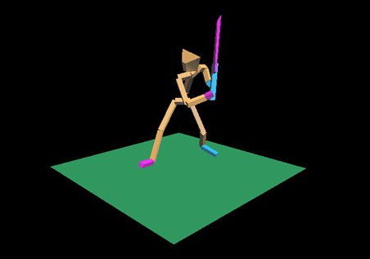
Possible Applications
Rollercoaster Safety
Analysing sporting technique
Flight path analysis
The real world applications are endless.

Slide 7
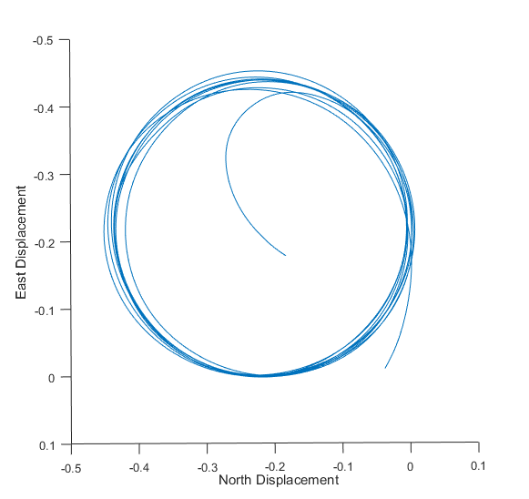
After

Slide 8
Side-by-side Comparison
Raw Data After

