Slide 1

A chemical equations solver game

Slide 2
Table of contens
1. Our team
2. Our idea
3. Stages of realization
4. Used technologies

Slide 3

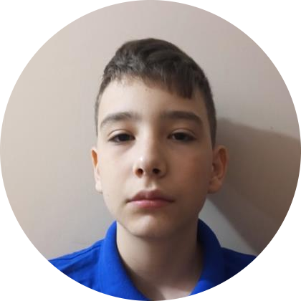
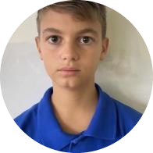

Our team
Stoyan Skuliev Scrum Trainer 10G
Angel Angelov Backend Developer 10A
Vicho Vichev Backend Developer 10V
Dimitar Byandov Frontend Developer 10B

Slide 4
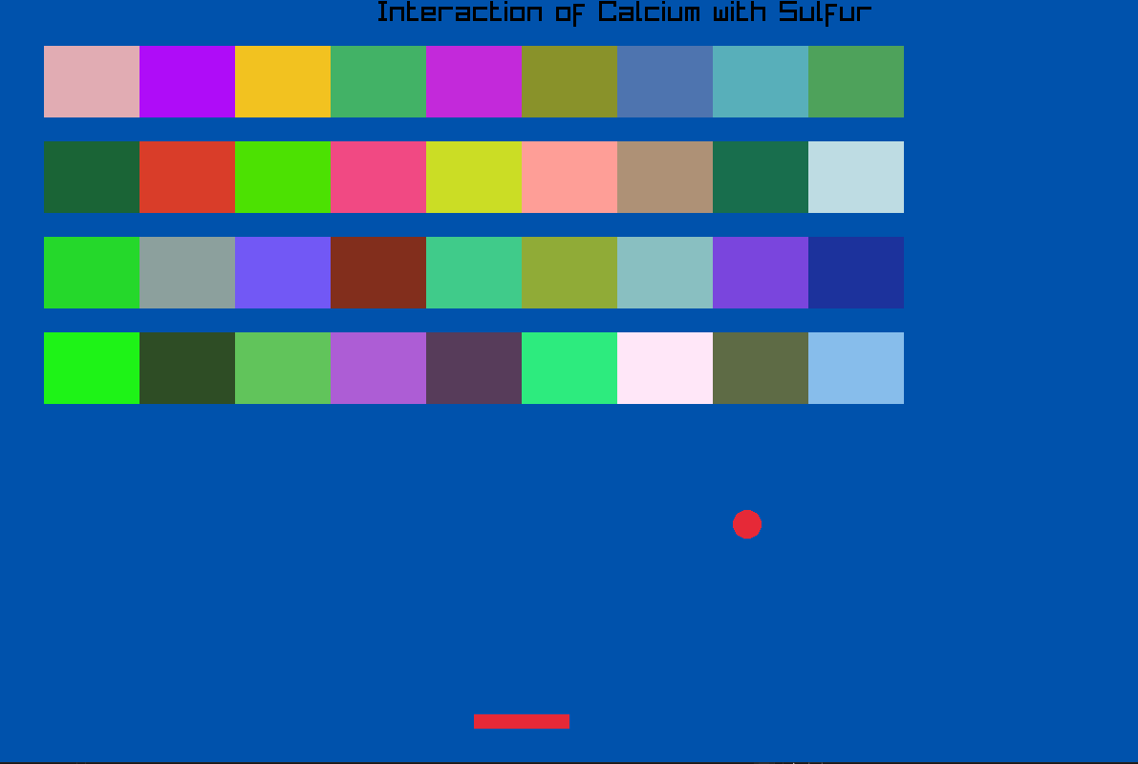
Our idea
Our idea was to make a chemical equations solver game where you solve equations while playing a block breaker game

Slide 5
Stages of realization
1. Distribute the roles
2. Invent an idea
3. Realization of the idea
4. Present the project

Slide 6








Used technologies

Slide 7
Now let’s jump to the game!

