Slide 1
Davs
An app for testament

Slide 2
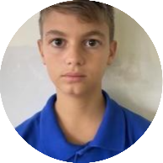
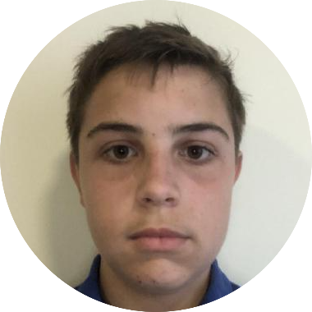
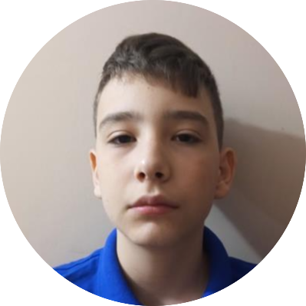
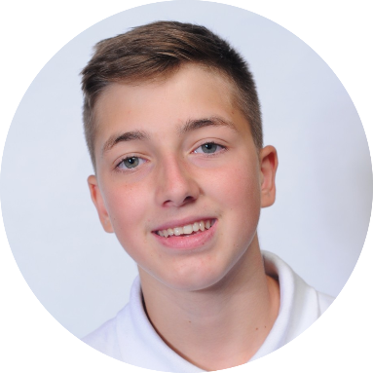
Our team
Vicho Vichev Backend Developer 10V
Stoyan Skuliev Scrum Trainer 10G
Angel Angelov Backend Developer 10A
Dimitar Byandov Frontend Developer 10B

Slide 3
Our idea

Slide 4
Stages of realization
Distribute the roles
Invent the idea
Realization of the idea
Present the project

Slide 5








Used technology

Slide 6
Now let’s jump to the app

