Slide 1
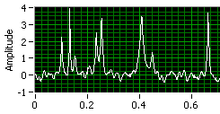
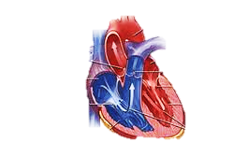
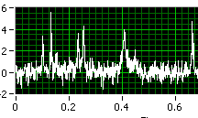

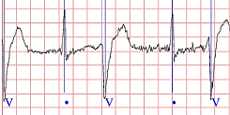
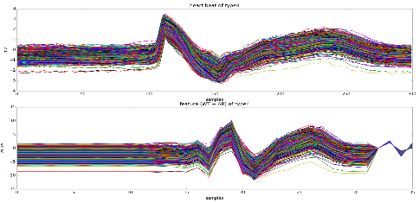
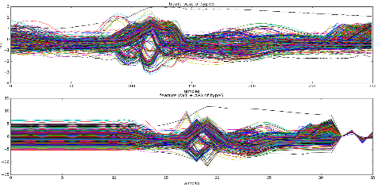
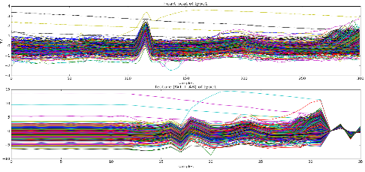
Disease Detection and Prediction Sunil Mandhan
Problem How to be aware and prepared for deadly diseases well in advance
Value Proposition A product targeted for wearables empowering its users to detect and predict life threatening health issues
Technology
Future Plan Prototype 1: Detection of heart arrhythmia from ECG signals Prototype 2: Prediction of heart arrhythmia & relevant recommendations to the users Final Stage: Detection & Prediction of other Diseases based on ECG signals
Wavelet Transform
Raw ECG
Heart Beat Recognition
AR Modeling
SVM Classification
Reference
[1] MIT-BIH Arrhythmia Database - https://physionet.org/physiobank/database/mitdb
[2] B. Vuksanovic, M. Alhamdi, “Analysis of Human Electrocardiogram for Biometric Recognition Using Analytic and AR Modeling Extracted Parameters", International Journal of Biometrics and Bioinformatics (IJBB), Vol. 9, November 2015
[3] ECG feature extraction and classification using wavelet transform and support vector machines Zhao, L Zhang
2005 International Conference on Neural Networks and Brain 2, 1089-1092
Supervised ML (SVM) learning – on limited available data

