Slide 1
Kernelized locality Sensitive Hashing for Scalable Image Search
May, 2013
Presenter: Sunil Mandhan

Slide 2
Agenda
Problem Background Part 1
Problem Background Part 2
Problem Statement
Solution Design using KLSH
KLSH Algorithm
Accuracy Analysis
Speed Analysis
Observations and Parameters
Q&A

Slide 3
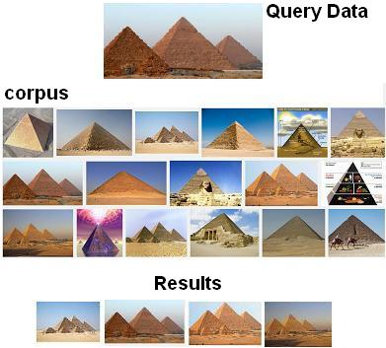
Problem Background Part 1
Use Case – Content based image search

Slide 4
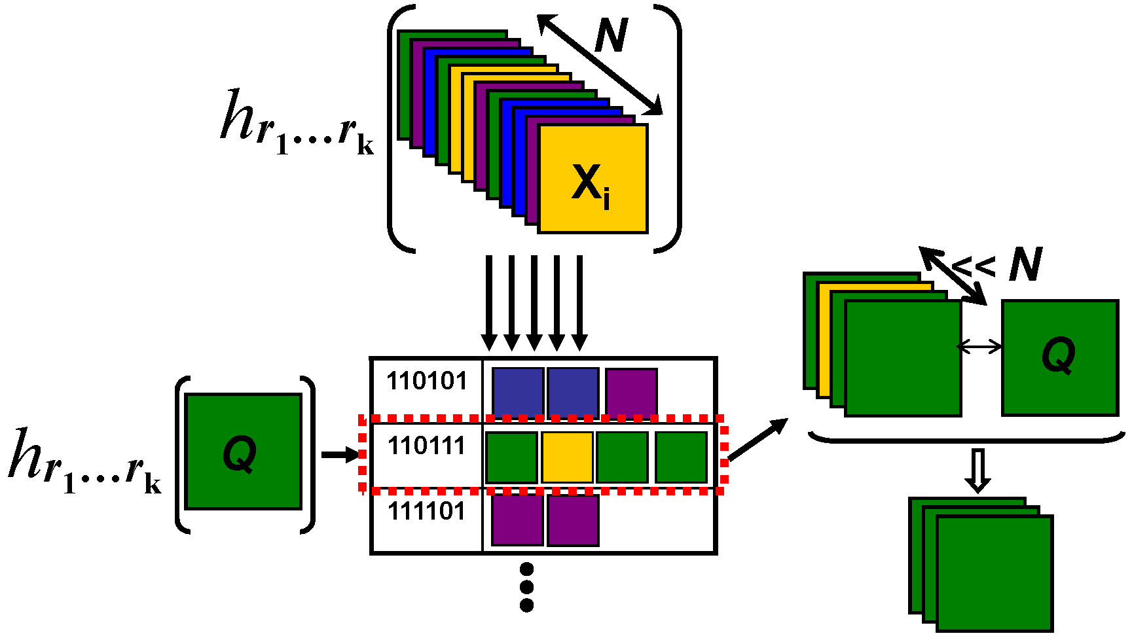
Problem Background Part 2
Many Algorithms convert high dimensions data to low dimensions, perform linear search.
Locality Sensitive Hashing also handles the use case with sub-linear search guarantee

Slide 5
Problem Statement
Why we need yet another method
Existing algorithms don’t apply to kernelized data with unknown feature embedding
Kernelized Locality Sensitive Hashing (KLSH) handles this new use case and generalizes LSH to arbitrary kernel functions

Slide 6
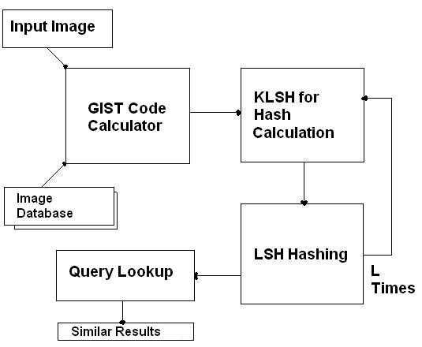
Solution Design Using KLSH
GIST descriptor was used for image’s features extraction
Hash codes were received by KLSH
L permutation for KLSH hash codes were performed
L bins were searched for similar images to query
Matlab used for code

Slide 7
KLSH Algorithm
Select P data points and make a kernel matrix over those points. In this solution, Gaussian kernel was used
Center the kernel matrix
Form E_S by selecting random t points from [1, …, p]
Form w = K^{(-1/2)} * E_S
H( data(i) ) = sign( ∑_{i} w(i) * kernel(x, x_{i}) )
Hash key from k hash functions, [h₁, h₂, … , h_{k}]

Slide 8
Accuracy Analysis
Accuracy is analyzed w.r.t. results from linear search that used Euclidian distances
Average accuracy over 50 runs was ~65%

Slide 9
Speed Analysis
On average, all the searches took less than .3 seconds. The database size was in range of 50 to 450 images.
Performance was more or less same as linear search because hashing was expensive
Results could be improved by spending more time in formulating hashing method and avoiding the loops in calculations.

Slide 10
Observations and Parameters
Images from Caltech 101 object categories were used for testing the solution
GIST descriptor features were highly successful where clear structural boundaries were present in images
640 dimensions were working much better than 384 or 512 d GIST features vectors
L = 200, b = 300, and t = 30. lesser values than the noted ones are not recommended

Slide 11
Q&A
Discussion

Slide 12
References
Publications and Papers
Kernelized Locality-Sensitive Hashing for Scalable Image Search, Brian Kulis & Kristen Grauman In Proc. 12th International Conference on Computer Vision (ICCV), 2009
Similarity Estimation Techniques from Rounding Algorithms, M. Charikar, Proc. ACM Symp. Theory of Computing,2002.
Locality-sensitive hashing for finding nearest neighbors, M Slaney, M Casey - Signal Processing Magazine, IEEE, 2008
Similarity Search in High Dimensions via Hashing, A. Gionis, P. Indyk, and R. Motwani, Proc. 25th Int’l Conf. Very Large Data Bases,1999.
General links
http://www.cse.ohio-state.edu/~kulis/klsh/klsh.htm -KLSH Engine
http://www.vision.caltech.edu/Image_Datasets/Caltech101/
http://infolab.stanford.edu/~ullman/mmds.html
http://www.mit.edu/~andoni/LSH/
http://people.csail.mit.edu/torralba/code/spatialenvelope/ - GIST Source Code

