Slide 1
Transclusion
Kyle Yu

Slide 2
Transclusion
Previous chapters
How directives affects HTML by template, binding, and plugins.
This chapter
Transclusion allows original content to impact directives

Slide 3
Not a word
Not in dictionary
Inclusion
In a template, repeated code snippets
Don’t repeat yourself
Include
Templating
Parse dynamic variables

Slide 4
…it a solution
Create widget in a isolated scope
Tunnel back out into the parent scope to parse the original content

Slide 5
code in book (1)
<body>
<div>
<input type="text" ng-model="name" />
<select ng-model="movie">
<option value="Man Of Steel">Superman</option>
<option value="A New Hope">Star Wars</option>
</select>
<input type="number" ng-model="friendCount" />
</div>
<div movie-info="movie">
<p>Hi, I'm {{name}}, and I'm going to see {{movie}} with {{friendCount}} friends</p>
</div>
</body>

Slide 6
code in book (1)
angular.module('myApp', [])
.directive('movieInfo', function () {
return {
template : '<div class=”movie-info”>' +
'<h1 class=”movie-title”>{{name}}</h1>' +
'<img class=”movie-poster” ng-src=”posters/{{name}}.jpg” />' +
'<div ng-transclude></div>' +
'</div>',
transclude : true,
scope : {
'name' : '=movieInfo’
}}});

Slide 7
code in book (1)
<body>
<div>
<input type="text" ng-model="name" />
<select ng-model="movie">
<option value="Man Of Steel">Superman</option>
<option value="A New Hope">Star Wars</option>
</select>
<input type="number" ng-model="friendCount" />
</div>
<div movie-info="movie">
<p>Hi, I'm {{name}}, and I'm going to see {{movie}} with {{friendCount}} friends</p>
</div>
</body>
<div class=“movie-info”>
<h1 class=”movie-title”>{{name}}</h1>
<img class=”movie-poster” ng-src=”posters/{{name}}.jpg” />
<div ng-transclude><p>Hi, I'm {{name}}, and I'm going to see {{movie}} with {{friendCount}} friends</p></div>
</div>
Notes:
藍色自己跑
紅色插入

Slide 8
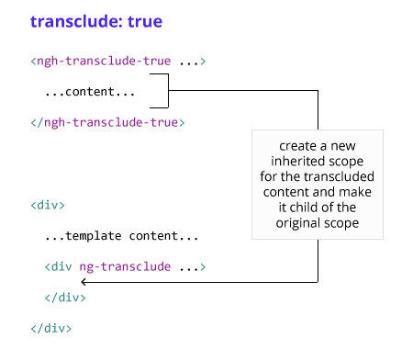
transclude: true

Slide 9
code in book (2)
<div class="post">
<h2 class="post-header">
<span class="title">{{postTitle}}</span> |
<span class="author">{{author}}</span>
<span class="date">{{formattedDate}}</span>
</h2>
<div class="content">...</div>
</div>
Change the DOM
<div class="post-header">
<span class="date" style="display:none;">{{formattedDate}}</span>
<h2 class="title">{{postTitle}}</h2>
<span class="author" style="display:none;">{{author}}</span>
</div>

Slide 10
code in book (2)
angular.module('myApp', []).directive('postHeader', function () {
return {…
transclude : 'element’
controller : function ($scope, $element, $attrs, $transclude) {
$transclude(function (clone) {
clone.removeClass('post-header');
var title = clone.find('.title').text();
var dateEl = clone.find('.date’).hide();
var authorEl = clone.find('.author’).hide();
$element.append(dateEl).append('<h2 class="title">'+title +'</h2>’)
.append(authorEl);});
$element.waypoint(function () {
$element.find('.date, .author').fadeIn();
});
}}});

Slide 11
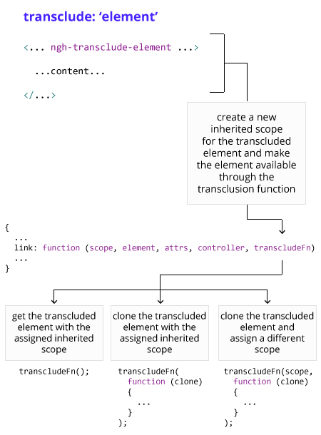
transclude element

Slide 12
Thank you

Slide 13
Reference
http://www.angularjshub.com/examples/customdirectives/transclusion/
http://plnkr.co/edit/eydYuG5LGCQJBzsBJDJB?p=preview
http://plnkr.co/edit/yFLe7OXj2u8epHXe6a0s?p=preview

