Slide 1

Introduction
Roxanne Chang
roxanne_chang@trend.com.tw

Slide 2
Purpose of this sharing
Share how to use AngularJS.
Share AngularJS structure and components.
Ability
Learning Time

Slide 3
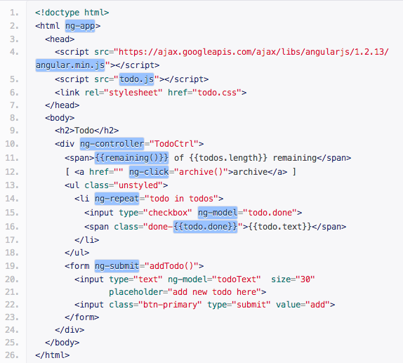
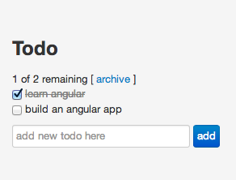
HTML enhanced for web apps!
Lets you extend HTML vocabulary.
The resulting environment is expressive, readable, and quick to develop.

Slide 4
MVC Sturcture
Model: Plain Javascript.
View: HTML template (including custom components) bound to model.
Controller: Exposes the model to the view by setting on $scope which is watched for changed.

Slide 5
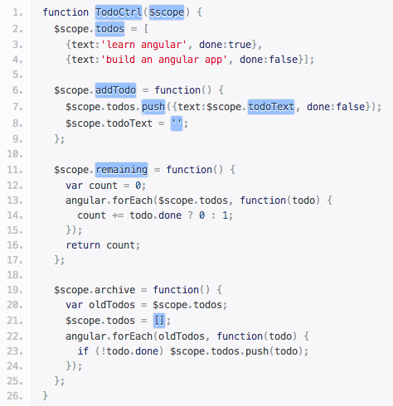
MVC Structure
$scope
(Model)
View
Controller

Slide 6
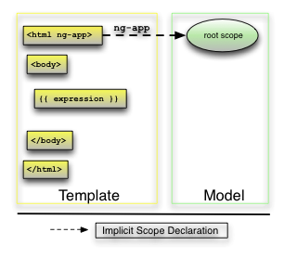
Use ng-app to include a Module and Start it

Slide 7
Use ng-controller to link View and Controller
$scope
todo
addTodo
remaining

Slide 8
Use ng-repeat as a loop Use {{expression}} to show value

Slide 9
Result

Slide 10
It’s our turn

Slide 11
Start to use AngularJS
Include AngularJS library.
Create an AngularJS module.
Design your template and model.
Create a controller.
Link template and controller.

Slide 12
Start to use AngularJS
Include AngularJS library.
<script src=“https://ajax.googleapis.com/ajax/libs/angularjs/1.2.13/angular.min.js”></script>
Create an AngularJS module.
Design your template and model.
Create a controller.
Link template and controller.

Slide 13
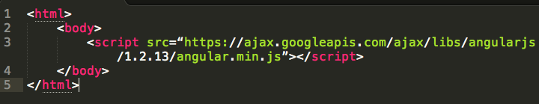
1. Include AngularJS library

Slide 14
Start to use AngularJS
Include AngularJS library.
Create an AngularJS module.
html: ng-app=‘helloApp’
javascript: angular.module(‘helloApp’, []);
Design your template and model.
Create a controller.
Link template and controller.

Slide 15
Use ng-app to include a Module and Start it

Slide 16
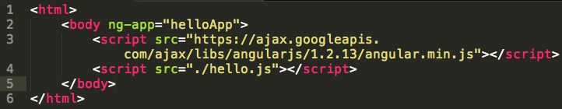
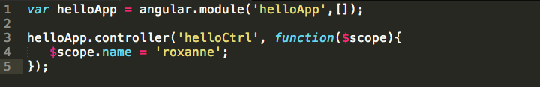
2. Create an AngularJS module
index.html
hello.js

Slide 17
Start to use AngularJS
Include AngularJS library.
Create an AngularJS module.
Design your template and model.
Create a controller.
Link template and controller.

Slide 18
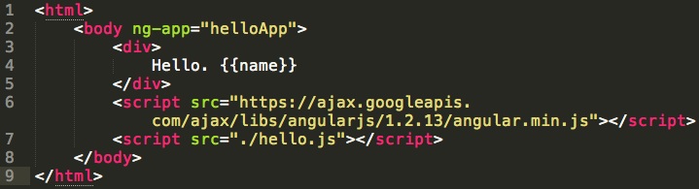
3. Design template and model
index.html

Slide 19
Start to use AngularJS
Include AngularJS library.
Create an AngularJS module.
Design your template and model.
Create a controller.
Link template and controller.

Slide 20
4. Create a controller
hello.js

Slide 21
Start to use AngularJS
Include AngularJS library.
Create an AngularJS module.
Design your template and model.
Create a controller.
Link template and controller.

Slide 22
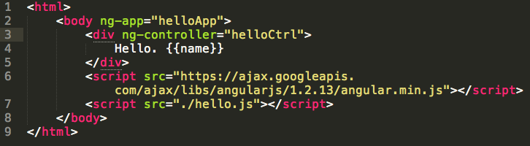
5. Link template and controller
index.html

Slide 23
Easy ? Let’s add something more…

Slide 24
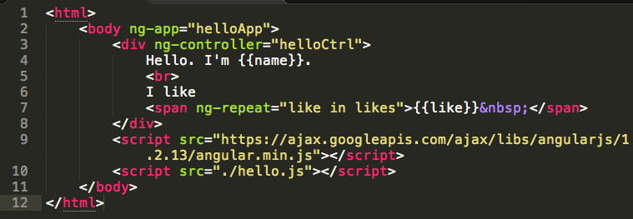
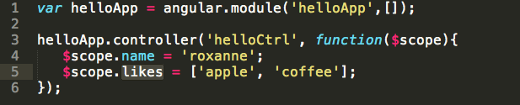
ng-repeat: add some introduction…
index.html
hello.js

Slide 25
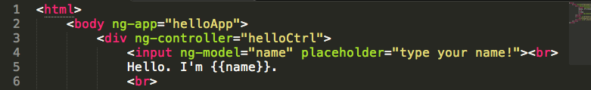
ng-model: interactive with the DOM
index.html
no need to do anything in controller !

Slide 26

Result

Slide 27
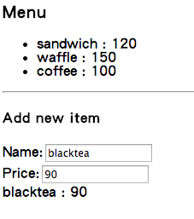
Your Turn
Implement an webpage as the left picture with AngularJS.
Use ng-repeat, ng-model
Hint:
$scope.menu = [
{…},…
];
$scope.newItem = {…};
http://docs.angularjs.org/api

Slide 28
How does it happen ?

Slide 29
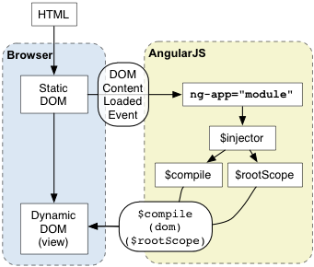
AngularJS bootstrap
Notes:
當 dom Content loaded event 觸發後， angular 會開始尋找 ng-app，ng-app 就是你的app 的root,
在找到 ng-app 後，angularjs 會把 ng-app 指定的module load 進來，
再建立 injector application，($inject 的作用是取得module 內要用到的 物件的實體，像是service, dependency module..
$compile ng-app 指定的DOM，並以此DOM 元素為編譯的開始點。

Slide 30
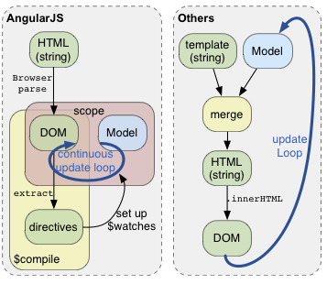
Become what we saw (comparision)
Notes:
The AngularJS $scope variable acts as a big key/value storage hash which is internally looped on a timeout interval and dirty checked against it's former value(s) each time a digestion occurs.

Slide 31
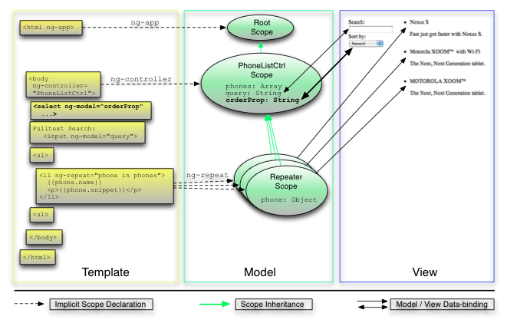
Something about $scope

Slide 32
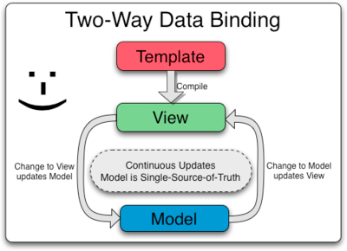
Become what we saw
Notes:
http://docs.angularjs.org/guide/compiler

Slide 33
It is not the end

Slide 34
Except MVC…
Extend view (HTML) ability – Directive.
Provide service between controllers – Service, Factory, Provider.
Format the data in view – Filter.
Actually AngularJS’s unit is – Module.
Dependency Injection:
Module can include 3rd party modules.
Controller can include other services.

Slide 35
AngularJS App Structure
Module
3rd party Module
$scope
(Model)
View
Controller
Directives
Services*
Filters

Slide 36
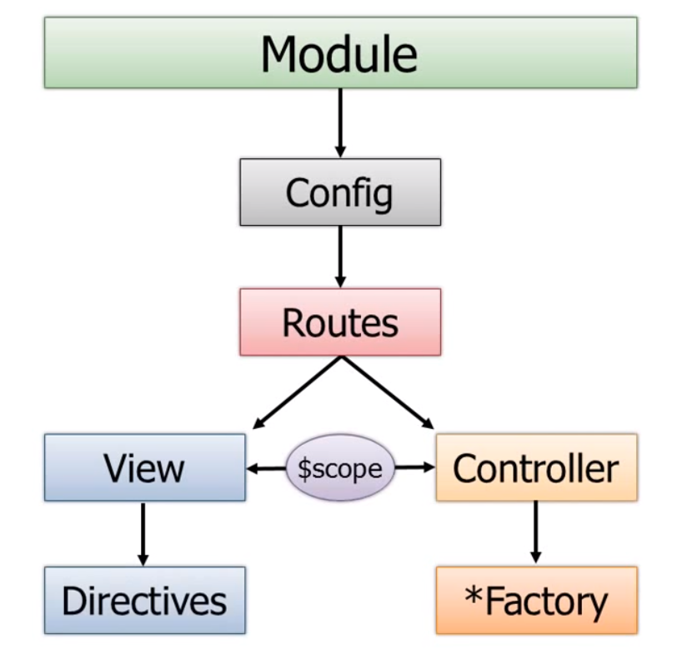
AngularJS App Structure
Dan Wahlin

Slide 37
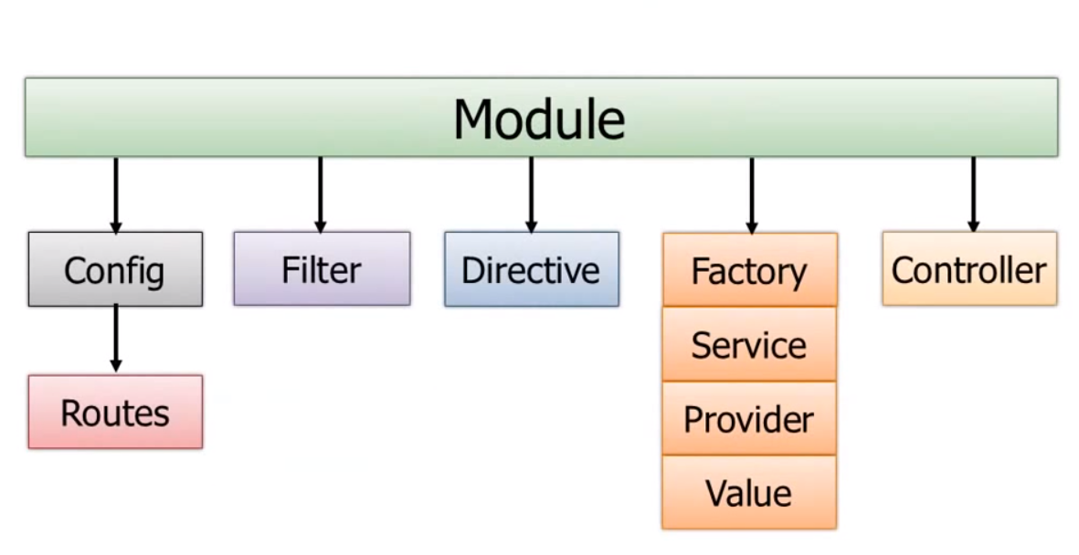
Module Components
Dan Wahlin

Slide 38
Dependency Injection
Module:
angular.module(‘myApp’, [‘module1’, ‘module2’, …]);
Controller:
myApp.controller(‘myCtrl’, [‘DI1’, ‘DI2’, function(DI1, DI2){
//Controller code …
}]);

Slide 39
3rd party module: ui-bootstrap
Native AngularJS directives for Twitter’s Bootstrap.
http://angular-ui.github.io/bootstrap/#/
Dependencies:
Bootstrap css.
<link href="http://netdna.bootstrapcdn.com/bootstrap/3.1.1/css/bootstrap.min.css" rel="stylesheet”>

Slide 40

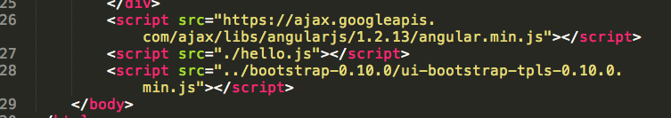
Add module: ui.bootstrap
index.html (add ui.bootstrap dependency)
index.html (add ui.bootstrap lib)

Slide 41
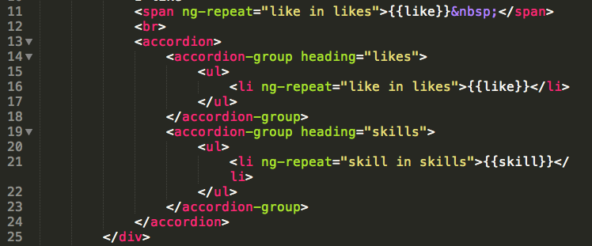
Add module: ui.bootstrap
index.html (using the 3rd party module.)

Slide 42
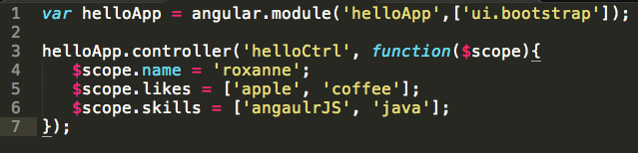
Add module: ui.bootstrap
hello.js (add ui.bootstrap module)

Slide 43
Directive
extend HTML with custom attributes and elements.
AngularJS provides:
ngApp
ngRepeat
ngModel
ngClick
… check http://docs.angularjs.org/api/ng/directive
You can develop a directive by yourself.
ngRepeat / ng-repeat ?

Slide 44
Service: Service, Factory, Provider
reusable business logic independent of views.
AngularJS provides:
$log
$http
$location
… check http://docs.angularjs.org/api/ng/service
You can develop a service by yourself.

Slide 45
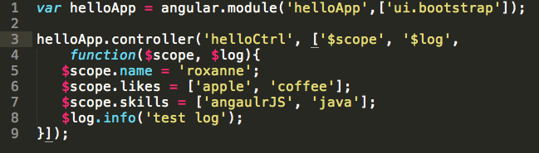
add Service: $log
hello.js (add $log service)

Slide 46
Filter
formats the value of an expression for display to the user.
AngularJS provides:
currency
number
date
… check http://docs.angularjs.org/api/ng/filter
You can develop a filter by yourself.

Slide 47
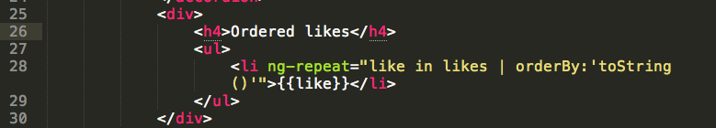
using filter: orderBy
index.html
http://docs.angularjs.org/api/ng/filter/orderBy

Slide 48
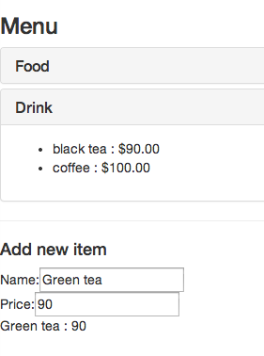
Your Turn
Redesign your model to separate food and drink.
Add ui.bootstrap module to your app and use accordion to show the menu.
order your menu item.
add currency filter to price.
Plus: add new item function

Slide 49
Reference
http://kozmic.github.io/angularjs-workshop
http://angularjs.org/
http://youtu.be/i9MHigUZKEM

Slide 50
Useful Resources
Angular-UI: http://angular-ui.github.io/
Angular Modules: http://ngmodules.org/

Slide 51
Purpose of this sharing
Share how to use AngularJS.
Share AngularJS structure and components.
Ability
You are here now !
Learning Time

Slide 52
Other Topics

Slide 53
Will tell you !

Slide 54
Question?

Slide 55
Thank you!

