Slide 1










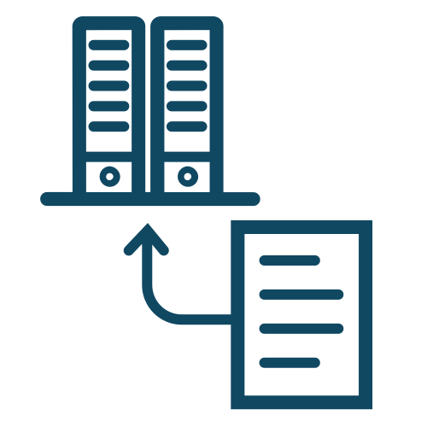





site
generator
data
discovery
catalog
markdown
researcher
data steward
data
access
groups
collection
globus connect
permissions
datasets
https

Slide 2


login
user
receive
access token

Slide 3


login
globus auth
1
receive
access token
globus group
check
request data
researcher
2
collection
receive
file
permissions
render chart
3

