Slide 1
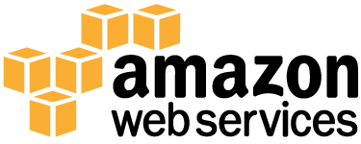
AWS Migration Planning and Roadmap

Slide 2
Welcome & Objectives
Defining the “Migration Bubble”
Overview of the AWS Migration Methodology
Migration Cost Considerations
Application Disposition Options
AWS Migration Considerations
Methodologies routes based on speed and process
Level of Effort
Tools (Native AWS or Partner tools)
Building the Migration Plan
Estimating Total Cost of Migration (“TCM”)
Lessons Learned

Slide 3
Application Migration Challenges
Challenges
Lack of accurate discovery tools and processes
Lack of application contexts / information
Limited CMDB or similar data sources
Inaccurate on premise costs
Lack of detail and scope with respect to operating model, governance, risk, compliance, security, software licensing, etc.
Indicators of potential operational practice maturity gaps within examined datasets
Increased cost
Longer time to value
Inaction

Slide 4
The Migration Bubble

Slide 5






The Migration Bubble – Components
Planning and Assessment
Migration Tools
Consulting Partners
Internal Training
Duplicate Environments
Lease Penalties

Slide 6
The Migration Bubble
Migration Bubble
Cost
Planning and Assessment
Duplicate Environments
Staff Training
Migration Consulting
3rd Party Tooling
Lease Penalties
Planning
Operation and Optimization
Time

Slide 7
AWS Migration Planning and Execution Considerations

Slide 8

Understand Your On-premises Cost
It is important to accurately understand your current costs in order to know how to plan and build your migration model for optimal cost efficiency

Slide 9
On-premises Cost Considerations
illustrative
1
Server
costs
Hardware – server, rack chassis PDUs, ToR switches
(+maintenance)
Software - OS, virtualization licenses
(maintenance)
Overhead cost
Space
Power
Cooling
2
Storage
costs
Hardware – storage disks, SAN/FC switches
Storage admin costs
Overhead cost
Space
Power
Cooling
3
Network
costs
Network hardware – LAN switches, load balancer
bandwidth costs
Network admin costs
Overhead cost
Space
Power
Cooling
4
IT labor
costs
Server admin
Virtualization admin
Diagram doesn’t include every cost item. E.g. software costs can include database, management, middle tier software costs. Facilities cost can include costs associated with upgrades, maintenance, building security, taxes etc. IT labor costs can include security admin and application admin costs.

Slide 10
On-premises Cost Drivers
Labor – How much do you spend on maintaining your environment?
Network – How much bandwidth do you need? Network gear?
Capacity – What is the cost of over-provisioning for peak capacity?
Availability / Power – Do you have a DR facility? Cost of power?
Server – What is the cost of over-provisioning? Average utilization?
Space – Will you run out of data center space? When is your lease up?

Slide 11
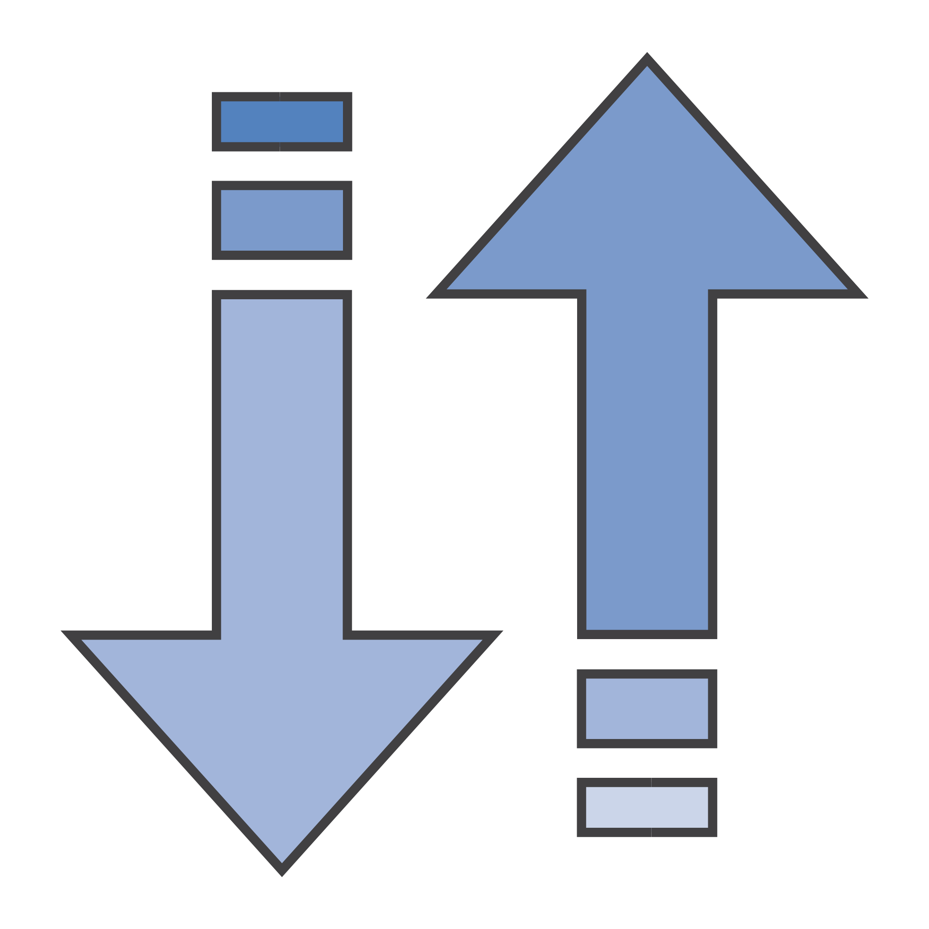
Speed and Process Decisions Change Migration Costs
The cost of migration has many levers that can be pulled in order to speed up or slow down the process. Each of these has a corresponding cost associated with it.

Slide 12
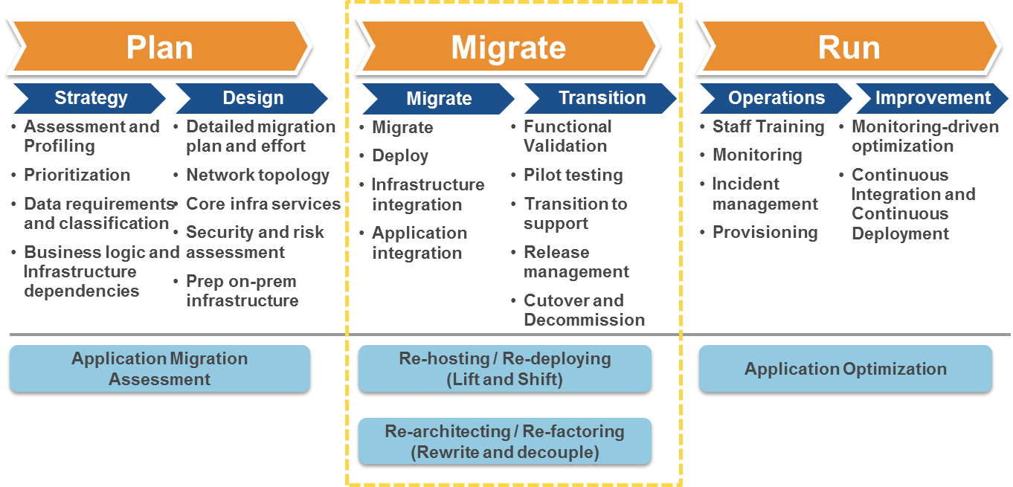
Application Migration Methodology

Slide 13
Application Disposition – All Options
Rebuild Application Architecture
Refactor for AWS
AWS VM Import
Decommission
Org/Ops Impact Analysis
Change Management Plan
Do Not Move
Lift and Shift (Minimal Change)
3rd Party Tools
Move the App Infrastructure
Determine Migration
Process
Identify Ops Changes
Design, Build AWS Environment
Manually Move App and Data
Migration and UAT Testing
Signoff
Operate
Discover, Assess (Enterprise Architecture and Applications)
Determine
Migration Path
Application Lift and Shift
Determine Migration Process
Plan Migration and Sequencing
Tuning
Cutover
Vendor S/PaaS (if available)
Move the Application
3rd Party Migration Tool
Recode App
Components
Manually Move App and Data
Refactor for AWS
Architect AWS Environment and Deploy App, Migrate Data
Replatform (typically legacy applications)
Rearchitect Application
Recode Application

Slide 14
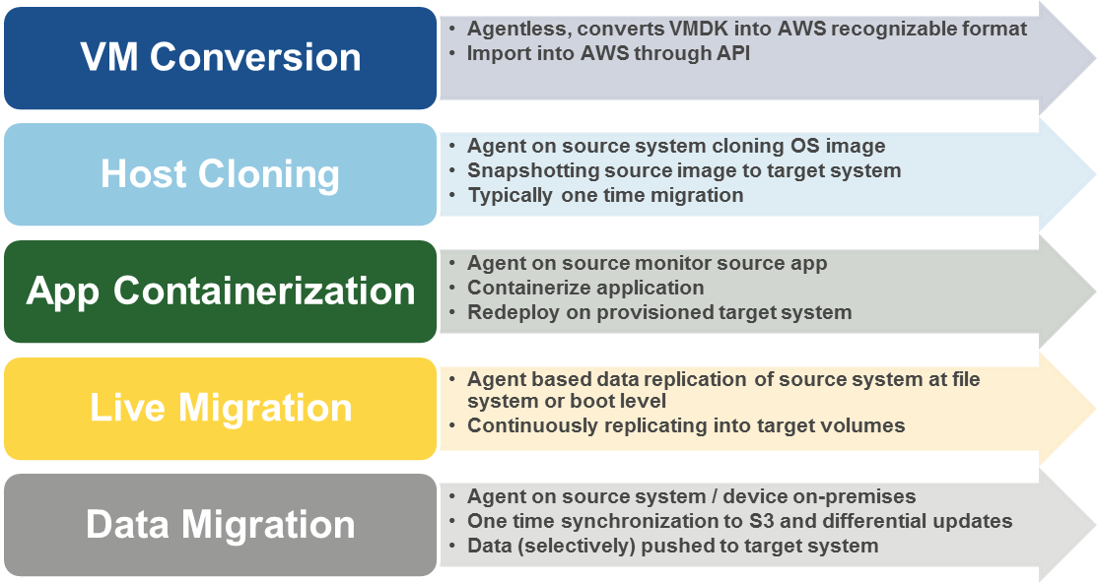


Application (Infrastructure) Migration Options

Slide 15
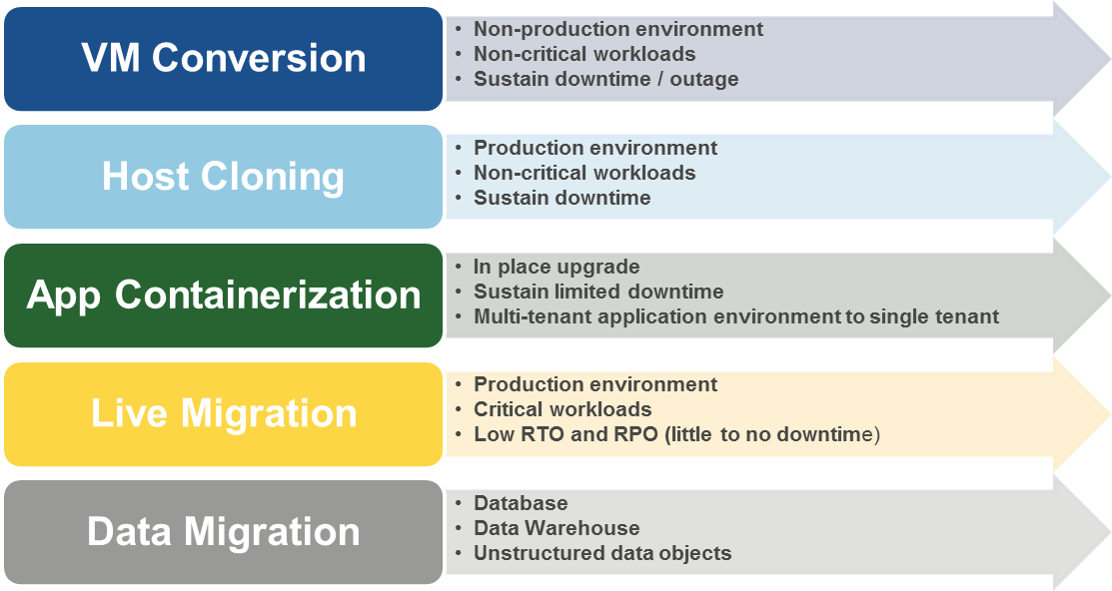
Application (Infrastructure) Migration Use Cases

Slide 16
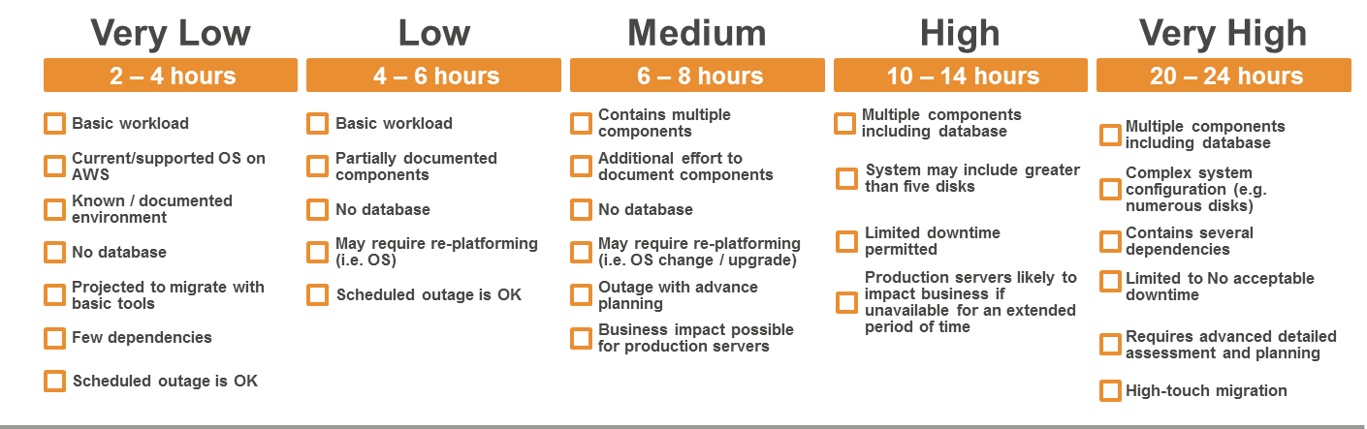
Application Migration Level of Effort
2 – 4 hours
4 – 6 hours
6 – 8 hours
10 – 14 hours
20 – 24 hours
Migration Method
VM Conversion
VM Conversion
Host Cloning
Live Migration
Live Migration
Host Cloning
Host Cloning
Live Migration
App Containerization
App Containerization

Slide 17
AWS Migration Cost Considerations
3rd Party Costs
3rd Party Migration Tools
Storage Vendors
3rd Party Application Licensing
AWS Costs
Amazon EC2 (right-sized based on utilization metrics)
OS Licensing
Amazon EBS (anticipated usable volume size)
Amazon S3 (usable storage)
Amazon Elastic Load Balancing
Amazon CloudFront
Other Applicable Costs (Amazon RDS, Amazon Redshift, Amazon EMR, etc.)
AWS Direct Connect
Amazon EBS snapshots
Labor
Employees (FTE)
Onshore Consultants
Offshore Consultants
Refactoring Effort
Unsupported OS
OS Upgrade
Database to RDS
Tools
Change Management
Training
Continuous Delivery / Continuous Integration
Financial Management and Measurements
Configuration Management
Governance
Operating Model
Service Management
2nd (or 3rd) Availability Zone

Slide 18




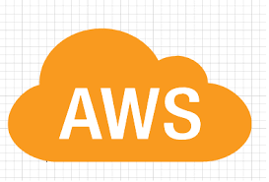
Automated Migration Tool - Use Cases
Description | Tool assisted migration option
Production environment, LIVE migration with minimum downtime | CloudEndure
Production environment, not so critical workload, can sustain outage | RACEMI
Non-supported OS | No credible tool option
Windows 2003, in-place upgrade and migration | AppZero
Database migrations, all use cases | Attunity
Non-Prod / Non-critical migrations | AWS VM Import

Slide 19
Map out Application Migration Activities
Week 1
Week 2
Application Owner Meeting
Document Success Criteria
Verify VPC Connectivity
Review Existing Blueprints
Initial Architecture Design
VPC Architecture Design
Update Final Design Document
Application Dependencies
Resolve Dependency Conflicts
App Architecture Review
App Owner Review
Identify Testing Process
Identify Enhancement Opportunities
Intra-port Requirements
Deploy AMI’s
Identify Application Artifacts
Allocate Credentials
Data Migration Requirements
VPC Port Exception
Connectivity Requirements
Verify Subnet Connectivity
Baseline Performance
Application Installation
Migrate Data
Firewall Port Determination
Firewall Requests
Test Application Connectivity
Complete Artifact Checklist
End to End Testing
Key
Owner Sign-off
Discover
Design
Build

Slide 20
Build Agile Plan/Roadmap in Phases
Each Phase – 2 Week Sprint + 2-Days for Lessons Learned
Phase 1
AWSGOVDEV1
AWSGovDev2
AWSIntranet1
AWSInventory1
AWSKEYSTONE2
AWSrectrac1
AWSWEB10
Phase 2
AWSEMS3
AWSFireDEV2
AWSFirehouse2
AWSOneRoof2
AWSPAGEGATE2
Phase 3
AWSAWATCH1
AWSFBO1
AWSSQL12
AWSSQLDW1
AWSSQLFBO1
AWSTicketMGR3
AWSTicketMGR4
AWSTKTMGRWEB1
Phase 4
AWS3MSelfCHK1
AWSAPPSQL1
AWSAPPSQLDEV1
AWSILS3
AWSPAC3
AWSPRIVATESP1
AWSSPPRODAPP1
AWSSPPRODAPP2
Phase 4 – Cont.
AWSSPPRODAPP3
AWSSPPRODSQL1
AWSSPPRODSQL2
AWSSPPRODWFE1
AWSSPPRODWFE2
AWSSQLDEV2
AWSTime3
AWSTimeDEV3

Slide 21
Let’s do a sample Total Cost of Migration (TCM) exercise…

Slide 22
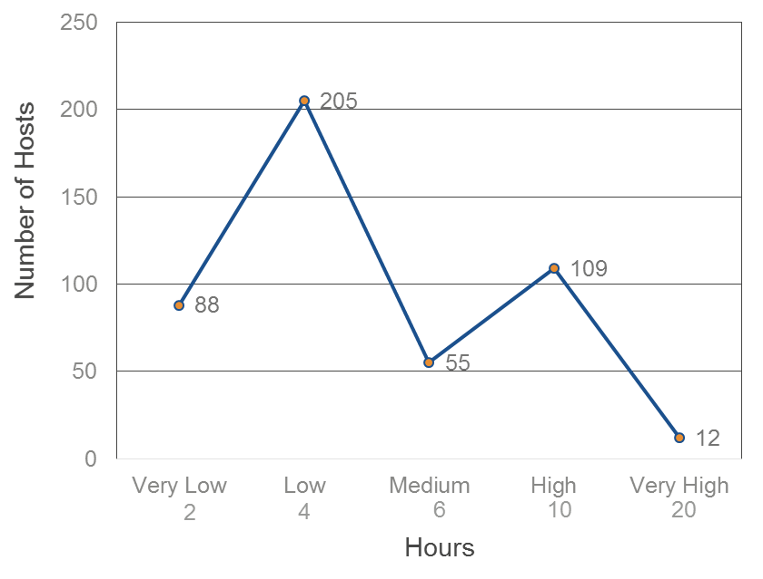
Sample Migration Cost Model Total Migration Effort Across 469 Hosts
Sample Cost Model is based on a fictitious Enterprise Migration of 469 workloads of varying complexities.
Mean Migration Effort Across Hosts: 5.45hrs per host average

Slide 23
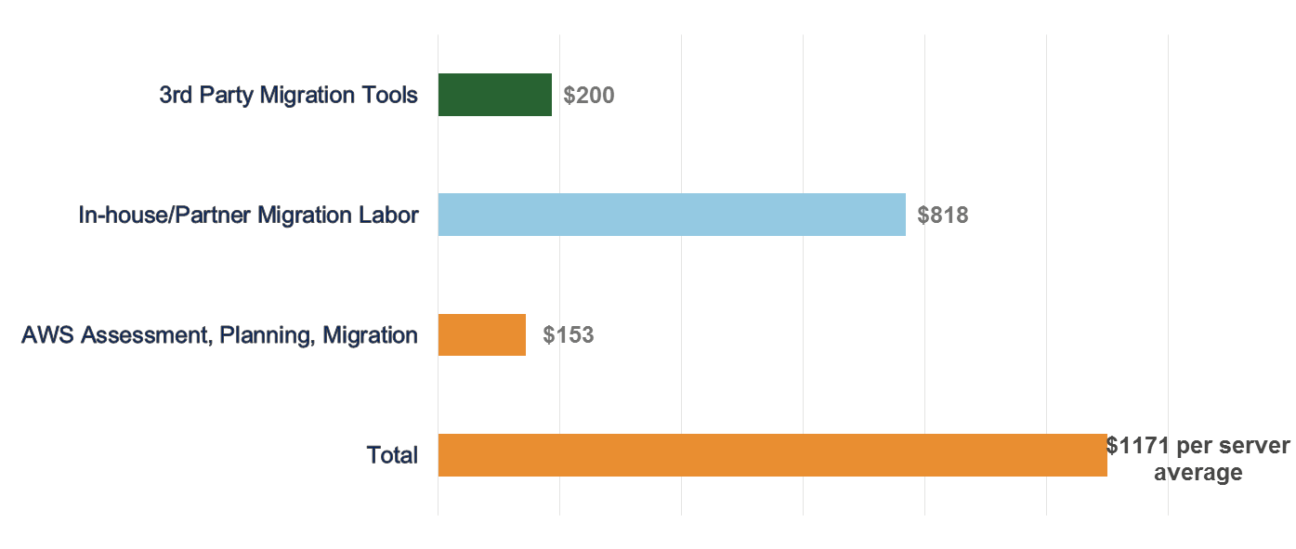
Per Server Average Migration Investment Estimate
2560 hours @$150/hr Avg
250 hours @$287.50 Avg
Total Cost of Migration = $549,199

Slide 24
Migration Investment Overview/Pay Back
3yr On premises costs: $3,567,880
3yr AWS costs: $1,629,686
Annual savings: $646,064
1-Time Migration costs: $549,199
Estimated Pay Back:
10.5 Months
 | On-premises | AWS
Server | $1,720,061 | $698,858
Storage | $774,800 | $245,353
Network | $367,659 | $37,104
IT Labor | $675,360 | $550,240
AWS Support | $0 | $98,131
Total | $3,567,880 | $1,629,686

Slide 25

1st Lesson Learned
Early Planning, Communication and Buy-In is Essential
Map out the timeline
Understand and Categorize your Applications
Define your strategy
Limit the variables
“Without a plan, there can be no victory”

Slide 26
Categorize Apps and Reduce Variables
 | Critical and/or Strategic | Not Critical or Strategic
Easy to Move | 1 SaaS or IaaS | 2
Hard to Move | 3 Custom Business Apps. Oracle Financials | 4 Legacy App Zone Kill or Replace Services

Slide 27

2nd Lesson Learned
Personnel requirements in the cloud really are different from traditional operations
Strong Ops need for Software Engineering skills
Minimized need for deep Network or Storage
Not just in Ops…also for QA, Release, Dev and Security

Slide 28

3rd Lesson Learned
The Burden of “Day Jobs” During Migration
Existing Staff frequently asked to:
Maintain current infrastructure
Learn new skills
Build out new infrastructure
Migrate applications to the new environment
Decommission the old environment
Do all of the above on the same salary, and…

Slide 29

Get excited about it!

Slide 30
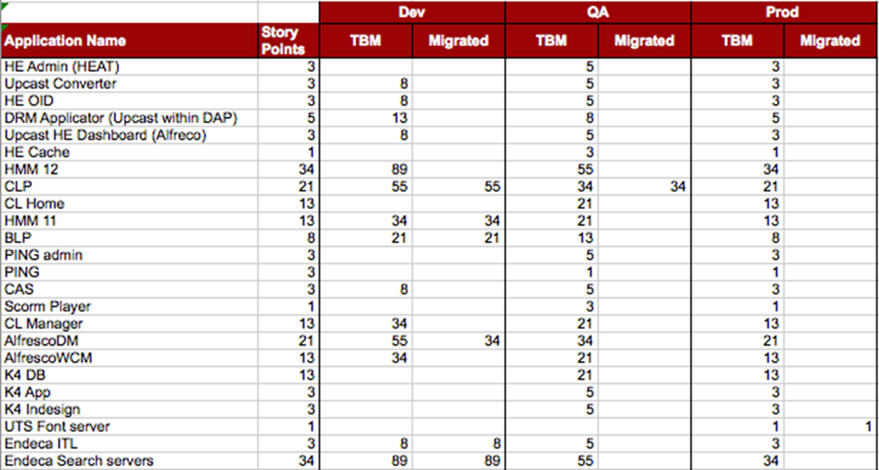

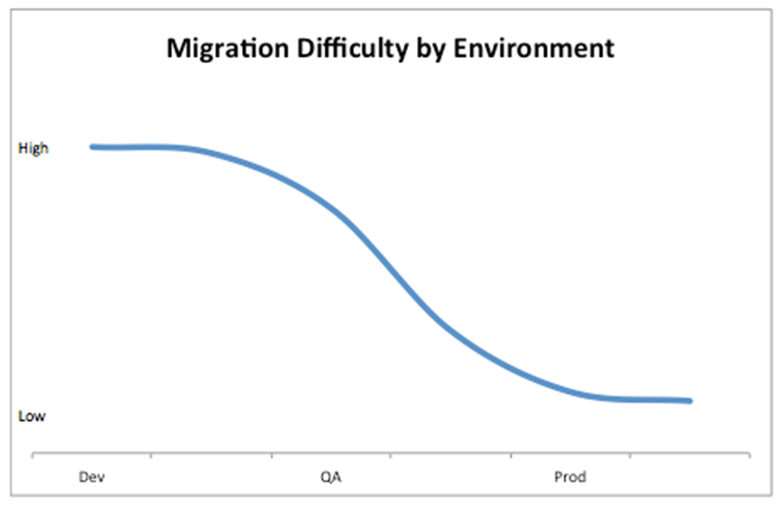
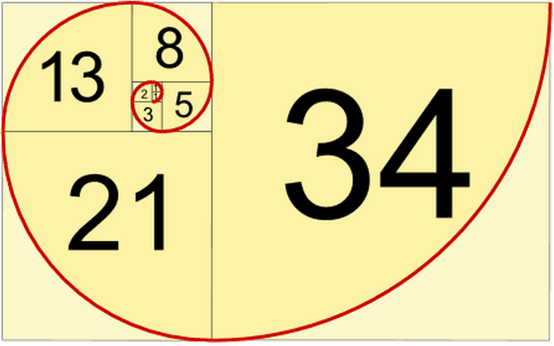
4th Lesson Learned Build Momentum, Monitor and Report Status
Migration
Progress

Slide 31
5th Lesson Learned
Architecture is Key
Unexpected Savings
What…No Web Servers?
Compliance - FedRAMP
European Privacy Laws

Slide 32

6th Lesson Learned
Help is available from AWS – Use it!
Documentation and Whitepapers
Solution Architects
Professional Services/APN Partners
Technical Account Managers (TAM)

Slide 33

Key Takeaways
Have a strategy and A Plan (even if it changes as you migrate)
Understand the components of your Migration Bubble and their corresponding costs
Determine the best “migration path” for each workload to optimize cost/outcome in the migration process
Leverage the Tools: APN Partners, Tooling, and AWS to shorten the migration window
Go fast!

Slide 34
Questions?
AsnaniS@amazon.com

