Slide 1
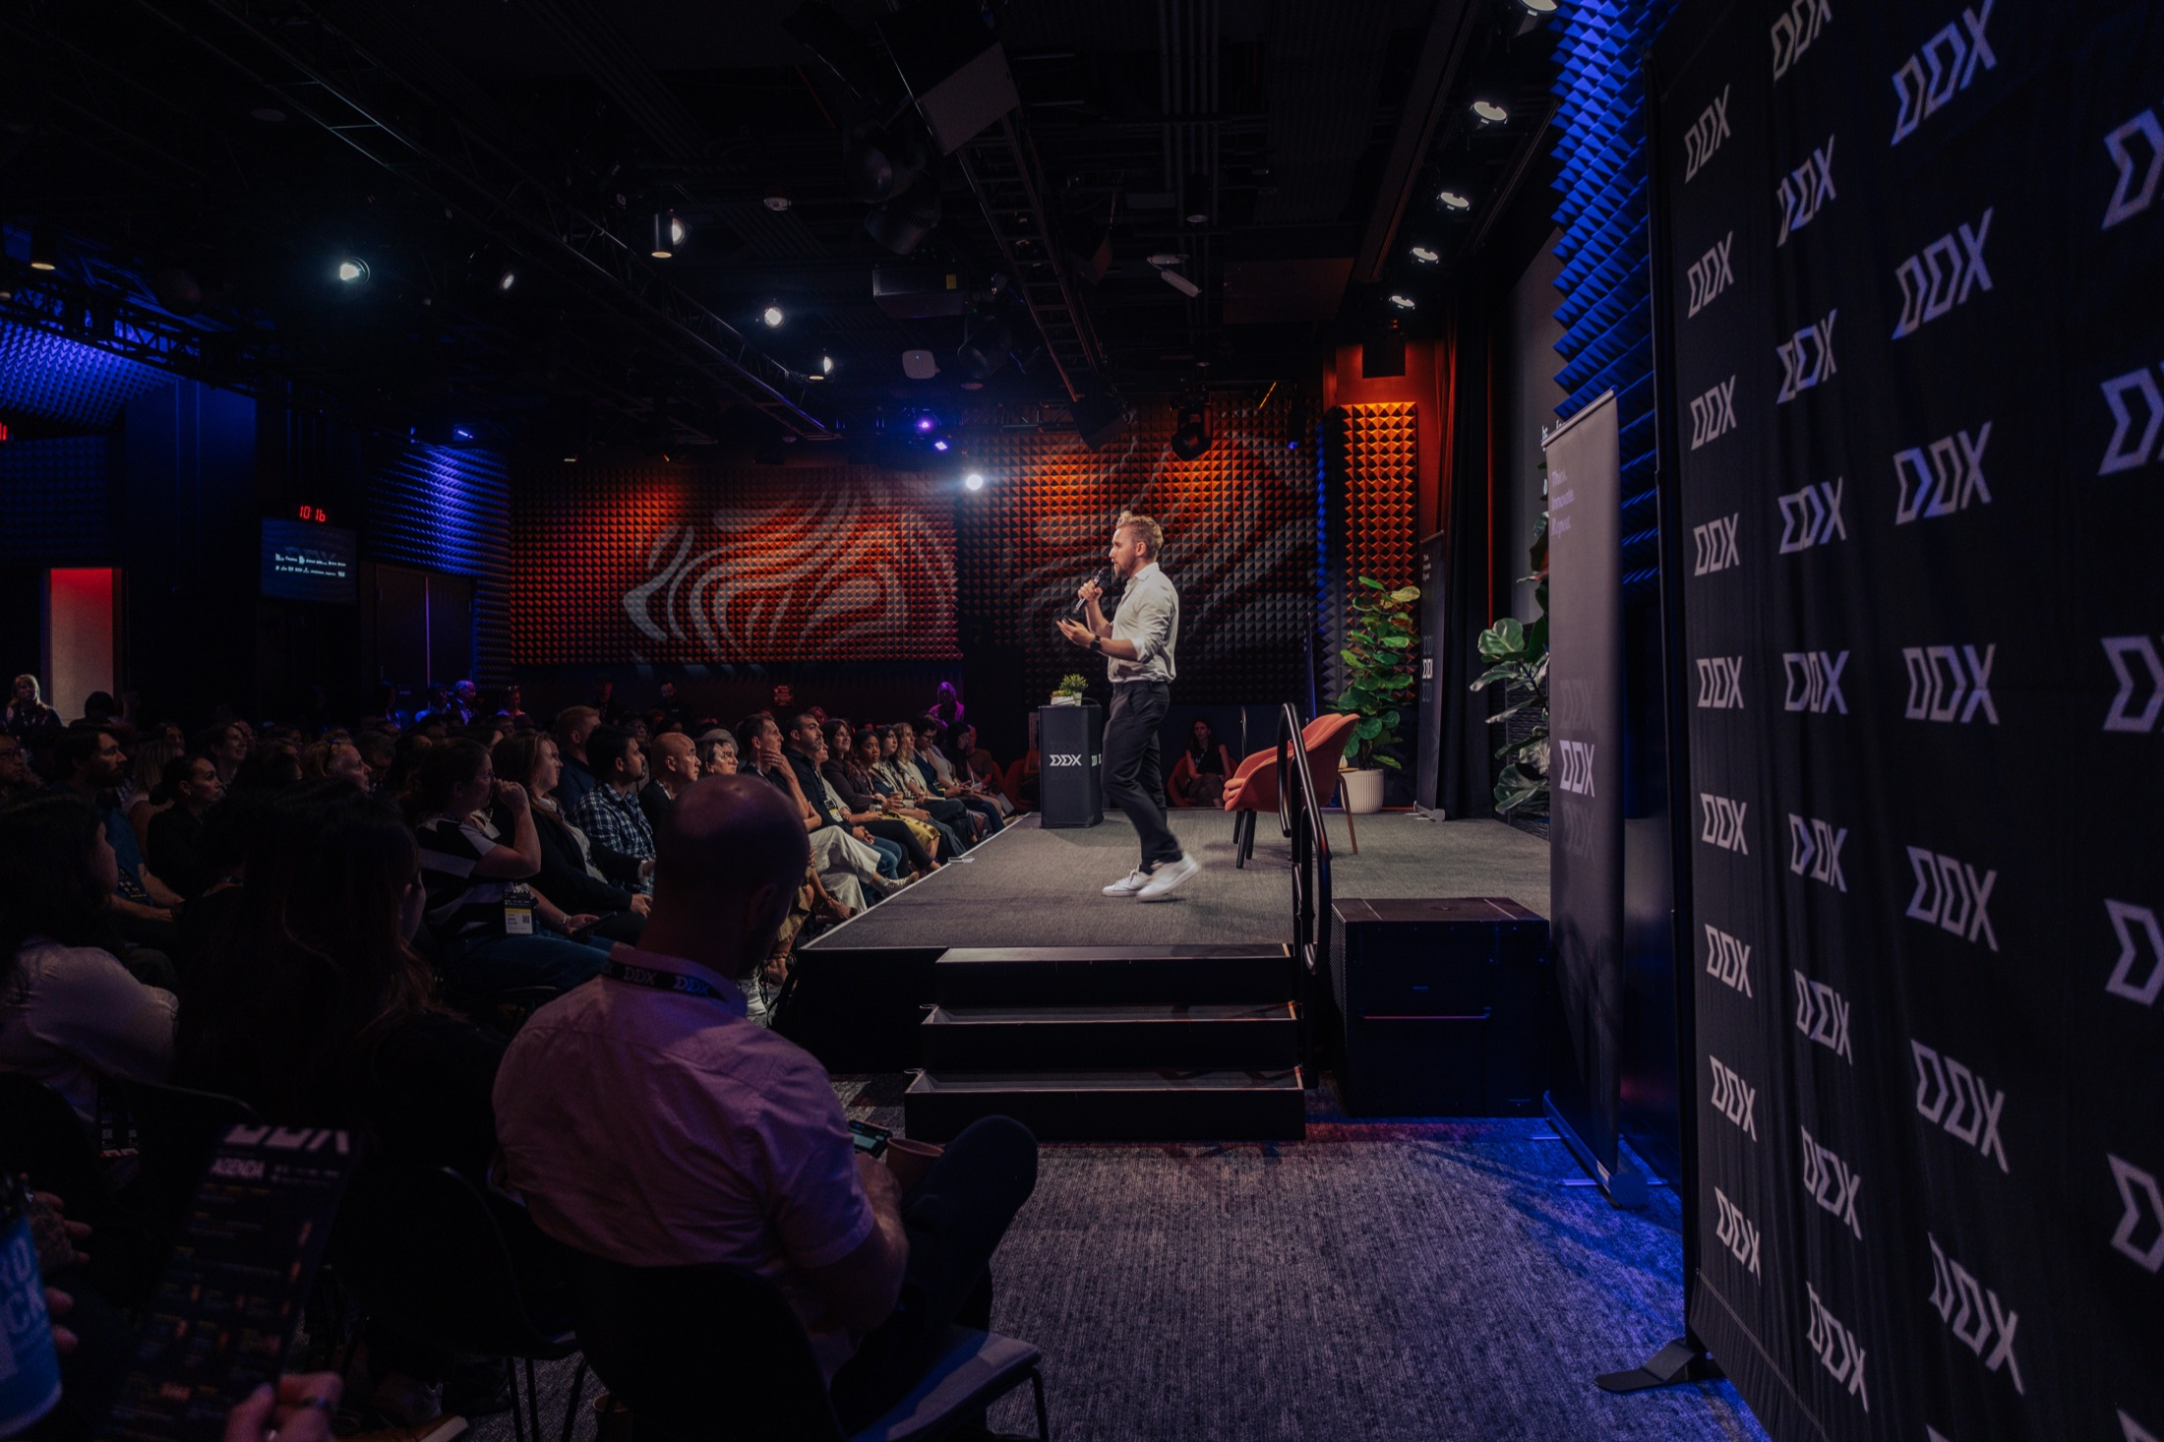









CONFERENCE RECAP 17 SEPTEMBER 2026
THE
INFLECTION
POINT
DDX’26 San Diego UC San Diego Park & Market Design & Product Leaders Exchange on the Future of Digital Innovation
WITH

Slide 2
IN BRIEF
ONE DAY, THREE STAGES,
ONE QUESTION
If AI can produce “good enough” design on demand, what is the job of a design and product leader now?
25
3
SPEAKERS ON STAGE
STAGES IN PARALLEL
Twenty-five leaders from Adobe, Google, IDEO, Webflow, Otter.ai, Target, Netflix, Careem, TaylorMade, Marvin, Dscout and the Obama White House took the question to a room that came to argue back. Don Norman opened the day; three enterprise design leaders closed it by comparing the expectations of the role with its reality in 2026.
3 · 6
9
PANELS · WORKSHOPS
TABLE TALKS
400+
4,000+
LEADERS REGISTERED
DDX ALUMNI WORLDWIDE
DDX’26 SAN DIEGO · RECAP
02

Slide 3
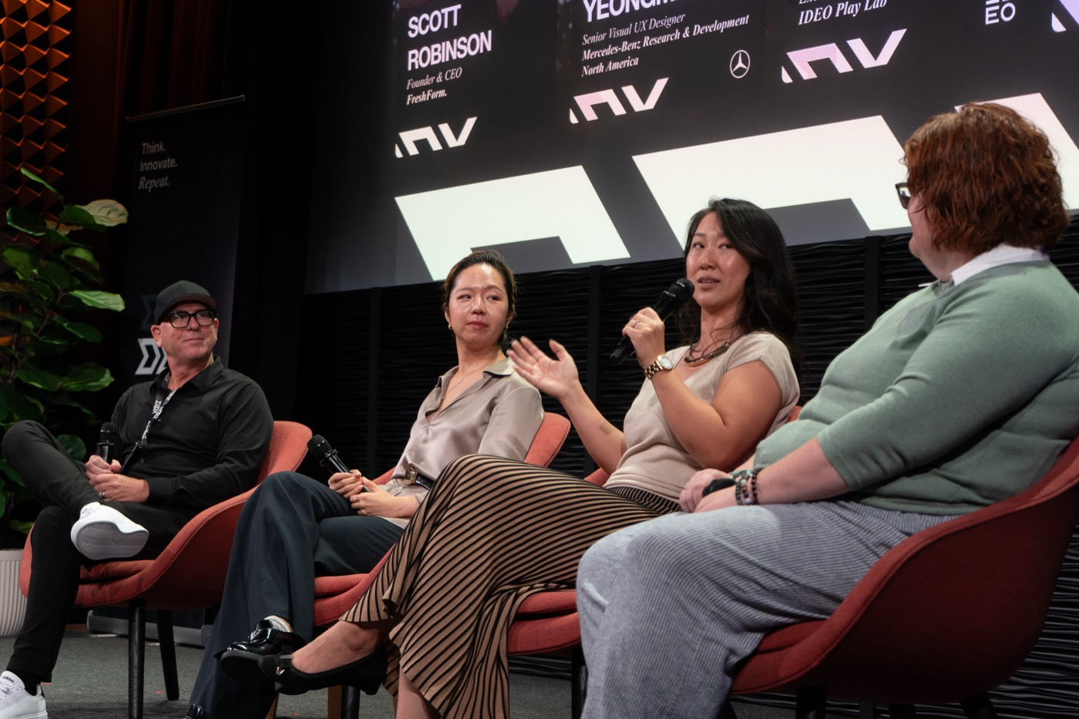
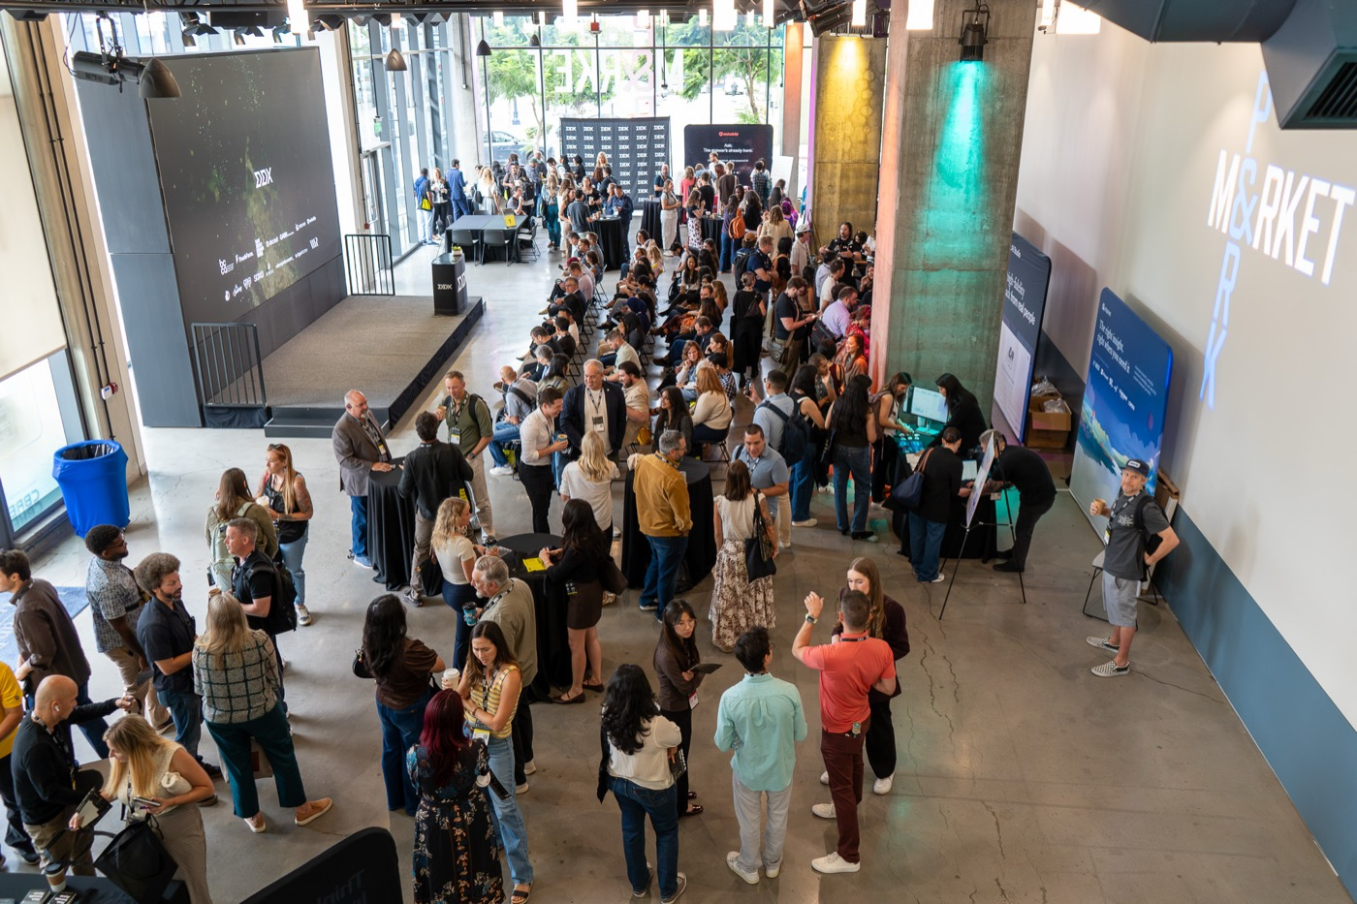
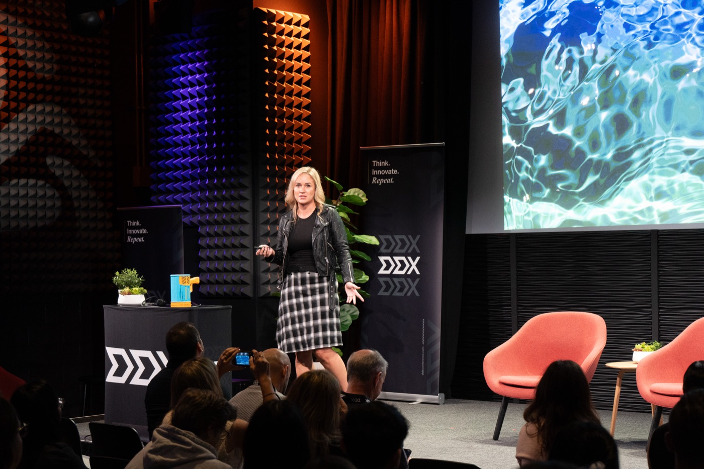
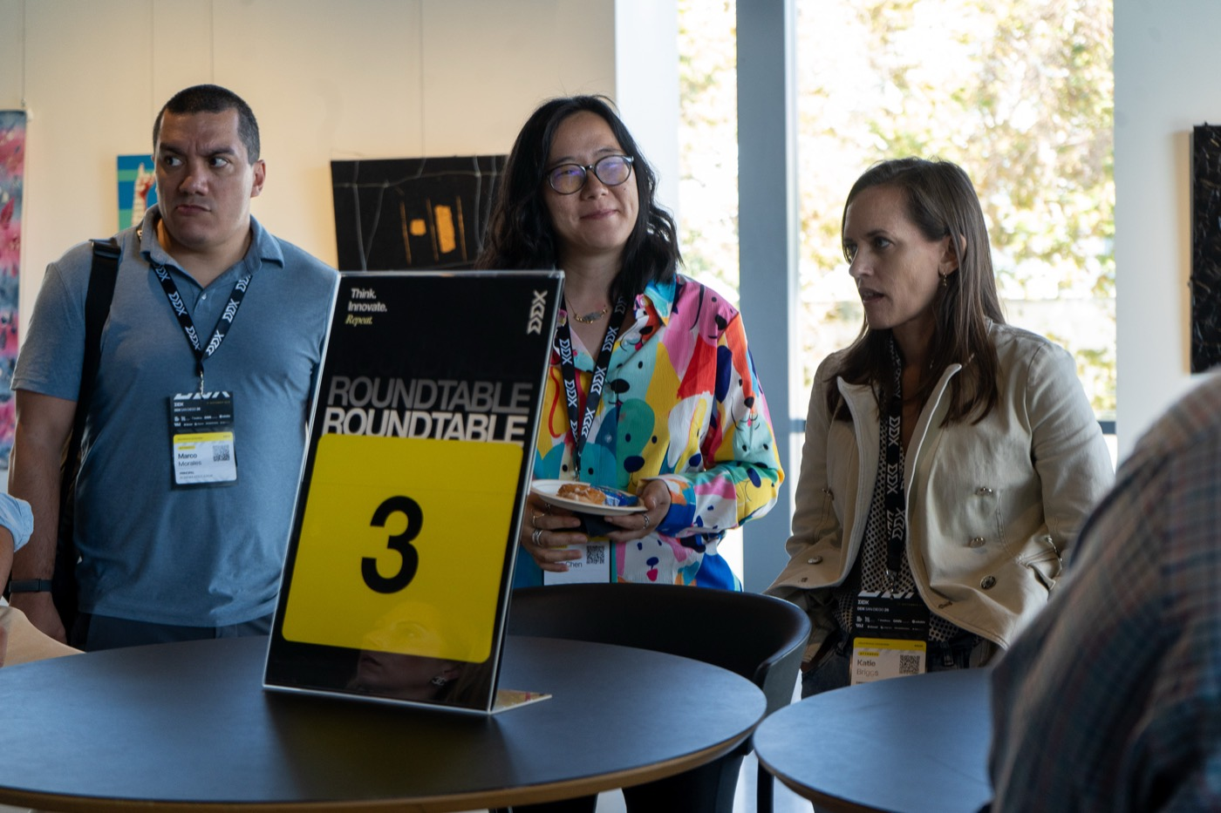
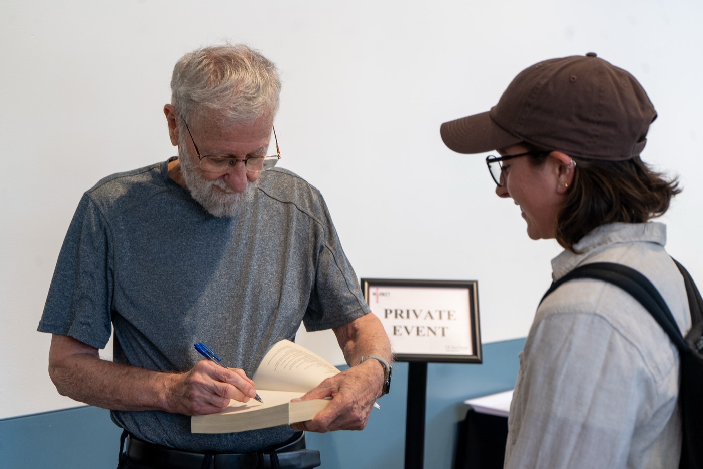
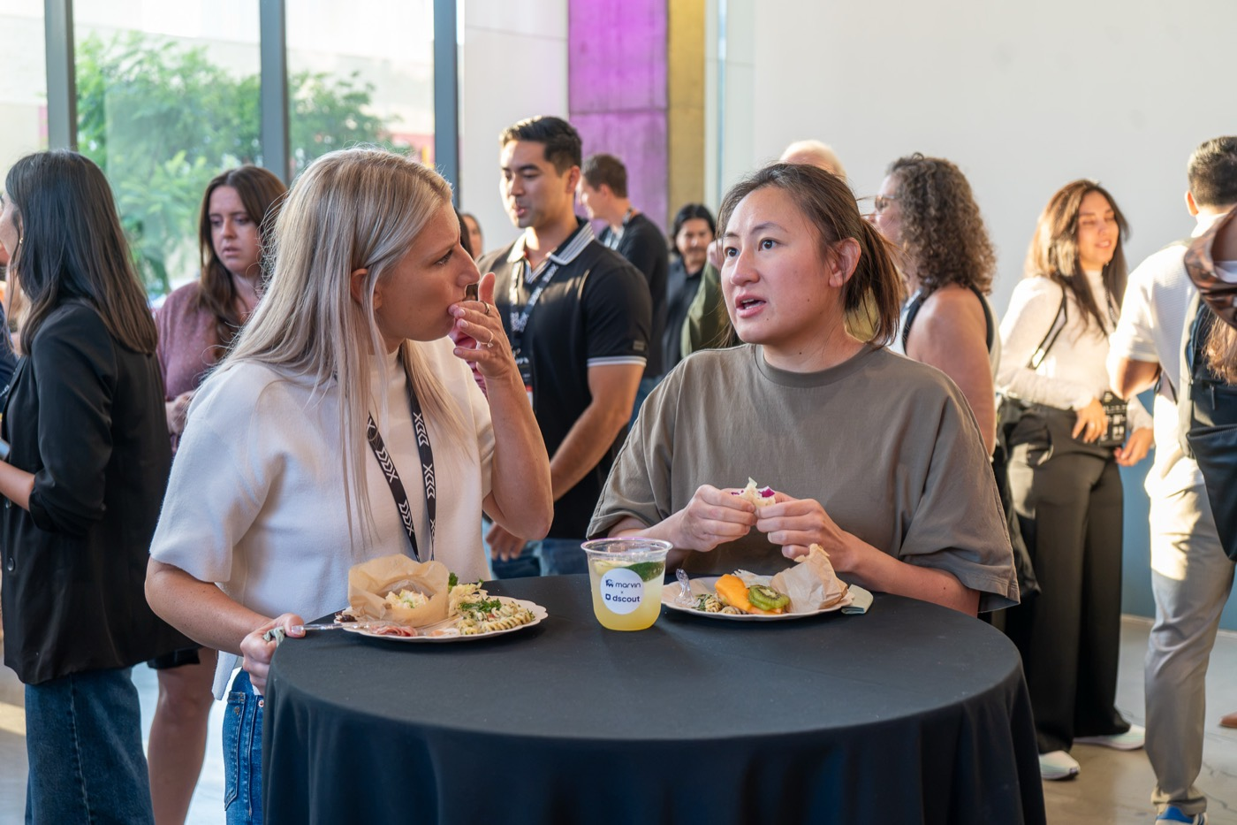
THE ROOM PHOTOS BY DESMOND CHUA AND NICOLE GOSÉ
Drive, Play, Eat panel
Park & Market atrium
Stephanie Mencarelli
Table talks in the breaks
Don Norman signing
Happy hour by Marvin & Dscout
DDX’26 SAN DIEGO · RECAP
03

Slide 4
WHAT THE ROOM AGREED ON
THE FLOOR ROSE.
THE CEILING DIDN’T MOVE.
Good is free now. Great is the job.
Research stops being a project and becomes a pulse.
Design leaves the screen: decisions, systems, organisations.
The human stays irrational, and irreplaceable.
Context is the asset. The experience is the business.
Taste, judgment and a durable point of view are what AI cannot generate.
When teams ship weekly, episodic studies arrive after the decision.
Value is measured by influence on what gets built, not by deliverables.
AI can read the deck. It cannot read the room.
Tools change weekly; structured knowledge compounds.
DDX’26 SAN DIEGO · RECAP
04

Slide 5
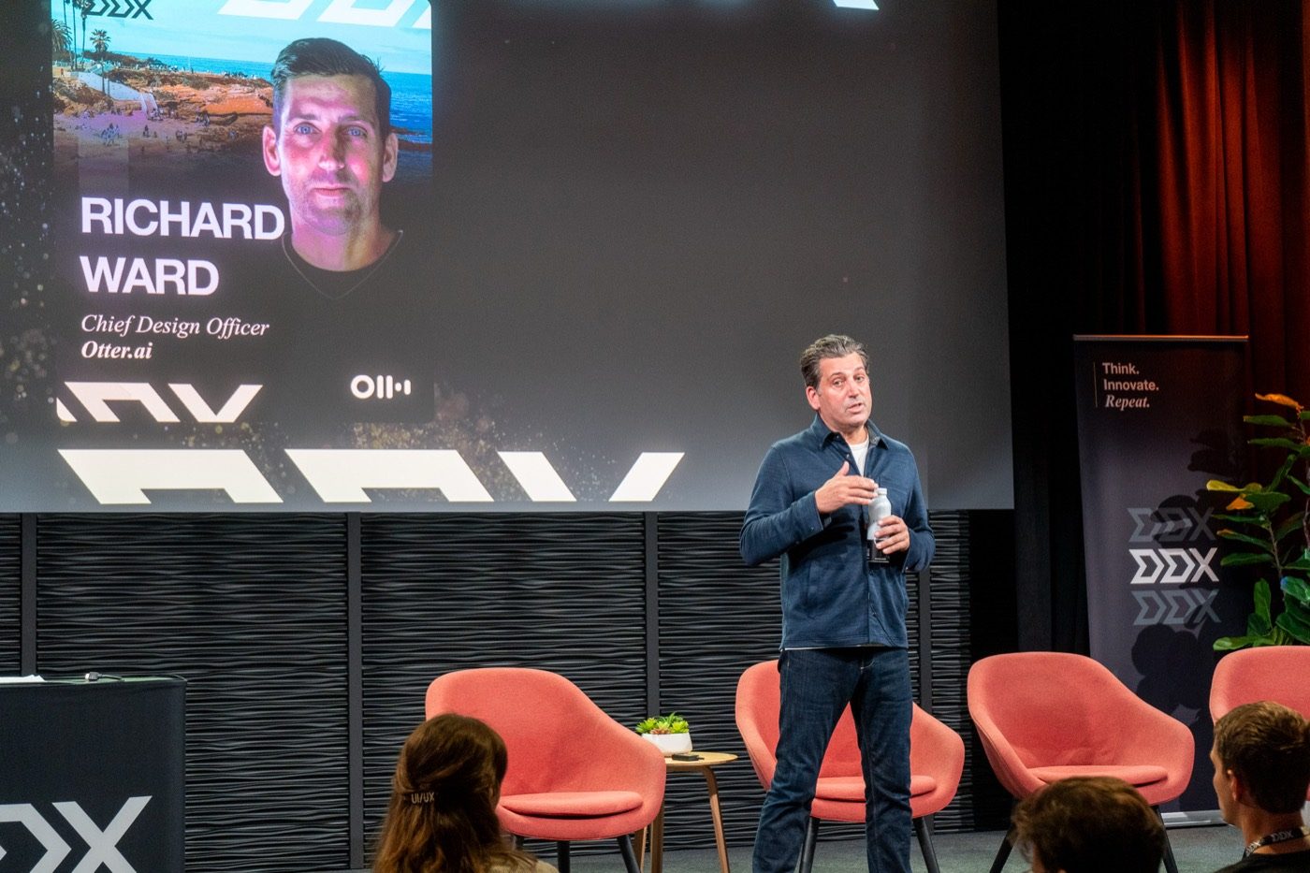
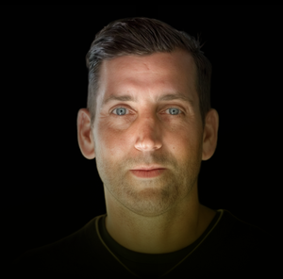
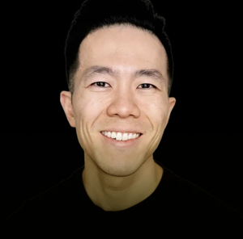

THEME CRAFT IN AN AI-NATIVE WORLD
Good is free now. Great is the job.
Richard Ward called the “death of design” narrative backwards: when everyone can clear the bar for good, the differentiator is knowing what great looks like. Kevin Wong went further: AI has not changed design, it has exposed how little depth most organisations were designing with. At the tables, Jaleesa Chagan framed the edge as a shift “from capability to conviction”.
2026 EVIDENCE
AND YET
91%
49%
of designers use AI for design tasks every week, up from 54% a year earlier.
of US consumers say generative AI has made content quality worse.
Richard Ward, Otter.ai
Kevin Wong, Webflow
Designer Fund, AI in Design 2026, May 2026
Gartner, June 2026
Jaleesa Chagan, GAIN
DDX’26 SAN DIEGO · RECAP
05

Slide 6
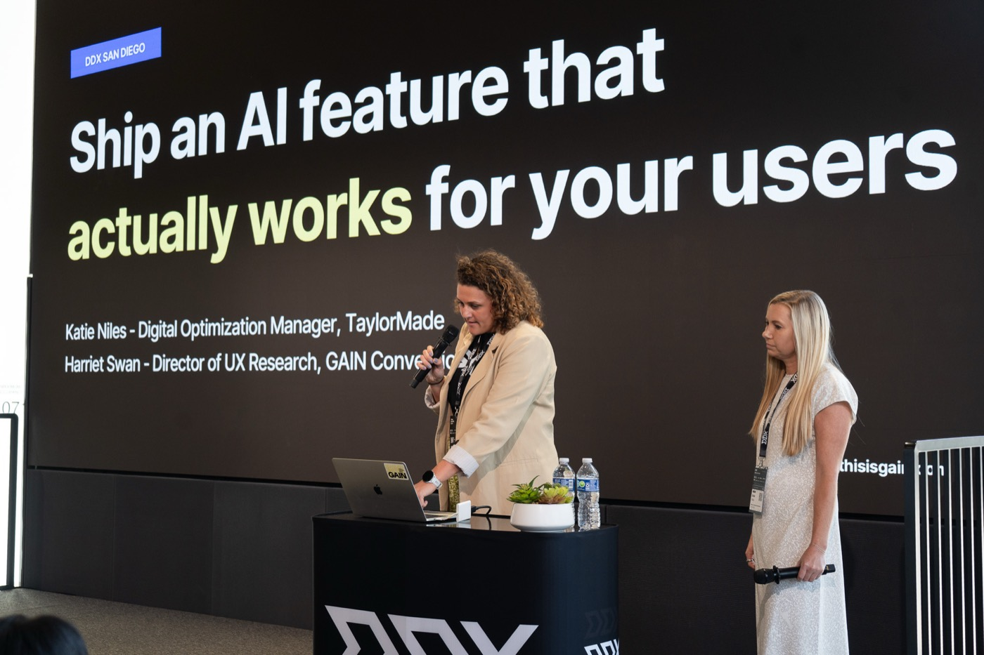




THEME RESEARCH AT THE SPEED OF SHIPPING
Research stops being a project and becomes a pulse.
Prayag Narula made the case for always-on research. Harriet Swan and Katie Niles showed it in practice with TaylorMade’s AI caddie, CHIP: exploratory research to decide what it should say and do, A/B tests to find what moved engagement, and evaluative research to catch what the tests could not, inconclusive results included. Bhavik Gandecha’s table put it in one line: AI moves fast, research still has to lead.
2026 EVIDENCE
THE GAP TO CLOSE
8 → 22%
37%
of organisations call research “essential to all levels of business strategy”, nearly tripling in a year.
say AI has contributed to enterprise EBIT, unchanged, while 80% say it improved their own productivity.
Prayag Narula, Marvin
Harriet Swan, GAIN
Maze, Future of User Research 2026, March 2026
McKinsey, State of AI 2026, August 2026
Katie Niles, TaylorMade
Bhavik Gandecha, Dscout
DDX’26 SAN DIEGO · RECAP
06

Slide 7
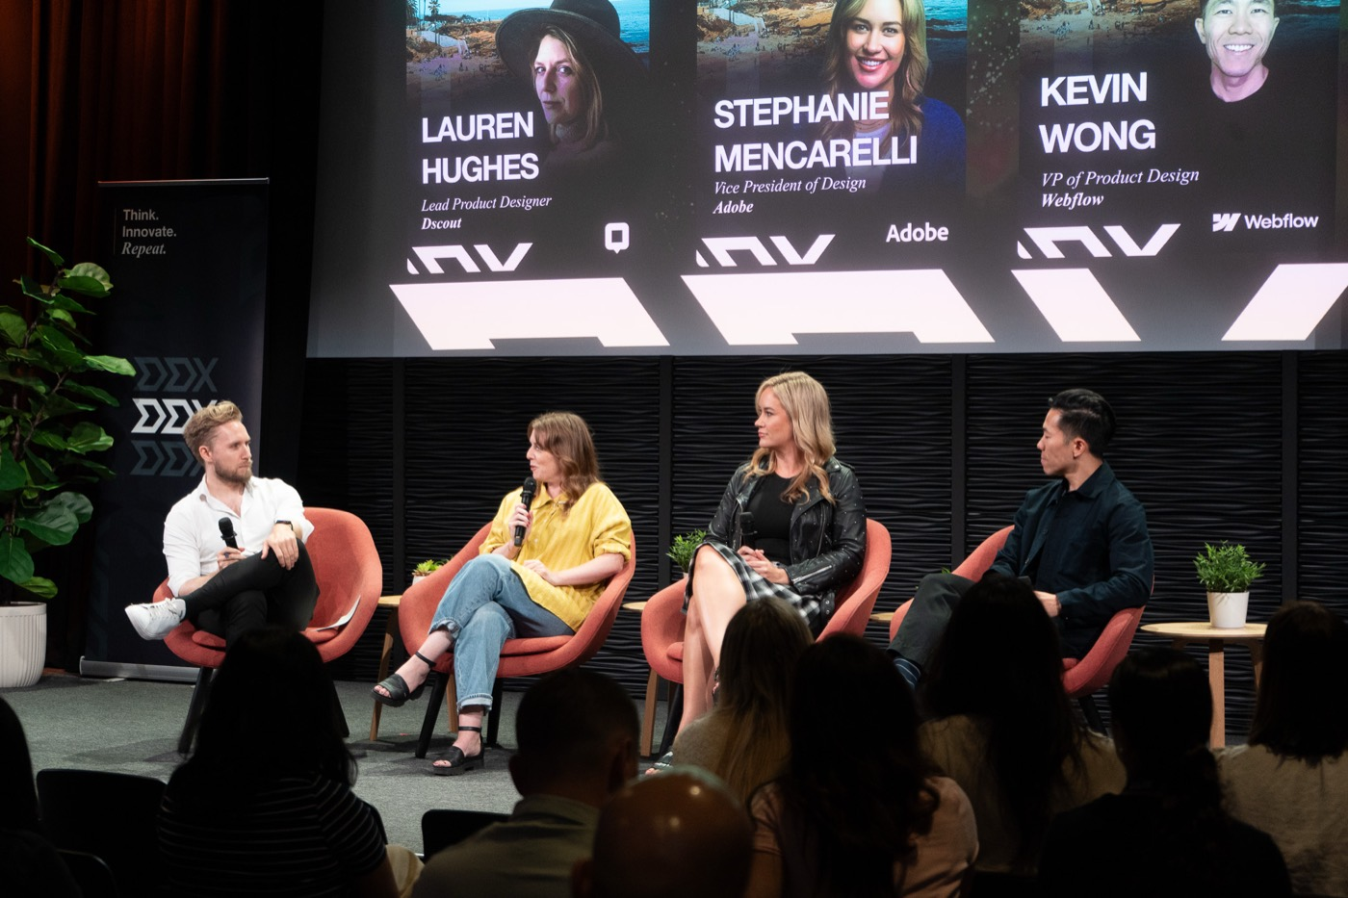
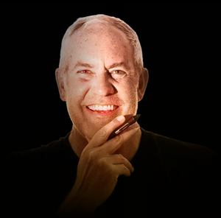

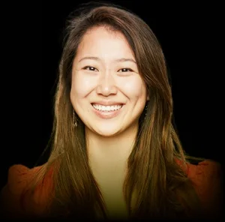
THEME THE EXPANDING BRIEF
Design leaves the screen: decisions, systems, organisations.
Chris Gielow asked designers to stop designing screens and start designing decisions, and to measure their value by influence on what gets built. Twisha Shah-Brandenburg took it a level up: AI transformation succeeds or fails on fragmented systems, invisible labour and unclear ownership, so the brief is now the organisation itself. The closing panel compared the expectations placed on enterprise design leaders with the reality of the role.
2026 EVIDENCE
AT THE TOP
21 → 41%
72%
of designers now do development work; developers doing design rose from 44% to 60%.
of CEOs say they are now the main AI decision-maker, double the prior year.
Chris Gielow, UX Speakeasy
Twisha Shah-Brandenburg, Target
Figma, 2026 AI Report, June 2026
BCG, AI Radar 2026, January 2026
Diana Tobey, IDEO
DDX’26 SAN DIEGO · RECAP
07

Slide 8
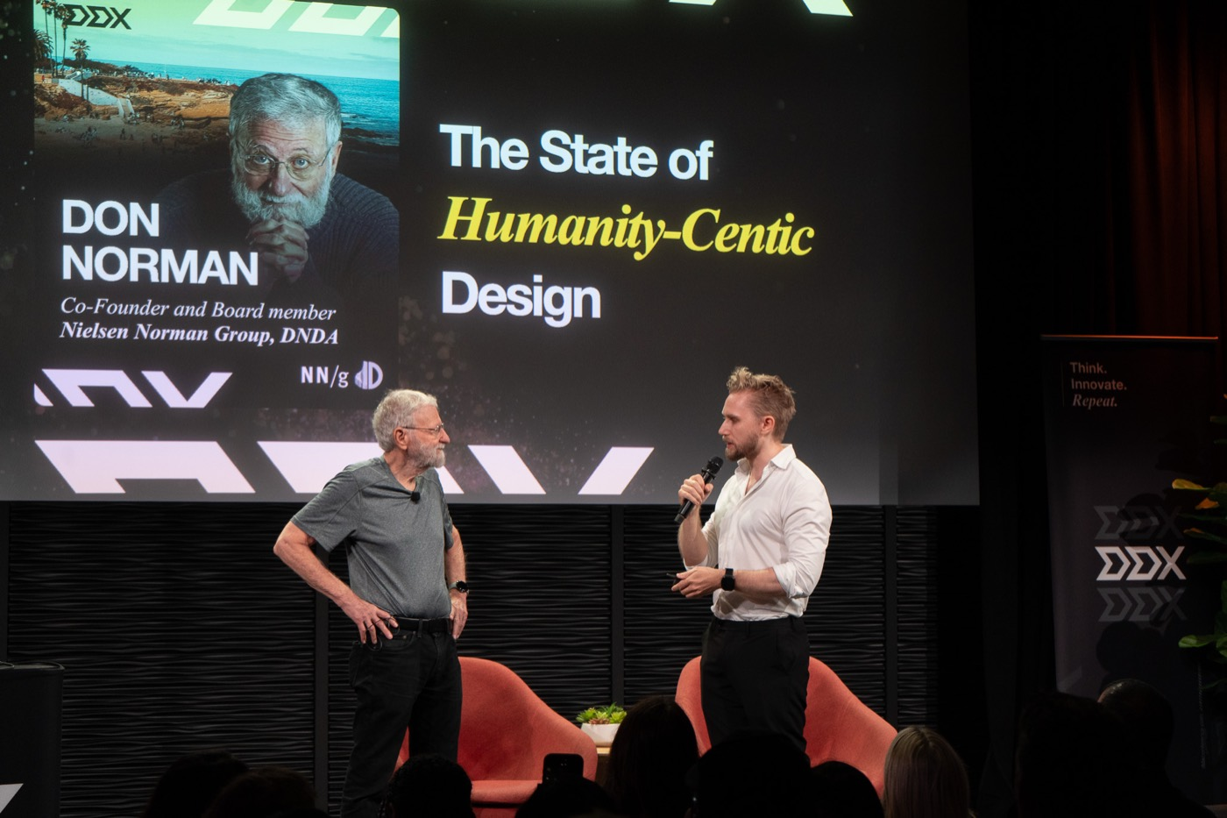




THEME HUMANITY-CENTRED, STILL
The human stays irrational, and irreplaceable.
Don Norman opened on the state of humanity-centred innovation. Rowan Salama reminded the room that the rational user most products are designed for does not exist, and that AI’s best use is understanding the “beautifully irrational” ways people decide. Stephanie Mencarelli argued that as machines generate more, human originality becomes the scarce resource, which is why joy, not productivity, was her metric. Kara Fitzpatrick: AI can read the deck, it cannot read the room.
2026 EVIDENCE
THE TRUST PROBLEM
82%
50%
of research practitioners say interpreting nuance and emotion remains a job for humans.
of US consumers prefer brands that do not use generative AI in customer-facing content.
Don Norman
Rowan Salama, Careem
Maze, March 2026
Gartner, March 2026
Stephanie Mencarelli, Adobe
Kara Fitzpatrick
DDX’26 SAN DIEGO · RECAP
08

Slide 9
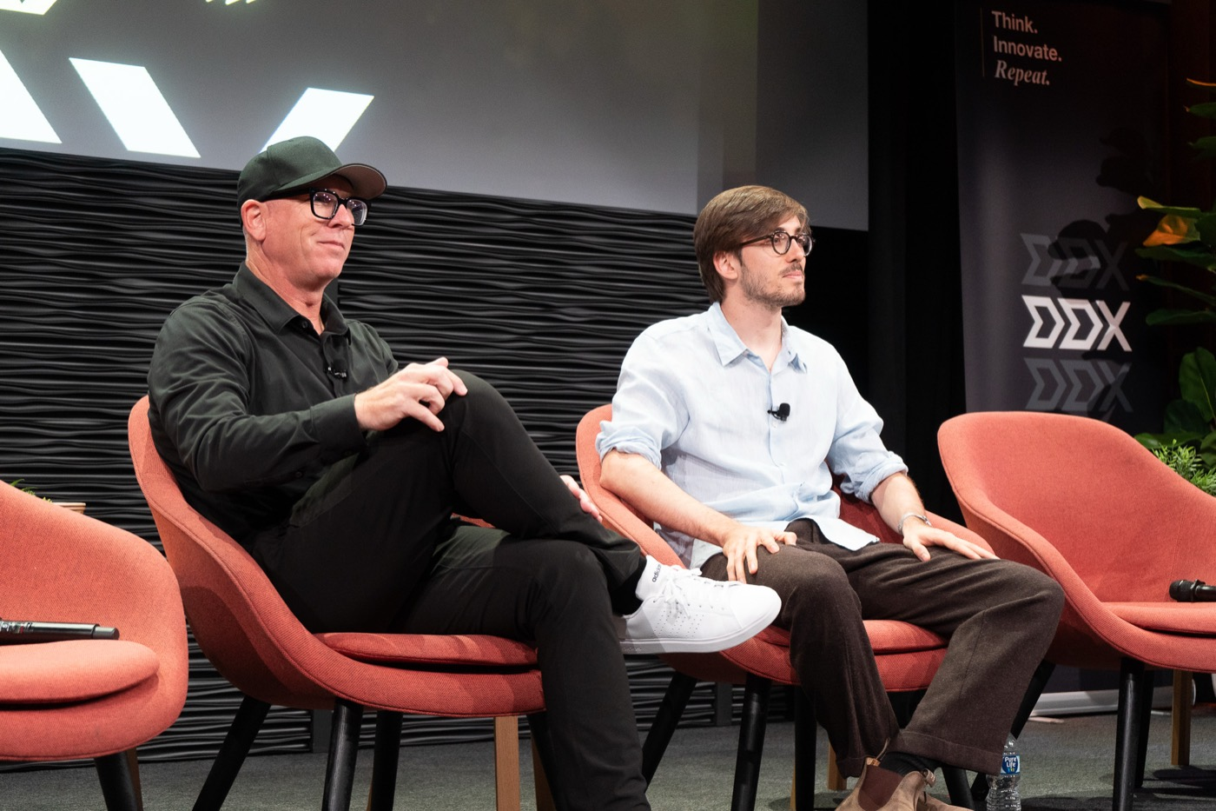


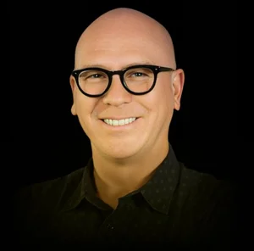

THEME AGENTS, CONTEXT AND THE EXPERIENCE ECONOMY
Context is the asset. The experience is the business.
Diana Wolosin’s “context engineers” argued that models change weekly while well-structured knowledge compounds; AJ Azzi’s MCP roundtable showed the same from the tool side. Scott Robinson asked who we design for when an agent is the one browsing and buying. The Experience Economy panel drew the conclusion: digital experiences are no longer a layer on the business, they are the business.
2026 EVIDENCE
THE EXPERIENCE GAP
20 → 77%
43%
AI agents’ success rate on real-world tasks, up from 20% in 2025.
of customers are willing to interact with a brand’s AI agent; 78% of organisations expect agents to handle half of support within 18 months.
Diana Wolosin, Netflix
AJ Azzi, Askable
Stanford HAI, 2026 AI Index, April 2026
Adobe, 2026 Digital Trends, February 2026
Scott Robinson, FreshForm
Ann Kostopanagiotou, Mondo Robot
DDX’26 SAN DIEGO · RECAP
09

Slide 10
IN THEIR WORDS
“The next era of innovation will not belong to the companies that automate the fastest, but to those that intentionally design systems in which humans and intelligent technology can learn, adapt, and make better decisions together.”
Twisha Shah-Brandenburg
Principal, Target
Workshop “From Optimizing Interfaces to Designing Organizations”
DDX’26 SAN DIEGO · RECAP
10

Slide 11
IN THEIR WORDS SPEAKERS ON THE FUTURE OF INNOVATION
“Democratized tools didn't lower the bar for great design. They raised it, because now everyone can clear the bar for good.”
“As AI becomes more capable and generates more machine output, human originality becomes a scarce resource. We need to protect and foster the conditions where humans can continue to create original ideas.”
Richard Ward
Stephanie Mencarelli
Chief Design Officer, Otter.ai
Vice President of Design, Adobe
“While AI can read a deck, a doc, a website, your emails… it can’t read the room. AI is a tool, just like the internet was a tool. It may augment us, but it can never replace us.”
“Research must shift from slow, episodic projects to an always-on practice that stays one step ahead, helping teams see around corners, make better decisions, and know where to invest next.”
Kara Fitzpatrick
Prayag Narula
Director of Design & Product, Obama White House
Co-founder and CEO, Marvin
DDX’26 SAN DIEGO · RECAP
11

Slide 12
IN THEIR WORDS SPEAKERS ON THE FUTURE OF INNOVATION
“The winners of this era will be those who invest in curating and structuring their context and their knowledge, because tools change every week, but context never gets old.”
“We can use AI and emerging technology not to remove the human from the process, but to understand human behavior better and design for the beautifully irrational ways people actually think, behave, and make decisions.”
Diana Wolosin
Rowan Salama
Sr. AI Systems Architect, Ads · Netflix
Lead Product Researcher, Careem (Uber)
“The real competitive edge shifts from capability to conviction. Having a clear point of view, and the trust it builds, becomes the actual differentiator.”
“Digital experiences are no longer a layer on top of the business — they are the business.”
Jaleesa Chagan
Ann Kostopanagiotou
Senior UX Researcher, GAIN
Managing Director, Mondo Robot
DDX’26 SAN DIEGO · RECAP
12

Slide 13


IN THEIR WORDS SPEAKERS ON THE FUTURE OF INNOVATION
“The future of design belongs to those who move beyond creating interfaces and toward shaping decisions.”
“We are starting to think about designing webpages not just for users, but for LLMs.”
Chris Gielow
Harriet Swan
President, UX Speakeasy
Director of UX Research, GAIN
“Embracing the AI transformation is incredibly exciting because the book on how we design for it isn’t finished yet — we’re the ones actively writing the chapters.”
“Good design has always been about staying close to real people. The future of innovation is about embracing speed without losing that.”
Brandon Burlington
Lauren Hughes
Staff UX Designer, Google
Lead Product Designer, Dscout
DDX’26 SAN DIEGO · RECAP
13

Slide 14
THE DAY THURSDAY 17 SEPTEMBER 2026
GUGGENHEIM THEATRE
FORUM SPACE
EXECUTIVE SPACE
TABLE TALKS IN THE BREAKS
10:00
Welcome
Tad Parzen (BCCA), Sebastian Gier, Scott Robinson
11:30
The User You Designed For Doesn’t Exist
Rowan Salama, Careem (Uber)
11:30
Service Design / Service Jam
Brian LeDuc, Grace Rieger LeDuc · workshop
Your Customer Is Not Human
Scott Robinson, FreshForm · 11:00
10:15
The State of Humanity-Centric Innovation
Don Norman · fireside chat & Q&A
12:15
Always-On Customer Research for the AI Era
Prayag Narula, Marvin
15:30
Playful Career Experiments for Thriving in the AI Era
Diana Tobey, IDEO · workshop
The Rise of Context Engineers
Diana Wolosin, Netflix · 11:00
10:45
Industry insights from the global DDX series
Sebastian Gier
17:00
From Optimizing Interfaces to Designing Organizations
Twisha Shah-Brandenburg, Target · workshop
AI: Enhancing Experiences or Adding Complexity?
Brianna Koch, SDXD · 11:00
14:00
From AI Experimentation to Agentic Transformation
Brandon Burlington, Google
11:30
F*** Productivity: Make Space for Creative Joy
Stephanie Mencarelli, Adobe
Are Relationships Part of the Work?
Alex Diener, Dexcom · 15:00
14:30
Ship an AI feature that actually works for your users
Harriet Swan (GAIN), Katie Niles (TaylorMade)
18:00
Happy Hour
Hosted by Marvin & Dscout · Lobby
12:15
Drive, Play, Eat: designers shaping our culture
Panel · Scott Robinson, Elizabeth Yeongmin, Diana Tobey, Kara Fitzpatrick
AI Interviews: Hype or Here to Stay?
Prayag Narula, Marvin · 15:00
14:00
Design Isn’t Dead, It’s Just Getting Harder to Be Great
Richard Ward, Otter.ai
15:30
Stop Designing Screens. Start Designing Decisions.
Chris Gielow · workshop
Shipping AI features that work for users and business
Jaleesa Chagan, GAIN · 15:00
14:30
Design Didn’t Change – AI Just Exposed What Was Missing
Kevin Wong, Webflow
Play Your Hand: an MCP Roundtable
AJ Azzi, Askable · 16:30
15:30
Closing the Design-to-Dev Gap
Scott Robinson, Alexander Danilowicz
Human-Centered Design in the Age of AI
Jordi Morillo, Insulet · 16:30
16:00
The Rise of the Experience Economy
Panel · Ann Kostopanagiotou, Twisha Shah-Brandenburg, Diana Wolosin, Dave Rowley
17:00
Expectations and realities of being an enterprise design leader today
Panel · Lauren Hughes, Stephanie Mencarelli, Kevin Wong
AI Moves Fast. Research Still Has to Lead.
Bhavik Gandecha, Dscout · 16:30
DDX’26 SAN DIEGO · RECAP
14

Slide 15
MADE POSSIBLE BY
Don Norman Design Award
J.S. Held
Edenspiekermann
Appsfactory
San Diego Design Week
Friends of Figma San Diego
SDXD
UX Speakeasy
THE SERIES CONTINUES
SAME EXCHANGE, NEXT CITY
DUBAI
TOKYO
SAN DIEGO ’27
27–28 January 2027
12 February 2027
Early-bird tickets: luma.com/ddx-sd27
DDX’26 SAN DIEGO · RECAP
15

Slide 16
SOURCES ALL EXTERNAL FIGURES PUBLISHED IN 2026
Designer Fund & Foundation Capital, AI in Design 2026: The Inflection Point Is Here, May 2026
designerfund.substack.com/p/ai-in-design-2026-the-inflection
BCG, AI Radar 2026: As AI Investments Surge, CEOs Take the Lead, January 2026
bcg.com/publications/2026/as-ai-investments-surge-ceos-take-the-lead
Figma, Figma’s 2026 AI Report, June 2026
figma.com/blog/2026-ai-report
Stanford HAI, The 2026 AI Index Report, April 2026
hai.stanford.edu/news/inside-the-ai-index-12-takeaways-from-the-2026-report
Maze, The Future of User Research Report 2026, March 2026
maze.co/blog/future-user-research-2026
Adobe, 2026 AI and Digital Trends Report, February 2026
business.adobe.com/resources/digital-trends-report.html
McKinsey & QuantumBlack, The State of AI in 2026: On the Road to ROI, August 2026
mckinsey.com/capabilities/quantumblack/our-insights/the-state-of-ai
DDX, Programme and roles as published at ddxconference.com/sd-agenda; speaker statements from their DDX submissions.
Gartner, Consumer surveys on GenAI in brand content, March and June 2026
gartner.com/en/newsroom
DDX’26 SAN DIEGO · RECAP
16

