Slide 1
Trello : an online tool for managing projects and personal tasks
Test Types
Svitlana Havryshchuk, 2016

Slide 2
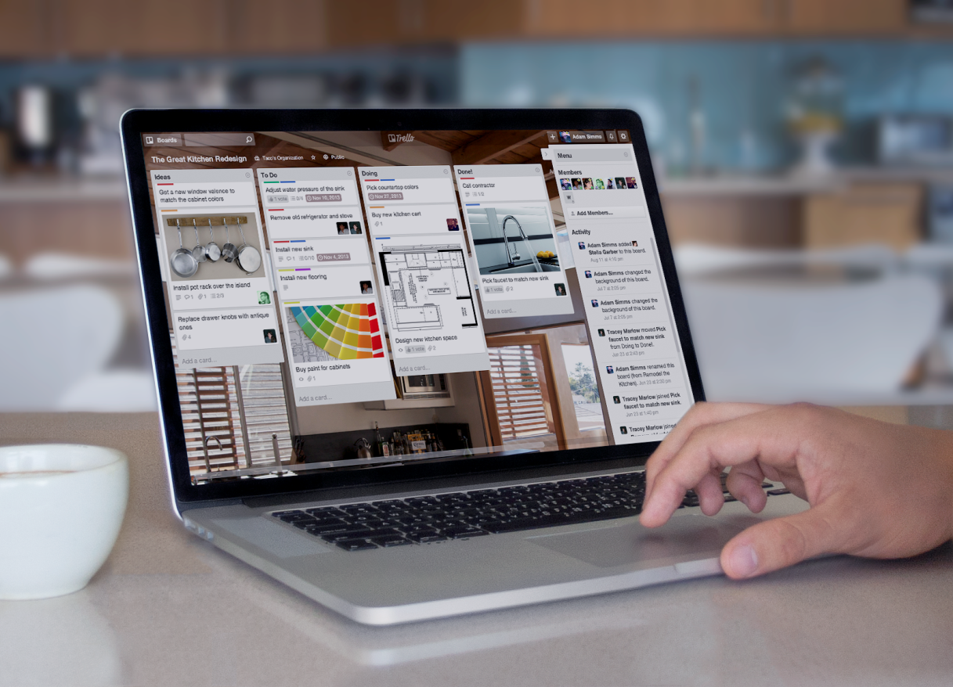

Object for testing:
Trello: a web-based project management application that has a variety of work and personal uses including real estate management, software project management, lesson planning and law office case management.

Slide 3

Agenda
Smoke testing
Functional testing:
- suitability
- security
- interoperability
Non-functional testing:
- localization
- internationalization

Slide 4
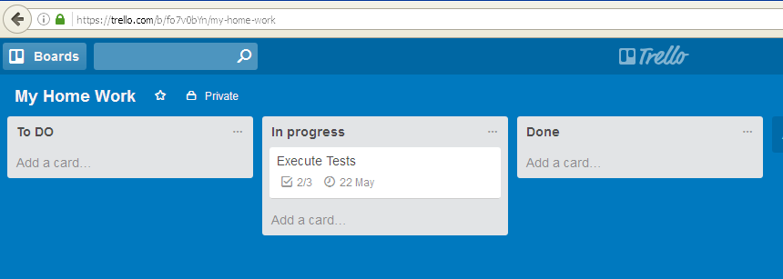

Smoke testing
Requirement: As a User, I want to create a new board so I can manage my project
Testing Procedure:
Open URL: https://trello.com
Log in to the system
Click the "+" in the header and select “Create Board…"
Enter the title of a new board
Expected result:
A new board is created

Slide 5
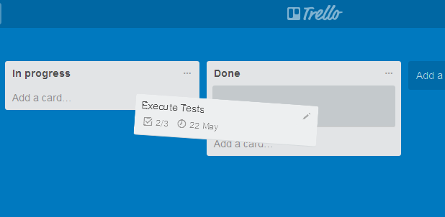
Positive testing
Requirement: As a User, I want to move the cards from list to list on the board to indicate progress in my project
Testing Procedure:
Open URL: https://trello.com
Log in to the system
Open the existing board
Drag and drop a card from one list to another
Expected result:
A card from one list
is moved to another list

Slide 6
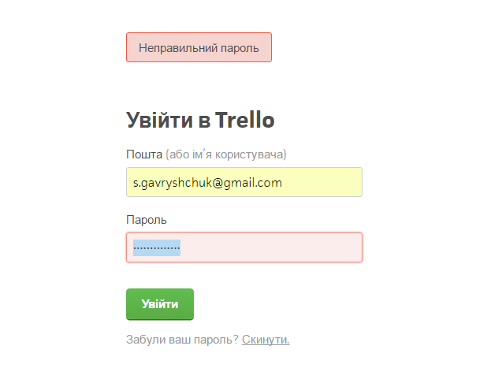

Negative testing
Requirement : As a registered User I should enter a valid password in ‘Password’ field to enter the system
Testing Procedure:
Open URL: https://trello.com/login
Type valid values into ‘Email’ field
Type invalid password into ‘Password’ field
Press ‘Log in’ button
Expected result:
1. The user is not logged in
2. Entered in ‘Password’ field symbols are transformed into bullets
3. An error message is displayed

Slide 7
Functional testing: suitability
Requirement: As a User, I want adding members to the board so I allow everyone to visually see each phase of the project
Testing Procedure:
Open URL: https://trello.com
Log in to the system
Open an existing board
Click the sidebar menu on the right hand side
Click the “Add Members” button and enter their name (if they’re on Trello) or their email address (if they’re new to Trello)
Select members to be added

Slide 8
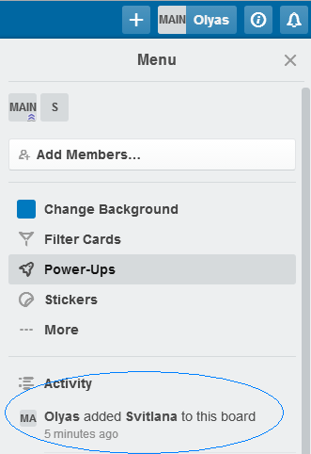
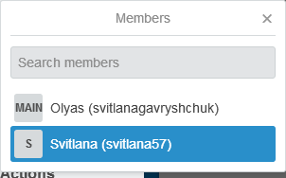
Functional testing: suitability
Expected result:
New members are shown in a
“Members” section of the board

Slide 9
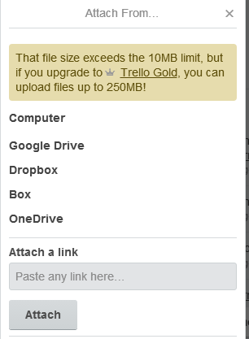
Functional testing: security
Requirement: With Trello Free user can attach files up to 10MB
Testing Procedure:
Open URL: https://trello.com
Log in to the system
Open an existing board
Click the front of the card to open it
Click the "Attachment" button on the right side of the card to upload
Choose the file from a drive which size is more than 10MB
Expected result:
The file is not uploaded

Slide 10

Functional testing: interoperability
Requirement : As a User I want to log in using my Google Account.
Testing Procedure:
Open URL: https://trello.com
Click ‘Sign in with Google’ button
Enter Google Account data
Click ‘Create new Trello account’
Expected result:
The user is registered and logged in

Slide 11
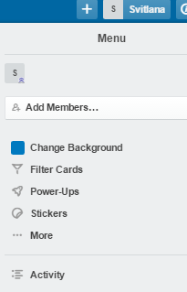
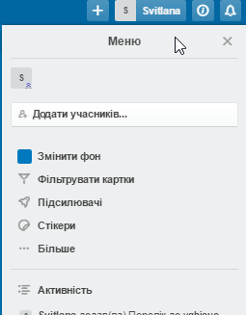
Non-functional testing: localization
Requirement: As a User I want to change the language from ukrainian to english, so all service information should be translated into english
Testing Procedure:
Open URL: https://trello.com
Log in to the system
Click user profile menu in the right top corner of the page
Click ‘Змінити мову…’ link
Choose ‘English ‘language
Check whether service information
on the page is translated into English
Expected result:
All service information on the page
is translated into selected language.

Slide 12
Non-functional testing: internationalization
Requirement: As a User I want to see data/time formats are displayed according to selected locale
change the language from ukrainian to english, so all service information should be translated into english
Testing Procedure:
Open URL: https://trello.com
Log in to the system
Click user profile menu in the right top corner of the page
Click ‘Змінити мову…’ link
Choose ‘English ‘language
Check whether data/time formats are displayed according to selected locale

Slide 13
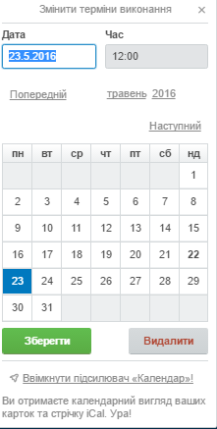
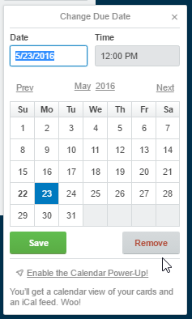
Non-functional testing: internationalization
Expected result:
Data/time formats
are displayed
according to US location

Slide 14
Thank you !

