Slide 1


Smart Traffic Flow Optimization with Multi Agent Reinforcement Learning
Group 25-26J-473
1

Slide 2




Our Team
Luvinson I
IT22323316
Sangeerthan S
IT22346568
Krushanth A
IT22920218
Fernandopulle S N
IT22000576
2

Slide 3
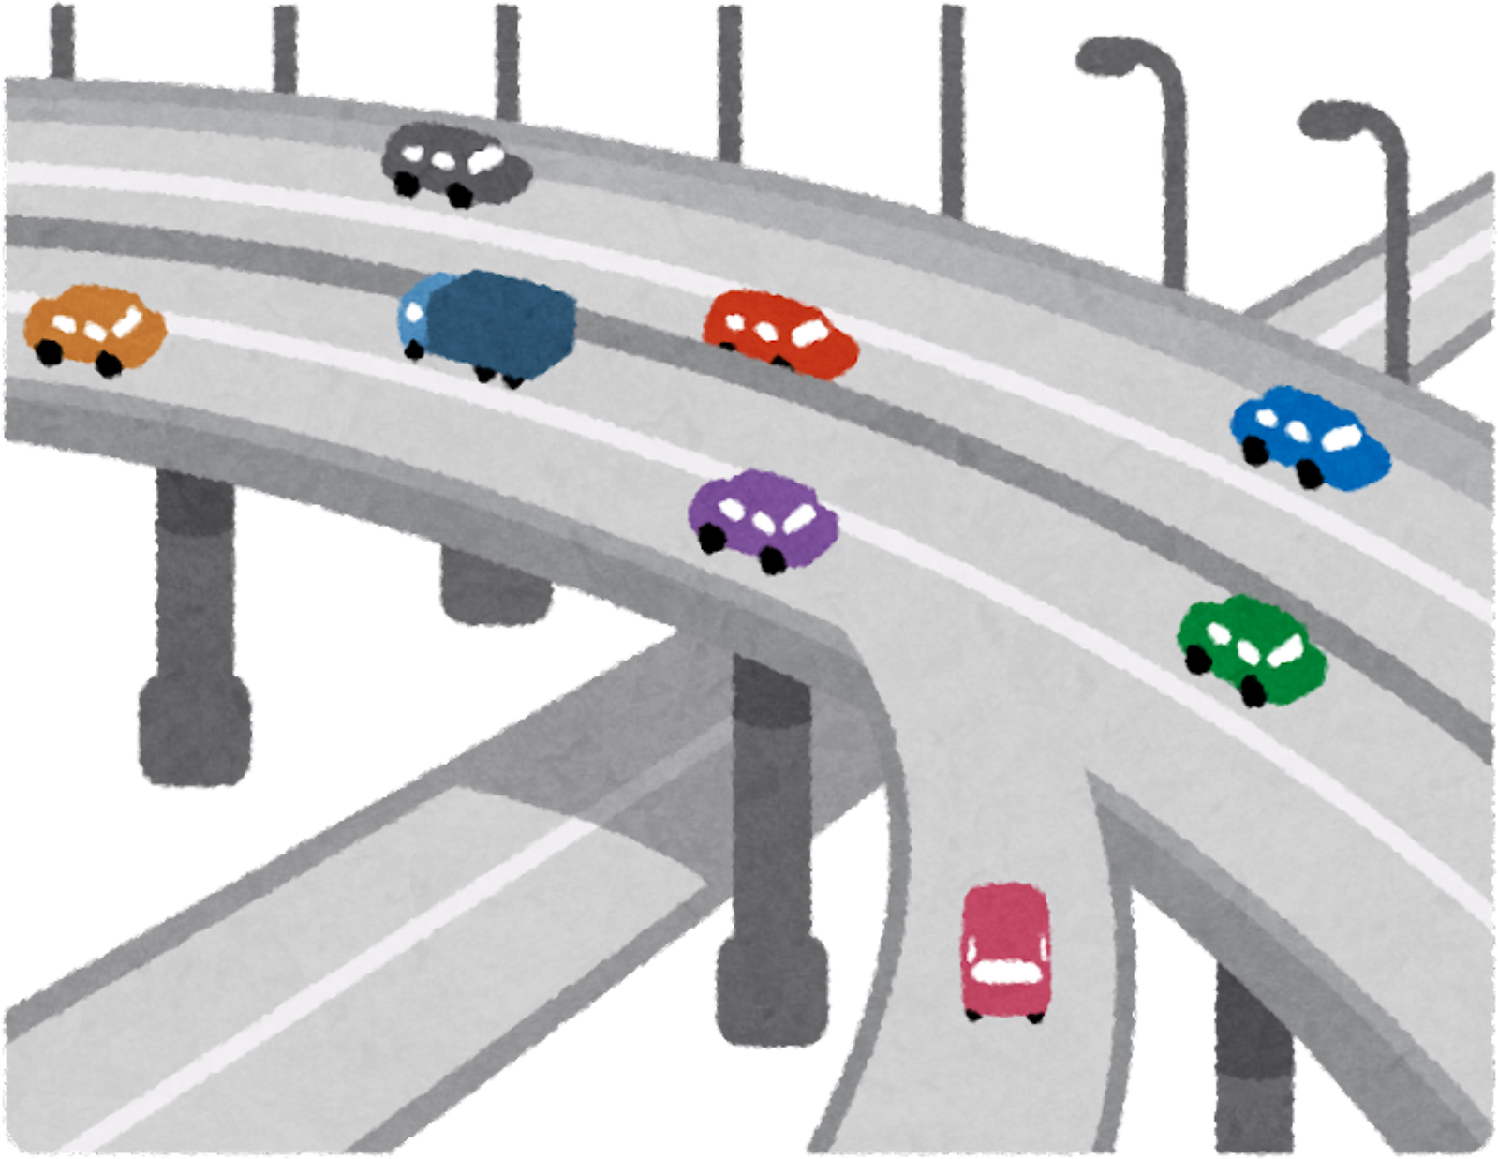
Introduction
Research Problem & It’s Impact
1
  Problem Solution
  2
  Beneficiaries by the solution
  3
Overall System Diagram and
  Design Excellece
  4
3

Slide 4
Research Problem ,Research Gap and Solution
Video Link - https://drive.google.com/file/d/19A2HQQNmodHreLTcJSCrmI4FNYjO6MdJ/view?usp=sharing
4

Slide 5
IT22920218 | Krushanth A
Software Engineering
Reinforcement Learning Problem Formulation for Traffic Signal Control Agents
IT22920218 | Krushanth A | 25-26J-473 | Date: 06/01/2026
5

Slide 6
EMERGENCY VEHICLE DETECTION AND TRIGGERING SIGNAL
Solution Approach for the Identified Sub-Problem
Optimizing Traffic Signal Control
  State Observation – Monitor real-time traffic conditions such as vehicle counts, queue lengths, and active signal phases from the traffic environment.
  Action Selection – Dynamically decide whether to extend, switch, or hold traffic signal phases based on current intersection conditions.
Memory-Based Learning – Store past traffic states and signal decisions to guide future actions and improve decision quality over time.
User Requirements Fulfilled by the Solution
  Real-time adaptive traffic signal control based on live traffic conditions
  Reduced vehicle waiting time and intersection congestion
  Autonomous signal decision-making without fixed-time schedules
IT22920218 | Krushanth A | 25-26J-473
06/01/2026
6

Slide 7
EMERGENCY VEHICLE DETECTION AND TRIGGERING SIGNAL
  Single-Agent Reinforcement Learning Architecture – Utilizes a learning-based traffic signal controller that adapts signal timing decisions based on real-time traffic conditions.
  Memory-Based Decision Mechanism – Leverages historical traffic state–action outcomes to guide future signal control decisions and improve performance over time.
Design Excellence/Contribution
User Feedback on Prototype
  Users reported that the traffic signal control interface was easy to understand and intuitive, especially the clear visualization of junction status and active signal phases.
  Users appreciated the decision explanation feature, which improved trust in automated signal control.
IT22346568 | Sangeerthan S | 25-26J-473
06/01/2026
7

Slide 8
IT22000576 | Fernandopulle S N
Software Engineering
CENTRALIZED TRAINING AND DECENTRALIZED
EXECUTION OF MULTI-AGENT REINFORCEMENT LEARNING SYSTEM FOR COOPERATIVE TRAFFIC SIGNAL CONTROL
8

Slide 9

COMPONENT 2 : CENTRALIZED TRAINING AND DECENTRALIZED EXECUTION OF REINFORCEMENT LEARNING AGENT SYSTEM FOR COOPERATIVE TRAFFIC SIGNAL CONTROL
  Current traffic light control systems operate in isolation, each focusing only on its own individual intersections.
  This fragmented approach fails to address the interconnected nature of urban traffic, often leading to cascading congestion and inefficiencies across the wider road network.
Limitations of Current Systems
Problem Definition
IT22000576 | Fernandopulle S N | 25-26J-473 | Date: 06/01/2026
9

Slide 10
COMPONENT 2: CENTRALIZED TRAINING AND DECENTRALIZED EXECUTION OF REINFORCEMENT LEARNING AGENT SYSTEM FOR COOPERATIVE TRAFFIC SIGNAL CONTROL
  Current traffic light control systems operate in isolation, each focusing only on its own individual intersections.
  This fragmented approach fails to address the interconnected nature of urban traffic, often leading to cascading congestion and inefficiencies across the wider road network.
Limitations of Current Systems
Limitations of Current Systems
Problem Definition
Problem Definition
IT22000576 | Fernandopulle S N | 25-26J-473 | Date: 06/01/2026
10

Slide 11


COMPONENT 2 : CENTRALIZED TRAINING AND DECENTRALIZED EXECUTION OF REINFORCEMENT LEARNING AGENT SYSTEM FOR COOPERATIVE TRAFFIC SIGNAL CONTROL
VDN Mixing Network
a_1 agent_1(s_1)
Q1(s_1, a_1)
Global Reward (r)
Q_tot
Global Reward (r)
Work
Breakdown & real-world
Implementation
Optimizer
System
Overview
a_2 agent_2(s_2)
Q2(s_2, a_2)
loss
Experience Replay Buffer
States
Actions
Rewards
Next State
Backpropogation
Qn(s_n, a_n)
a_n agent n(s_n)
Centralized Training Arc
IT22000576 | Fernandopulle S N | 25-26J-473 | Date: 06/01/2026
11
Notes:
this is the multi agentic network. each takes their local observations (queue lengths, waiting times etc) and outputs and actions.
these observations and actions are used to create their Q value through their NN and all are stored in this experience replay buffer.
a small batch of these expereinces along with the cumulative Q value will be fed into the VDN mixing network and there it will will compared within the optimizer (adam) to output the loss through thr loss fucntion.
the error signal from this loss is backpropagated through the Mixing Network and down into the individual networks of every agent. This updates all agent networks to improve their collective performance.
loop

Slide 12

User Requirements
COMPONENT 2: CENTRALIZED TRAINING AND DECENTRALIZED EXECUTION OF REINFORCEMENT LEARNING AGENT SYSTEM FOR COOPERATIVE TRAFFIC SIGNAL CONTROL
  The system shall reduce average vehicle waiting time at intersections by compared to fixed-time traffic lights
  Intersections shall coordinate with neighboring intersections to optimize city-wide traffic flow
  Scalability
  Traffic signals shall adjust timing based on real-time vehicle queues
  A dashboard that shows system comparison prediction before switching to the system
  flexibilty to switch in between systems controls
s
Work
Breakdown & real-world
Implementation
messages
a
System
Overview
s
Functional Requirements
a
  VDN Architecture Implementation through CT
  DE with Real-time Control
  Lightweight Communication Protocol for inter agent communication
  Dashboard Integration for metrics analysis and research purposes
messages
s
a
IT22000576 | Fernandopulle S N | 25-26J-473 | Date: 06/01/2026
12

Slide 13
IT22346568 | Sangeerthan S
Software Engineering
EMERGENCY VEHICLE DETECTION AND TRIGGERING SIGNAL IN SUMO SIMULATOR
IT22346568 | Sangeerthan S | 25-26J-473
06/01/2026
13

Slide 14
EMERGENCY VEHICLE DETECTION AND TRIGGERING SIGNAL
Solution Approach for the Identified Sub-Problem
Identifying the Emergency Vehicles
  Vision-Based Detection - Detect emergency vehicles using object detection models from camera feeds.
  Audio-Based Detection - Identify emergency siren sounds using sound classification techniques.
  Light Pattern Detection - Detect flashing siren lights based on color and intensity patterns.
User Requirements Fulfilled by the Solution
  Real-time visualization of emergency vehicle detection status
  Automatic traffic signal override for emergency vehicles
  Notification alerts when emergency vehicles are detected
  Management and review of detected video and event data
IT22346568 | Sangeerthan S | 25-26J-473
06/01/2026
14

Slide 15
EMERGENCY VEHICLE DETECTION AND TRIGGERING SIGNAL
Design Excellence/Contribution
  Multi-Modal Detection Architecture-Combines vision-based, audio-based, and light-based detection to improve accuracy and reduce false positives.
  Event-driven traffic signal prioritization integrated with SUMO TraCI interface
  Scalable architecture suitable for real-world smart city deployment
User Feedback on Prototype
  Users reported that the emergency vehicle detection system was easy to understand and intuitive to use mention about location based UI.
  The real-time visualization of detected emergency vehicles was considered clear and informative.
IT22346568 | Sangeerthan S | 25-26J-473
06/01/2026
15

Slide 16
IT22323316 | Luvinson I
Software Engineering
PEDESTRIAN DETECTION AND
SIGNAL ADJUSTMENT
IT22323316 | Luvinson I | 25-26J-473
06/01/2026
16

Slide 17
PEDESTRIAN DETECTION AND SIGNAL ADJUSTMENT
Solution Approach for the Identified Sub-Problem
  Vision-Based Pedestrian Detection
    Detect pedestrians at intersections using a YOLOv8 object detection model on camera feeds.
  Mobility-Based Pedestrian Classification
    Classify pedestrians into Adult, Elder, Student, and Mobility Aid categories.
  Improper Pedestrian Behavior Detection
    Identify pedestrians crossing outside designated crosswalks or during red signal phases.
    Maintain counts of rule-violating pedestrians.
  Adaptive Signal Timing Support
    Increase pedestrian crossing time when students or mobility aid users are detected.
    Provide safety-aware inputs to traffic signal control logic.
  Integration with RL Agents (SUMO)
    Share pedestrian classification and violation data with reinforcement learning agents.
    Enable adaptive and pedestrian-prioritized signal optimization.
  Dashboard Visualization
    Display detections, classifications, and rule-violation counts in a web-based interface.
IT22323316 | Luvinson I | 25-26J-473
06/01/2026
17

Slide 18
PEDESTRIAN DETECTION AND SIGNAL ADJUSTMENT
User Requirements Fulfilled by the Solution
  Real-time visualization of pedestrian detection and classification
  Automatic adjustment of pedestrian crossing time for vulnerable users
  Detection and counting of pedestrians violating traffic rules
  Safety-aware inputs to reinforcement learning–based signal control
  Review of detected pedestrian and event data
IT22323316 | Luvinson I | 25-26J-473
06/01/2026
18

Slide 19
PEDESTRIAN DETECTION AND SIGNAL ADJUSTMENT
Design Excellence/Contribution
  Vision-based pedestrian detection and mobility classification using a custom-trained YOLOv8 model
  Pedestrian-aware adaptive signal timing integrated with SUMO and reinforcement learning agents
  Rule-violation detection to improve pedestrian safety and traffic decision-making
  Modular and scalable design suitable for smart city traffic systems
User Feedback on Prototype
  Users reported that the pedestrian detection and classification dashboard was easy to understand and intuitive to use.
  The real-time visualization of pedestrian categories and detections was considered clear and informative.
IT22323316 | Luvinson I | 25-26J-473
06/01/2026
19

Slide 20
Commercialization
Offer the target audience a software-driven solution to reduce congestion and citizen commute times. Steps;
  Protect the Intellectual Property
  Create a Minimal Viable deployable Product
  Offer a free pilot program to a targeted municipality or a large commercial property
  Charge an annual subscription fee per intersection controlled
  Partner with Hardware Vendors to increases the value of their hardware, thereby they becoming a sales channel
Target Market
Customer Profile
  Government traffic management authorities
  City councils
  Ambulances, fire brigades, and police departments
  Smart city solution providers
  IoT companies
  Traffic control center operators
  City planners and officials
  Emergency dispatch teams
  Everyday pedestrians and drivers
Value propositions
  Smart traffic signal system allowing intersections to communicate & learn optimal patterns.
  Safer for pedestrians with disabilities & children when crossing the road
  Real-time signal preemption system for vehicle detection that allows priority for instances such as ambulances and other emergency vehicles
  System testing before deployment with SUMO therefore low-risk in deployment
  UI for logging and monitering real-time analytics
20
Notes:
Academic Value & Funding:
Project recognized under final-year research, reducing future academic costs.
Potential for university research grants or government innovation funds (ITS/AI).
Commercialization & Cost Recovery:
Licensing to municipalities / smart city projects for real-time traffic management.
Subscription-based dashboard service for traffic departments (monthly hosting fees).
Partnerships with transportation authorities → deployment reduces congestion & fuel loss → cost justified.
Scalability & Sustainability:
Cloud-based infrastructure can be scaled with minimal recurring costs.
Once deployed, low maintenance compared to infrastructure-heavy solutions.
Future integration into Sri Lanka Intelligent Transportation Systems (ITS) can open commercialization opportunities.
Recovery Path: Initial cost (~LKR 130,000) is recovered through a combination of research funding, institutional adoption, and future commercialization of the traffic optimization platform.
----------------
commercialization
Municipalities & City Councils: Offer them a software-driven solution to reduce congestion and without the massive cost of expensive smart infrastructure. Companies that already provide hardware/software to cities. License your algorithm as a "Smart Coordination Module" they can integrate into their existing offerings, making their products more advanced and competitive.
in doing so;
Step 1;Protect the Intellectual Property (IP). File for a software patent
Step 2;
Step 3;
Step 4;Choose a Licensing Business Model.
Software-as-a-Service (SaaS)

Slide 21
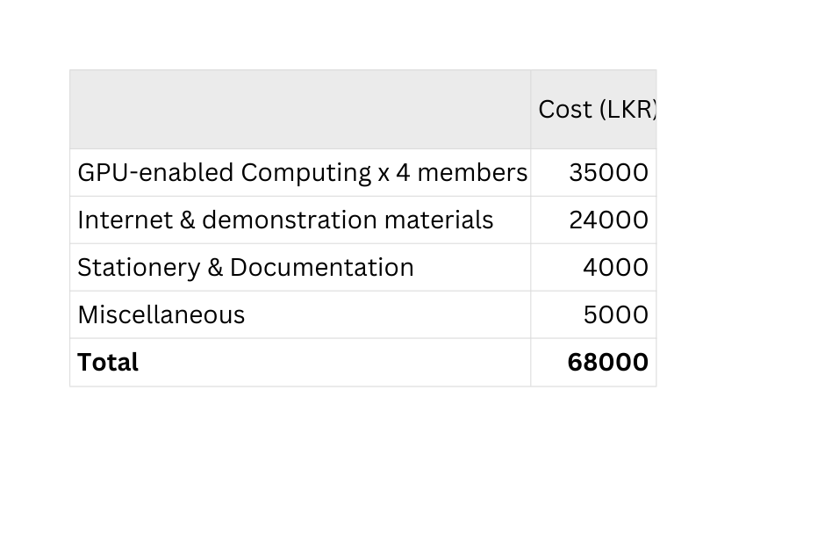
Intellectual property rights
  Codebase, algorithms, and datasets will be copyright protected.
  Patentable innovations - The pedestrian-aware MARL traffic signals, dashboard integration
  Proprietary assets - labeled datasets for pedestrians, mobility detection
  Branding will follow a licensing or SaaS business model - “Traffixion” (System name), “SafeCity AI Traffic Manager” (Trademarked Headline)
Investment Cost
Cost Recovery
Academic Value & Funding:
  Project recognized under final-year research through awards and recognitions
  Potential for university research grants or government innovation funds (ITS/AI).
Cost Recovery through Commercialization:
  Licensing to municipalities / smart city projects for real-time traffic management.
  Subscription-based dashboard services for traffic departments (monthly hosting fees).
  Partnerships with transportation authorities
  Future integration into Sri Lanka Intelligent Transportation Systems (ITS)
Recovery Path: Initial cost (~LKR 130,000) is recovered through a combination of research funding, institutional adoption, and future commercialization of the traffic optimization platform.
21
Notes:
1. Target Market (What to say)
“Our main target market includes government traffic management authorities and city councils, who are actively seeking smart traffic solutions for urban congestion.
We also focus on emergency services like ambulances, fire brigades, and police departments, who benefit from faster signal preemption.
Another key segment is smart city solution providers and IoT companies that want to integrate AI-based traffic systems.
Global development projects and NGOs working on smart infrastructure are also potential customers, as they fund modernization of traffic systems.”
🔹 2. Customer Profile (What to say)
“Our customers include traffic control center operators who need real-time dashboards to make decisions quickly.
City planners and officials will use this system for long-term infrastructure decisions based on traffic data.
Emergency dispatch teams will directly benefit by having priority at intersections, reducing response time.
Finally, everyday pedestrians and drivers are indirect beneficiaries—experiencing safer crossings, fewer delays, and smoother commutes.”
🔹 3. Value Proposition (What to say)
“Unlike traditional fixed-time or simple adaptive traffic systems, our system introduces multi-agent reinforcement learning for traffic signals, allowing intersections to communicate and learn optimal patterns.
We use computer vision models to classify pedestrians by age and detect mobility aids like wheelchairs, ensuring vulnerability-aware crossings.
The system integrates YOLOv8-based emergency vehicle detection, enabling real-time signal preemption.
By running this in the SUMO simulator first, we guarantee safe, risk-free testing before deployment.
All this is managed via an intuitive dashboard for monitoring, making it both powerful and user-friendly.”
🔹 4. Intellectual Property Rights (What to say)
“Our codebase, algorithms, and datasets will be copyright protected.
The pedestrian-aware MARL control algorithms and dashboard integration are patentable innovations.
Our labeled datasets for pedestrians and mobility detection will be proprietary assets.
Branding, like ‘SafeCity AI Traffic Manager,’ will be trademark protected, and commercialization will follow a licensing or SaaS business model for cities.”

Slide 22
THANK YOU
25-26J-473
06/01/2026
22

Slide 23
Q & A
25-26J-473
06/01/2026
23

