Slide 1


Smart Traffic Flow Optimization with Multi Agent Reinforcement Learning
Group 25-26J-473
1

Slide 2




Our Team
Luvinson I
IT22323316
Sangeerthan S
IT22346568
Krushanth A
IT22920218
Fernandopulle S N
IT22000576
2

Slide 3
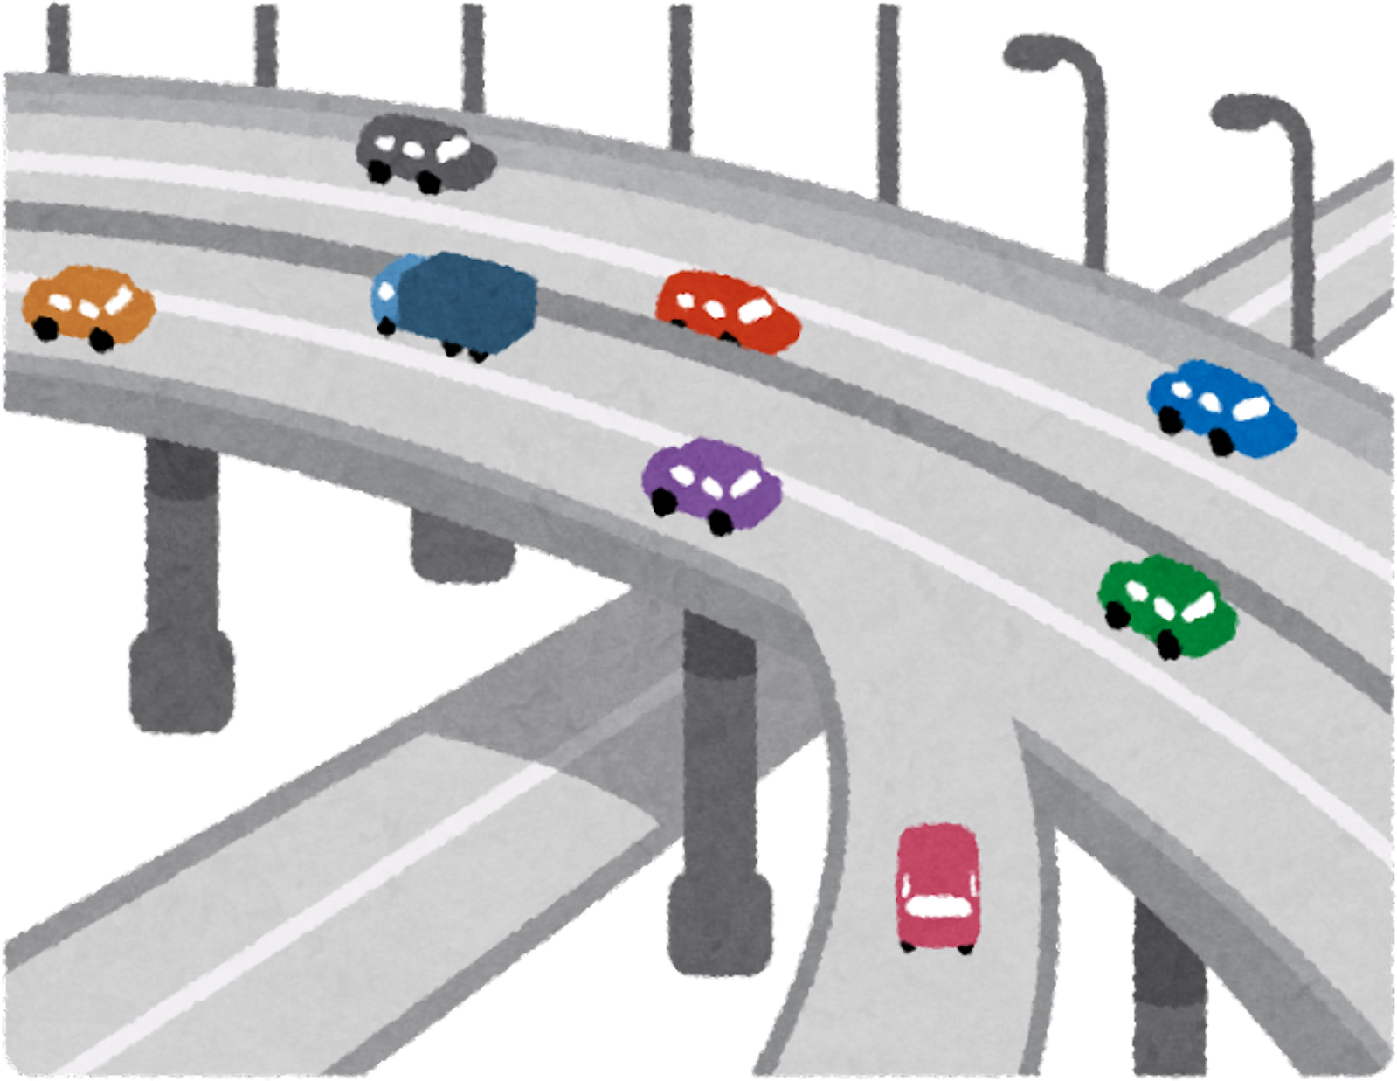
Introduction
Problem Statement & Stakeholders
1
  Research Gap & Objectives
  2
  Solution Overview (What We Built)
  3
  4
  System Architecture & Integration
  5
  Commercialization / Impact
3

Slide 4
Problem Statement & Stakeholders
  Context : Urban traffic management in smart city environments, with intelligent traffic control with real-time sensing and adaptive signal systems.
  Stakeholders:
  Primary users: Traffic control authorities, Emergency vehicle drivers
  Secondary users: Daily commuters, pedestrians, and public transport operators
  Decision makers: City traffic management departments, smart city planners, and municipal authorities
  Observed issue : Traditional traffic signal systems rely on static timing plans, which cannot adapt to real-time traffic conditions, causing increased congestion, long vehicle waiting times, and delayed emergency vehicle movement at intersections.
4

Slide 5
Stakeholders details , Design excellence , Solution overview
Video Link - https://drive.google.com/file/d/1uqDFj2NN2vXGW4y0fyfxnS794WNUMJLP/view?usp=sharing
5

Slide 6
Research gap & Objectives
Gap : Most traffic signal systems focus on single-intersection vehicle flow and rely on static or centralized control, which limits real-time adaptability and scalability.
Gap : They also lack multi-modal emergency vehicle detection, intersection coordination, and adaptive pedestrian support needed for smarter citywide traffic management.
Main Objective : To develop an intelligent decentralized traffic signal control system using Multi-Agent Reinforcement Learning (MARL) that optimizes traffic flow in real time while prioritizing emergency vehicles and improving pedestrian safety.
6

Slide 7
Solution Overview
1
An intelligent smart traffic management system using Multi-Agent Reinforcement Learning and real-time emergency vehicle detection to dynamically optimize traffic signals and improve urban traffic flow.
  2
FR1: Real-time emergency vehicle detection using audio and vision-based detection.
FR2: Adaptive traffic signal control using Multi-Agent Reinforcement Learning to reduce congestion and waiting time.
FR3: Smart pedestrian assistance system with adaptive crossing signals.
  3
System implementation, simulation integration, and dashboard visualization are completed, with the project currently at ~90% completion.
7

Slide 8
Solution Overview
Video Link - https://drive.google.com/file/d/1FmF1OFh5o4AlMhmpVAbuuwQxp4s63HQe/view?usp=sharing
8

Slide 9
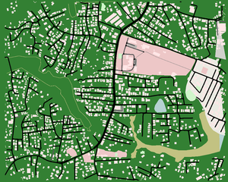




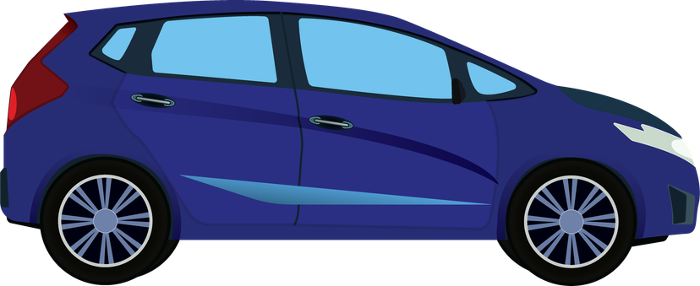

System Architecture & Integration
Emergency vehicles
Databases
SUMO Environment
Pedestrians
Decisions via Traci
Physical demo
States via Traci
Vehicles
Analytics
Agent control on laptop
IoT
Live Dashboard
Live data via sockets
9
Notes:
this is the multi agentic network. each takes their local observations (queue lengths, waiting times etc) and outputs and actions.
these observations and actions are used to create their Q value through their NN and all are stored in this experience replay buffer.
a small batch of these expereinces along with the cumulative Q value will be fed into the VDN mixing network and there it will will compared within the optimizer (adam) to output the loss through thr loss fucntion.
the error signal from this loss is backpropagated through the Mixing Network and down into the individual networks of every agent. This updates all agent networks to improve their collective performance.
loop

Slide 10
IT22920218 | Krushanth A
Software Engineering
Vehicle Detection and Traffic State Generation Module
IT22920218 | Krushanth A | 25-26J-473 | Date: 06/01/2026
10

Slide 11
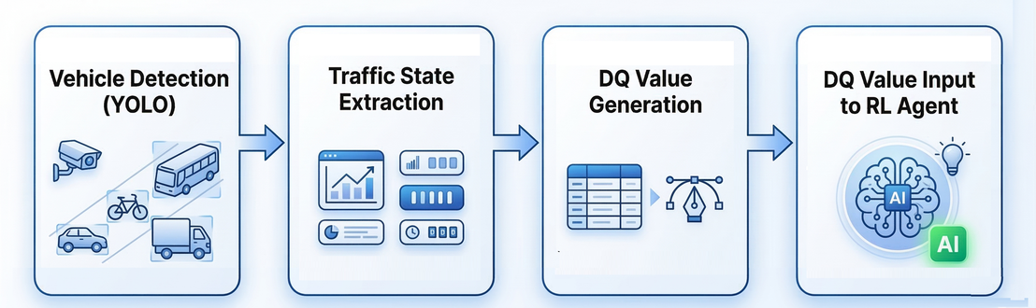
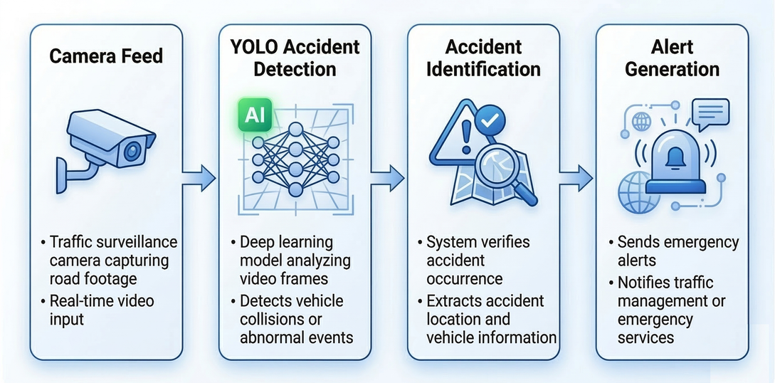
Vehicle Detection and Traffic State Generation Module
How it works
  Vehicles detected using YOLO model
  Vehicles classified (car, bike, bus, truck, auto)
  Queue length calculated for each road
  Traffic features converted into DQ state values
Output
  Generates structured traffic state data
  Sends state vector to Reinforcement Learning agent
Real-Time Accident Detection Using YOLO
IT22920218 | Krushanth A | 25-26J-473 | Date: 06/01/2026
11

Slide 12
COMPONENT 1 : CENTRALIZED TRAINING AND DECENTRALIZED EXECUTION OF REINFORCEMENT LEARNING AGENT SYSTEM FOR COOPERATIVE TRAFFIC SIGNAL CONTROL
IT22000576 | Fernandopulle S N
Software Engineering
CENTRALIZED TRAINING AND DECENTRALIZED
EXECUTION OF MULTI-AGENT REINFORCEMENT LEARNING SYSTEM FOR COOPERATIVE TRAFFIC SIGNAL CONTROL
IT22000576 | Fernandopulle S N | 25-26J-473 | Date: 11/03/2026
12

Slide 13

COMPONENT 1 : CENTRALIZED TRAINING AND DECENTRALIZED EXECUTION OF REINFORCEMENT LEARNING AGENT SYSTEM FOR COOPERATIVE TRAFFIC SIGNAL CONTROL
Implementing a cooperative multi-agent reinforcement learning agent system with Centralized Training and Decentralized Execution using
Value Decomposition Architecture
VDN
Framework
Value
Decomposition
Centralized
Training
Tools &
Technologies
  The core of the system
  Uses Centralized training - All junctions share the same experience
  Decentralized execution - perform with all the experiences
  Lightweight communication protocol - shares data between neighboring agents for better city-wide traffic management
  Dashboard - to manage and monitor the area traffic
  Fallback mechanisms - for flexibility in extreme scenarios
Decentralized
Execution
IT22000576 | Fernandopulle S N | 25-26J-473 | Date: 11/03/2026
13

Slide 14
IT22346568 | Sangeerthan S
Software Engineering
EMERGENCY VEHICLE DETECTION AND TRIGGERING SIGNAL IN SUMO SIMULATOR
IT22346568 | Sangeerthan S | 25-26J-473
06/01/2026
14

Slide 15
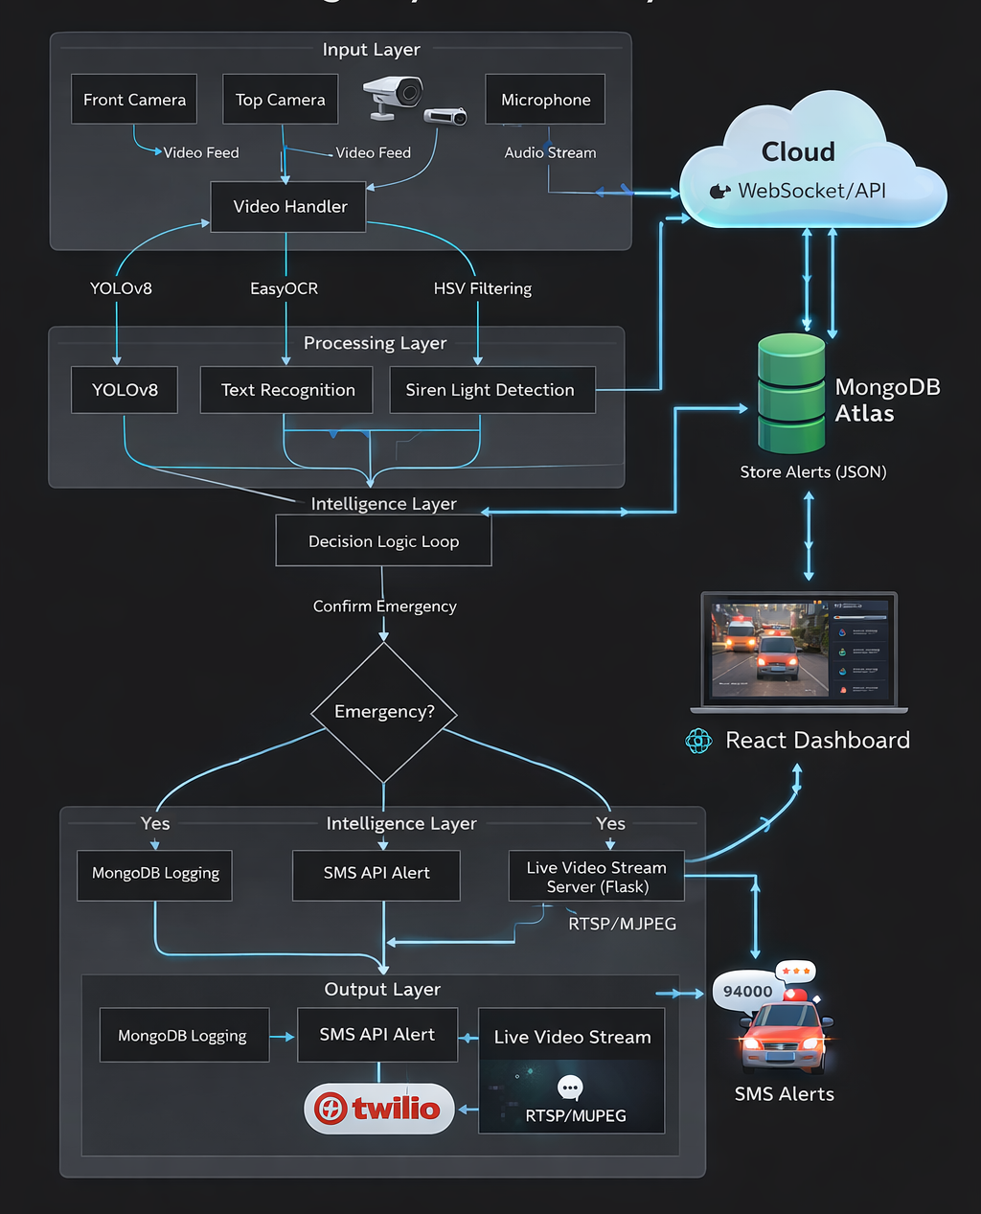
EMERGENCY VEHICLE DETECTION AND TRIGGERING SIGNAL
Solution Approach for the Identified Sub-Problem
Vision-Based Detection - Detect emergency vehicles using object detection models from camera feeds with yolov8.
Audio-Based Detection - Identify emergency siren sounds using sound classification techniques with YAMNnet.
Light Pattern Detection - Detect flashing siren lights based on color and intensity patterns.
IT22346568 | Sangeerthan S | 25-26J-473
06/01/2026
15

Slide 16
EMERGENCY VEHICLE DETECTION AND TRIGGERING SIGNAL
Research Survey and Data Collection
Video Link - https://drive.google.com/file/d/1bTZ4_Bn5wMiLCSUawtOgwx8YvyopiloK/view?usp=sharing
IT22346568 | Sangeerthan S | 25-26J-473
06/01/2026
15

Slide 17
IT22323316 | Luvinson I
Software Engineering
PEDESTRIAN DETECTION AND
SIGNAL ADJUSTMENT
IT22323316 | Luvinson I | 25-26J-473
06/01/2026
16

Slide 18
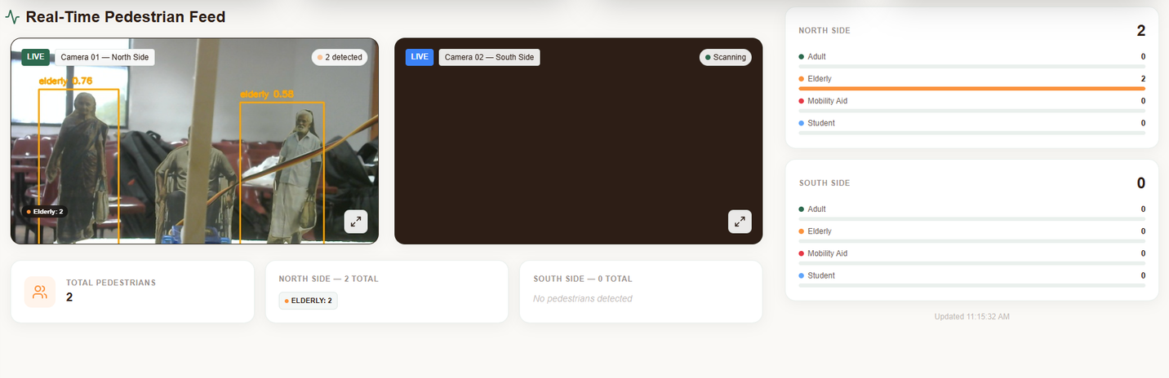
PEDESTRIAN DETECTION AND SIGNAL ADJUSTMENT
Solution Approach for the Identified Sub-Problem
  Vision-Based Pedestrian Detection
    Detect pedestrians at intersections using a YOLOv8 object detection model on camera feeds.
  Mobility-Based Pedestrian Classification
    Classify pedestrians into Adult, Elder, Student, and Mobility Aid categories.
  Adaptive Signal Timing Support
    Increase pedestrian crossing time when students or mobility aid users are detected.
    Provide safety-aware inputs to traffic signal control logic.
  Integration with RL Agents (SUMO)
    Share pedestrian classification and violation data with reinforcement learning agents.
    Enable adaptive and pedestrian-prioritized signal optimization.
  Dashboard Visualization
    Display detections, classifications, and rule-violation counts in a web-based interface.
IT22323316 | Luvinson I | 25-26J-473
06/01/2026
17

Slide 19
Commercialization
Target Market
Customer Profile
  Government traffic management authorities
  City councils
  Ambulances, fire brigades, and police departments
  Smart city solution providers
  IoT companies
  Traffic control center operators
  City planners and officials
  Emergency dispatch teams
  Everyday pedestrians and drivers
Value propositions
  Smart traffic signal system allowing intersections to communicate & learn optimal patterns.
  Safer for pedestrians with disabilities & children when crossing the road
  Real-time signal preemption system for vehicle detection that allows priority for instances such as ambulances and other emergency vehicles
  System testing before deployment with SUMO therefore low-risk in deployment
  UI for logging and monitering real-time analytics
18
Notes:
Academic Value & Funding:
Project recognized under final-year research, reducing future academic costs.
Potential for university research grants or government innovation funds (ITS/AI).
Commercialization & Cost Recovery:
Licensing to municipalities / smart city projects for real-time traffic management.
Subscription-based dashboard service for traffic departments (monthly hosting fees).
Partnerships with transportation authorities → deployment reduces congestion & fuel loss → cost justified.
Scalability & Sustainability:
Cloud-based infrastructure can be scaled with minimal recurring costs.
Once deployed, low maintenance compared to infrastructure-heavy solutions.
Future integration into Sri Lanka Intelligent Transportation Systems (ITS) can open commercialization opportunities.
Recovery Path: Initial cost (~LKR 130,000) is recovered through a combination of research funding, institutional adoption, and future commercialization of the traffic optimization platform.
----------------
commercialization
Municipalities & City Councils: Offer them a software-driven solution to reduce congestion and without the massive cost of expensive smart infrastructure. Companies that already provide hardware/software to cities. License your algorithm as a "Smart Coordination Module" they can integrate into their existing offerings, making their products more advanced and competitive.
in doing so;
Step 1;Protect the Intellectual Property (IP). File for a software patent
Step 2;
Step 3;
Step 4;Choose a Licensing Business Model.
Software-as-a-Service (SaaS)

Slide 20
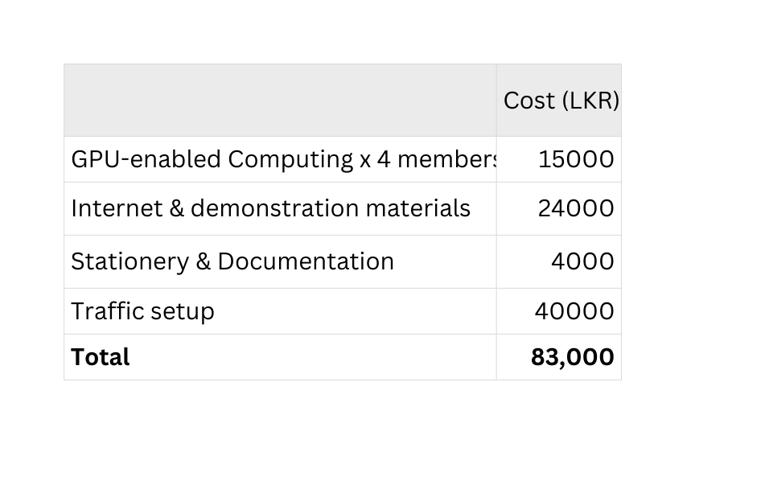
Investment Cost
Cost Recovery
Cost Recovery through Commercialization:
  Licensing to municipalities / smart city projects for real-time traffic management.
  Subscription-based dashboard services for traffic departments (monthly hosting fees).
  Partnerships with transportation authorities
  Future integration into Sri Lanka Intelligent Transportation Systems (ITS)
  Smart City Universities
Recovery Path: Initial cost (~LKR 130,000) is recovered through a combination of research funding, institutional adoption, and future commercialization of the traffic optimization platform.
19
Notes:
1. Target Market (What to say)
“Our main target market includes government traffic management authorities and city councils, who are actively seeking smart traffic solutions for urban congestion.
We also focus on emergency services like ambulances, fire brigades, and police departments, who benefit from faster signal preemption.
Another key segment is smart city solution providers and IoT companies that want to integrate AI-based traffic systems.
Global development projects and NGOs working on smart infrastructure are also potential customers, as they fund modernization of traffic systems.”
🔹 2. Customer Profile (What to say)
“Our customers include traffic control center operators who need real-time dashboards to make decisions quickly.
City planners and officials will use this system for long-term infrastructure decisions based on traffic data.
Emergency dispatch teams will directly benefit by having priority at intersections, reducing response time.
Finally, everyday pedestrians and drivers are indirect beneficiaries—experiencing safer crossings, fewer delays, and smoother commutes.”
🔹 3. Value Proposition (What to say)
“Unlike traditional fixed-time or simple adaptive traffic systems, our system introduces multi-agent reinforcement learning for traffic signals, allowing intersections to communicate and learn optimal patterns.
We use computer vision models to classify pedestrians by age and detect mobility aids like wheelchairs, ensuring vulnerability-aware crossings.
The system integrates YOLOv8-based emergency vehicle detection, enabling real-time signal preemption.
By running this in the SUMO simulator first, we guarantee safe, risk-free testing before deployment.
All this is managed via an intuitive dashboard for monitoring, making it both powerful and user-friendly.”
🔹 4. Intellectual Property Rights (What to say)
“Our codebase, algorithms, and datasets will be copyright protected.
The pedestrian-aware MARL control algorithms and dashboard integration are patentable innovations.
Our labeled datasets for pedestrians and mobility detection will be proprietary assets.
Branding, like ‘SafeCity AI Traffic Manager,’ will be trademark protected, and commercialization will follow a licensing or SaaS business model for cities.”

Slide 21
THANK YOU
25-26J-473
06/01/2026
20

Slide 22
Q & A
25-26J-473
06/01/2026
21

Slide 23
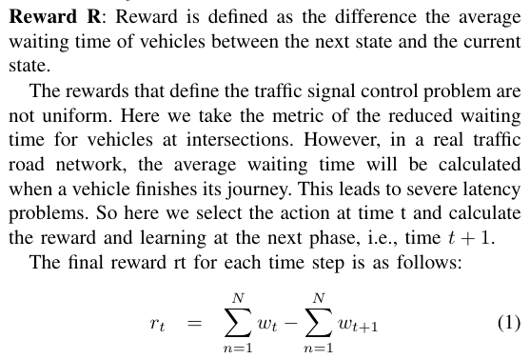
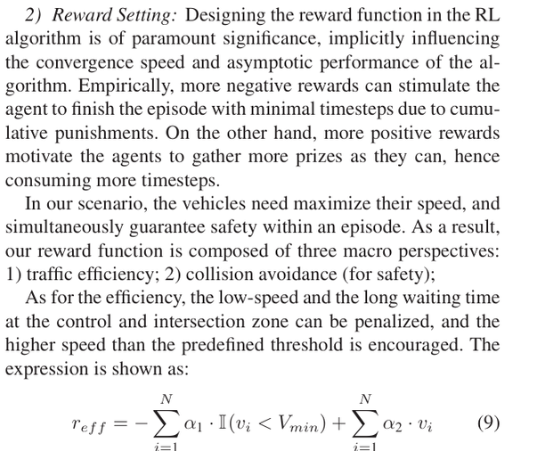
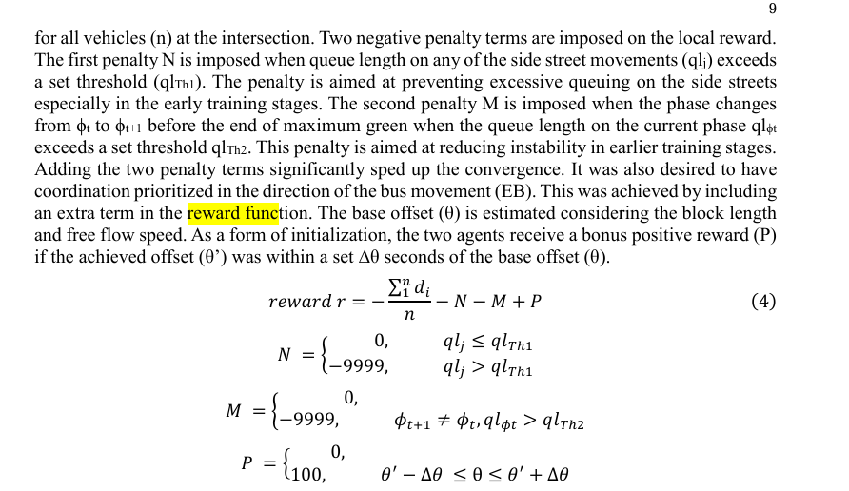
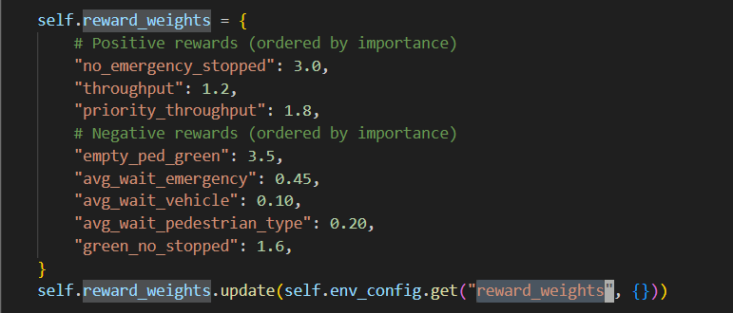
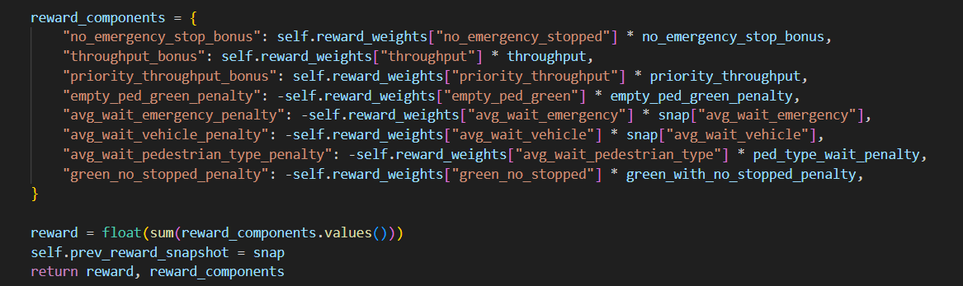
reward = (
-avg_waiting * 0.1 + # Penalize waiting
-total_queue * 0.05 + # Penalize queues
vehicles_left * 0.01 # Reward throughput
)
22

Slide 24
Emergency vehicles/ Pedestrians/ vehicles
Databases
SUMO Environment
Decisions via Traci
Physical demo
States via Traci
Analytics
Agent control on laptop
IoT
Live Dashboard
Live data via sockets
23
Notes:
this is the multi agentic network. each takes their local observations (queue lengths, waiting times etc) and outputs and actions.
these observations and actions are used to create their Q value through their NN and all are stored in this experience replay buffer.
a small batch of these expereinces along with the cumulative Q value will be fed into the VDN mixing network and there it will will compared within the optimizer (adam) to output the loss through thr loss fucntion.
the error signal from this loss is backpropagated through the Mixing Network and down into the individual networks of every agent. This updates all agent networks to improve their collective performance.
loop

Slide 25
VDN Mixing Network
Trained Local Policy Network
a_1 agent_1(s_1)
Q1(s_1, a_1)
Global Reward (r)
Q_tot
Global Reward (r)
Optimizer
Trained Local Policy Network
a_2 agent_2(s_2)
Q2(s_2, a_2)
loss
Experience Replay Buffer
Trained Local Policy Network
States
Actions
Rewards
Next State
Backpropogation
Qn(s_n, a_n)
a_n agent n(s_n)
Centralized Training Arc
Decentralized Execution Arc
IT22920218 | Krushanth A | 25-26J-473 | Date: 11/03/2026
24

