Slide 1

[1]
[2]

Slide 2
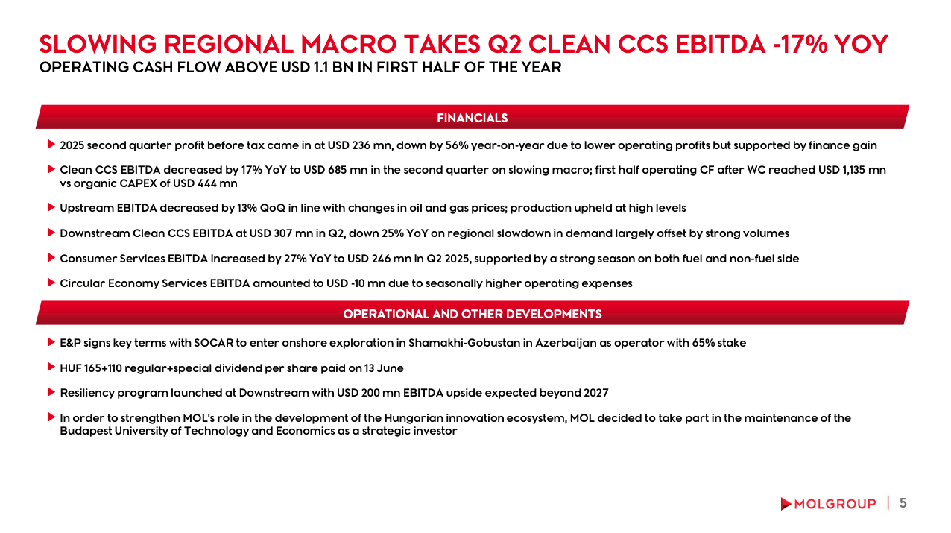
[1]
[2]
FINANCIALS
[3]
OPERATIONAL AND OTHER DEVELOPMENTS
[4]

Slide 3
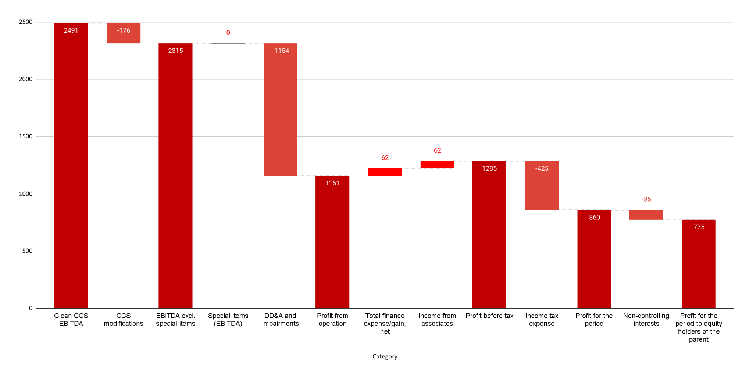
FIRST NINE MONTHS' NET INCOME REACHED USD 775 MN
Q1-Q3 2025 EARNINGS (USD mn) (1) - BELOW THE EBITDA LINE ITEMS

Slide 4
[1]
Clean CCS effect, gain / loss (USD mn)
Comments
[2]
DD&A (USD mn)
[3]
Total Financial expense (+) / gain (-) (USD mn)
[4]
Income from associates (USD mn)
[5]
Income tax expenses (USD mn)
Deferred tax →
16
-2
18
[6]

Slide 5
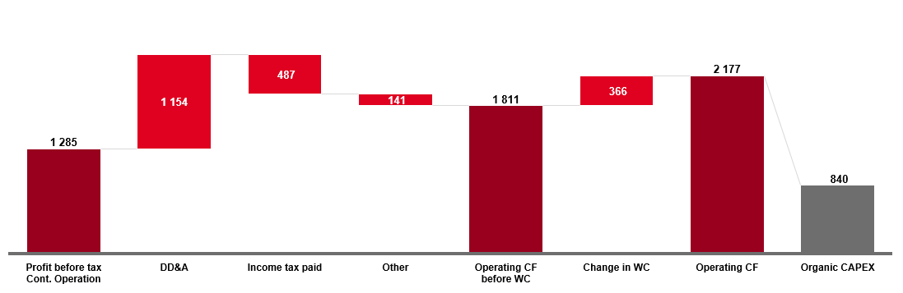
[1]
[2]
OPERATING CASH FLOW IN Q1-Q3 2025 (USD mn)
COMMENTS
[3]

Slide 6
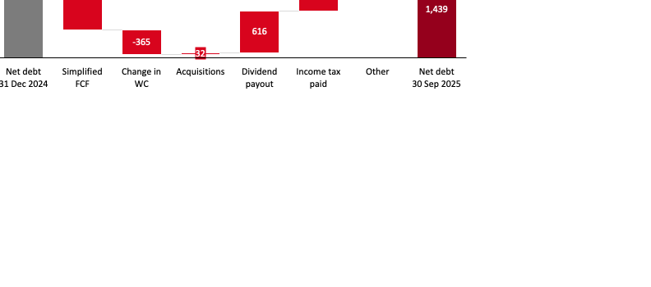
[1]
[2]
NET DEBT TO EBITDA (x)
NET DEBT TO EBITDA (x
GEARING (%)
CHANGES IN NET DEBT IN Q1-Q3 2025 (USD mn)
COMMENTS
CHANGES IN NET DEBT IN Q1-Q3 2025 (USD mn)
COMMENTS
► [1]
► [2]
► MOLGROUP
| 13

Slide 7
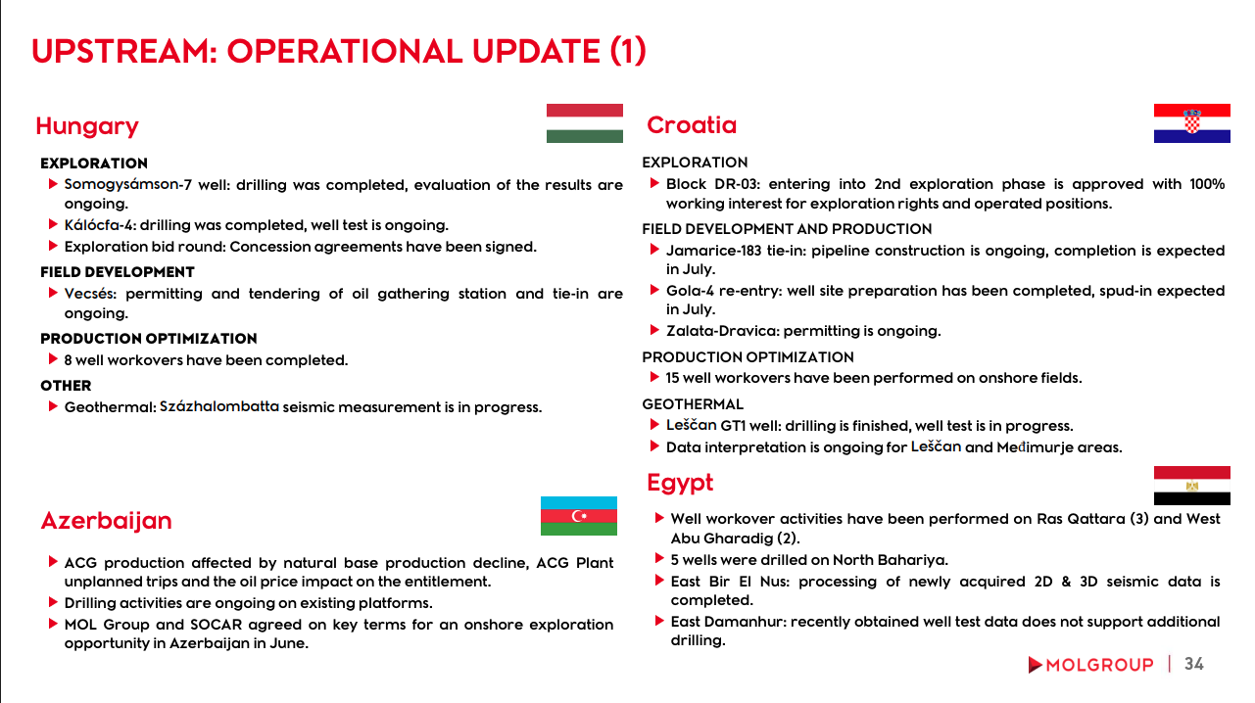
UPSTREAM: OPERATIONAL UPDATE (1)
Hungary
Croatia
EXPLORATION
EXPLORATION
[1]
[5]
FIELD DEVELOPMENT AND PRODUCTION
[6]
FIELD DEVELOPMENT
[2]
PRODUCTION OPTIMIZATION
[3]
PRODUCTION OPTIMIZATION
OTHER
[7]
[4]
GEOTHERMAL
[8]
Egypt
Azerbaijan
[10]
[9]

