Slide 1
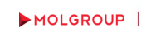
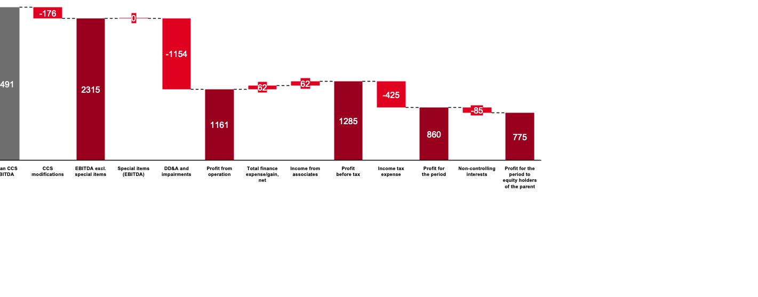
Quarterly Business Review
Q1 2026
FY 2025 EARNINGS (USD mn) - BELOW THE EBITDA LINE ITEMS

