Slide 1

Bayesian Volatility at Scale
> Loading project_proposal.pdf… [OK]
> Parsing Magris & Iosifidis (2023)… [OK]
> Executing VI_GARCH.ipynb… [DONE]
> QML · MCMC · BBVI · Full-cov VI… [OK]
Runtime: NumPy + PyTorch | Data: MSFT | Method: VI
Notes:
- Today I will be discussing 'Bayesian Volatility at Scale.’
- My project bridges the gap between traditional financial econometrics and modern machine learning frameworks.
- While the GARCH framework is the gold standard for modeling time-varying volatility, estimating these models under a Bayesian framework has historically been a computational nightmare.
- Today, I’ll show how Variational Inference, allows us to scale these models using PyTorch to handle the complexities of modern financial data.

Slide 2
The project in plain English
What is volatility?
Why forecast it?
What did we compare?
What did we find?
How bumpy a stock’s ride is. Stormy days cluster together, a bit like the weather.
Banks and investors use it to set risk limits, price options and decide how much to invest.
The trusted-but-slower Bayesian method (MCMC) against a machine-learning shortcut (VI) for fitting the standard volatility model, GARCH.
Same forecasts (within 1%). Simple VI is over-confident; full VI is not. For this small model, the shortcut is not faster.
Analogy: MCMC explores a landscape on foot, step by step. VI flies over it and fits a simple map. The question is whether the map is accurate enough to navigate by.
Data: Microsoft daily prices 2018–2023 (the paper’s own example), plus 28 large US companies.

Slide 3

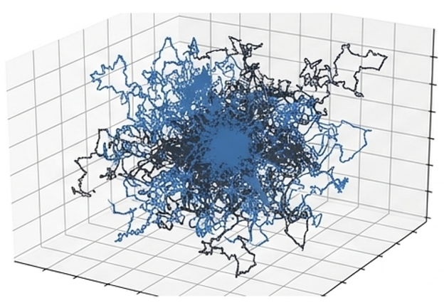
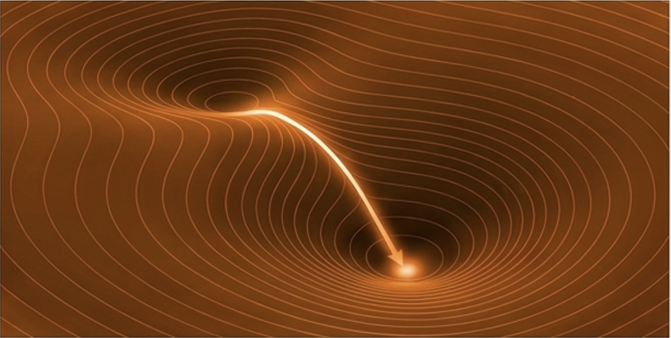
MCMC is the Bayesian gold standard, but it becomes a bottleneck at scale
Traditional Bayesian Estimation
(Markov Chain Monte Carlo)
The Chosen Architecture
(Variational Inference)
Method: Random-walk posterior sampling
Cost: Sequential draws, tuning, diagnostics
Scalability: Mixes slowly in high dimensions
Method: Optimize the ELBO (momentum / Adam)
Cost: One convergence curve, generic tuning
Scalability: Built for high-dimensional models
Notes:
- To understand the importance of our chosen approach, we first look at the industry standard.
- Which is the Traditional Bayesian estimation that relies on Markov Chain Monte Carlo or MCMC sampling.
- Looking at the diagram on the left, MCMC relies on random sampling to explore the posterior distribution.
- While statistically accurate, this creates a massive computational bottleneck because it must 'walk' through the space step-by-step which makes it extremely difficult to scale in high-dimensional settings, making it too slow for the demands of real-time financial applications.
- As such, we pivot from MCMC towards the precision of Optimization.
- On the right, our chosen architecture—Variational Inference (VI)—recasts Bayesian estimation as a gradient descent problem.
- We use the Adam optimizer to efficiently drive toward the solution.
- By treating estimation as an optimization task, this allows for high-dimensional scaling through modern machine learning frameworks like PyTorch.
- Through which, we unlock the speed & scalability needed for modern volatility modelling.

Slide 4
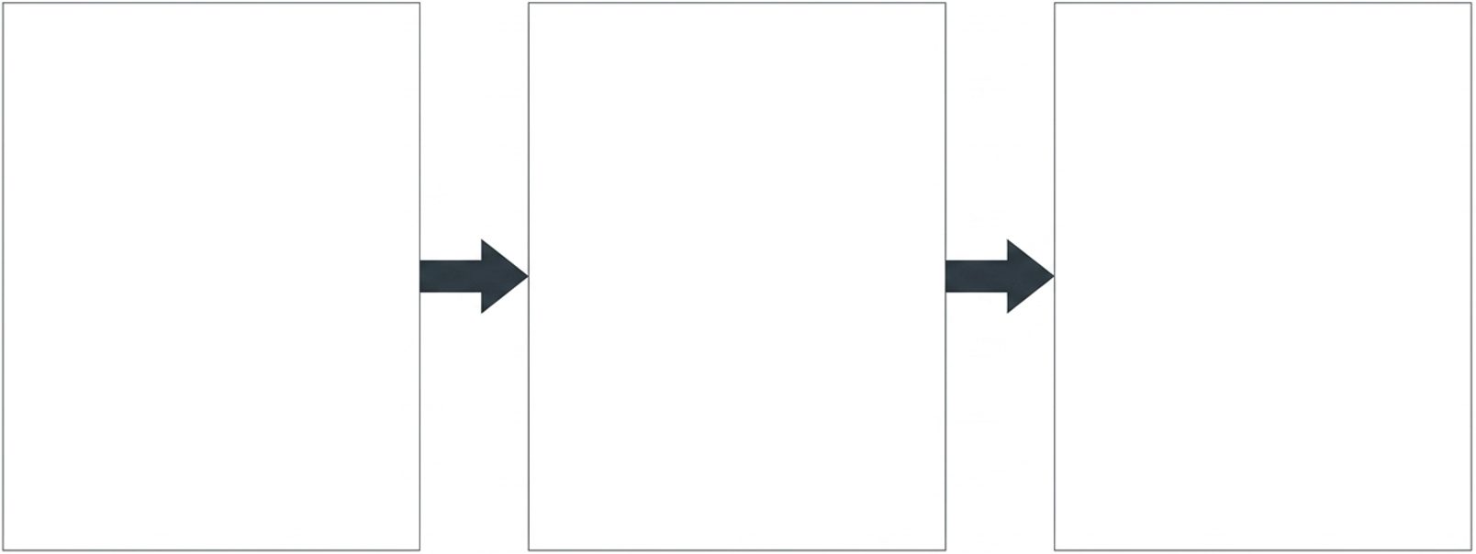
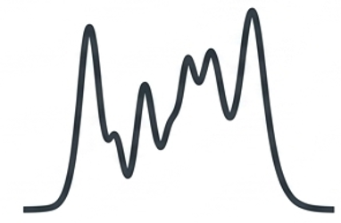

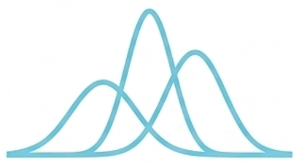
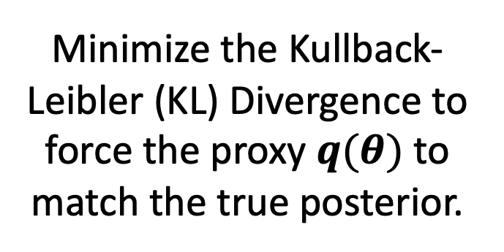
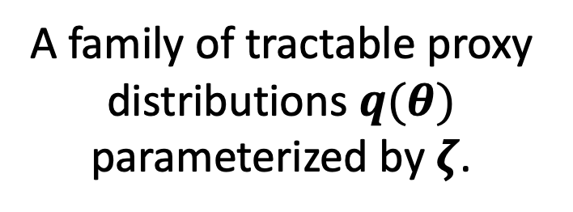
Variational Inference recasts Bayesian estimation into a scalable optimization problem
1. The Intractable True Posterior
2. The Variational Family
3. The Optimization Bridge
Minimize the Kullback-Leibler (KL) Divergence to force the proxy $q(θ)$ to match the true posterior.
Marginal likelihood p(y) is
often intractable.
A family of tractable proxy distributions $q(θ)$ parameterized by $ζ$.
In plain English: instead of exploring every possible answer, VI fits the closest simple bell curve, like tuning a dial until the fit stops improving.
Notes:
This brings us to the core of our methodology: Variational Inference.
- We recast the entire Bayesian estimation problem into a scalable optimization task. Let’s look at three distinct parts:
- 1st The Intractable True Posterior: In traditional financial modelling, the marginal likelihood $p(y)$ is often intractable. Meaning we can’t calculate the 'true' posterior distribution analytically.
- As you can see by the irregular black line, this distribution is complex and difficult to work with.
- 2nd The Variational Family: Instead of struggling with that complexity, we introduce a Variational Family.
- We chose a family of tractable proxy distributions, $q(\theta)$, parameterized by $\zeta$—typically a Gaussian distribution.
This gives us a smooth, mathematically 'friendly' starting point.
- 3rd The Optimization Bridge: Finally, we build the Optimization Bridge.
- This minimizes the Kullback-Leibler (KL) Divergence, which acts as a force that pulls our proxy distribution $q(\theta)$ until it matches the true posterior as close as possible.
- By following this process, we stop trying to sample every point in a hairball and instead use gradient descent to find the optimal fit.

Slide 5
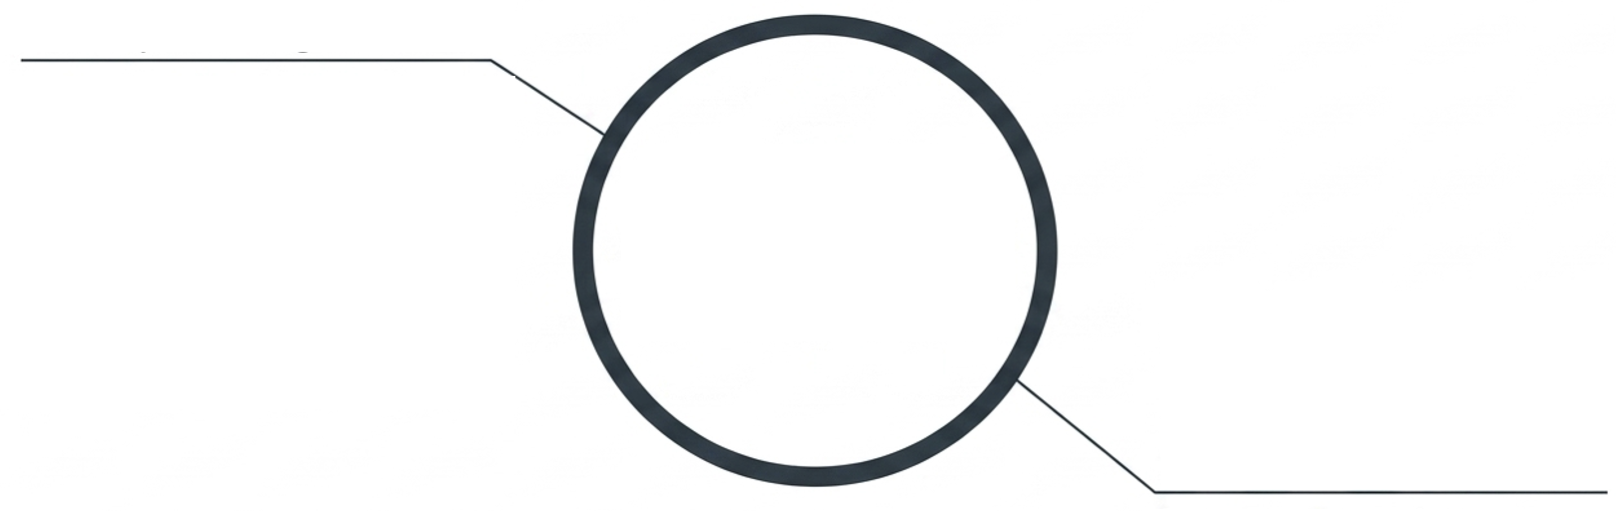
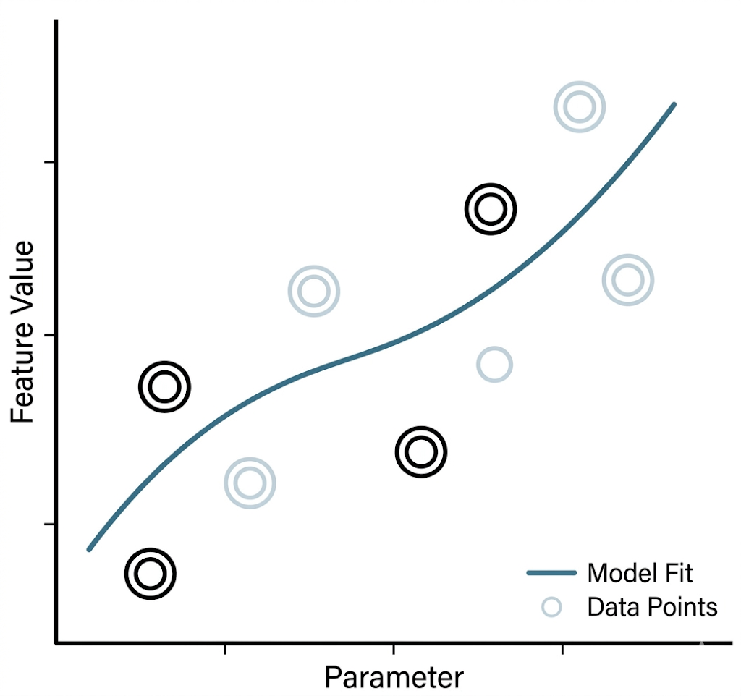
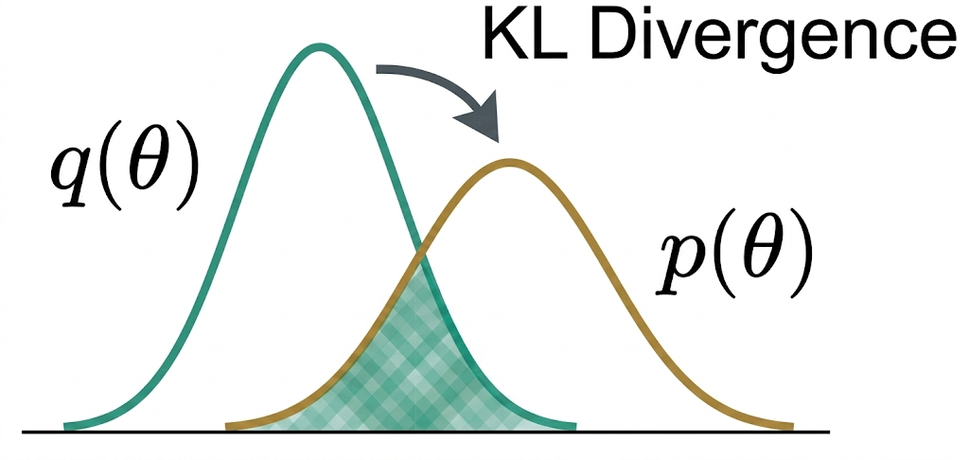
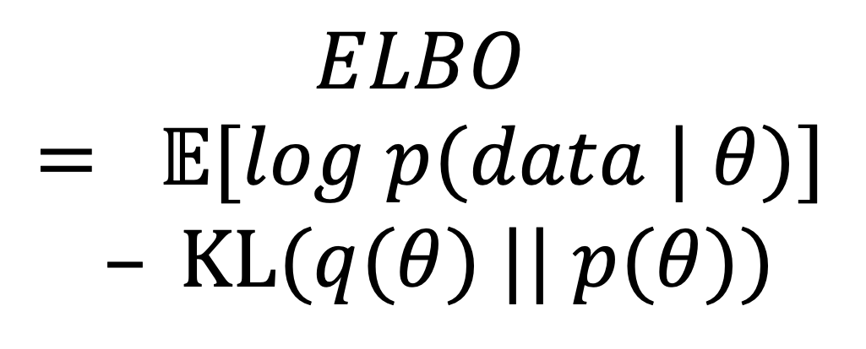
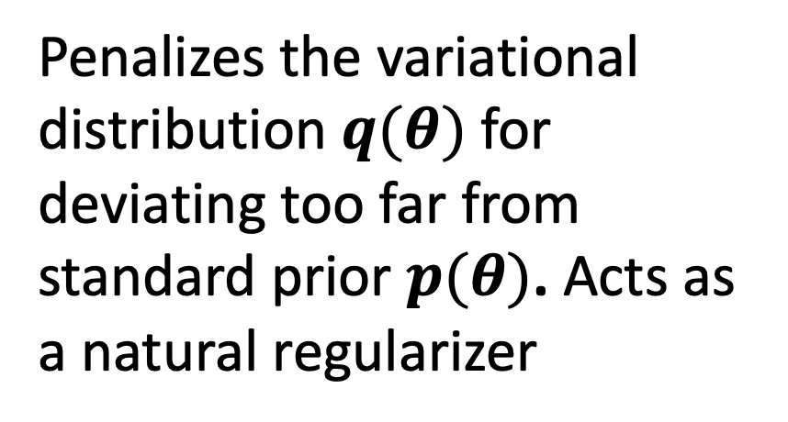
The Evidence Lower Bound (ELBO) objective balances data fit against prior beliefs
The Expected Log-Likelihood
$$ELBO = 𝔼[log p(data | θ)]$$
$$– KL(q(θ) || p(θ))$$
The KL Divergence
Maximizes the model’s fit to the empirical financial data.
Averaged over random guesses.
Penalizes the variational distribution $q(θ)$ for deviating too far from standard prior $p(θ)$. Acts as a natural regularizer
Notes:
- The heart of this optimization is the Evidence Lower Bound, or ELBO.
- The ELBO is the equation seen here: $$\text{ELBO}(q) = \mathbb{E}[\log p(\text{data} | \theta)] - KL(q(\theta) || p(\theta))$$
- This equation consist of 2 components that the ELBO has to balance out.
- Expected Log-Likelihood: This maximizes how well the model fits the empirical financial data.
- KL Divergence: Which acts as a natural regularizer, penalizing the model if it deviates too far from our prior beliefs, $p(\theta)$.
- By maximizing the ELBO, we are simultaneously finding the best fit and preventing overfitting.

Slide 6
Paper transforms map unconstrained VI parameters into a valid, stationary GARCH
Unconstrained Space
The Transform (Prop. 2 in the paper)
Constrained GARCH Space
θ = (θω, θα, θβ) ∈ ℝ³
θω
ω = exp(θω)
• ω > 0
(baseline variance)
• α ≥ 0
(reaction to shocks)
• β ≥ 0
(volatility persistence)
torch.exp
The Gaussian posterior q(θ) = N(μ, Σ) lives here.
Prior p(θ) = N(0, I), as in the paper.
θα
α = sigmoid(θα)
torch.sigmoid
θβ
β = sigmoid(θβ) · (1 − α)
α + β < 1 for every θ
stationary by construction:
no if-statement, no rescaling
torch.sigmoid
In plain English: the three dials get built-in guardrails, so the model can never produce an impossible forecast (negative or exploding volatility).
Fix vs. first draft: replaces the old “if α + β ≥ 0.99, rescale” rule, which was not smooth and not the paper’s method.

Slide 7
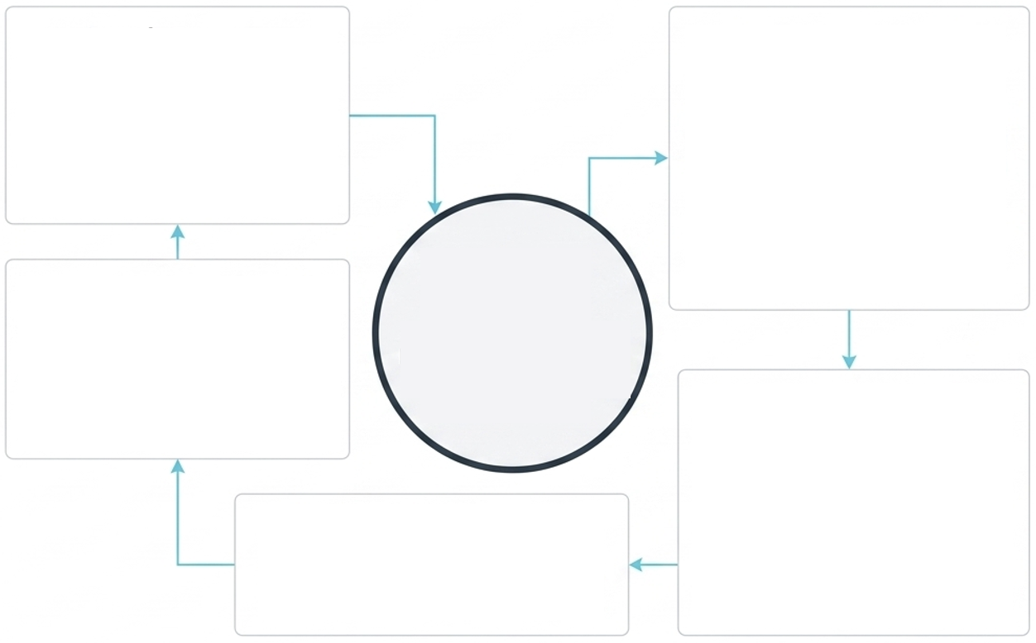
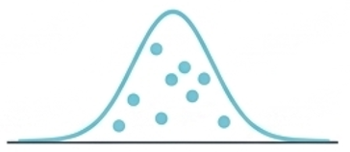
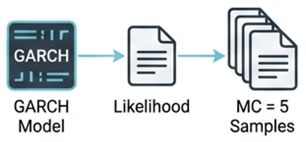
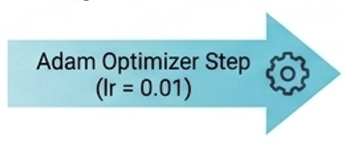
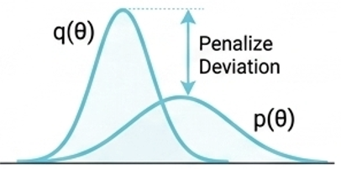
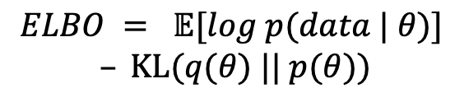
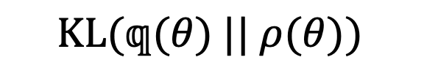
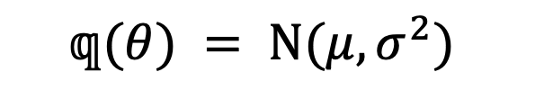
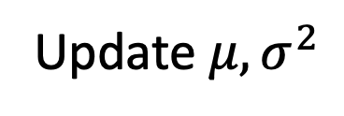
The VI training loop: sample, score, update in PyTorch
1. Sample Parameters
2. Calculate Expected Log-Likelihood
In plain English
Guess the dials, score the fit, nudge the guess, repeat about 1,500 times until the score stops improving.
Two versions
BBVI (paper): needs only fit scores; assumes the dials are unrelated.
Full-cov VI: PyTorch does the calculus; captures how the dials move together.
$$𝕢(θ) = N(μ,σ^{2})$$
S = 10
samples
The ELBO Objective
Compute GARCH Likelihood over MC samples.
5. Update Parameters
$$ELBO = 𝔼[log p(data | θ)]$$
$$– KL(q(θ) || p(θ))$$
3. Compute KL Divergence
Update $μ,σ^{2}$
4. Backpropagate ELBO Loss
loss.backward() → Adam step
Autodiff gradients
$$KL(𝕢(θ) || ρ(θ))$$
Notes:
T- o train this, we implement a Black-Box VI training loop that allows for pure PyTorch optimization.
1. We begin by sampling from our variational distribution, $q(\theta)$, which Normal distributed with mean $\mu$ and variance $\sigma^2$ and we use the reparameterization trick here to ensure the entire loop remains differentiable.
2. We then Calculate Expected Log-Likelihood by passing those samples into our GARCH model. By using Monte Carlo sampling with just 5 samples, we can quickly approximate the likelihood of our financial data without sacrificing too much speed.
3. Simultaneously, we calculate the KL Divergence. As seen on the graph, this acts as a penalty that prevents our proxy distribution from deviating too far from our prior, $p(\theta)$.
4. Then we Backpropagate ELBO Loss, in which the log-likelihood & KL Divergence component feed into our central ELBO Objective.
We then call loss.backward() with Gradient Clipping. This is essential in volatility models to prevent gradients from 'exploding' during market stress periods.
5. Finally, the Adam Optimizer takes a step to update our $\mu$ and $\sigma^2$.
- This loop lets us use PyTorch’s optimization suite for econometric modelling.

Slide 8
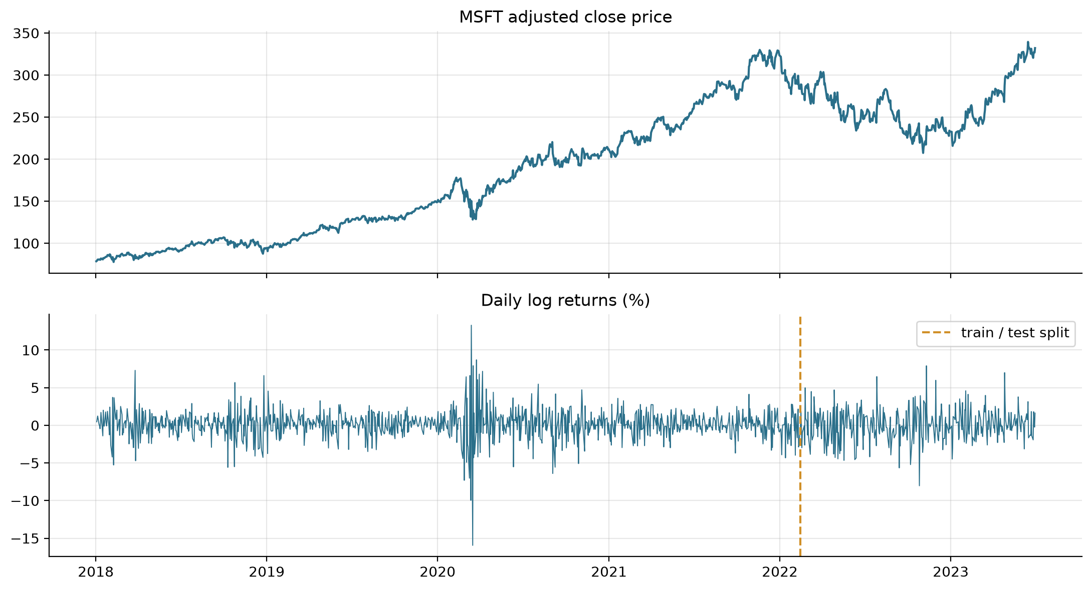
Data pipeline: the paper’s Microsoft case study, cleaned and split in time order
Data Pipeline
Prices and Returns
Step | Detail
Source | Yahoo Finance (yfinance), adjusted close
Asset | Microsoft (MSFT), as in the paper; plus a Dow 30 panel
Window | 2 Jan 2018 – 30 Jun 2023: 1,383 days → 1,382 returns
Cleaning | 0 missing, 0 duplicates, 0 non-positive prices; longest gap 4 days (holidays)
Returns | Daily % change: rₜ = 100 · (log Pₜ − log Pₜ₋₁)
Split | Learn on first 75% (to 11 Feb 2022); test on last 25% (the “exam”)
Takeaway: the test period (2022 rate hikes) is more volatile than most of the training period, so it is a genuine out-of-sample challenge.

Slide 9
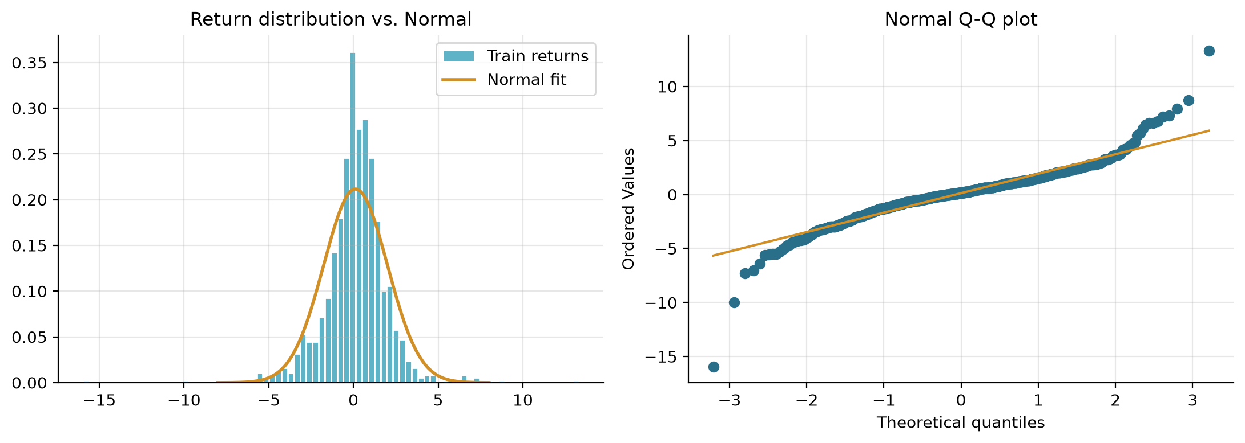
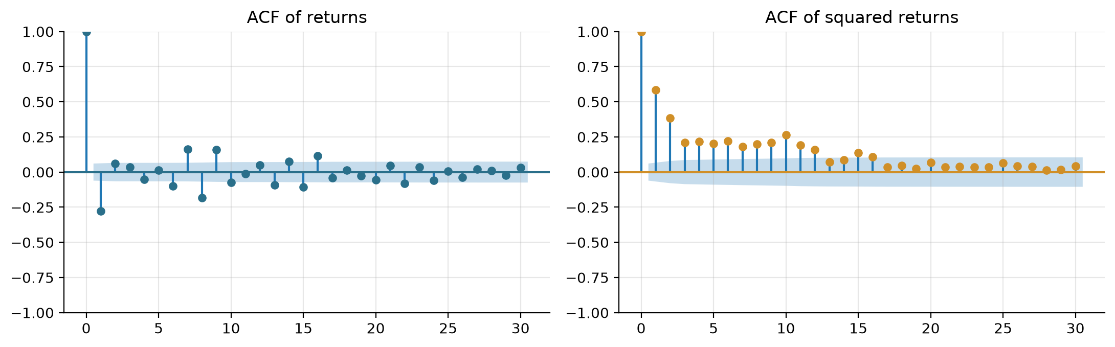
Exploratory analysis: MSFT returns show the stylised facts GARCH is built for
Fat tails
Extreme days are far more common than a bell curve predicts (excess kurtosis 9.5; Jarque-Bera p < 0.001)
Volatility clustering
Stormy days follow stormy days (Ljung-Box on r²: 890, p < 0.001)
Predictable turbulence
Yesterday’s swings predict today’s (ARCH-LM: 393, p < 0.001)
Average return ≈ 0
The daily drift (0.12%) is tiny next to the daily swings (1.9%), so we model only the swings
In plain English: turbulence comes in waves and crashes are more common than “normal” suggests; GARCH handles the waves, Student-t the crashes.

Slide 10
Our GARCH(1,1) estimates replicate the paper’s Table II for Microsoft
Method | ω (ours) | α (ours) | β (ours) | ω (paper) | α (paper) | β (paper)
QML | 0.160 | 0.186 | 0.769 | 0.15 | 0.19 | 0.77
MCMC | 0.217 ± 0.049 | 0.203 ± 0.031 | 0.731 ± 0.036 | 0.200 ± 0.046 | 0.203 ± 0.031 | 0.737 ± 0.036
BBVI (diagonal) | 0.214 ± 0.022 | 0.201 ± 0.023 | 0.732 ± 0.023 | 0.196 ± 0.021 | 0.199 ± 0.023 | 0.740 ± 0.023
Full-cov VI* | 0.220 ± 0.050 | 0.200 ± 0.029 | 0.732 ± 0.035 | 0.205 ± 0.047 | 0.201 ± 0.030 | 0.736 ± 0.035
ω = baseline turbulence · α = reaction to yesterday’s shock · β = memory of past turbulence. Bayesian columns: average ± spread of plausible values. *Paper column = MGVB, its full-covariance VI.
Replicated
Our numbers match the published paper (all within ≈ 0.02), so the code is doing the right thing.
Persistence
α + β ≈ 0.955: a volatility shock has a half-life of ≈ 15 trading days.
Out-of-sample check
Test NLL (QML): 764.6 ours vs 761.4 in the paper.

Slide 11
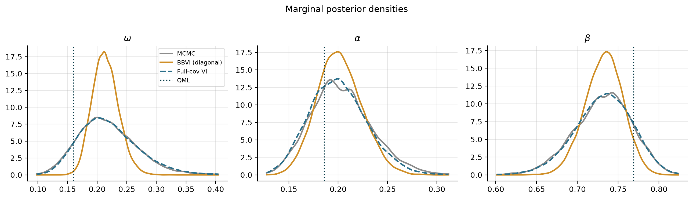
Full VI gets the uncertainty right; the simpler diagonal VI is over-confident
Spread (uncertainty) of ω
Spread (uncertainty) of β
Fit score, ELBO (higher = better)
MCMC: 0.049
Full-cov VI: 0.050
BBVI: 0.022 (−55%)
MCMC: 0.036
Full-cov VI: 0.035
BBVI: 0.023 (−35%)
Full-cov VI: −1945.3
BBVI: −1946.2
Same ordering as the paper
In plain English: all methods agree on the best guess, but simple VI claims to be about twice as sure as it should be, like a forecaster who never says “maybe”.

Slide 12
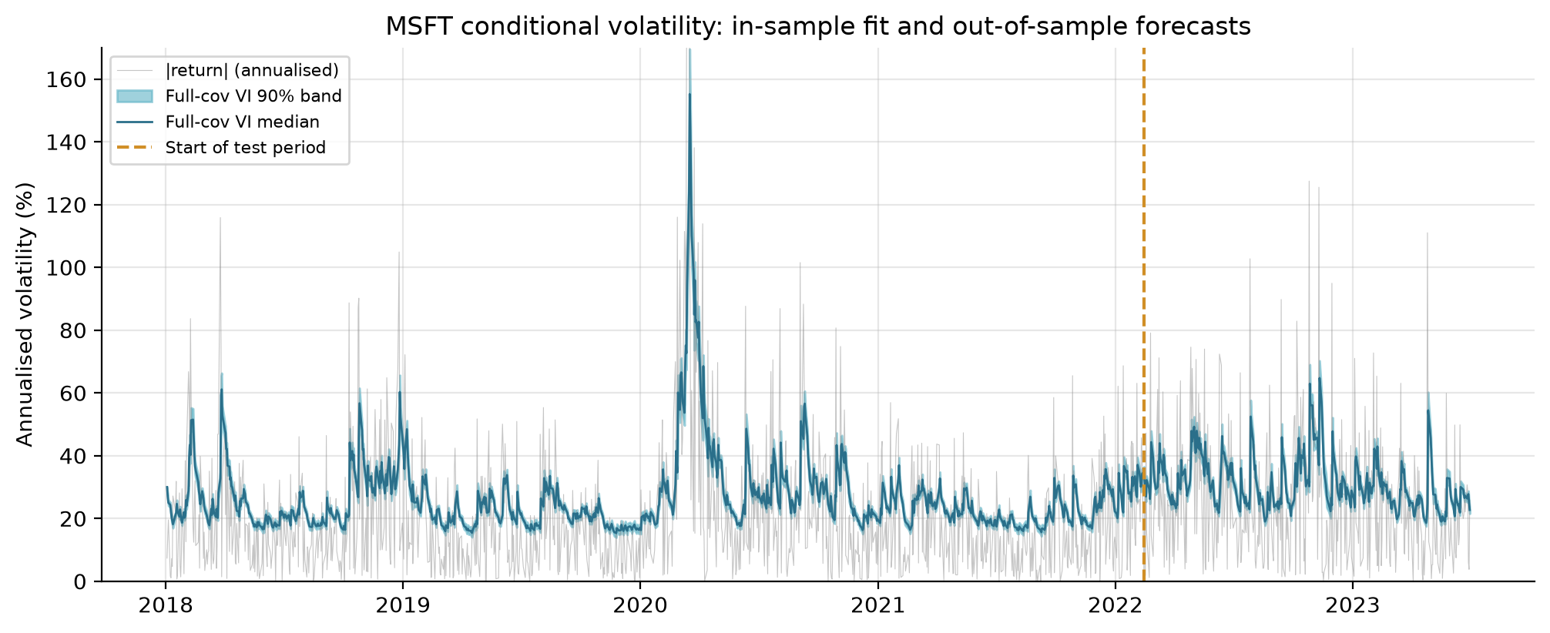
Bayesian estimation turns volatility into a forecast with credible bands
In plain English: like a weather forecast with a range: the line is expected turbulence, the shaded band its likely range. It catches the COVID-19 crash and the 2022 sell-off, which it never saw while learning.
Average 90% band width (test): MCMC 3.5 · Full-cov VI 3.5 · BBVI 3.1 vol-points (diagonal VI is over-confident).

Slide 13
VI forecasts as well as QML and MCMC, but it is not faster for a 3-parameter GARCH
Out-of-sample accuracy: % difference vs QML
Computational cost (MSFT, one run)
Method | NLL | RMSE | MAD | QLIK
MCMC | +0.15 | +0.23 | −0.60 | +0.26
BBVI (diagonal) | +0.19 | +0.18 | −0.82 | +0.32
Full-cov VI | +0.16 | +0.13 | −0.94 | +0.27
Method | Run time | Likelihood evals
QML | < 0.01 s | ≈ 380
MCMC (RWM) | ≈ 0.3 s | 30,000
BBVI (diagonal) | ≈ 1 s | 125,000
Full-cov VI (PyTorch) | ≈ 16 s | 15,000
NLL, RMSE, MAD, QLIK are forecast-error scores (lower = better). Every gap is under 1% (paper: sub-1% on average); negative = better than QML.
In plain English: all methods forecast equally well. For this small 3-dial model, the trusted method (MCMC) is actually quicker, so VI is not a speed win here.
VI’s real advantages: one ELBO curve to monitor, the same hyperparameters for every stock, a reusable analytical posterior, and scalability to high-dimensional models where MCMC mixes slowly.

Slide 14
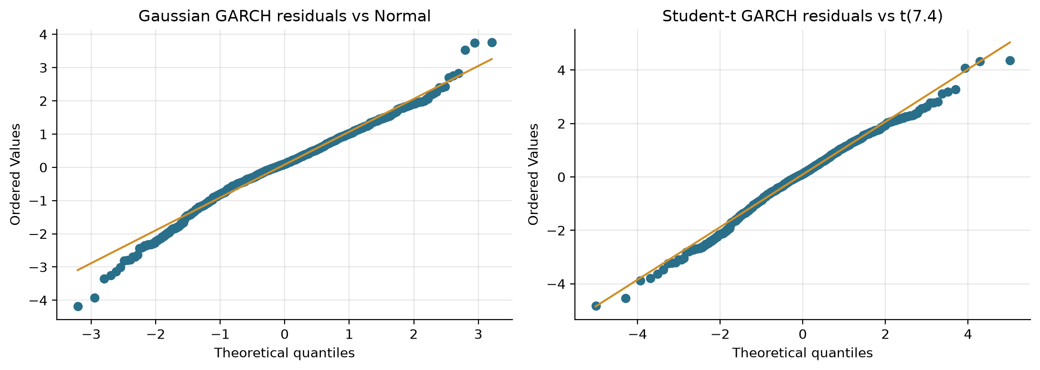
Extension: Student-t innovations capture the fat tails that Gaussian GARCH misses
Heavy Tails (Student-t Innovations)
• The problem: Gaussian-GARCH residuals are still fat-tailed (left Q-Q).
• The extension: ν = 2 + exp(θν), estimated jointly with full-covariance VI (4 parameters).
• The result: ν ≈ 7.4 (90% interval 5.2–10.2), far from Normal.
In plain English: this version expects the occasional crash day, so real markets surprise it less.
Criterion
Gaussian VI-GARCH
Student-t VI-GARCH
Fit score, ELBO (higher = better)
−1945.3
−1934.6 (+10.7)
Forecast score on unseen data
−765.9
−754.1 (+11.8)
Volatility path
almost identical
almost identical

Slide 15
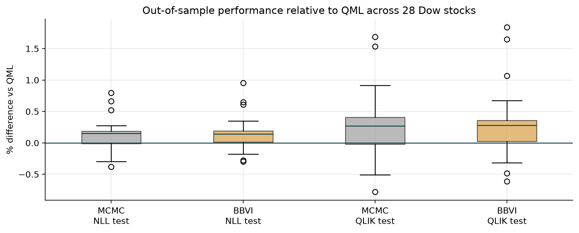
Scaling up: the same conclusion holds across 28 Dow Jones stocks
Data: 28 Dow 30 stocks (DOW, WBA dropped: incomplete) | 2018–2023 | Split: 75% / 25% | identical hyperparameters for every stock
Mean % deviation vs QML
Test NLL: MCMC +0.12 · BBVI +0.14
Test QLIK: MCMC +0.25 · BBVI +0.28
Train NLL: QML lowest for 100% of stocks (it maximises it by design)
Average time per stock: MCMC ≈ 0.3 s, BBVI ≈ 1.1 s
This project (28 stocks)
MCMC and BBVI forecasts sit within ≈ 0.3% of QML on average and are almost indistinguishable from each other.
Magris & Iosifidis (488 stocks)
Across seven GARCH-family models and four VI optimisers, deviations from QML are sub-1% on average (paper, Table I).

Slide 16
Execution Summary & Core Takeaways
Replication
• Goal: Implement VI for GARCH as in Magris & Iosifidis (2023).
• Result: QML, MCMC and BBVI match the paper’s Table II within ≈ 0.02; the transforms guarantee α + β < 1.
Accuracy & Uncertainty
• Goal: Match MCMC/QML accuracy.
• Result: VI is within 1% of QML out of sample (MSFT and 28 stocks). Full-cov VI ≈ MCMC posterior; diagonal BBVI is over-confident.
Fat Tails & Cost
• Goal: Model real-world returns efficiently.
• Result: Student-t (ν ≈ 7) wins on ELBO and test log-likelihood. At 3 parameters MCMC is cheap; VI pays off through generic tuning and scale.
Variational Inference is an accurate, well-calibrated alternative to MCMC for GARCH,
as long as the variational family is rich enough (full covariance).
Next steps: GJR / EGARCH / FIGARCH · natural-gradient optimisers (QBVI, MGVB) · realised-volatility proxies from intraday data (e.g. WRDS TAQ)

Slide 17
Jargon buster
Term | What it means
Volatility | How big the daily price swings are (shown annualised, in %)
GARCH(1,1) | Forecasts tomorrow’s volatility from today’s shock (α) and today’s volatility (β), plus a baseline (ω)
Stationary (α + β < 1) | Shocks eventually fade, so volatility cannot explode
QML | Classic method that finds the single best-fitting setting of the dials
Prior / Posterior | What we believe about the dials before / after seeing the data
MCMC | Traditional Bayesian method: a long random walk through plausible settings
Variational Inference (VI) | Machine-learning shortcut: fit the closest simple bell curve to the posterior
ELBO | The fit score VI maximises (higher = better); also used to compare models
BBVI vs full-covariance VI | Diagonal VI assumes the dials are unrelated; full VI captures how they move together
Train / test | Data the model learns from / unseen “exam” data used to check forecasts
NLL, QLIK, RMSE, MAD | Forecast-error scores: lower is better
Student-t / fat tails | Allows extreme days to be more common than a bell curve predicts

Slide 18
References
Magris, M., & Iosifidis, A. (2023). Variational Inference for GARCH-family Models. arXiv:2310.03435.
Blei, D. M., Kucukelbir, A., & McAuliffe, J. D. (2017). Variational Inference: A Review for Statisticians. JASA, 112(518), 859–877.
Bollerslev, T. (1986). Generalized Autoregressive Conditional Heteroskedasticity. Journal of Econometrics, 31(3), 307–327.
Bollerslev, T. (1987). A Conditionally Heteroskedastic Time Series Model for Speculative Prices and Rates of Return. REStat, 69(3), 542–547.
Ranganath, R., Gerrish, S., & Blei, D. (2014). Black Box Variational Inference. AISTATS.
Kingma, D. P., & Welling, M. (2014). Auto-Encoding Variational Bayes. ICLR.
Roberts, G. O., Gelman, A., & Gilks, W. R. (1997). Optimal Scaling of Random Walk Metropolis Algorithms. Annals of Applied Probability, 7(1).
Patton, A. J. (2011). Volatility Forecast Comparison Using Imperfect Volatility Proxies. Journal of Econometrics, 160(1), 246–256.
Code & data: github.com/SGhuman123/Fordham-Time-Series-Econometrics (VI_GARCH.ipynb)

