Slide 1
JRC’s Cabin Model
Susana Gil-Sayas

Slide 2
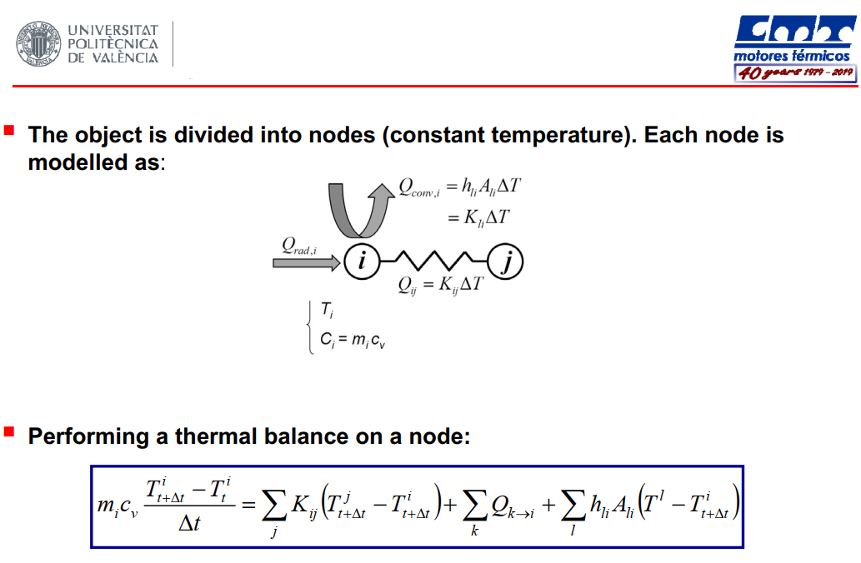
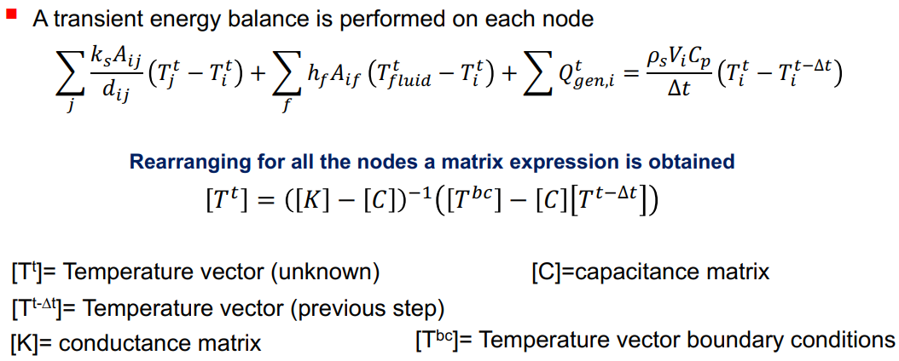
Lumped model
[Accumulation] = [Input]- [Output]+ [Generation]- [Consumption]
20/12/2022

Slide 3
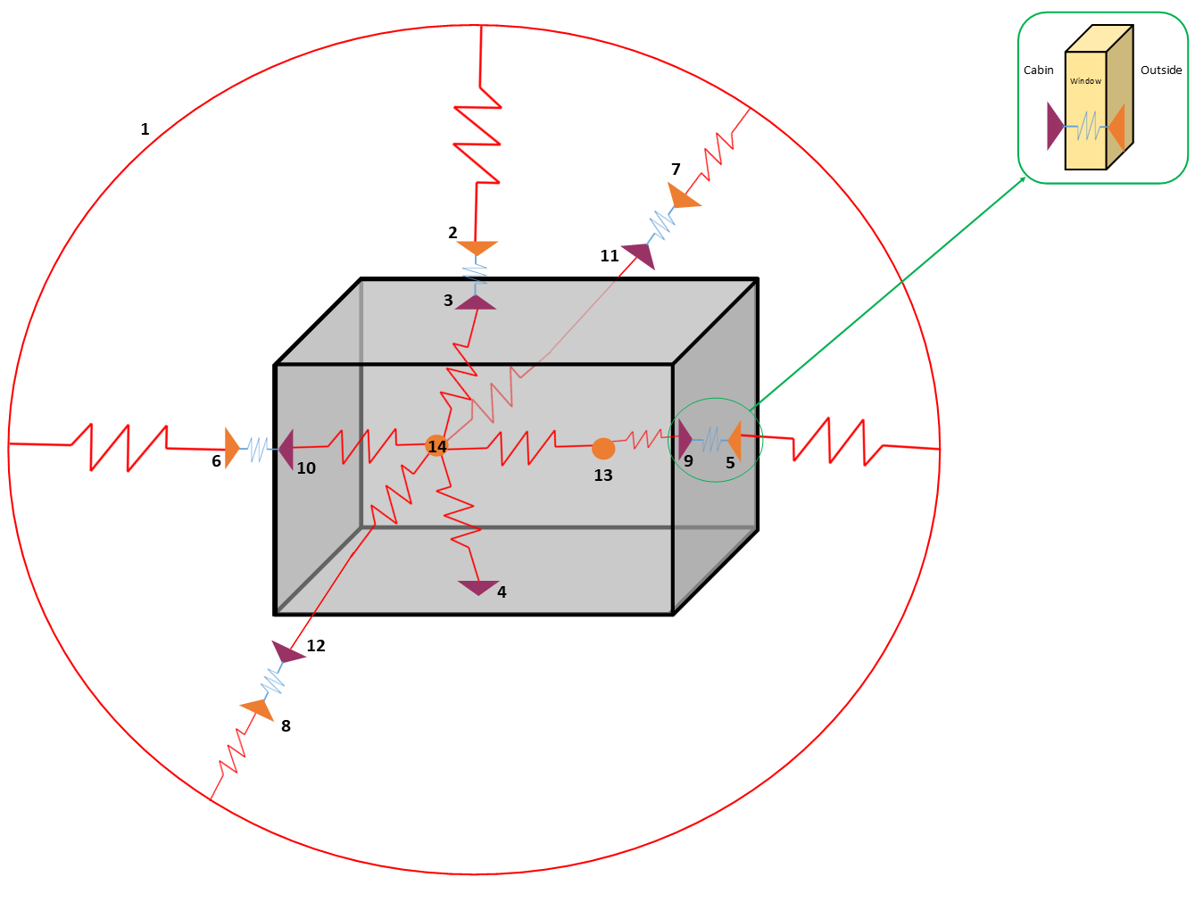
Diagram lumped model - 14 nodes
Red: convection; Blue: conduction (windows).
Radiation included in boundary conditions
Temperature Nodes
T ambient (Tamb)
T roof
T ceiling
T base
T window external surface, windshield (Tw_ext_ws)
T window external surface, read window (Tw_ext_rw)
T window external surface, left side window (Tw_ext_lsw)
T window external surface, right side window (Tw_ext_rsw)
T window internal surface, windshield (Tw_int_ws)
T window internal surface, read window (Tw_int_rw)
T window internal surface, left side window (Tw_int_lsw)
T window internal surface, right side window (Tw_int_rsw)
T cabin air, back (Tcabin_back)
T cabin air, front (Tcabin_front)
Windshield

Slide 4
Thermal Equations
m_air*Cp_air*(T_air(t)-T_air(t-1))/timestep = Q_windows + Q_ceiling + Q_base + Q_human;
T_air(t) = (Q_windows(t)+Q_ceiling(t)+Q_base(t)+Q_human(t))*(timestep/(CabinVolume*cp_air*density_air))
+ T_air(t-1);
Q_ws(t) = h_ws*A_ws*(T_ws(t)- T_air(t-1));
Q_cv_ext(t) = h_ext*A_ws*(T_ws_ext(t)-T_ext(t)); %Exterior convection
Q_rd_ext(t) = epsilon_ws*sigma*A_ws*((T_ws_ext(t))^4-(T_sky)^4); %Exterior radiation
Q_cd(t) = ((k_ws*A_ws)/e_ws)*(T_ws_ext(t)-T_ws(t));
Q_windows(t) = Q_ws(t)+Q_lsw(t)+Q_rsw(t)+Q_rw(t);

Slide 5
Arrays
Qbase = alfa_base*( (A_ws*G_ws_t) + (A_rw*G_rw_t)+ (A_lsw*G_lsw_t) + (A_lsw*G_rsw_t) );
Qhum=N_Humans * 120;
C_cabin=rho*(Vcabin/2)*Cp_air/timestep

