Slide 1
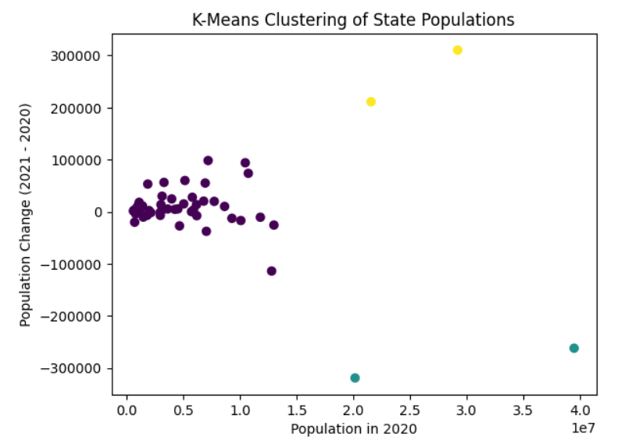
Predictive Modeling of State Population Changes: A Data-driven Exploration
Sandesh Gnawali
Computer Science Major, Fisk University, Nashville, TN 37208
Abstract
Results
Before Research
This project employs machine learning techniques to analyze state-level population data from 2020 to 2021. Utilizing k-means clustering and regression analysis, the research aims to reveal patterns and predictive models for demographic shifts. In the clustering phase, states are grouped based on population characteristics, uncovering regional similarities and differences. Simultaneously, regression analysis predicts population changes, identifying factors influencing growth or decline. Using Python's scikit-learn library, the models are evaluated with metrics like accuracy, confusion matrix, and ROC/AUC scores. Cross-validation ensures robustness. Results offer actionable insights for policymakers and researchers, providing a foundation for informed decision-making. This project contributes to the field of data-driven demographic analysis, showcasing the practical applications of machine learning in understanding state-level population dynamics.
Research Questions:
R1: What are the discernible patterns and groupings in state populations based on demographic characteristics such as population size, growth, and regional trends?
R2: How accurately can machine learning regression models predict state population changes from 2020 to 2021, and what factors contribute significantly to these changes?
Hypotheses:
H1: States clustered based on demographic features will exhibit distinct population dynamics, reflecting shared characteristics and regional trends.
H2: Machine learning regression models will demonstrate predictive accuracy in forecasting state population changes, with key contributing factors identified as economic indicators, employment rates, and housing affordability. Data Analysis
Data from state-wise population figures and other relevant demographic features will be utilized in the analysis. The application of k-means clustering, and regression analysis will be performed using Python's scikit-learn library.
H1: A k-means clustering algorithm will be employed to identify statistically significant groupings of states based on population change. The Silhouette score will be used to assess the quality of the clustering.
H2: Regression analysis, specifically linear regression, will be conducted to predict state population changes from 2020 to 2021. Metrics such as Mean Absolute Error (MAE) and R-squared will be used to evaluate the accuracy and goodness of fit of the regression model.
Fig. A shows the statistical relationship between population in two years and states with minimal change in population
Methodology
The methodology for this project involves a systematic approach to analyze state-level population data using machine learning techniques. Initially, a comprehensive dataset encompassing population figures for each state in 2020 and 2021 is collected. Subsequently, data preprocessing steps are undertaken to ensure data cleanliness, handle missing values, and convert features into a numeric format suitable for analysis. Exploratory Data Analysis (EDA) follows, providing insights into data distributions and identifying potential trends in state populations. Feature engineering is employed to derive additional variables, such as the population change from 2020 to 2021. To facilitate clustering analysis, the dataset is scaled, and k-means clustering is applied to group states based on population characteristics. Simultaneously, regression analysis is utilized to predict population changes, with model performance evaluated using metrics like Mean Absolute Error (MAE) and R-squared. Cross-validation techniques are implemented to assess the generalizability and robustness of the clustering and regression models. The results are interpreted to understand state groupings and factors influencing population changes. Visualizations, such as scatter plots and heatmaps, are generated to communicate findings effectively. In conclusion, the methodology encompasses a structured workflow, integrating clustering and regression techniques to gain valuable insights into state-level demographic dynamics.
Fig. B shows the relationship between states and population in two years with most increase in population by number
.
Conclusions
a trend of population reduction in densely populated cities such as New York and California due to various factors such as changes in economic conditions, housing affordability, or shifts in lifestyle preferences.
a significant increase in population in growing cities like Texas and Florida because of job opportunities, a favorable business environment, or lifestyle considerations, attracting individuals and families to these regions.
Fig. C shows the relationship between states and population in two years with most decrease in population by number
Limitations
The population was of 2020 and 2021 so we cannot make modern plans based on these data.
The selected machine learning models may not capture more complex relationships or nonlinear patterns in the data
Citation
https://api.census.gov/data/2021/pep/population

