Slide 1
Machine Learning Final Project
Adam King
Elliot Ignatyev
Cam Knopp
Scott Gordon

Slide 2
The datasets we used
Small Regression: Boston Housing Prices
Small Classification: Iris Flower
Large Regression: California Housing
Large Classification: Olivetti Faces

Slide 3
Boston Housing Prices
Target: Median value of houses in Boston area in $1000s
13 attributes given such as crime rate, number of rooms, highway access and property tax.

Slide 4
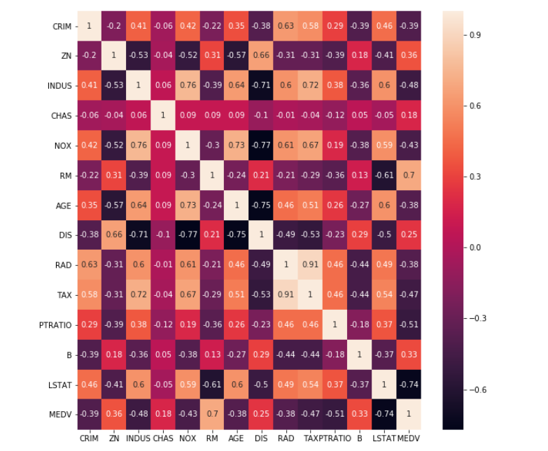
Boston: Attribute Correlation
Heatmap

Slide 5
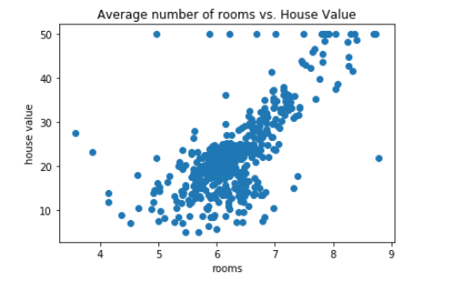
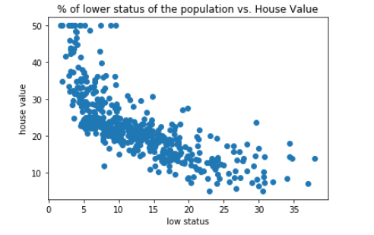
Boston: Attribute Correlation
Most Correlated with Median Value: Number of Rooms, Lower Status Population

Slide 6
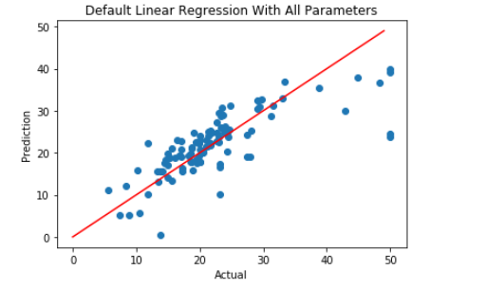
Boston: Linear Regression
MSE: 33.45
R2 Score: 0.49

Slide 7
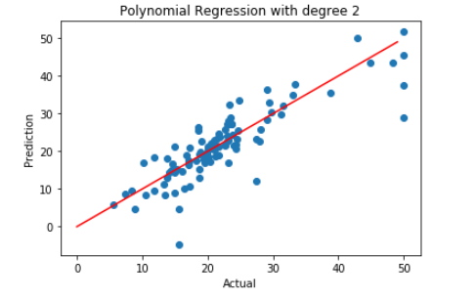
Boston: Polynomial Regression
Degree 2
MSE: 25.22
R2 Score: 0.69

Slide 8
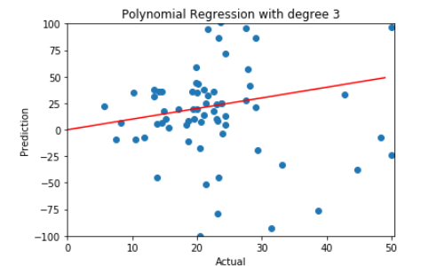
Boston: Polynomial Regression
Degree 3
MSE: 1050370.42
R2 Score: -12898.31

Slide 9
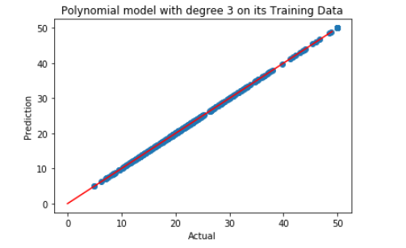
Boston: Polynomial Regression
Degree 3 On Its Training Data (Evidence of Overfitting)
MSE: 0.0000048
R2 Score: 0.999999

Slide 10
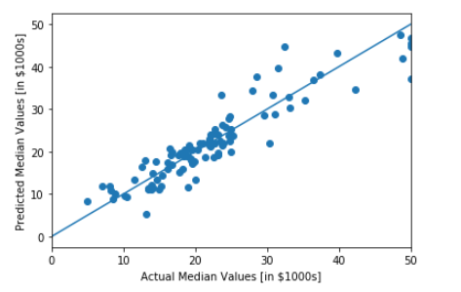
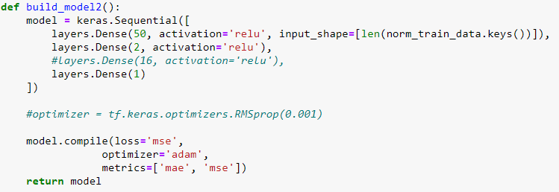
Boston: Neural Network
MSE: 14.43
R2: 0.86

Slide 11
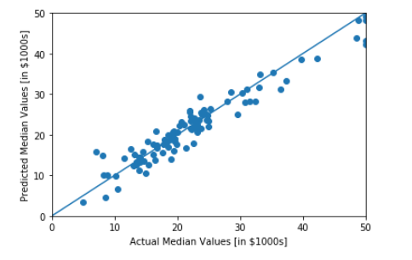
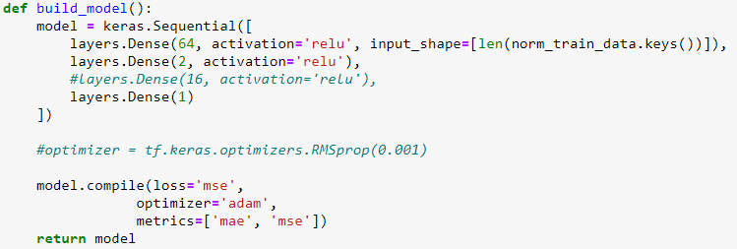
Boston: Normalized Data Neural Network
MSE: 7.76
R2: 0.92

Slide 12
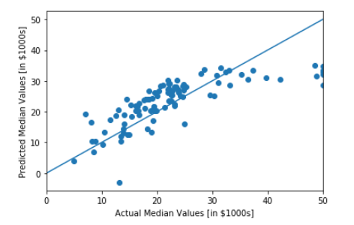

Boston: Early Stopping
Top graphs: no early stopping
Bottom graphs: early stopping
Right side is using normalized data
Early Stopping Model performed worse for both normalized and non-normalized data.
Bottom left:
MSE: 44.54
R2: 0.57
Bottom Right:
MSE: 8.83
R2: 0.91

Slide 13
Boston: Results
Linear Regression - MSE: 33.45, R2 Score: 0.49
Degree 2 Polynomial Regression - MSE: 25.22, R2 Score: 0.69
Best Neural Network (Normalized, No Early Stopping) - MSE: 7.76, R2: 0.92

Slide 14
Iris
Classification of Iris into one of three classifications
Iris-Setosa
Iris-Versicolour
Iris-Virginica
Based on four attributes
Petal Length
Petal Width
Sepal Length
Sepal Width

Slide 15
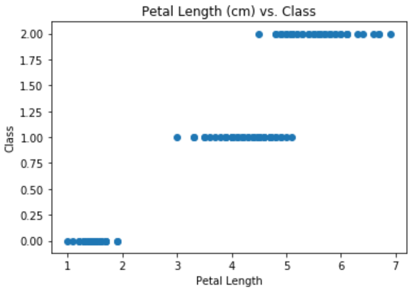
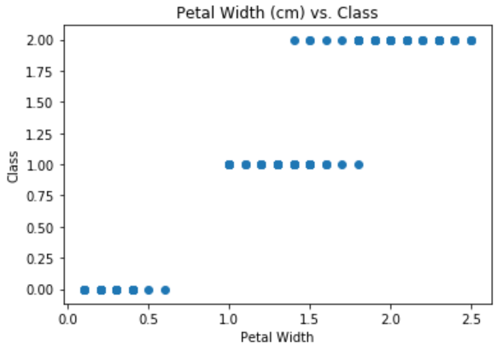
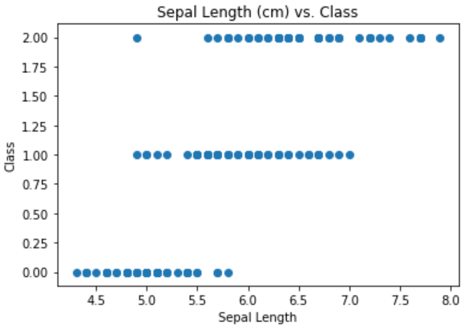
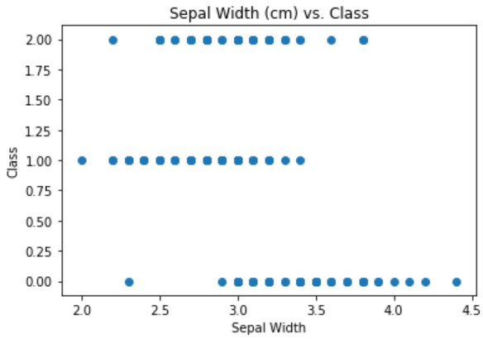
Iris: Attribute Correlations

Slide 16

Iris: Logistic Regression
Correctly predicted all values in the testing data
Accuracy score of 1.0
Precision score of 1.0
Recall score of 1.0
F1 score of 1.0
Confusion Matrix:

Slide 17

Iris: Support Vector Model
Also correctly classified each value in the testing data
Accuracy score of 1.0
Precision score of 1.0
Recall score of 1.0
F1 score of 1.0
Confusion Matrix:

Slide 18
Iris: Cross Validation
For Logistic Regression:
Accuracy score of 0.973
Precision score of 0.977
Recall score of 0.973
F1 score of 0.973
For Support Vector Machine:
Accuracy score of 0.980
Precision score of 0.981
Recall score of 0.980
F1 score of 0.980
Notes:
Say something about how the perfect scores were suspicious or something so we ran a bunch of cross validation.

Slide 19
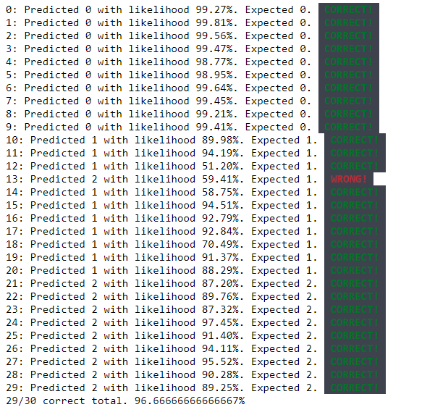
Iris: Neural Network
Tested with normal train test split and cross validation
With cross validation we achieved
Accuracy score of 0.966
Precision score of 0.968
Recall score of 0.967
F1 score of 0.966

Slide 20
Iris: Overview
Linear Regression - 97.3% accuracy
SVM - 98.0% accuracy
Neural Network - 96.6% accuracy
Data that was already correlated made it easier for simple models
We could not get the neural network to do better despite many tests

Slide 21
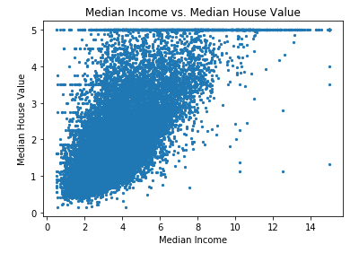
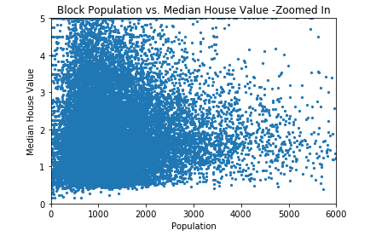
California Housing Prices
Target Variable: The median house value for California Districts
Eight Attributes Given
Very few of the attributes correlated, the Median Block Income and the Block Population
Notes:
Again, briefly mention what this is predicting and some of the attributes. Definitely make mention of how the target values only range from 0.15 to 5 (relevant later) and what those units represent (I don’t actually know myself atm)
Only median income looked correlated, maybe show the graph of that

Slide 22
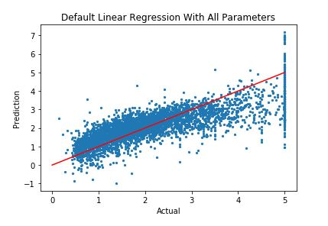
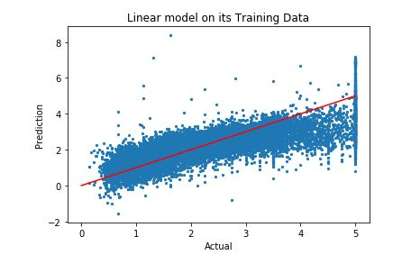
California - Linear Regression
R2: 0.59
RMSE: 0.73
R2: 0.61
RMSE: 0.72
Notes:
Linear Regression. Put the graphs, rmse, r2. Talk about how the very low looking rmse isn’t as great as it sounds when you consider the target values range.

Slide 23
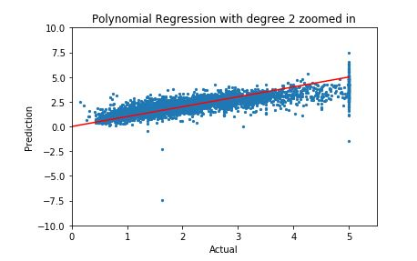
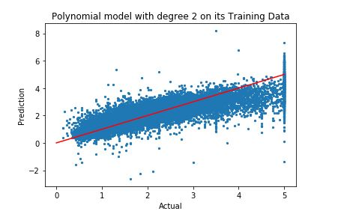
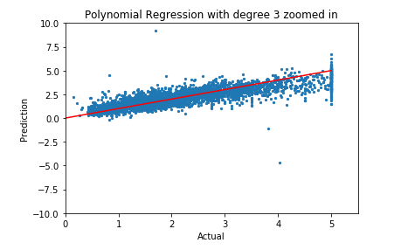
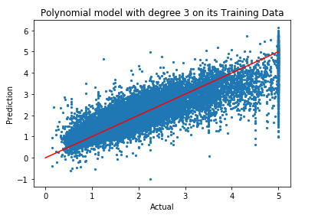
California - Polynomial Regression Degree 2 & 3
R2: -1.12
RMSE: 1.66
R2: 0.68
RMSE: 0.64
R2: -225817.24
RMSE: 542.63
R2: 0.74
RMSE: 0.58

Slide 24
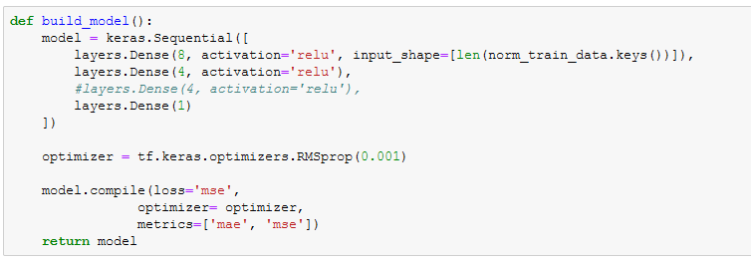
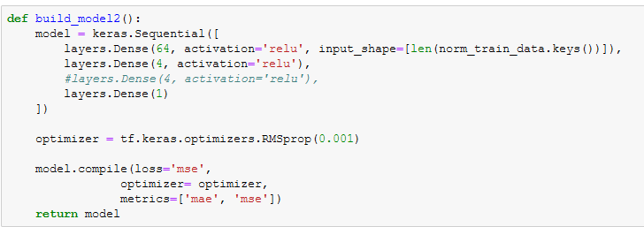
California - Neural Network
← Normalized Data
← Non-Normalized Data

Slide 25
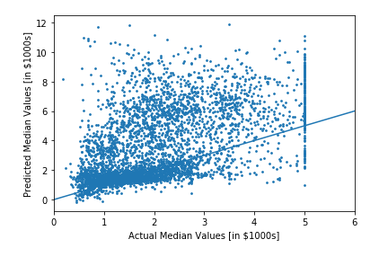
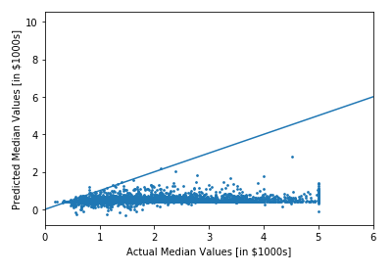
California - Normalized
No Early Stopping
Early Stopping
MAE: 1.75
MSE: 6.44
RMSE: 2.54
MAE: 2.93
MSE: 21.42
RMSE: 4.63

Slide 26
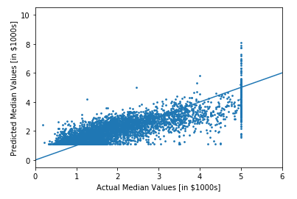
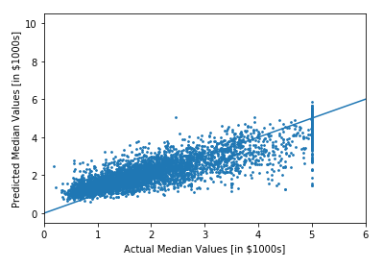
California - Non-Normalized
No Early Stopping
Early Stopping
MAE: 0.54
MSE: 0.49
RMSE: 0.70
MAE: 0.50
MSE: 0.43
RMSE: 0.66

Slide 27
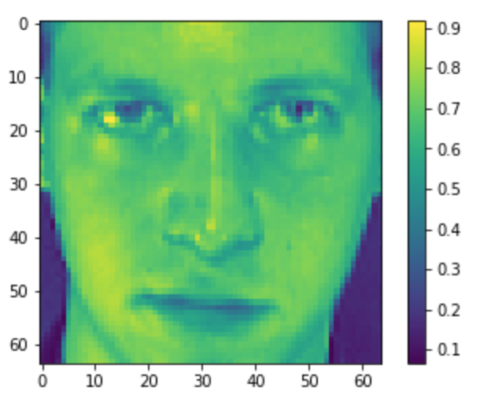
Olivetti Faces: Large Classification
Set of face images taken between April 1992 and April 1994 at AT&T Laboratories Cambridge
40 distinct subjects, 10 photos per subject
Total of 400 photos
Images stored in grayscale pixel values (0 = black, 1 = white)
Target = integer 0-39 to indicate identity of image

Slide 28
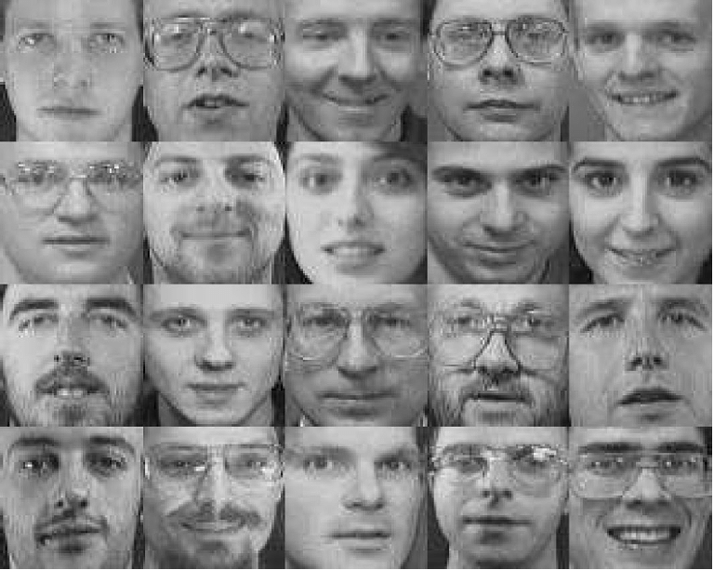
Olivetti Faces: Models Used

Slide 29
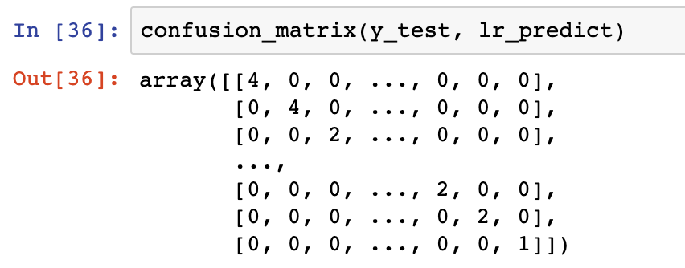
Olivetti Faces: Logistic Regression
Test Data
Accuracy = 0.963
Precision = 0.948
Recall = 0.957
F1 score = 0.952
Confusion Matrix:
Cross Validation
Accuracy = 0.972
Precision = 0.975
Recall = 0.972
F1 score = 0.970

Slide 30
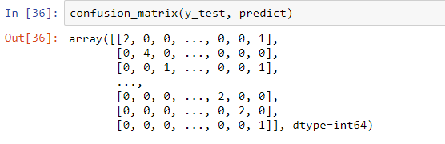
Olivetti Faces: SVC
Test Data
Accuracy = 0.825
Precision = 0.895
Recall = 0.899
F1 Score = 0.865
Confusion Matrix:
Cross Validation
Accuracy = 0.943
Precision = 0.953
Recall = 0.943
F1 Score = 0.939

Slide 31
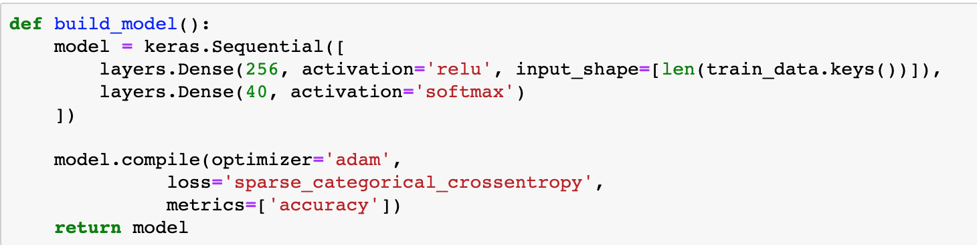
Olivetti Faces: Neural Network
No need to normalize data
Cross Validation
Accuracy = 0.953
Precision = 0.951
Recall = 0.954
F1 Score = 0.945

Slide 32
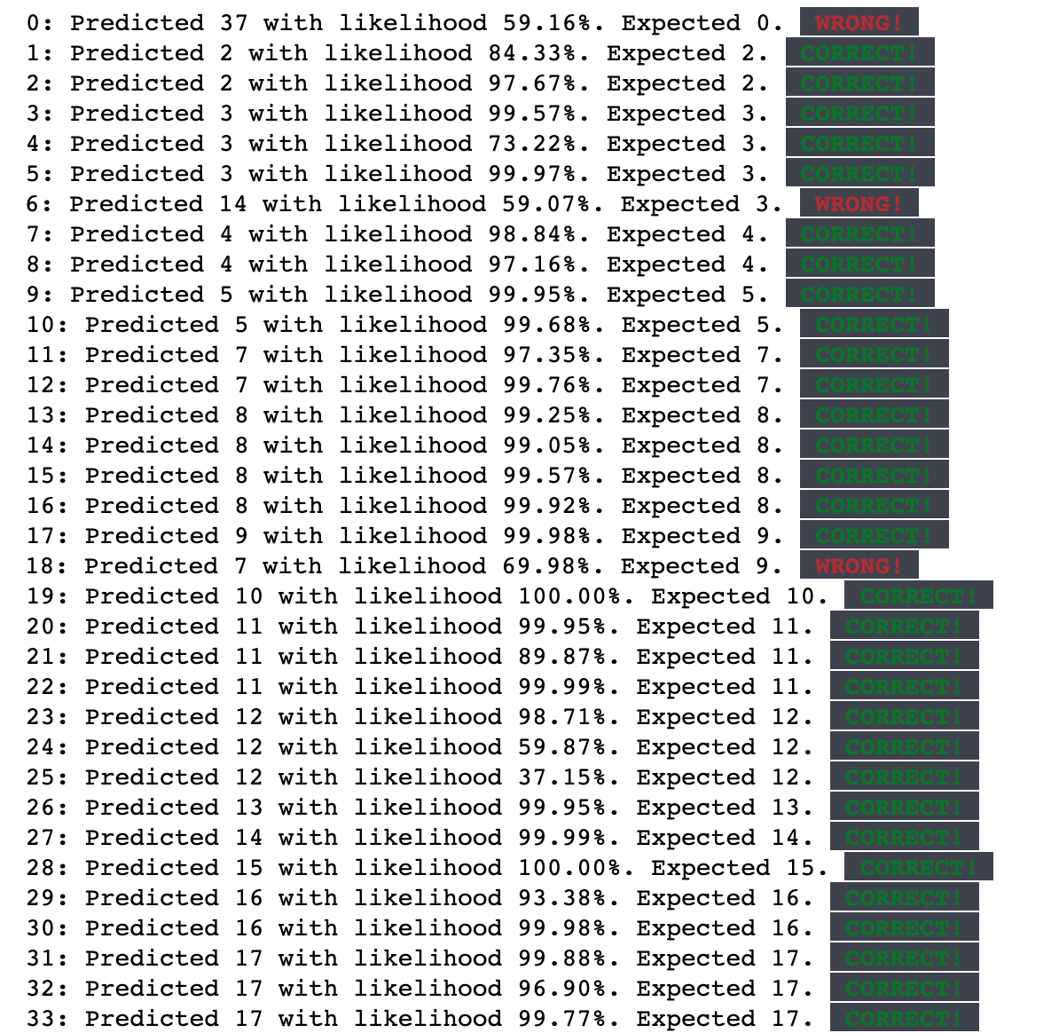
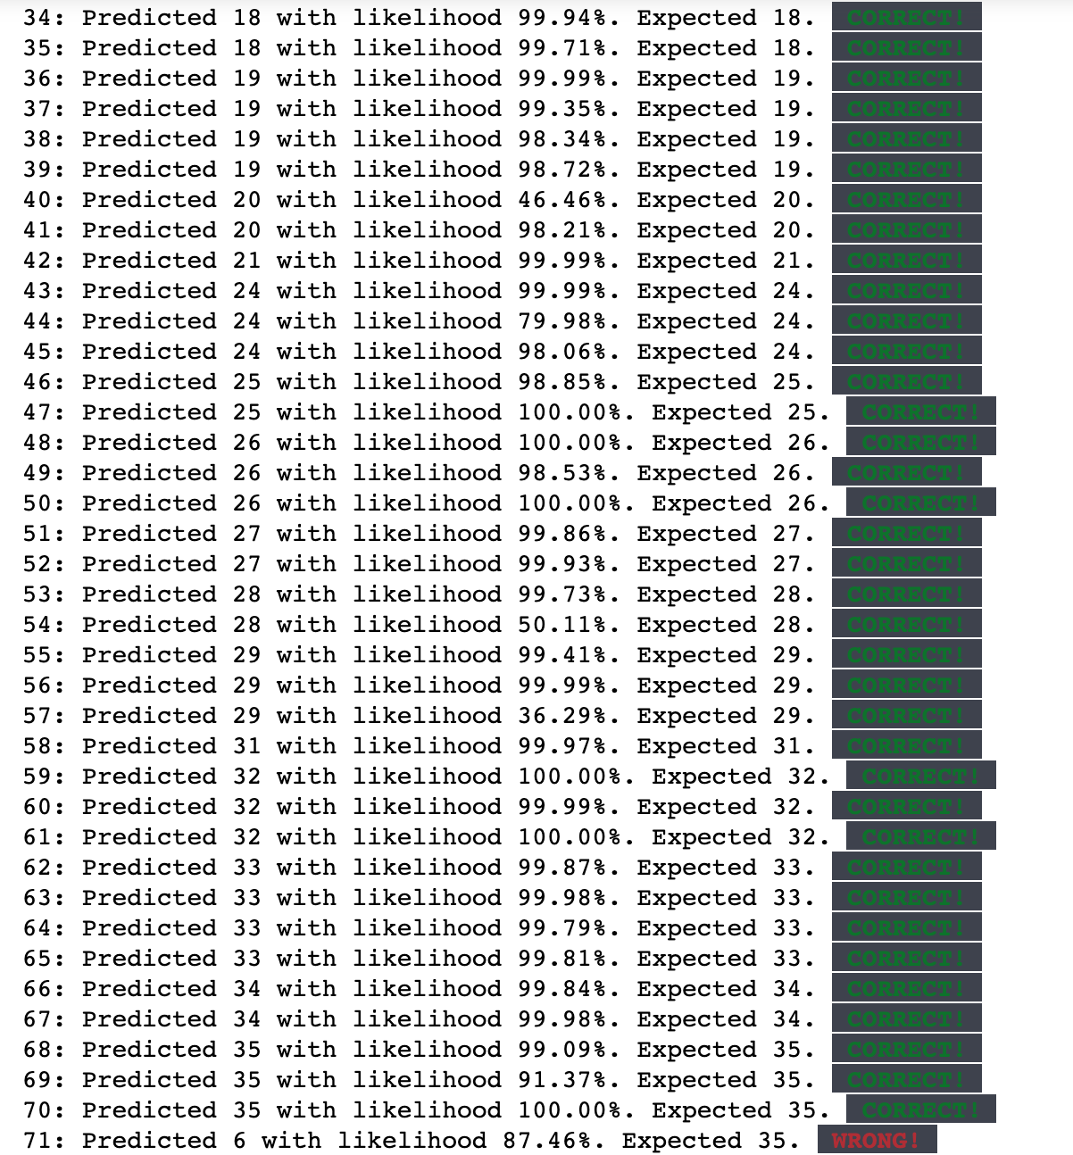
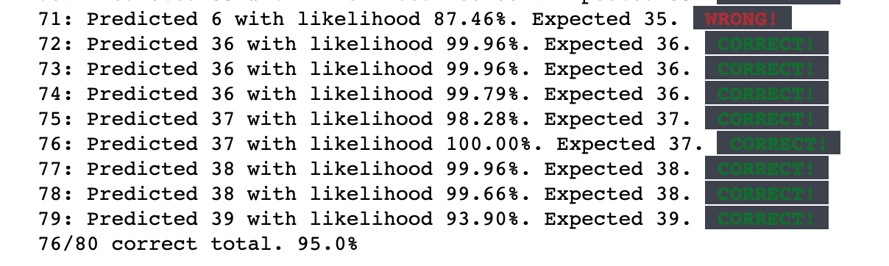
Olivetti Faces: Neural Network (cont.)

Slide 33
Thank You!

