Slide 1
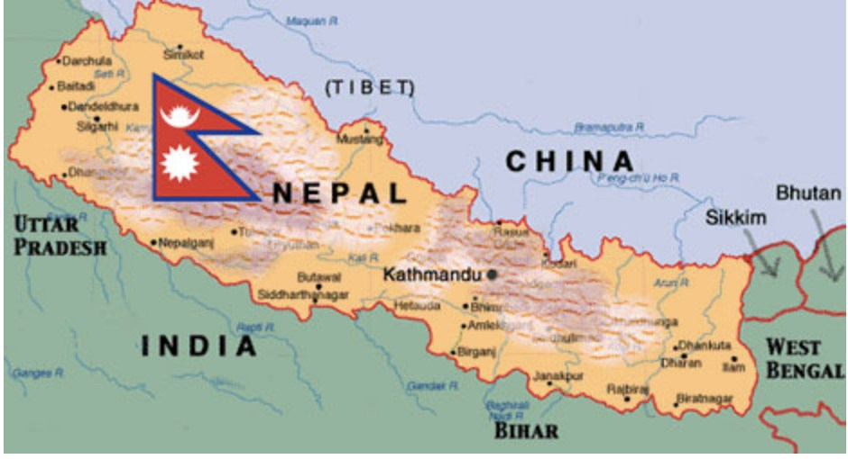
Visualizing Migration in Nepal
Sophia Graybill
GEOG 456

Slide 2
Nepal’s Migration Context
Labor migration is the primary type of migration from Nepal:
50% of households have at east one family member who works outside of the country and sends remittances home (Kunwar, 2020).
Remittances constitute roughly 26% of Nepal’s GDP as of 2018 (International Labor Organization).
Ethnic caste and religious persecution due to growth in extremist groups is a historical and current motivator for Nepalese people of lower caste or Buddhist faith to seek asylum out of Nepal.
Religious persecution
Ethnic persecution
Poverty
Natural Disaster
Slow Onset Environmental Change
Livelihood Diversification/Wage Opportunities

Slide 3
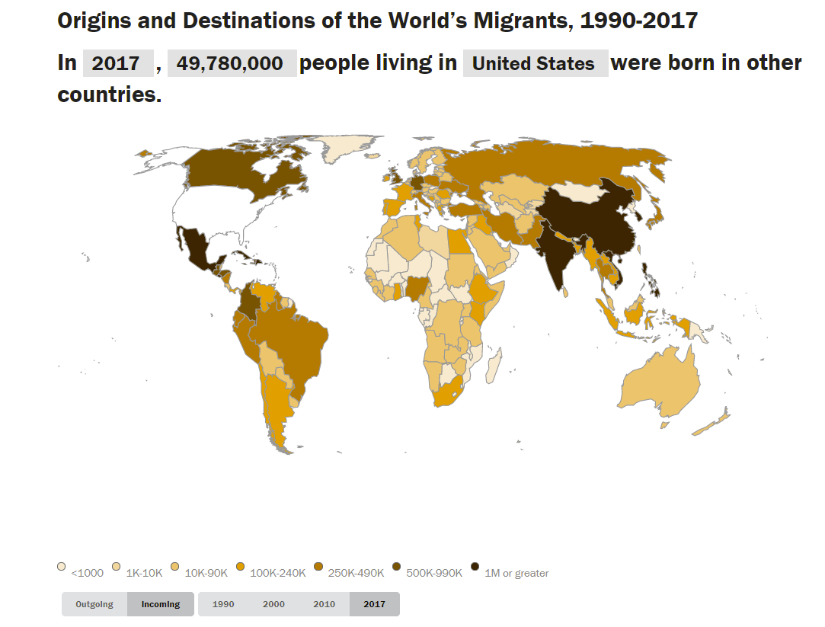
Pew Research Center’s Global Migration MAP

Slide 4
Successes and Limitations
Abundant information.
Interactive features are useful for organizing data and keeping viewer interested.
Visually appealing.
Multiple forms of information: visual and numerical.
Lacks details about types of migration occurring and being visualized.
Excludes political, economic, and social context about migration motivators.
If viewers aren’t engaged or have short attention spans, they may not take advantage of the interactive features of this map, leaving with only a small picture of what’s going on.
GAP: No such map exists for just Nepal; data and information is very dispersed and hard to find.

Slide 5
My Method
Produced three Graphics Interchange Formats (GIFs):
Destinations and Quantities of Nepalese Labor Migrants
Destinations and Quantities of Nepalese Asylum Seekers
Origins and Quantities of People Seeking Asylum in Nepal
QGIS: Produced my own projection (Robinson_84) to center Nepal in the map.
ArcMap: Imported Robinson_84 and produced choropleth maps for each year of data for each of the above maps. Saved individual year maps as JPEG files.
Adobe Creative Cloud Premiere: Imported individual JPEGs and produced GIFs on loop to show change in destination/origin over time.
For the map of Destinations of Nepalese People Seeking Asylum I also produced graphs for each year to represent data numerically, using the same color scheme as the choropleth maps and embedded those in each year’s map before producing the GIF.

Slide 6
Final Visualization Webpage

Slide 7
Literature Cited in Written Proposal
Baldwin, A., & Erickson, B. (2020). Introduction: Whiteness, coloniality, and the Anthropocene. Environment and Planning D: Society and Space, 38(1), 3–11.
Bettini, G. (2017). Where Next? Climate Change, Migration, and the (Bio)politics of Adaptation. Global Policy, 8, 33–39.
Dodge, M. (2014). Mapping and Geovisualization. Approaches to Human Geography. Chapter 2. Sage Publications, 289-309.
Human Rights Watch. (2004). Between a Rock and a Hard Place: Civilians Struggle to Survive in Nepal’s Civil War. Human Rights Watch, 16(12).
Kraak, M. (2003). Geovisualization Illustrated. Journal of Photogrammetry and Remote Sensing, 57, 390-399.
Kunwar, L. S. (2020). Foreign Labour Migration and Governance in Nepal. Journal of Population and Development, 1(1), 115–129.
International Displacement Monitoring Center. (2019). Global Report on Internal Displacement 2019. IDMC.
International Organization for Migration (IOM). (2019). Migration in Nepal: A Country Profile 2019. IOM.
International Organization for Migration (IOM). (2020). World Migration Report 2020. United Nations.
Ministry of Population and Environment (MoPE). (2016). Nepal. Government of Nepal.
United Nations. (2019). International Migration 2019 Report. United Nations Department of Economic and Social Affairs.
Reid, Katheryn. (2018). 2015 Nepal Earthquake: Facts, FAQs, and How to Help. World Vision.

