Slide 1

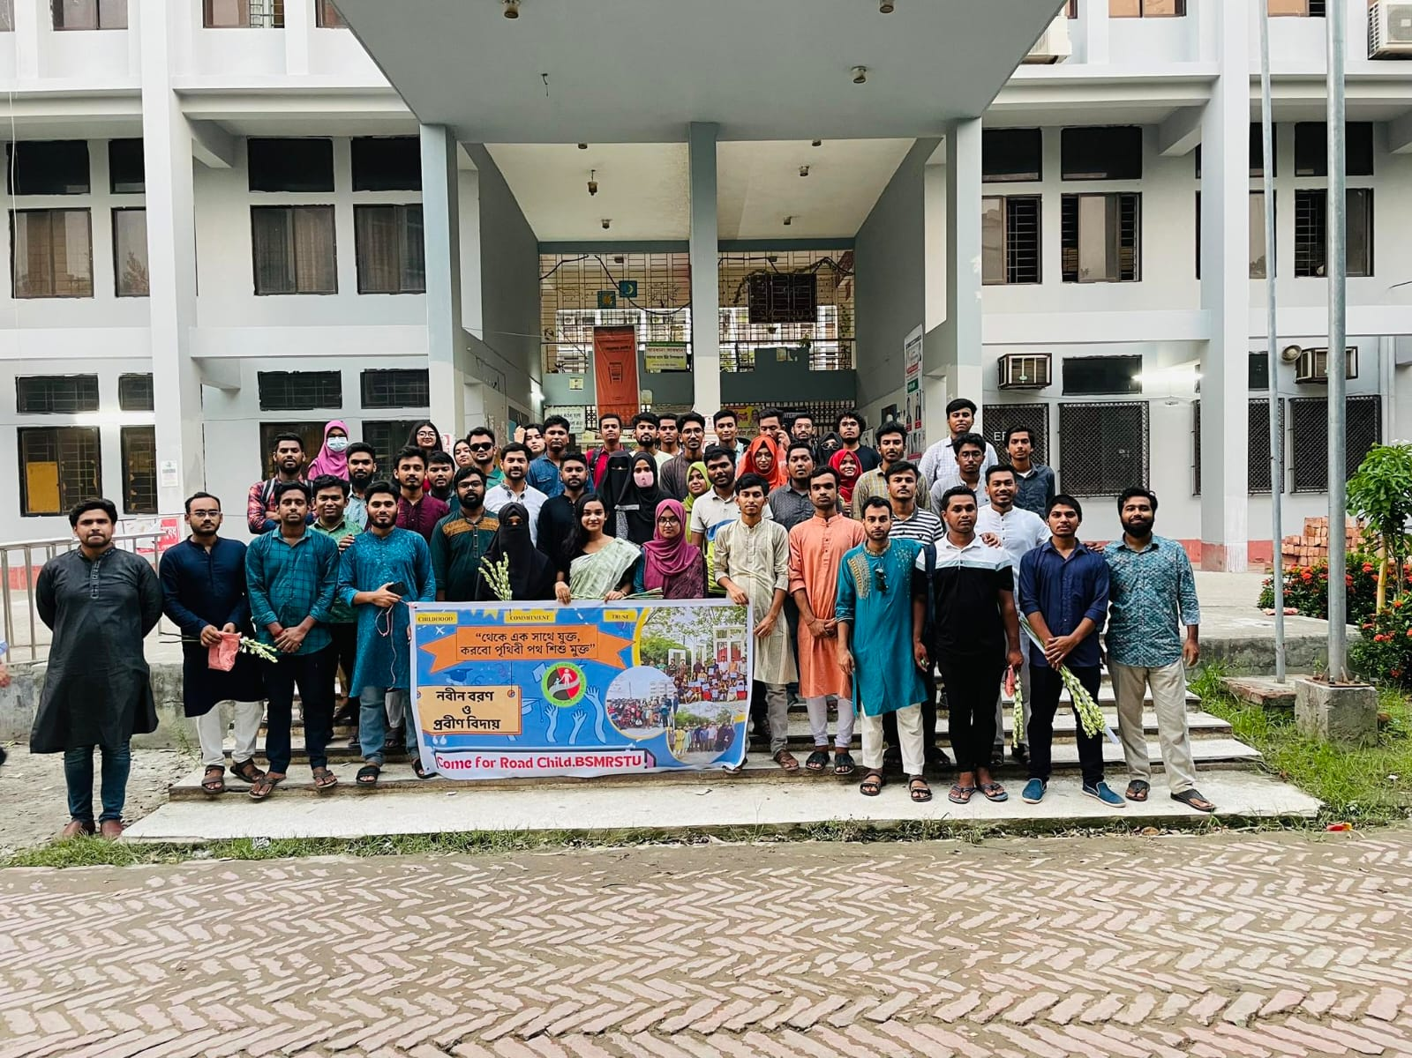
CRC
Come for Road Child
GSTU Branch
Latest
Donate
Sign in
Happening Now Who we are Our Work Our People Get involved Resources & Updates

Slide 2

CRC
Come for Road Child
GSTU Branch
Latest
Donate
Sign in
Who we are
Happening Now Who we are Our Work Our People Get involved Resources & Updates
Who we are
Fundamental Principles
About Principles Vision and mission Objectives Mode of Action Achievements | Our history How we founded Leadership over years | How we run Finance Governance | Identity Symbol & Flag Slogan Motto
Fundamental Principles of Come for Road Child
Learn More

Slide 3
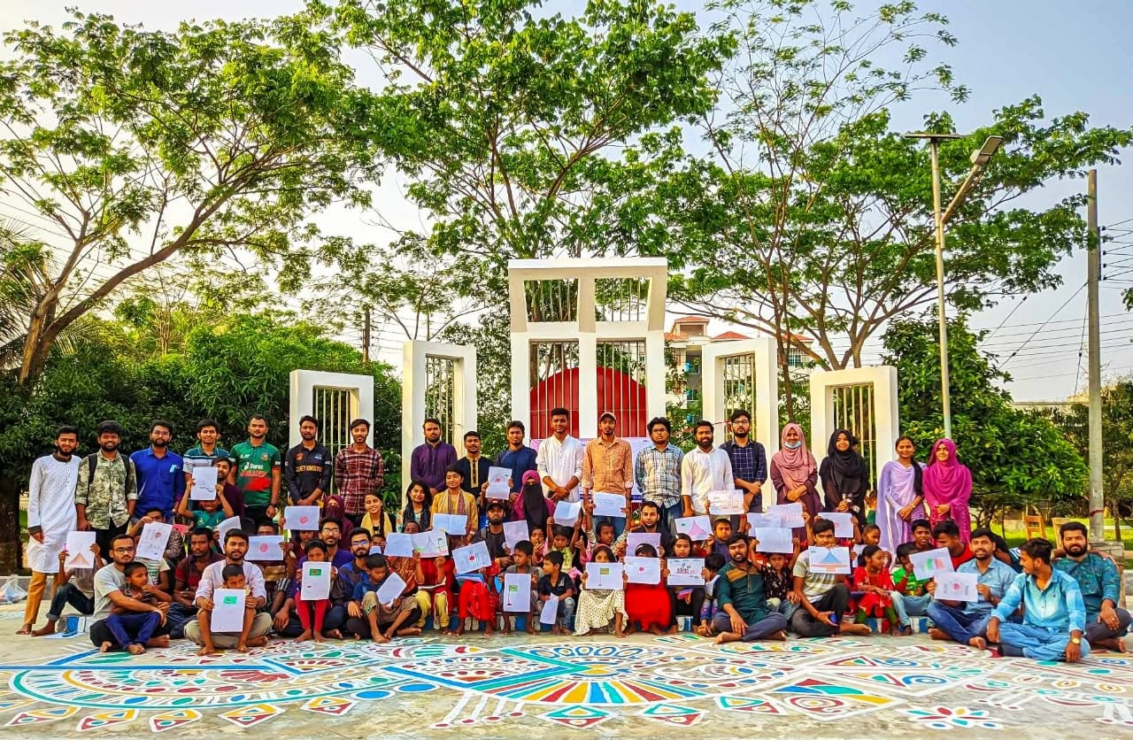
CRC
GSTU
Happening Now Who we are Our Work Our People Get involved Resources & Updates
Donate
Who we are
About
Principles
Our fundamental Principles
Fundamental
Principles
The Fundamental Principles of CRC GSTU are brotherhood, commitment, and trust. These principles guide all activities of the organization and its members, fostering mutual respect, dedication to the organization’s goals, and trust among members and are written in the constitution.

Slide 4
Our fundamental Principles
Fundamental
Principles
The Fundamental Principles of CRC GSTU are brotherhood, commitment, and trust. These principles guide all activities of the organization and its members, fostering mutual respect, dedication to the organization’s goals, and trust among members and are written in the constitution.

Slide 5
Fundamental
Principles
The Fundamental Principles of CRC GSTU are brotherhood, commitment, and trust. These principles guide all activities of the organization and its members, fostering mutual respect, dedication to the organization’s goals, and trust among members and are written in the constitution.
Three Fundamental
Principles
Brotherhood
We foster mutual love, empathy, and respect among all members, building friendly and family-like relationships within CRC GSTU
Commitment
We remain sincere and dedicated to the mission, goals, and responsibilities of CRC GSTU, serving with genuine commitment.
Trust
We build an environment of mutual trust and confidence, while respecting and protecting the confidentiality of our members

