Slide 1
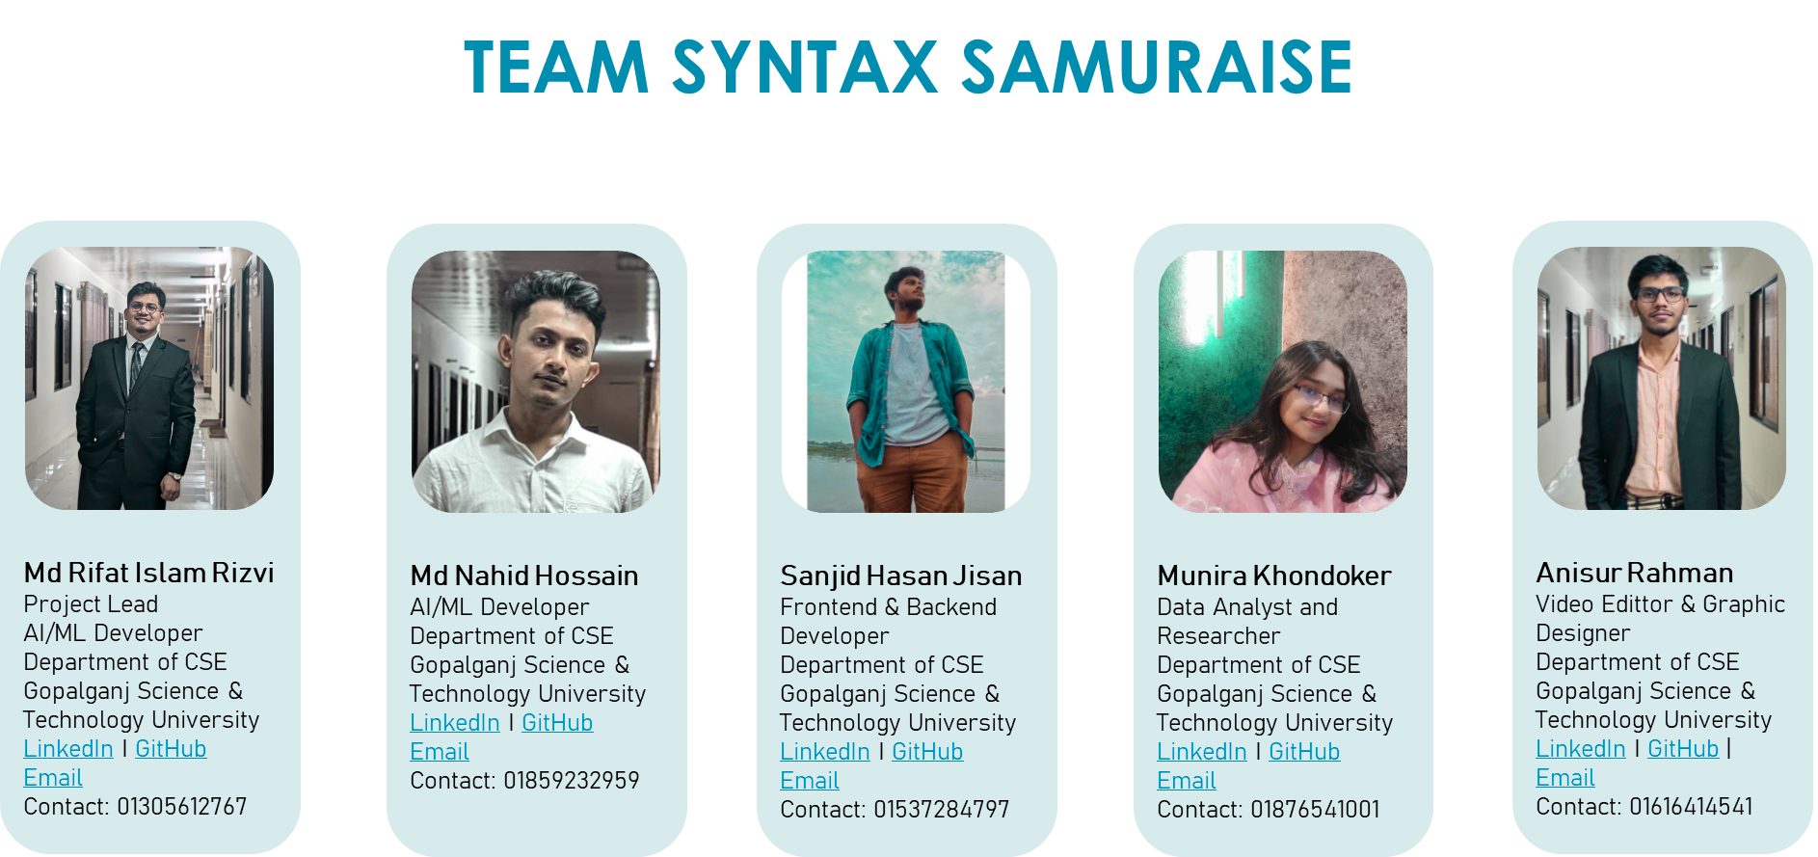
Team Syntax_Samuraise

Slide 2
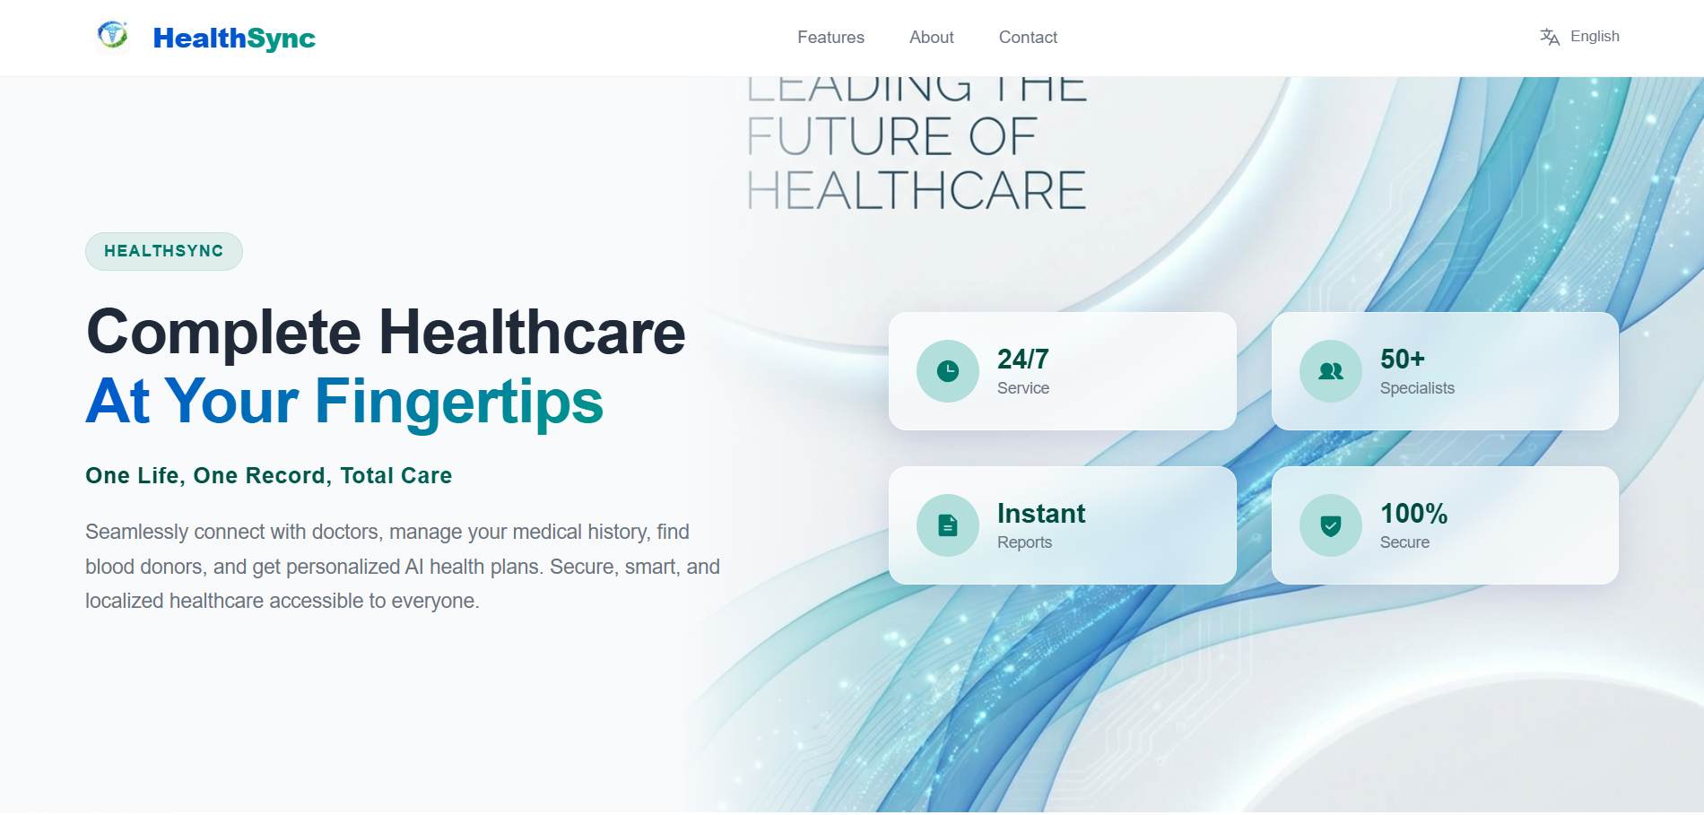

Slide 3
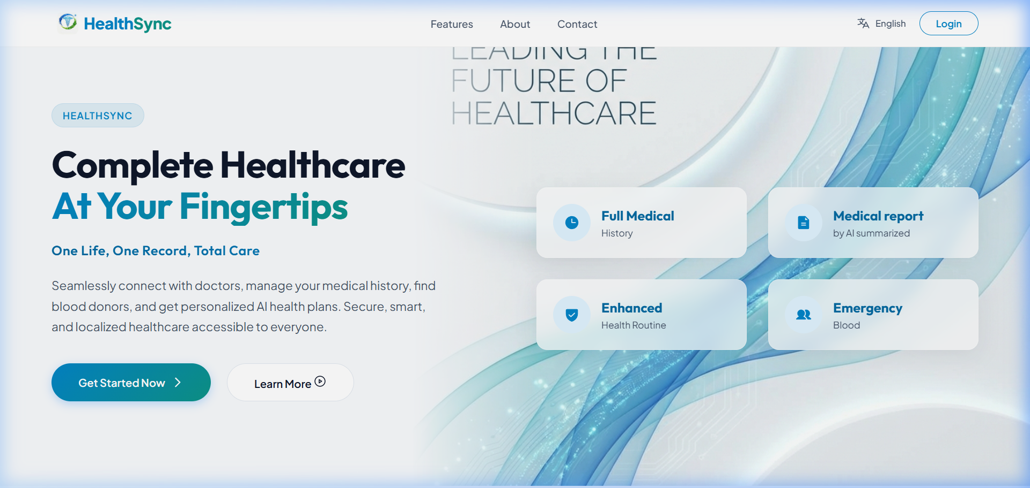
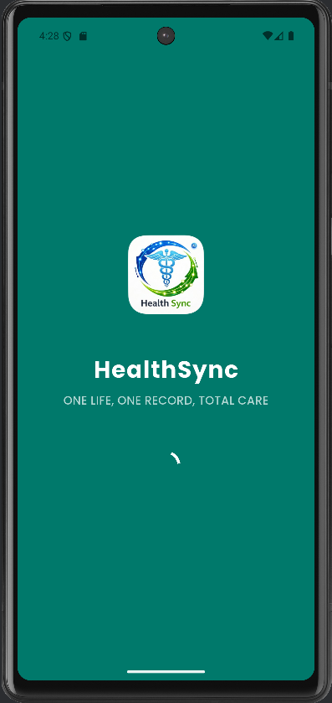
Profile
Health plan
About Us
Contact
HealthSync
ONE LIFE, ONE RECORD, TOTAL CARE
By Syntax_Samuraise

Slide 4
The Problem
  Scattered Medical Records:
Medical records are scattered and mostly paper-based
  Delayed Treatment:
Treatment is delayed due to manual report collection
  Lack of Continuity of Care:
Doctors lack access to complete patient history
  Repeated Tests & Higher Costs:
Repeated tests increase healthcare costs
  Poor Emergency Readiness:
No real-time, location-based emergency support

Slide 5
Our Solution
  Secure unified patient health profile
  Complete medical history stored digitally
  Symptom input in Bangla & English with smart doctor guidance
  Digital lab reports with AI data extraction
  AI-generated health timeline for quick understanding
  Doctor-assist AI for faster decisions (human-controlled)
  Privacy-first system with full patient consent

Slide 6
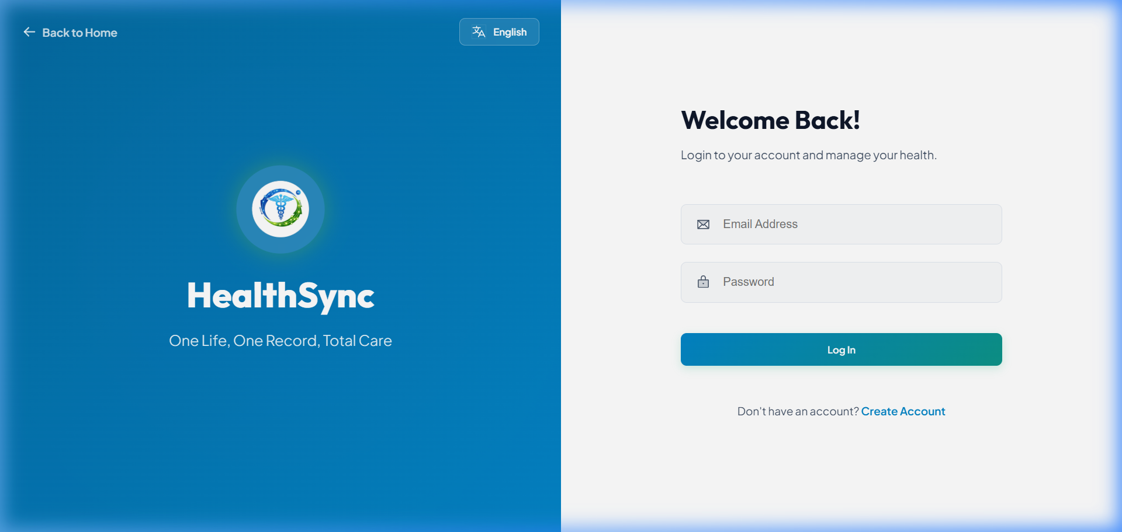
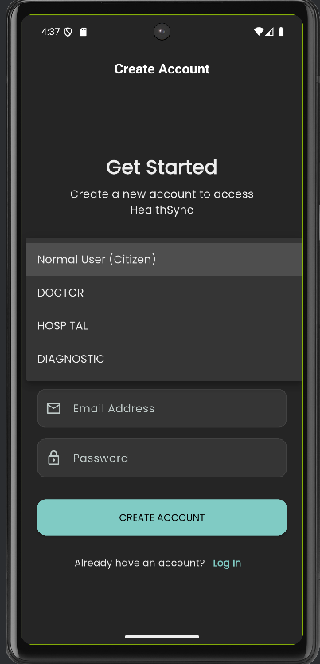
Create account
This is the AI-powered onboarding of HealthSync.
Users can create a secure account as a citizen or healthcare provider using basic details like phone and email.
Once registered, our AI system personalizes the experience, securely linking medical records, reports, and future health data to the user’s profile.
This simple entry point enables intelligent symptom analysis, doctor guidance, and seamless digital healthcare—while keeping patient data fully private and consent-controlled.”

Slide 7
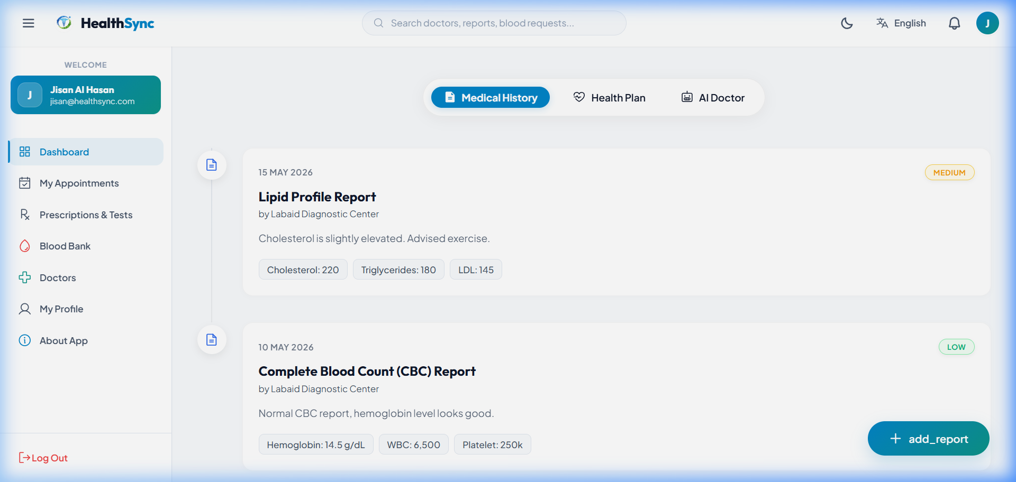
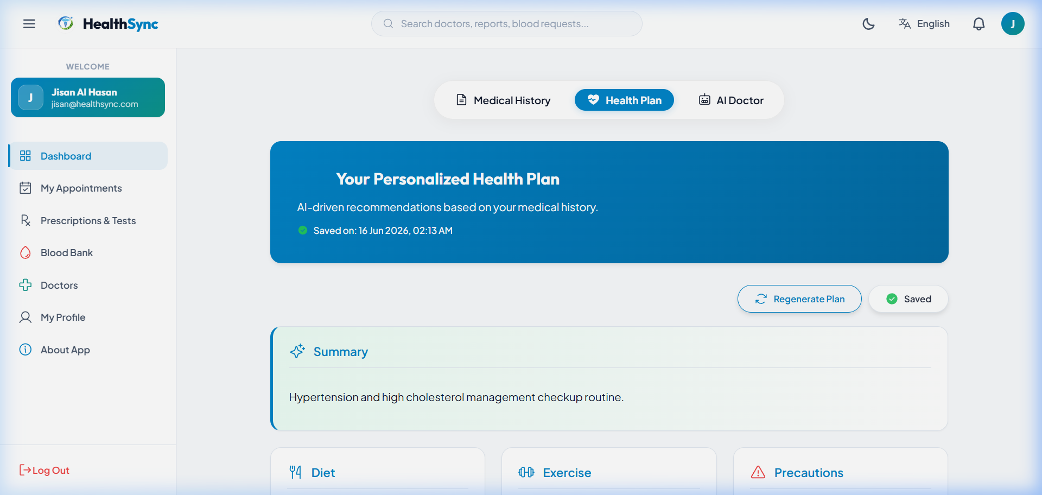
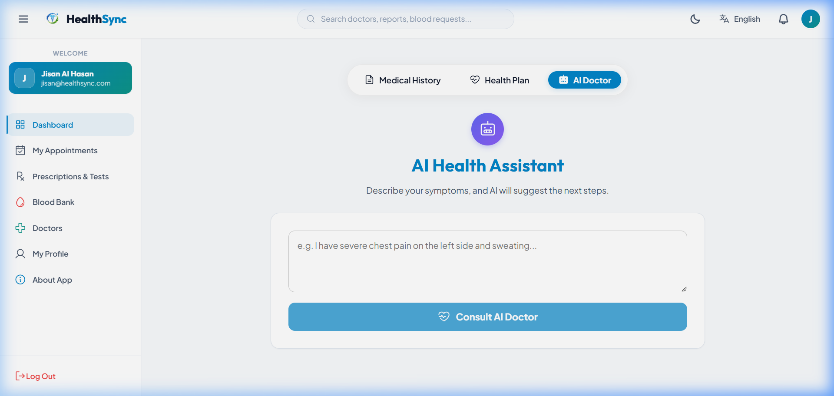
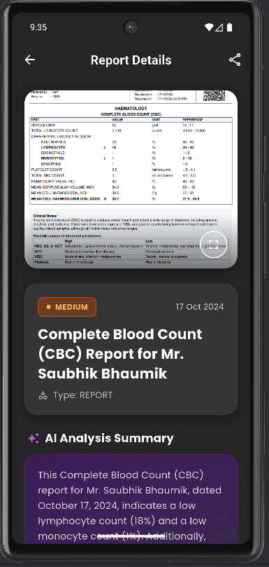
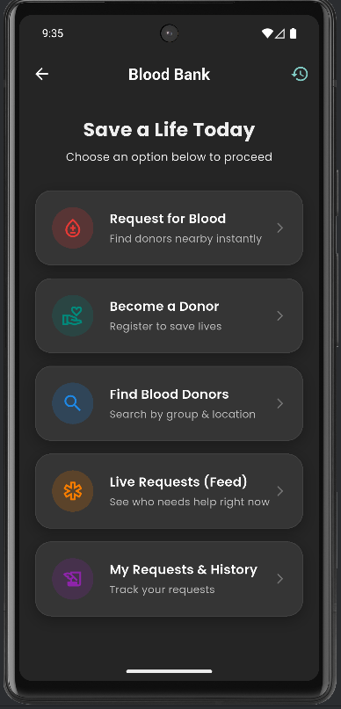
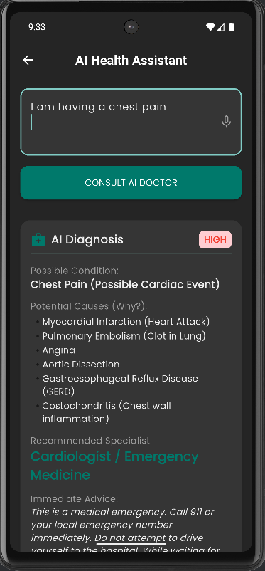
Website Features
  Lifelong digital health record
  AI symptom input (Bangla & English)
  Smart medical timeline
  Secure document upload
  AI report analysis (OCR)
  Personalized health planner
  Real-time blood donor matching

Slide 8
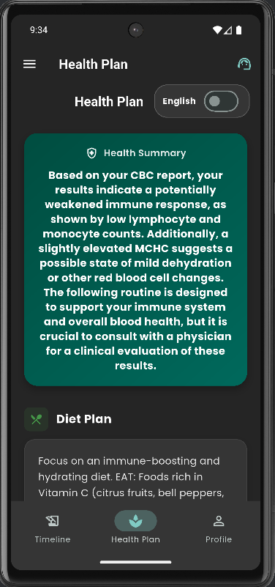
AI Health Assistant
  Understands symptoms in Bangla & English
  Summarizes patient data for doctors
  Answers patient questions
  Assists doctors (does not replace)
Personalized Health Plan
  Custom diet, exercise & lifestyle guidance
  Based on medical history and lab reports
  Auto-updates with new data
  Supports Bangla & English

Slide 9
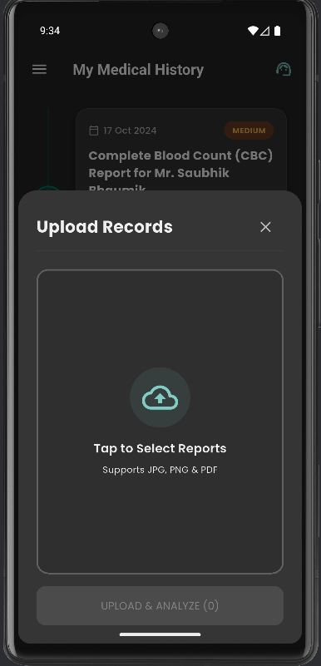
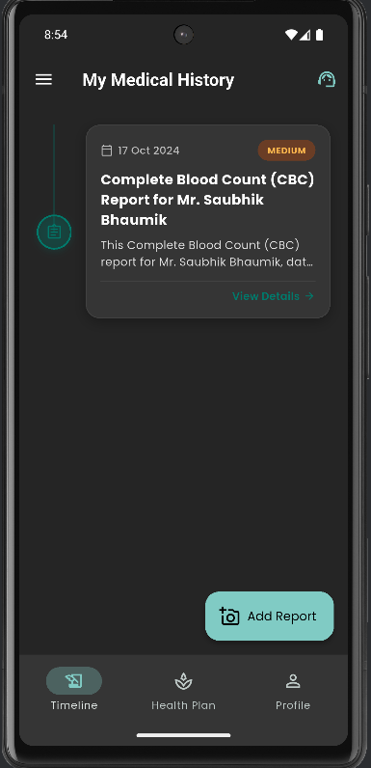
3
1
AI Summarize
User or any diagnostic center uploads any medical test report into user profile.
AI model (gemini 2.5 pro) analyze the report and make a detailed summary of that report.
Finally the summarized report will be add to the user ‘Medical History’ timeline which can be seen by the doctors.
2

Slide 10
Health plan
1
Making a proper health plan with this website is easy
Based on the reports in the timeline, AI will create a proper health plan for the user.
2

Slide 11
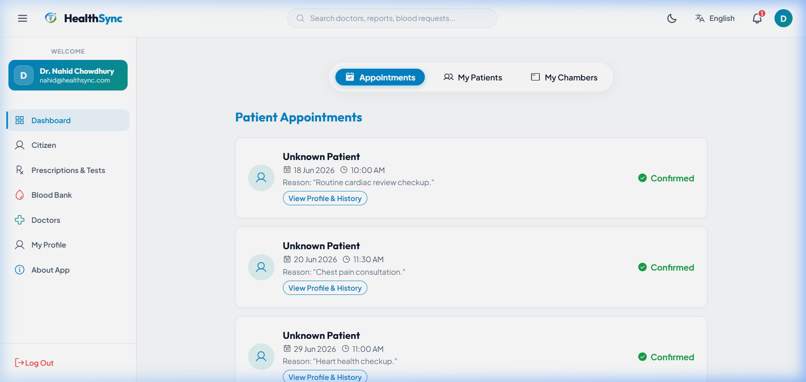
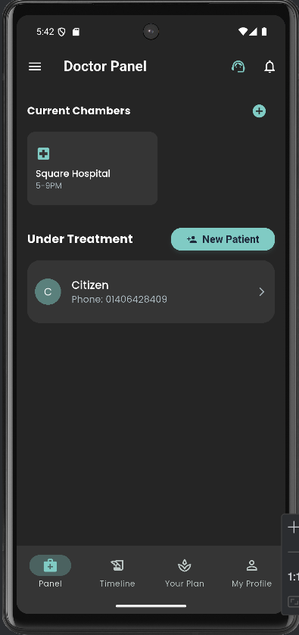
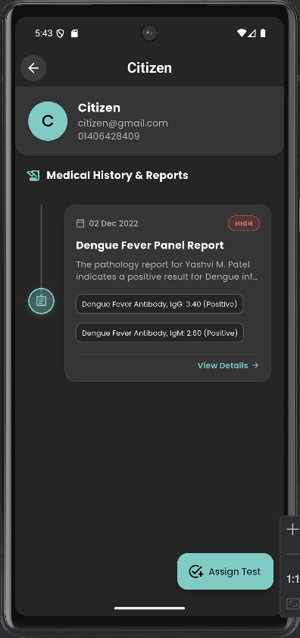
Doctor Dashboard
Doctors have a normal dashboard like other users, with a medical history timeline, health plan, blood donation, and AI health assistance.
The extra feature in the doctors’ dashboard is a doctor panel, from where they can view their old patients’ medical history and assign new patients.
Also, doctors will be able to view patients’ medical timelines and assign medical tests.

Slide 12
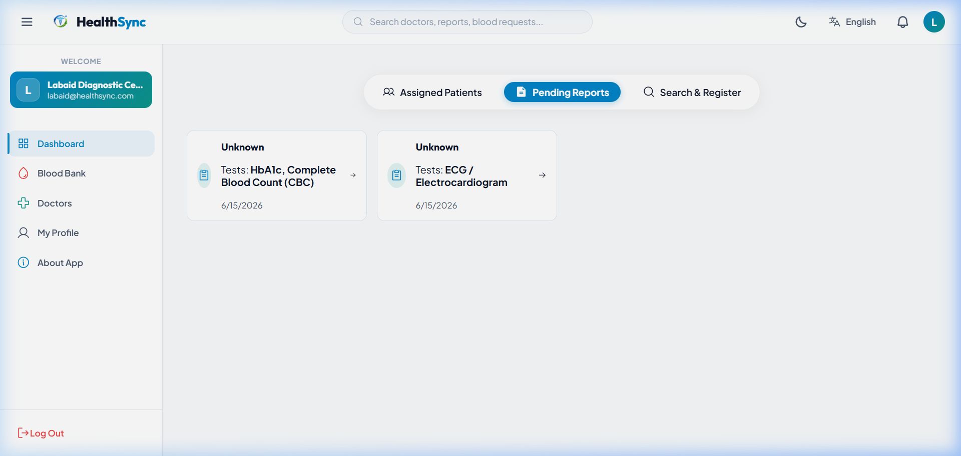
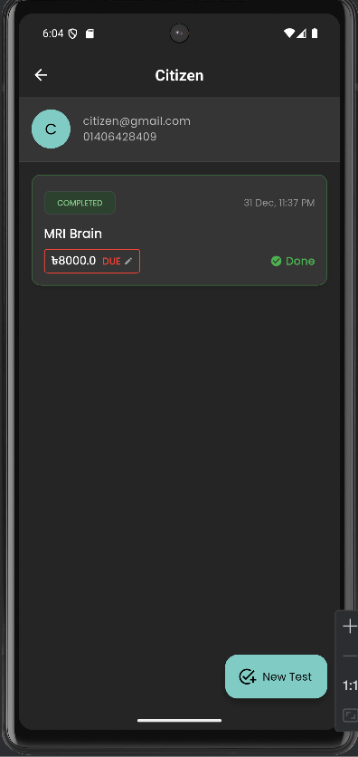
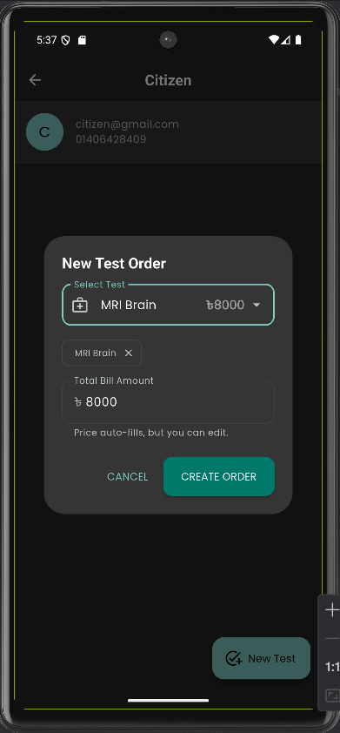
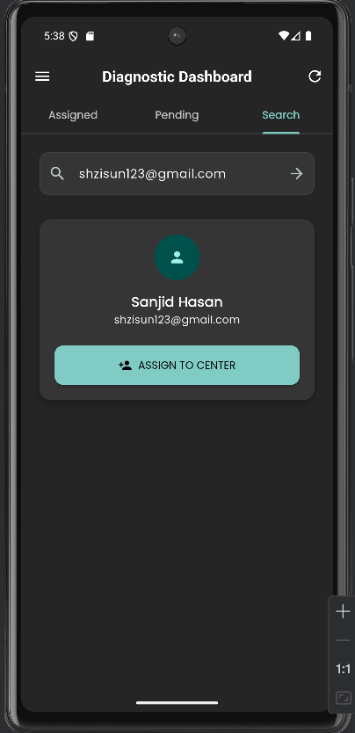
Diagnostic Center Dashboard
Through this website, diagnostic centers will be able to add users to their own diagnostic database.
They will be able to assign medical tests to the profiles of the added patients.
And when a report for an added test is uploaded, the AI will summarize it and automatically add it to that patient’s medical history timeline—no hassle, saving time.

Slide 13
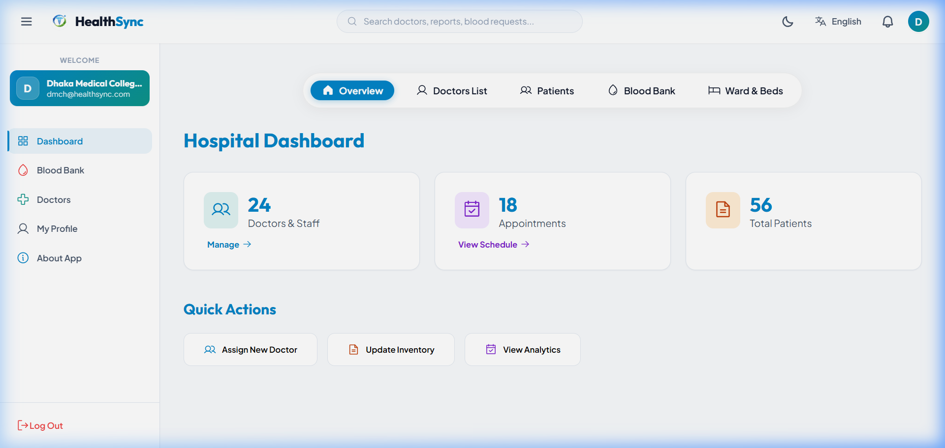
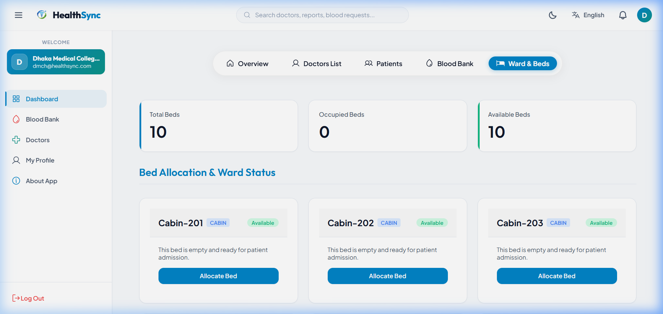
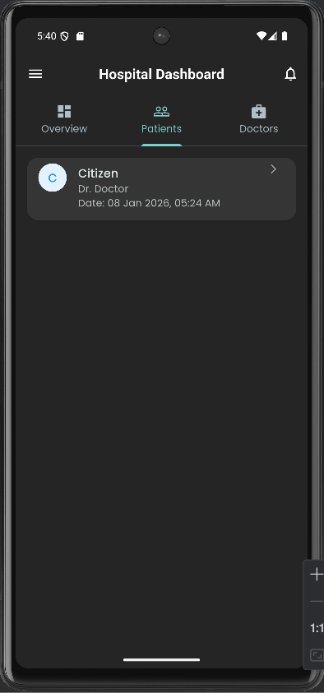
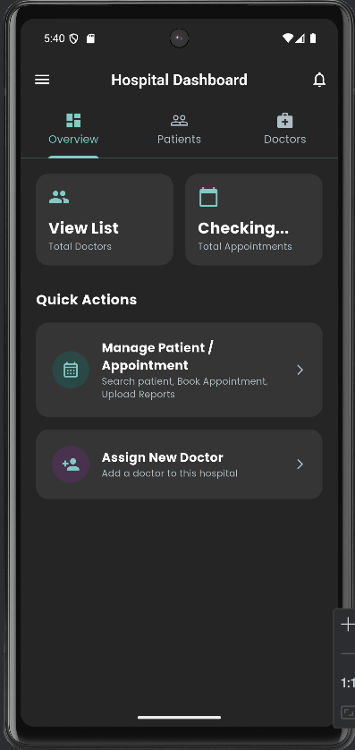
Hospital Dashboard
Through the hospital dashboard, hospitals will be able to assign their own doctors.
From the hospital dashboard, patients can be added.
Hospitals will be able to view their old patients’ medical history through this website

Slide 14
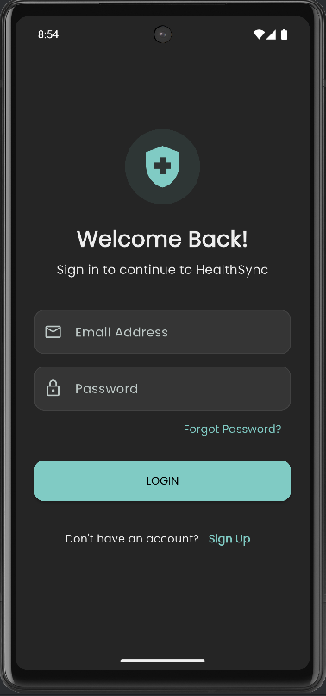
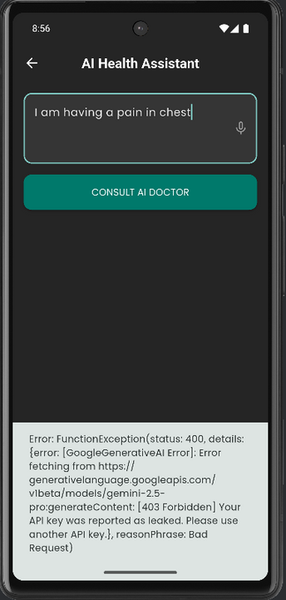
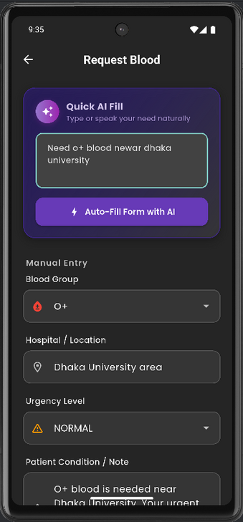

Website Prototype

Slide 15
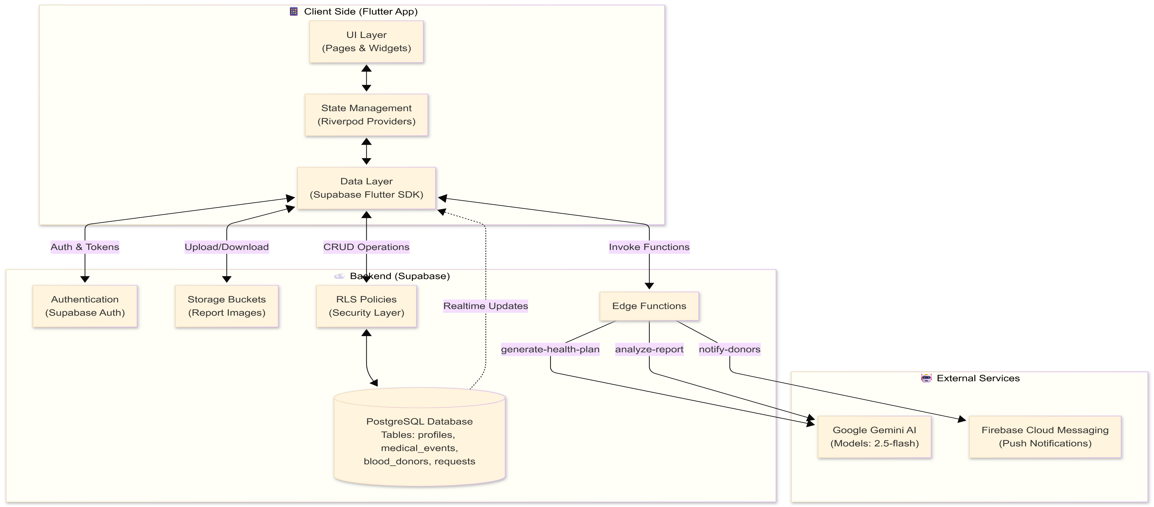
How the website works

Slide 16
Architecture diagram
React Web Application: UI & state management for user interactions.
04
Database: MySQL stores profiles, medical events, donors, and requests.
01
Data Layer: Handles CRUD, auth, uploads/downloads via Express API & MySQL.
Express Backend: Generate health plans, analyze reports, notify donors
05
02
Authentication & Storage: User login and report image management.
External Services: Google Gemini AI for analysis; Firebase for notifications.
06
03

Slide 17
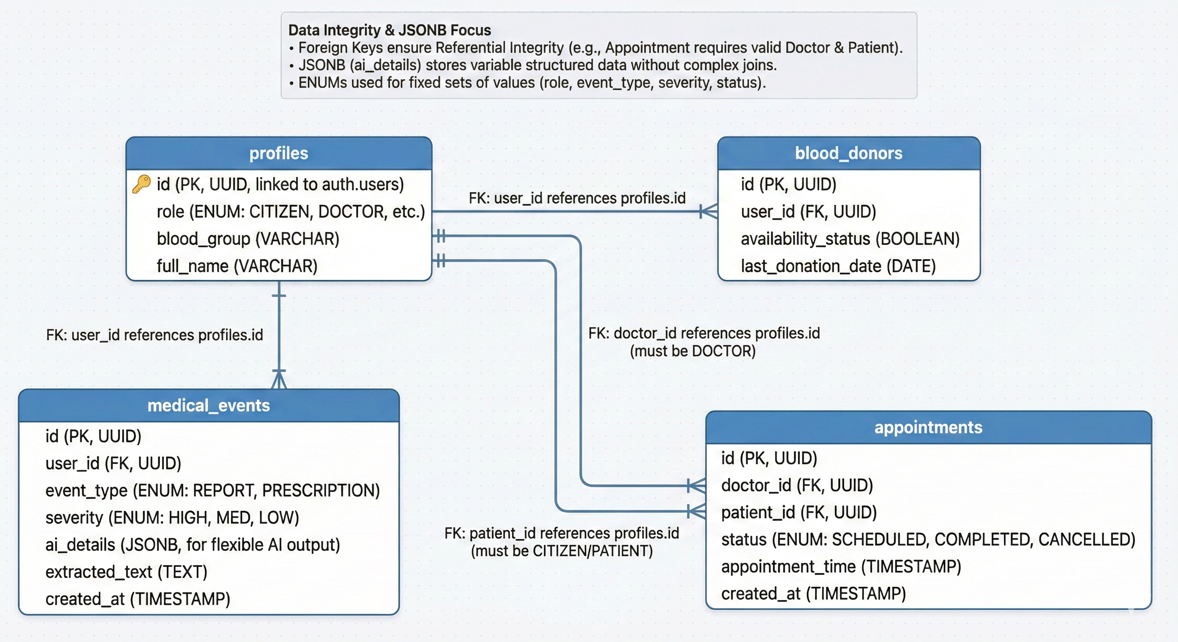
DATABASE
Smart & Secure Health Data System
Central user profiles for patients and doctors
Complete medical history stored in one place
Easy doctor–patient appointment management
Real-time blood donor availability
Why It Works
Prevents missing or incorrect data
Flexible AI data storage for future growth
Faster, safer healthcare decisions

Slide 18
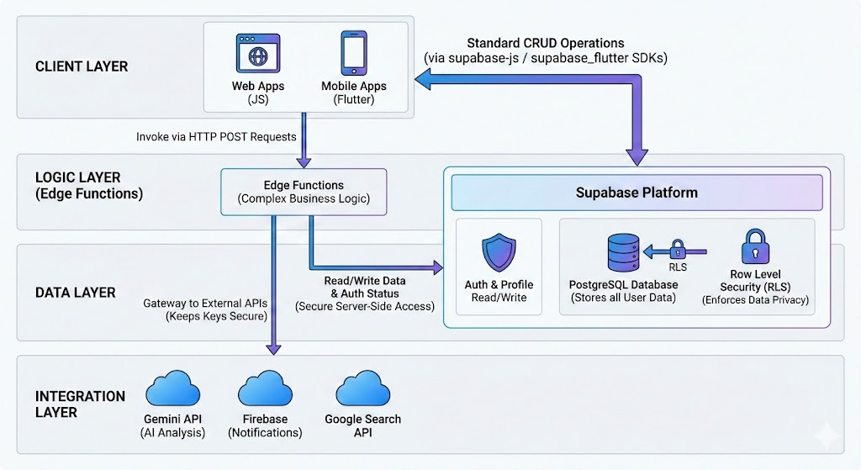
System Communication Flow
Client Layer
Web applications talk directly with MySQL Database
Used for login, profile read/write, and basic CRUD
SDKs used: Express Backend API and React / REST
Logic Layer (Express Backend)
Handles complex tasks like AI analysis and notifications
Client calls these using secure HTTP POST requests
Data Layer
MySQL stores all application data
Row Level Security ensures privacy
Patients can only access their own records
Integration Layer
Express Backend connect to external services
APIs: Gemini, Firebase, Google Search
API keys stay secure on the server

Slide 19
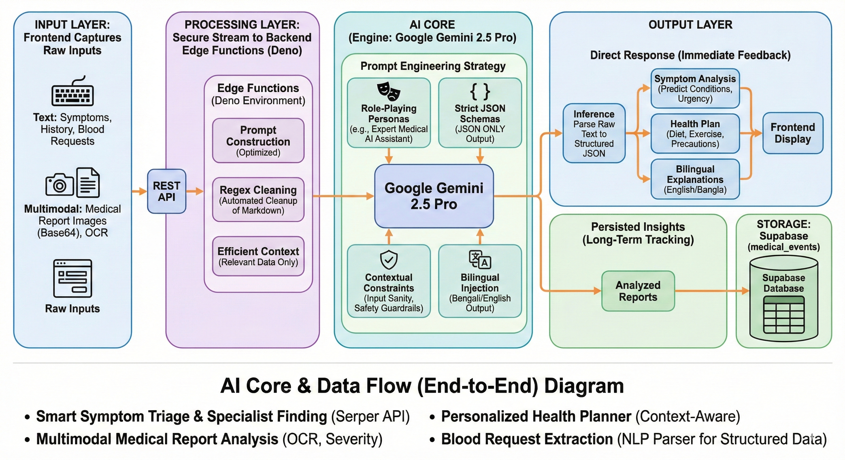
System Architecture: End-to-End Medical AI(how ai works)
1. Overview
A comprehensive pipeline transforming raw patient data into structured medical insights using Google Gemini 2.5 Pro and Edge computing.
2. Key Layers
Input Layer: Captures multimodal data—text symptoms and medical report images (OCR).
Processing Layer: Secure Express Backend (Node.js / Express) sanitize inputs and construct optimized prompts.
AI Core: Leverages Gemini 2.5 Pro with strict JSON schemas and persona-based reasoning.
Output & Storage: Delivers immediate bilingual feedback (English/Bangla) to the frontend while persisting records to MySQL Database.
3. Process Flow
Raw Input $\rightarrow$ Edge Sanitization $\rightarrow$ AI Inference $\rightarrow$ Structured JSON $\rightarrow$ User UI + Database
4. Why This Architecture?
Context-Aware: Integrates history and medical reports for accurate triage.
Resilient: "Strict JSON" ensures the frontend never breaks due to unstructured AI text.
Scalable: Decoupled processing ensures low latency and high availability.

Slide 20
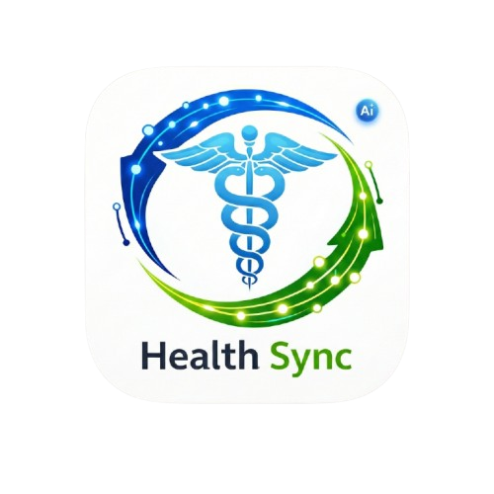
Timmerman Industries
Future Plan
  Expand MVP to more hospitals, clinics, and diagnostic centers.
  Improve AI accuracy for report analysis and health summaries.
  Add more structured medical data types (X‑ray, ECG, imaging metadata).
  Strengthen doctor dashboards and patient experience.
  Nationwide rollout across public & private healthcare facilities.
  Integrate with pharmacies and medicine delivery platforms.
  Implement advanced AI for chronic disease management.
  Develop into a national digital health record platform with government & insurance integration

Slide 21
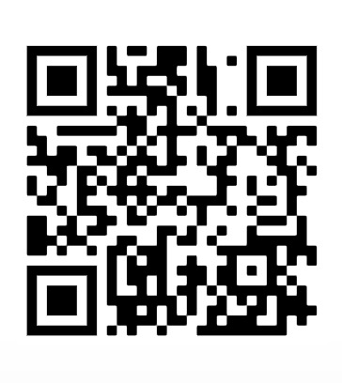
Timmerman Industries
Try Our Website
https://health-sync-ai.netlify.website/

