Slide 1
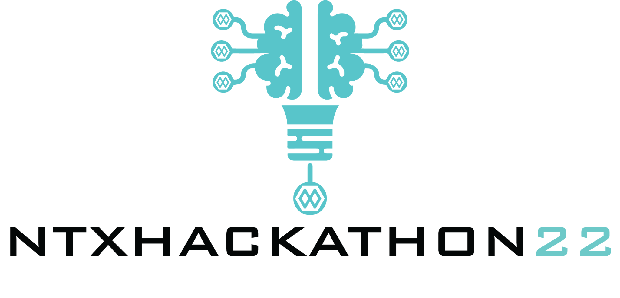

EEG-Controlled Real Time Modulation of Musical Performance
Mindmusic – Team 17

Slide 2
Problem and Approach
Few people experience the heightened joy (and therapeutic benefits) of creating a musical performance, rather than just listening
Many people cannot play conventional instruments or join musical groups (anymore) due to physical limitations, or cannot invest the required time
We aim to enable anyone to take an active role in musical performances regardless of factors such as motor ability by modulating music in real time based on EEG data

Slide 3
Data and Machine Learning
[Experimental data collection]
[Machine learning]

Slide 4
EEG-Based Real Time Modulation
[basic loop]
[music generator]

Slide 5
Documentation
Code repository: https://github.com/SH2282000/NeuroTechX
Hardware (OpenBCI): Ultracortex Mk IV, Cyton + Daisy boards (16 EEG ch.)
Software: brainflow, LabRecorder

